Slide 1
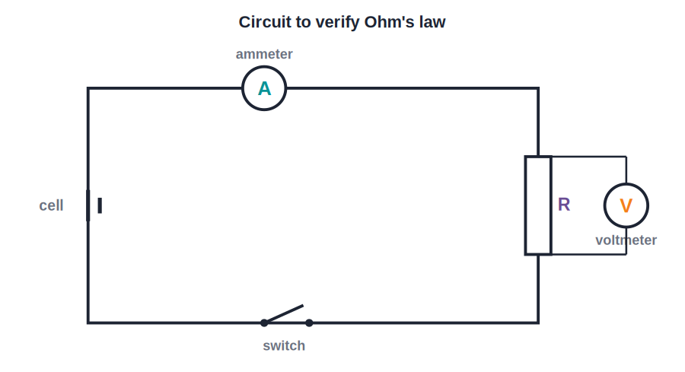
ICSE • CLASS 10 • ELECTRICITY
Current & Ohm's Law
Charge & current • Potential difference • Resistance • Ohm's law

Slide 2
INTRODUCTION
Learning Objectives
1
Define electric charge and electric current
2
Use the relation I = Q / t
3
Define potential difference and the volt
4
Define resistance and the ohm
5
State and apply Ohm's law, V = I R
6
Describe how Ohm's law is verified experimentally
Notes:
Open by previewing these objectives so students know what they should be able to do by the end of the session.

Slide 3
PART 1
Charge, Current & Potential Difference
1
The basic quantities of electricity

Slide 4
CHARGE
Electric Charge
What flows in a wire
• Two kinds positive and negative; like charges repel, unlike charges attract.
• Unit the coulomb (C); the charge on one electron is 1.6 × 10⁻¹⁹ C.
• Current is moving charge an electric current is a flow of charge (electrons in a metal).
• Conventional current taken to flow from + to −, opposite to the actual electron flow.
Notes:
Establish charge and its unit, then the key idea: current is charge in motion. Note conventional vs electron-flow direction.

Slide 5
CURRENT
Electric Current
Electric current is the rate of flow of charge through a conductor.
I = Q / t (1 ampere = 1 coulomb / second)
• Q is the charge in coulombs, t the time in seconds.
• The SI unit of current is the ampere (A).
• Measured with an ammeter, connected in series.
Notes:
Define current as Q/t. Ammeter in series — a key practical point repeated in the experiment slide.

Slide 6
WORKED EXAMPLE
Charge and Current
Problem. A current of 0.5 A flows through a lamp for 4 minutes. How much charge passes through it?
I = Q / t → Q = I × t
t = 4 minutes = 240 s
Q = 0.5 × 240 = 120 C
Answer: Q = 120 C of charge flows through the lamp
Notes:
Watch the unit of time — convert minutes to seconds first. A very common slip.

Slide 7
ELECTRON FLOW
How Current Flows in a Metal
Drift of free electrons
• Free electrons A metal has countless loosely-held electrons that move about randomly.
• A cell's push Connecting a cell sets up a p.d. that makes the electrons drift slowly in one direction.
• Slow drift, fast effect The drift is slow, but the effect (the current) is felt almost instantly all along the wire.
• Direction Electrons drift from − to +; conventional current is taken from + to −.
Notes:
Picture the slow electron drift versus the near-instant onset of current. Reinforce the two 'directions'.

Slide 8
POTENTIAL DIFFERENCE
Potential Difference (Voltage)
The potential difference between two points is the work done to move unit charge from one point to the other.
V = W / Q (1 volt = 1 joule / coulomb)
• It is the 'push' that drives current around a circuit.
• Measured with a voltmeter, connected in parallel.
• The SI unit is the volt (V).
Notes:
Voltage = energy per unit charge. Voltmeter in parallel (across the component) — contrast with the ammeter.

Slide 9
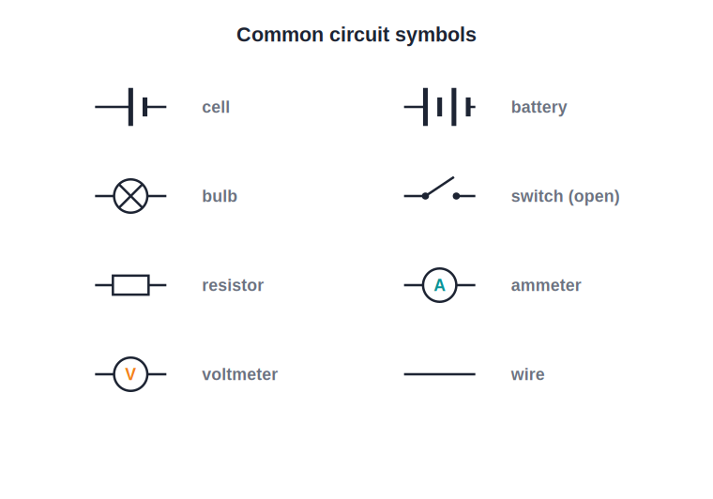
CIRCUIT SYMBOLS
Reading a Circuit Diagram
The standard symbols
• Circuits are drawn with standard symbols, not pictures.
• A cell is a long thin line (+) and a short thick line (−); several cells make a battery.
• An ammeter (A) goes in series; a voltmeter (V) goes in parallel across a component.
• A rheostat is a variable resistor used to change the current.
Cell, battery, bulb, switch, resistor, meters
Notes:
Go over each symbol. Students must read and draw these fluently for the circuit questions that follow.

Slide 10

CONDUCTORS
Conductors and Insulators
Conductors
Insulators
Have free electrons, so they carry current easily — e.g. copper, silver, aluminium.
Have almost no free electrons, so they block current — e.g. rubber, glass, plastic.
Why copper wires
Why plastic coating
Copper is a very good conductor and is relatively cheap.
The insulating coat keeps current in the wire and us safe.
Notes:
Free electrons are the difference. Link to everyday wiring: copper core, plastic sheath.

Slide 11
QUIZ 1
Check Your Understanding
5 questions • think before the answer reveals on the next slide

Slide 12
QUIZ QUESTION
Q1 — How Much Charge?
A current of 2 A flows for half a minute. The charge that passes is:
1 C
30 C
A
B
60 C
4 C
C
D

Slide 13
ANSWER REVEALED
Q1 — How Much Charge?
A current of 2 A flows for half a minute. The charge that passes is:
1 C
30 C
A
B
60 C
4 C
✓
D
WHY
Q = I × t = 2 × 30 s = 60 C. The catch is the time: half a minute is 30 seconds, not 0.5.

Slide 14
QUIZ QUESTION
Q2 — Meters
To measure the current through a lamp and the voltage across it, you connect:
Ammeter in parallel, voltmeter in series
Both in series
A
B
Ammeter in series, voltmeter in parallel
Both in parallel
C
D

Slide 15
ANSWER REVEALED
Q2 — Meters
To measure the current through a lamp and the voltage across it, you connect:
Ammeter in parallel, voltmeter in series
Both in series
A
B
Ammeter in series, voltmeter in parallel
Both in parallel
✓
D
WHY
An ammeter measures the current that flows through, so it goes in series. A voltmeter measures the p.d. across a component, so it goes in parallel with it.

Slide 16
QUIZ QUESTION
Q3 — Which Way?
In a metal wire the electric current is actually carried by electrons moving from − to +. The 'conventional current' is taken to flow:
In the same direction as the electrons
From + to −, opposite to the electrons
A
B
In both directions at once
It does not flow at all
C
D

Slide 17
ANSWER REVEALED
Q3 — Which Way?
In a metal wire the electric current is actually carried by electrons moving from − to +. The 'conventional current' is taken to flow:
In the same direction as the electrons
From + to −, opposite to the electrons
A
✓
In both directions at once
It does not flow at all
C
D
WHY
By convention, current direction is the direction positive charge would move — from + to −. This is opposite to the actual electron flow in a metal.

Slide 18
QUIZ QUESTION
Q4 — One Volt
Saying the p.d. across a bulb is 1 volt means that:
1 ampere flows through it
1 joule of energy is given to each coulomb of charge passing
A
B
1 coulomb flows per second
Its resistance is 1 ohm
C
D

Slide 19
ANSWER REVEALED
Q4 — One Volt
Saying the p.d. across a bulb is 1 volt means that:
1 ampere flows through it
1 joule of energy is given to each coulomb of charge passing
A
✓
1 coulomb flows per second
Its resistance is 1 ohm
C
D
WHY
1 volt = 1 joule per coulomb. The p.d. tells you how much energy each unit of charge delivers as it passes through the bulb.

Slide 20
QUIZ QUESTION
Q5 — Energy Delivered
A charge of 20 C flows through a bulb across which the p.d. is 6 V. The energy delivered to the bulb is:
3.3 J
26 J
A
B
120 J
0.3 J
C
D

Slide 21
ANSWER REVEALED
Q5 — Energy Delivered
A charge of 20 C flows through a bulb across which the p.d. is 6 V. The energy delivered to the bulb is:
3.3 J
26 J
A
B
120 J
0.3 J
✓
D
WHY
From V = W/Q, the energy is W = V × Q = 6 × 20 = 120 J. Each coulomb gives 6 J, and 20 coulombs pass through.

Slide 22
PART 2
Resistance & Ohm's Law
2
How conductors oppose current

Slide 23
RESISTANCE
Electrical Resistance
Resistance is the opposition a conductor offers to the flow of current through it.
R = V / I (1 ohm = 1 volt / ampere)
• A larger resistance means less current for the same voltage.
• The SI unit of resistance is the ohm (Ω).
• Resistance arises as electrons collide with the atoms of the conductor.
Notes:
Define R = V/I and the ohm. Physical picture: electrons colliding with lattice atoms.

Slide 24
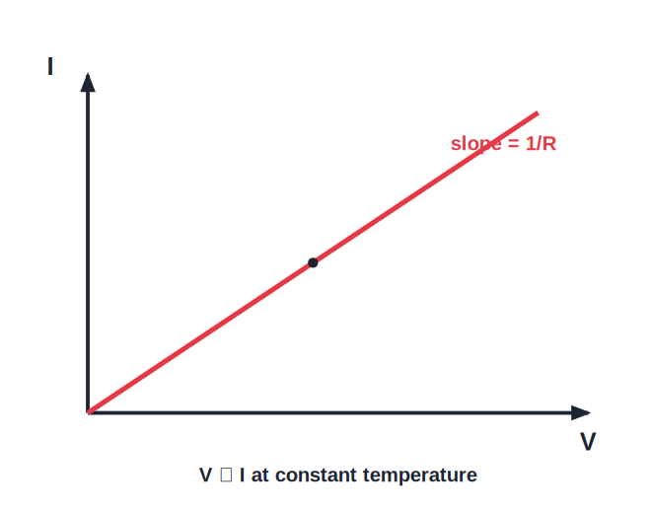
OHM'S LAW
Ohm's Law
V = I R
• Ohm's law: the current through a conductor is directly proportional to the p.d. across it, at constant temperature.
• So V / I is constant — that constant is the resistance R.
• A graph of V against I is a straight line through the origin.
• Its slope equals the resistance of the conductor.
V–I graph is a straight line (Ohmic)
Notes:
State Ohm's law with the 'constant temperature' condition. The straight-line graph is the visual signature.

Slide 25
EXPERIMENT
Verifying Ohm's Law
Cell, ammeter, voltmeter, rheostat
• Connect the resistor in series with a cell, ammeter and rheostat; a voltmeter across the resistor.
• Vary the rheostat to get several pairs of readings of V and I.
• Plot V against I — a straight line through the origin confirms Ohm's law.
• The slope of the line gives the resistance R.
Ammeter in series, voltmeter in parallel
Notes:
Walk through the standard practical. Reinforce meter placement and that constant slope proves the law.

Slide 26
WORKED EXAMPLE
Applying Ohm's Law
Problem. A 12 V battery drives a current of 0.4 A through a resistor. Find its resistance.
Ohm's law: V = I R → R = V / I
R = 12 / 0.4
R = 30 Ω
Answer: Resistance R = 30 Ω
Notes:
Straight substitution. Encourage a units check: volts ÷ amps = ohms.

Slide 27
BEYOND OHM
When Ohm's Law Does Not Hold
The condition
Filament lamp
Ohm's law applies only while temperature (and other physical conditions) stay constant.
It heats up as current rises, so its resistance climbs and the V–I graph curves.
Diode
Thermistor / LDR
Conducts well one way and barely the other — a strongly non-ohmic device.
Resistance changes with temperature or light, so these too are non-ohmic.
Notes:
Ohm's law is not universal. Filament lamps, diodes, thermistors and LDRs are common non-ohmic examples to remember.

Slide 28
WRAP UP
Quick Recap
✓ Charge & current — I = Q / t; current is the rate of flow of charge
✓ Potential difference — V = W / Q; the volt is a joule per coulomb
✓ Meters — ammeter in series, voltmeter in parallel
✓ Resistance — R = V / I; the ohm opposes current
✓ Ohm's law — V = I R at constant temperature
✓ V–I graph — straight line through the origin; slope = R
Notes:
Rapid recap; cold-call the formula and unit for each quantity.

Slide 29
QUIZ 2
Final Check — Resistance & Ohm
5 questions • think before the answer reveals on the next slide

Slide 30
QUIZ QUESTION
Q1 — Find R
A torch bulb carries 0.3 A when connected to a 1.5 V cell. Its resistance is:
0.2 Ω
4.5 Ω
A
B
5 Ω
1.8 Ω
C
D

Slide 31
ANSWER REVEALED
Q1 — Find R
A torch bulb carries 0.3 A when connected to a 1.5 V cell. Its resistance is:
0.2 Ω
4.5 Ω
A
B
5 Ω
1.8 Ω
✓
D
WHY
R = V / I = 1.5 / 0.3 = 5 Ω. Keep the volts on top and amps below.

Slide 32
QUIZ QUESTION
Q2 — Double the Voltage
A resistor obeys Ohm's law. If the voltage across it is doubled (temperature unchanged), the current through it:
Stays the same
Doubles
A
B
Halves
Becomes zero
C
D

Slide 33
ANSWER REVEALED
Q2 — Double the Voltage
A resistor obeys Ohm's law. If the voltage across it is doubled (temperature unchanged), the current through it:
Stays the same
Doubles
A
✓
Halves
Becomes zero
C
D
WHY
Since V = IR with R constant, current is proportional to voltage. Doubling V doubles I — the essence of Ohm's law.

Slide 34
QUIZ QUESTION
Q3 — Reading a Graph
On a V–I graph for a metal wire, a steeper straight line means the wire has a:
Smaller resistance
Larger resistance
A
B
Zero resistance
Variable resistance
C
D

Slide 35
ANSWER REVEALED
Q3 — Reading a Graph
On a V–I graph for a metal wire, a steeper straight line means the wire has a:
Smaller resistance
Larger resistance
A
✓
Zero resistance
Variable resistance
C
D
WHY
The slope of a V–I graph equals the resistance. A steeper line means more volts are needed per amp — a larger resistance.

Slide 36
QUIZ QUESTION
Q4 — Not Ohmic
Which of these would NOT give a straight line through the origin on a V–I graph?
A length of constant-temperature copper wire
A filament lamp that heats up as current rises
A
B
A fixed metal resistor at constant temperature
A standard resistance coil kept cool
C
D

Slide 37
ANSWER REVEALED
Q4 — Not Ohmic
Which of these would NOT give a straight line through the origin on a V–I graph?
A length of constant-temperature copper wire
A filament lamp that heats up as current rises
A
✓
A fixed metal resistor at constant temperature
A standard resistance coil kept cool
C
D
WHY
As the filament heats, its resistance rises, so the V–I graph curves rather than staying straight. Ohm's law holds only at constant temperature.

Slide 38
QUIZ QUESTION
Q5 — Same Charge, Less Time
Two wires carry the same charge. Wire X takes 10 s and wire Y takes 20 s. Compared with Y, the current in X is:
Half as large
The same
A
B
Twice as large
Four times as large
C
D

Slide 39
ANSWER REVEALED
Q5 — Same Charge, Less Time
Two wires carry the same charge. Wire X takes 10 s and wire Y takes 20 s. Compared with Y, the current in X is:
Half as large
The same
A
B
Twice as large
Four times as large
✓
D
WHY
I = Q / t. For the same charge, half the time means double the current. X (10 s) carries twice the current of Y (20 s).

Slide 40
Current, Voltage, Resistance
Three quantities, one law: V = I R ties the whole of circuit physics together.

