Slide 1
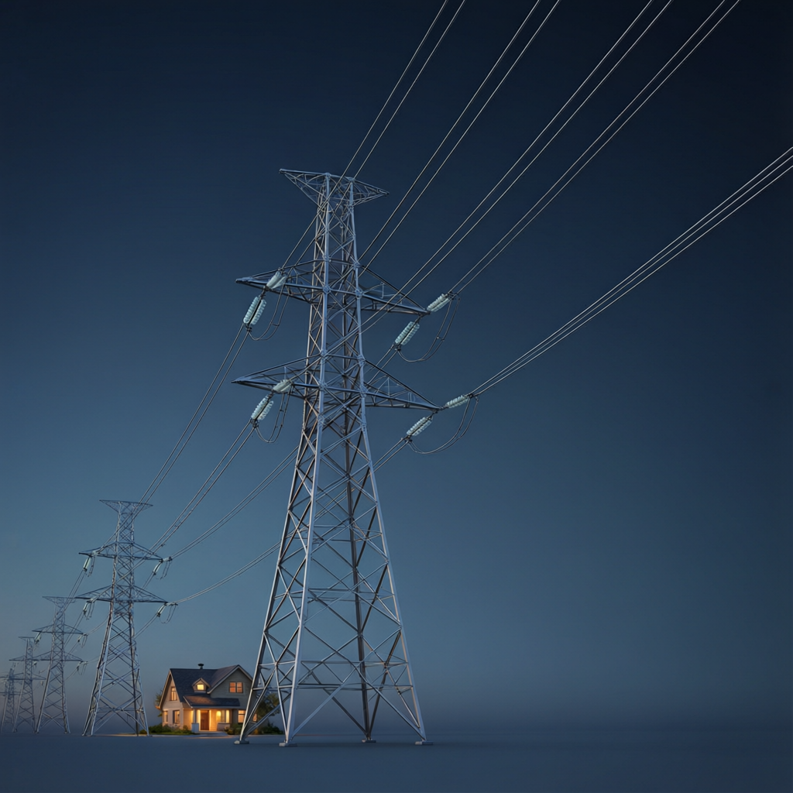
ICSE • CLASS 10 • ELECTRICITY
Power to Your Home
Transmission & distribution • House wiring • Fuses • Switches & dual control

Slide 2
INTRODUCTION
Learning Objectives
1
Describe how power reaches a house from the generating station
2
Outline the wiring of a house from the supply
3
Explain the purpose and action of a fuse
4
Explain why a fuse is placed in the live wire
5
Describe the role of switches in a circuit
6
Explain a staircase (two-way) dual-control switch
Notes:
Open by previewing these objectives so students know what they should be able to do by the end of the session.

Slide 3
PART 1
From Station to Socket
1
How electricity is delivered and distributed

Slide 4
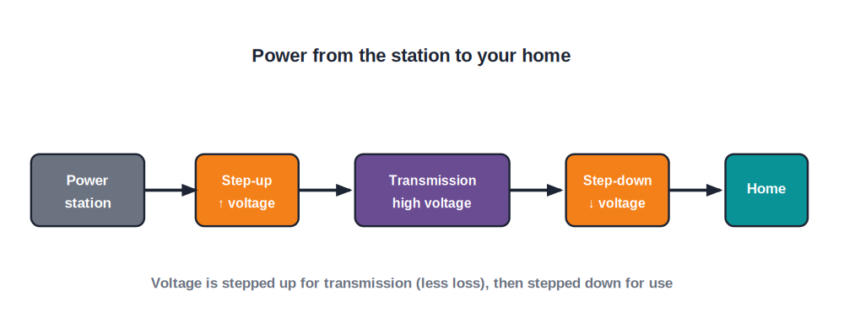
TRANSMISSION
Power From the Station
Step up, then step down
• Electricity is generated at a power station at a moderate voltage.
• A step-up transformer raises it to a very high voltage for transmission.
• High voltage means low current, so less energy is wasted as heat in the cables.
• Near towns, step-down transformers lower the voltage to a safe level for homes (about 230 V).
High-voltage transmission cuts energy loss
Notes:
The key idea: transmit at high voltage to keep current (and I²R losses) low, then step down for safe domestic use.

Slide 5
DISTRIBUTION
Power Distribution to a House
From the meter to the rooms
• Mains supply Two wires reach the house: live (at 230 V) and neutral (near 0 V).
• Electricity meter Records the energy used, in kilowatt-hours (units).
• Main fuse & switch Protect and isolate the whole house supply.
• Distribution board Splits the supply into separate circuits for lights, sockets, etc.
Notes:
Trace the path inside the house: meter → main switch/fuse → distribution board → individual circuits.

Slide 6
HOUSE WIRING
How a House Is Wired
Parallel circuits, three wires
• Separate circuits Lights and power sockets are on their own circuits so a fault in one does not kill the others.
• Everything in parallel Appliances are connected in parallel, so each gets the full 230 V and its own switch.
• Live, neutral, earth Three wires run to each socket — live, neutral and earth.
• Switches in the live Switches are placed in the live wire so that a switched-off appliance is truly safe.
Notes:
Two big ideas: parallel connection (full voltage, independent), and switches/fuses in the LIVE wire for safety.

Slide 7
THE FUSE
The Fuse — a Safety Weak Link
A fuse is a short piece of thin wire that melts and breaks the circuit if the current becomes dangerously large.
Fuse rating > normal current, but limits faults
• It is made of a metal with a low melting point.
• It is connected in the LIVE wire, so a blown fuse isolates the appliance from the live supply.
• Without it, an overload could overheat the wiring and start a fire.
Notes:
Fuse = deliberate weak link in the live wire. It melts on overload, cutting the live connection.

Slide 8

MCB
The Modern Alternative: MCB
What it is
Reusable
A Miniature Circuit Breaker — an automatic switch that trips off when the current is too large.
Unlike a fuse, it is simply switched back on after the fault is fixed — no wire to replace.
Fast acting
In the live wire
It breaks the circuit quickly on an overload or short circuit.
Like a fuse, it is connected in the live wire of the circuit.
Notes:
MCBs are the modern replacement for fuses: automatic, reusable, still in the live wire.

Slide 9


OVERLOAD VS SHORT
Overload and Short Circuit
Overload
Short circuit
Too many appliances draw more current than the wiring is rated for, so it overheats.
Live and neutral touch directly, giving a very large current through almost no resistance.
Same protection
Why dangerous
Both make the current shoot up, so the fuse or MCB cuts the supply.
Either can melt insulation and start a fire if not interrupted quickly.
Notes:
Distinguish overload (too many appliances) from a short circuit (live-neutral contact). Both trip the fuse/MCB.

Slide 10
WORKED EXAMPLE
Choosing a Fuse Rating
Problem. A 230 V electric kettle is rated 2300 W. What is the smallest standard fuse (3 A, 5 A, 13 A) that suits it?
Normal current I = P / V = 2300 / 230 = 10 A
The fuse must carry 10 A in normal use without blowing.
So 3 A and 5 A are too small; the 13 A fuse is the right choice.
Answer: Use a 13 A fuse (the next standard value above 10 A)
Notes:
Find the normal current from P = VI, then pick the next standard fuse just above it. Too low blows in normal use.

Slide 11


WHY LIVE WIRE
Why the Fuse & Switch Go in the Live Wire
Fuse in live
Fuse in neutral?
When it blows, the appliance is cut off from the dangerous live voltage.
Would stop the current, but the appliance would still be connected to the live wire — unsafe.
Switch in live
Golden rule
An 'off' switch then truly disconnects the live supply.
Anything that breaks the circuit for safety goes in the live wire.
Notes:
Drive home the rule. A fuse/switch in the neutral would still leave the appliance live and dangerous.

Slide 12
QUIZ 1
Check Your Understanding
5 questions • think before the answer reveals on the next slide

Slide 13
QUIZ QUESTION
Q1 — Why High Voltage?
Electricity is transmitted over long distances at very high voltage mainly to:
Make the wires glow
Reduce the current and so cut energy lost as heat in the cables
A
B
Increase the current
Make it safer to touch
C
D

Slide 14
ANSWER REVEALED
Q1 — Why High Voltage?
Electricity is transmitted over long distances at very high voltage mainly to:
Make the wires glow
Reduce the current and so cut energy lost as heat in the cables
A
✓
Increase the current
Make it safer to touch
C
D
WHY
Power lost in a cable is I²R. Sending power at high voltage means a smaller current for the same power, so far less energy is wasted heating the long transmission lines.

Slide 15
QUIZ QUESTION
Q2 — Fuse Placement
A fuse is always placed in the live wire rather than the neutral wire because:
The live wire is thicker
A blown fuse then disconnects the appliance from the live supply, making it safe
A
B
Neutral wires cannot melt
It looks neater
C
D

Slide 16
ANSWER REVEALED
Q2 — Fuse Placement
A fuse is always placed in the live wire rather than the neutral wire because:
The live wire is thicker
A blown fuse then disconnects the appliance from the live supply, making it safe
A
✓
Neutral wires cannot melt
It looks neater
C
D
WHY
If the fuse were in the neutral, a blown fuse would stop the current but leave the appliance still joined to the live wire — a shock hazard. In the live wire, a blown fuse makes it safe.

Slide 17
QUIZ QUESTION
Q3 — All in Parallel
Home appliances are connected in parallel so that each one:
Shares the voltage with the others
Receives the full mains voltage and can be switched separately
A
B
Carries the same current
Has the same resistance
C
D

Slide 18
ANSWER REVEALED
Q3 — All in Parallel
Home appliances are connected in parallel so that each one:
Shares the voltage with the others
Receives the full mains voltage and can be switched separately
A
✓
Carries the same current
Has the same resistance
C
D
WHY
Parallel connection puts the full 230 V across every appliance and gives each its own switch, so they work independently of one another.

Slide 19
QUIZ QUESTION
Q4 — Choosing a Fuse
A 230 V appliance normally draws 3 A. The most suitable fuse for it is:
A 1 A fuse
A 2 A fuse
A
B
A 5 A fuse
A 30 A fuse
C
D

Slide 20
ANSWER REVEALED
Q4 — Choosing a Fuse
A 230 V appliance normally draws 3 A. The most suitable fuse for it is:
A 1 A fuse
A 2 A fuse
A
B
A 5 A fuse
A 30 A fuse
✓
D
WHY
The fuse must be just above the normal current so it carries 3 A safely but blows on a fault. A 5 A fuse fits; 1–2 A would blow in normal use and 30 A would never protect it.

Slide 21
QUIZ QUESTION
Q5 — Short vs Overload
Live and neutral wires accidentally touch inside an appliance. This is a:
Normal load
Short circuit, drawing a very large current
A
B
Earth fault that is harmless
Drop in voltage
C
D

Slide 22
ANSWER REVEALED
Q5 — Short vs Overload
Live and neutral wires accidentally touch inside an appliance. This is a:
Normal load
Short circuit, drawing a very large current
A
✓
Earth fault that is harmless
Drop in voltage
C
D
WHY
With live and neutral in direct contact there is almost no resistance, so a huge current flows. The fuse or MCB must trip at once to prevent the wiring overheating.

Slide 23
PART 2
Switches & Dual Control
2
Controlling lights from more than one place

Slide 24
SWITCHES
Switches in a Circuit
Make or break the circuit
• Job of a switch To make (close) or break (open) a circuit, turning an appliance on or off.
• In the live wire Placed in the live wire so the appliance is isolated from the live supply when off.
• One-way switch A simple on/off switch controlling a light from a single point.
• Need for two-way Staircases and long corridors need control from two places.
Notes:
Define a switch's job and why it sits in the live wire, leading into the two-way switch.

Slide 25
DUAL CONTROL
Two-Way (Staircase) Switches
Two two-way switches let a single light be turned on or off from two different places — like the top and bottom of a staircase.
• Each switch can connect the live wire through one of two paths.
• Changing either switch makes or breaks the complete circuit.
• So the light's state can be flipped from either location.
Notes:
Explain the staircase wiring conceptually: either switch toggles the light because each offers two alternative paths.

Slide 26
EVERYDAY
Where Dual Control Helps
Staircases
Long corridors
Switch the light on going up, off at the top.
Control from both ends.
Bedrooms
Big halls
A switch at the door and one by the bed.
Several entrances, each with control of the lights.
Notes:
Relatable examples of two-way switching. Ask students where they have seen staircase switches.

Slide 27
WRAP UP
Quick Recap
✓ Transmission — step up to high voltage to cut I²R losses, then step down
✓ Distribution — meter → main switch/fuse → distribution board → circuits
✓ House wiring — appliances in parallel; live, neutral, earth
✓ Fuse — thin low-melting wire in the live; melts on overload
✓ Live-wire rule — fuses and switches go in the live wire
✓ Two-way switch — control one light from two places
Notes:
Rapid recap; the live-wire safety rule is the key takeaway.

Slide 28
QUIZ 2
Final Check — Wiring & Switches
5 questions • think before the answer reveals on the next slide

Slide 29
QUIZ QUESTION
Q1 — Switch Off, Still Live?
A lamp is switched off, but its switch was wrongly fitted in the neutral wire. The lamp is:
Completely safe
Off, but its live wire is still connected, so it is a shock hazard
A
B
Still glowing
Earthed
C
D

Slide 30
ANSWER REVEALED
Q1 — Switch Off, Still Live?
A lamp is switched off, but its switch was wrongly fitted in the neutral wire. The lamp is:
Completely safe
Off, but its live wire is still connected, so it is a shock hazard
A
✓
Still glowing
Earthed
C
D
WHY
A switch in the neutral can turn the lamp off, but the lamp stays joined to the live wire. Anyone touching a fault could get a shock. That is why switches go in the live wire.

Slide 31
QUIZ QUESTION
Q2 — Overload
Too many high-power appliances are plugged into one circuit. The most likely result is:
The voltage rises
The current rises and the fuse blows (or the wiring overheats)
A
B
The appliances speed up
Nothing happens
C
D

Slide 32
ANSWER REVEALED
Q2 — Overload
Too many high-power appliances are plugged into one circuit. The most likely result is:
The voltage rises
The current rises and the fuse blows (or the wiring overheats)
A
✓
The appliances speed up
Nothing happens
C
D
WHY
Each appliance adds to the current in the shared wire. The total can exceed the safe limit, melting the fuse (its job) before the wiring overheats and causes a fire.

Slide 33
QUIZ QUESTION
Q3 — Staircase Light
A single light controlled from both the top and bottom of a staircase uses:
One ordinary switch
Two two-way (dual-control) switches
A
B
A fuse at each end
No switch at all
C
D

Slide 34
ANSWER REVEALED
Q3 — Staircase Light
A single light controlled from both the top and bottom of a staircase uses:
One ordinary switch
Two two-way (dual-control) switches
A
✓
A fuse at each end
No switch at all
C
D
WHY
Two-way switches at each end let either one make or break the circuit, so the light can be toggled from the top or the bottom of the stairs.

Slide 35
QUIZ QUESTION
Q4 — Meter Reads
The electricity meter in a house measures the:
Voltage of the supply
Current drawn at that instant
A
B
Energy used, in kilowatt-hours
Resistance of the wiring
C
D

Slide 36
ANSWER REVEALED
Q4 — Meter Reads
The electricity meter in a house measures the:
Voltage of the supply
Current drawn at that instant
A
B
Energy used, in kilowatt-hours
Resistance of the wiring
✓
D
WHY
The meter totals the electrical energy consumed over time, in kilowatt-hours (units). The bill is the number of units times the price per unit.

Slide 37
QUIZ QUESTION
Q5 — Lights vs Sockets
Why are the lights and the power sockets of a house put on separate circuits?
To use more wire
So a fault or overload in one does not switch off the other
A
B
To save voltage
Because lights need no current
C
D

Slide 38
ANSWER REVEALED
Q5 — Lights vs Sockets
Why are the lights and the power sockets of a house put on separate circuits?
To use more wire
So a fault or overload in one does not switch off the other
A
✓
To save voltage
Because lights need no current
C
D
WHY
Separate circuits (with their own fuses) mean a problem in the socket circuit will not plunge the lights into darkness, and each can be rated for its expected current.

Slide 39
Electricity, Delivered Safely
From a distant turbine to your bedside lamp — transformers, fuses and careful wiring keep the power flowing safely.

