Slide 1
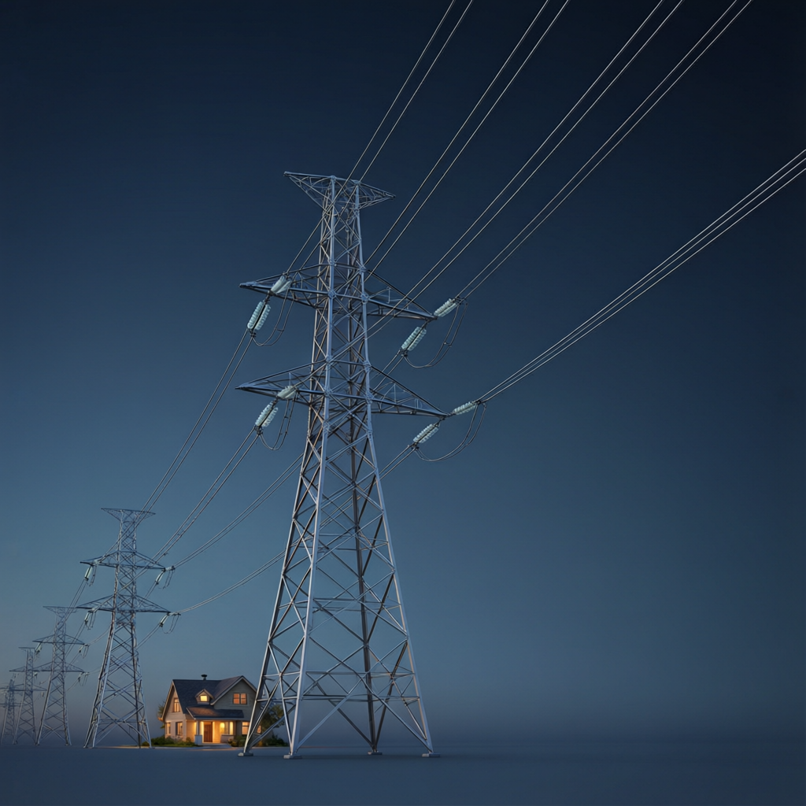
ICSE • CLASS 10 • ELECTRICITY
Earthing, Plugs & Safety
Earthing • The three-pin plug • Colour coding • Electrical safety

Slide 2
INTRODUCTION
Learning Objectives
1
Explain the purpose of earthing an appliance
2
Identify the three pins of a plug and their wires
3
State the colour code of live, neutral and earth wires
4
Explain why the earth pin is longer and thicker
5
Describe the danger of high-tension wires
6
List safety precautions for using electricity
Notes:
Open by previewing these objectives so students know what they should be able to do by the end of the session.

Slide 3
PART 1
Earthing & the Three-Pin Plug
1
How an appliance is made safe to touch

Slide 4
EARTHING
Why We Earth Appliances
Earthing connects the metal body of an appliance to the ground through the earth wire, so it can never reach a dangerous voltage.
• If the live wire touches the metal body, current flows safely to earth instead of through a person.
• This large current also blows the fuse, cutting off the supply.
• Without earthing, the body would stay live and give a shock when touched.
Notes:
Earthing gives a safe, low-resistance path for fault current — protecting the user and blowing the fuse.

Slide 5
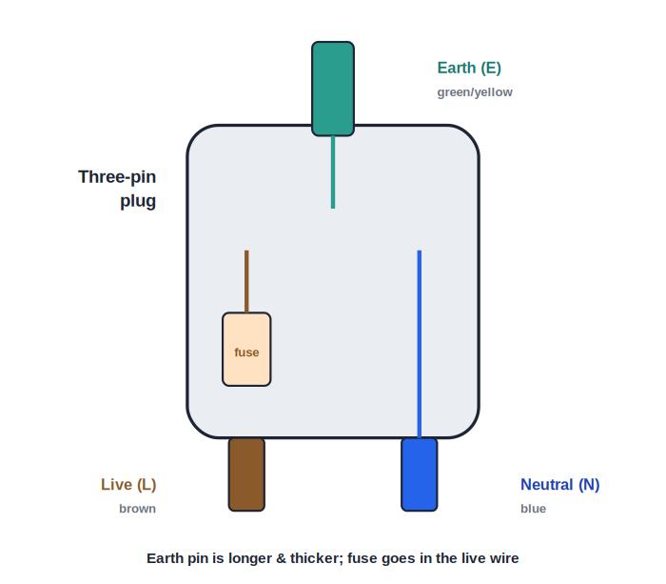
THREE-PIN PLUG
Inside a Three-Pin Plug
Live, neutral & earth
• The three pins are live (L), neutral (N) and earth (E).
• The earth pin is longer, so it connects first and disconnects last.
• It is also thicker to carry a large fault current safely.
• The fuse is fitted in the live wire of the plug.
Earth pin: longer and thicker; fuse in the live
Notes:
Walk through the three pins. The longer earth pin connects first (safety); the fuse is in the live wire.

Slide 6



TWO PROTECTIONS
Fuse and Earthing Do Different Jobs
Fuse
Earthing
Protects the wiring — it melts to cut off a dangerously large current.
Protects the user — it keeps the metal body at earth potential, safe to touch.
They work together
Both needed
On a fault the earth wire carries a large current that then blows the fuse.
A fuse alone leaves the body live until it blows; earthing makes that instant safe.
Notes:
Key distinction: the fuse protects the circuit/wiring, earthing protects the person. Together they make a fault safe.

Slide 7
COLOUR CODE
Colour Coding of Wires
Live — brown
Neutral — blue
Carries the dangerous 230 V supply (older code: red).
Completes the circuit, near 0 V (older code: black).
Earth — green/yellow
Why colours
The safety wire to the ground (older code: green).
So wires are connected to the correct terminals every time.
Notes:
Memorise the modern code: brown live, blue neutral, green/yellow earth. Wrong connections are dangerous.

Slide 8
EARTH PIN
Why the Earth Pin Is Special
First to connect, last to leave
• Longer It makes contact first when plugging in, so the appliance is earthed before it is live.
• Thicker It can safely carry a large fault current to the ground.
• Opens the shutters In many sockets the long earth pin pushes open safety shutters over the live and neutral holes.
• Connected to the body Inside the appliance the earth wire is joined to its metal casing.
Notes:
The earth pin's length and thickness are favourite exam points: connects first, carries fault current, opens shutters.

Slide 9
HOW WE EARTH
How a House Is Earthed
Plate or pipe earthing
• Earth electrode A metal plate or pipe is buried deep in moist ground near the house.
• Low resistance It is surrounded by charcoal and salt to keep the earth connection low in resistance.
• Earth wire A thick wire links the electrode to the earth pins of all the sockets.
• Why moist soil Damp, salted earth conducts well, giving fault current an easy path to ground.
Notes:
Outline plate/pipe earthing: a buried electrode in salted, charcoal-packed moist soil, linked by a thick earth wire.

Slide 10
QUIZ 1
Check Your Understanding
5 questions • think before the answer reveals on the next slide

Slide 11
QUIZ QUESTION
Q1 — Fault to the Body
The live wire inside a metal toaster comes loose and touches the casing. If the toaster is properly earthed, what happens?
The casing becomes live and dangerous
A large current flows to earth and blows the fuse, cutting the supply
A
B
Nothing changes
The toaster runs faster
C
D

Slide 12
ANSWER REVEALED
Q1 — Fault to the Body
The live wire inside a metal toaster comes loose and touches the casing. If the toaster is properly earthed, what happens?
The casing becomes live and dangerous
A large current flows to earth and blows the fuse, cutting the supply
A
✓
Nothing changes
The toaster runs faster
C
D
WHY
Earthing offers a low-resistance path to ground. The fault current is large, so the fuse melts and disconnects the supply, leaving the casing safe to touch.

Slide 13
QUIZ QUESTION
Q2 — Colour Check
In the modern colour code, the wire that is brown is the:
Earth wire
Neutral wire
A
B
Live wire
Signal wire
C
D

Slide 14
ANSWER REVEALED
Q2 — Colour Check
In the modern colour code, the wire that is brown is the:
Earth wire
Neutral wire
A
B
Live wire
Signal wire
✓
D
WHY
The modern code is brown = live, blue = neutral, green/yellow = earth. The brown live wire carries the dangerous 230 V.

Slide 15
QUIZ QUESTION
Q3 — Longer Pin
The earth pin of a plug is made longer than the other two so that:
It looks different
The appliance is earthed first, before the live pin makes contact
A
B
It carries the current
It fits more tightly
C
D

Slide 16
ANSWER REVEALED
Q3 — Longer Pin
The earth pin of a plug is made longer than the other two so that:
It looks different
The appliance is earthed first, before the live pin makes contact
A
✓
It carries the current
It fits more tightly
C
D
WHY
The longer earth pin enters the socket first and leaves last, so the appliance is safely earthed throughout the moment it is live — and it often opens the socket's safety shutters too.

Slide 17
QUIZ QUESTION
Q4 — No Earth
A plastic-bodied hair dryer with no metal parts is often sold with only two pins (no earth) because:
Plastic conducts electricity
Its non-conducting case can never become live, so earthing is not needed
A
B
It uses no current
Earthing would damage it
C
D

Slide 18
ANSWER REVEALED
Q4 — No Earth
A plastic-bodied hair dryer with no metal parts is often sold with only two pins (no earth) because:
Plastic conducts electricity
Its non-conducting case can never become live, so earthing is not needed
A
✓
It uses no current
Earthing would damage it
C
D
WHY
Earthing protects a conducting (metal) body. A fully insulated plastic body cannot give a shock even if a wire touches it, so such 'double-insulated' devices need no earth pin.

Slide 19
QUIZ QUESTION
Q5 — Fuse or Earth?
Which statement correctly matches each safety device to its job?
The fuse protects the user; earthing protects the wiring
The fuse protects the wiring; earthing protects the user
A
B
Both protect only the wiring
Both protect only the user
C
D

Slide 20
ANSWER REVEALED
Q5 — Fuse or Earth?
Which statement correctly matches each safety device to its job?
The fuse protects the user; earthing protects the wiring
The fuse protects the wiring; earthing protects the user
A
✓
Both protect only the wiring
Both protect only the user
C
D
WHY
The fuse melts to stop a dangerous current overheating the wiring. Earthing keeps the metal body at earth potential so it is safe to touch — and the fault current it carries then blows the fuse.

Slide 21
PART 2
High-Tension Wires & Safety
2
Respecting the dangers of electricity

Slide 22
HIGH TENSION
High-Tension (HT) Wires
Why HT lines are kept out of reach
• Very high voltage Transmission lines carry tens of thousands of volts.
• Bare and high up They are uninsulated, so they are strung high on tall pylons, out of reach.
• Keep away Never fly kites or raise poles near them — electricity can jump (arc) across a gap.
• Warning signs Danger boards and wide clearances keep people and vehicles at a safe distance.
Notes:
HT wires are bare and lethal; height and distance are the safety measures. Stress kite/pole dangers.

Slide 23
SAFETY
Safety Precautions With Electricity
Dry hands
Right fuse
Never touch switches or appliances with wet hands — water conducts electricity.
Always use a fuse of the correct rating; never replace it with thick wire.
Earth metal appliances
Repairs off
Connect the earth pin; do not bypass it.
Switch off and unplug before repairing or cleaning an appliance.
Notes:
Practical safety rules. Connect each to the physics: water conducts, correct fuse protects, earthing saves lives.

Slide 24
MORE SAFETY
Good Habits That Save Lives
Everyday electrical sense
• No overloading Avoid plugging many high-power appliances into one socket.
• Good insulation Replace frayed or damaged wires and cracked plugs promptly.
• Three-pin for metal Always use an earthed three-pin plug for metal-bodied appliances.
• Keep water away Keep electrical points away from taps, sinks and bathrooms unless specially protected.
Notes:
Reinforce habits: no overloading, good insulation, earthing, water awareness.

Slide 25
DOUBLE INSULATION
Double-Insulated Appliances
Two layers
No earth needed
The live parts are insulated, and the whole casing is a second layer of insulation.
Because the case can never become live, no earth wire is required.
The symbol
Examples
Marked with a 'square within a square' symbol.
Plastic hair dryers, electric shavers and many power tools.
Notes:
Double insulation is an alternative to earthing for plastic-bodied devices — two independent layers of insulation.

Slide 26
ELECTRIC SHOCK
If Someone Gets an Electric Shock
Cut the supply first
• Switch off the mains supply immediately — do not touch the person while they are still connected.
• If you cannot reach the switch, push them away using a dry, non-conducting object like wood.
• Never use your bare hands or anything wet or metal.
• Once they are clear, call for medical help and give first aid if trained.
Notes:
Emphasise: isolate the supply before touching the casualty, and only use dry, insulating materials.

Slide 27
WRAP UP
Quick Recap
✓ Earthing — safe path to ground; protects user and blows the fuse
✓ Three pins — live, neutral, earth; fuse in the live wire
✓ Colour code — brown live, blue neutral, green/yellow earth
✓ Earth pin — longer and thicker — connects first, carries fault current
✓ HT wires — very high voltage, bare, kept high and out of reach
✓ Safety — dry hands, correct fuse, earthing, switch off to repair
Notes:
Rapid recap; the earthing mechanism and colour code are the most examined points.

Slide 28
QUIZ 2
Final Check — Safety
5 questions • think before the answer reveals on the next slide

Slide 29
QUIZ QUESTION
Q1 — Wet Hands
Touching an electric switch with wet hands is dangerous because:
Water repels electricity
Water conducts electricity, lowering your resistance and allowing a larger shock current
A
B
Switches dislike water
It increases the voltage
C
D

Slide 30
ANSWER REVEALED
Q1 — Wet Hands
Touching an electric switch with wet hands is dangerous because:
Water repels electricity
Water conducts electricity, lowering your resistance and allowing a larger shock current
A
✓
Switches dislike water
It increases the voltage
C
D
WHY
Wet skin has a much lower resistance than dry skin, so for the same voltage a far larger and more dangerous current can flow through the body.

Slide 31
QUIZ QUESTION
Q2 — Thick Wire as Fuse
Replacing a blown fuse with a thick copper wire is dangerous because the thick wire:
Melts too easily
Will not melt on an overload, so the wiring can overheat and catch fire
A
B
Carries no current
Increases the voltage
C
D

Slide 32
ANSWER REVEALED
Q2 — Thick Wire as Fuse
Replacing a blown fuse with a thick copper wire is dangerous because the thick wire:
Melts too easily
Will not melt on an overload, so the wiring can overheat and catch fire
A
✓
Carries no current
Increases the voltage
C
D
WHY
A fuse is meant to be the weak link that melts first. A thick copper wire can carry a huge current without melting, so it removes the protection and the wiring itself may overheat.

Slide 33
QUIZ QUESTION
Q3 — Kite Warning
Why must you never fly a kite near high-tension power lines?
The kite may get dirty
Electricity can arc across to a wet string or the kite, giving a fatal shock
A
B
The lines will fall
The kite flies too high
C
D

Slide 34
ANSWER REVEALED
Q3 — Kite Warning
Why must you never fly a kite near high-tension power lines?
The kite may get dirty
Electricity can arc across to a wet string or the kite, giving a fatal shock
A
✓
The lines will fall
The kite flies too high
C
D
WHY
At tens of thousands of volts, current can jump across a small air gap to a kite or a damp string, sending a lethal current down to the person holding it.

Slide 35
QUIZ QUESTION
Q4 — Bird on a Wire
A bird can sit safely on a single bare power line because:
Its feet are insulated
There is no potential difference across its body — both feet are on the same wire
A
B
Birds do not conduct
The wire is switched off
C
D

Slide 36
ANSWER REVEALED
Q4 — Bird on a Wire
A bird can sit safely on a single bare power line because:
Its feet are insulated
There is no potential difference across its body — both feet are on the same wire
A
✓
Birds do not conduct
The wire is switched off
C
D
WHY
Both feet touch the same point, so there is almost no voltage difference across the bird and almost no current through it. Touching a second wire or the ground would be fatal.

Slide 37
QUIZ QUESTION
Q5 — Before Repair
Before repairing an electrical appliance you should always first:
Wet your hands
Switch off and unplug it from the mains
A
B
Increase the current
Remove the earth wire
C
D

Slide 38
ANSWER REVEALED
Q5 — Before Repair
Before repairing an electrical appliance you should always first:
Wet your hands
Switch off and unplug it from the mains
A
✓
Increase the current
Remove the earth wire
C
D
WHY
Disconnecting the appliance from the live supply removes the source of danger, so no current can flow through you while you work on it.

Slide 39
Stay Safe With Electricity
Earthing, the right fuse and a little caution turn a deadly force into a everyday convenience.

