Slide 1
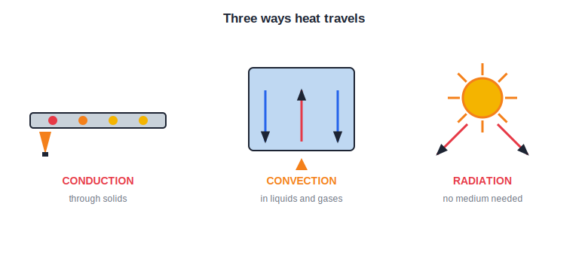
STD 7 • GENERAL SCIENCE • HEAT
Heat
Heat and temperature • Effects of heat • Conduction, convection and radiation

Slide 2
INTRODUCTION
Learning Objectives
1
Explain heat as a form of energy and name its sources
2
Tell heat apart from temperature
3
Describe the effects of heat, including expansion
4
Explain conduction, convection and radiation
5
Give everyday uses of good and bad conductors
6
Explain how a thermos (vacuum) flask keeps heat in
Notes:
Open by previewing these objectives so students know what they should be able to do by the end of the session.

Slide 3
PART 1
Heat, Temperature and Their Effects
1
What heat is and what it does to matter

Slide 4
HEAT
Heat and Temperature
Heat is energy
Heat is a form of energy that flows from a hotter body to a colder one.
Temperature
Temperature tells us how hot or cold a body is; it is measured with a thermometer.
Not the same thing
A cup and a bucket of water at the same temperature hold very different amounts of heat.
Units
Temperature is measured in degrees Celsius (°C); heat is a form of energy, measured in joules.
Notes:
Heat is energy in transit; temperature is the degree of hotness. Separate the two with the cup-vs-bucket idea.

Slide 5
HEAT FLOWS
Heat Always Flows Hot → Cold
Heat energy moves by itself from a hotter body to a colder one, until both reach the same temperature.
• Put a hot spoon in cold water — the spoon cools, the water warms.
• They stop changing when both are equally warm.
• Heat never flows on its own from cold to hot.
Notes:
Establish the one-way, on-its-own flow of heat from hot to cold until temperatures equalise (thermal equilibrium).

Slide 6



SOURCES
Where Heat Comes From
The Sun
Burning fuel
Our greatest natural source of heat energy.
Wood, gas and coal release heat when they burn.
Electricity
Friction
Heaters, irons and geysers turn electricity into heat.
Rubbing hands together warms them — friction makes heat.
Notes:
Name the everyday sources of heat: the Sun, fuels, electricity and friction.

Slide 7
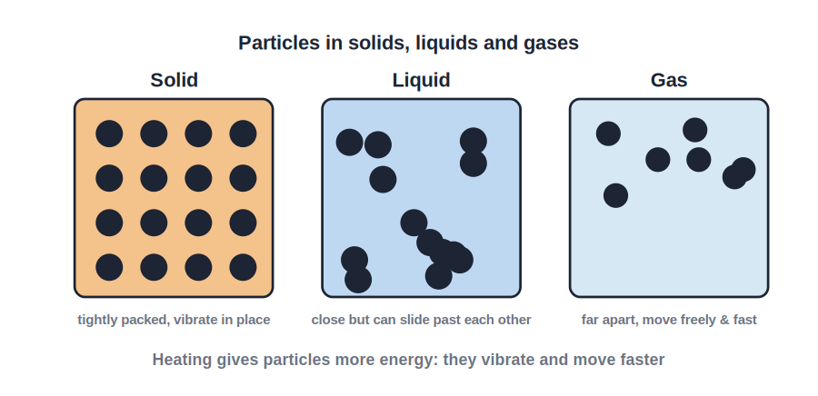
EFFECTS OF HEAT
What Heat Does to a Substance
Heat changes matter
• Raises temperature and makes molecules move faster.
• Expands solids, liquids and gases (thermal expansion).
• Can change the state — melting and boiling.
• Gaps in railway lines and bridges allow for this expansion.
Heating speeds up the molecules
Notes:
List the effects of heat. Expansion and change of state are the key ones; connect expansion to real gaps left in rails and bridges.

Slide 8
EXPANSION
Heat Makes Things Expand
Solids expand
A metal ball that just passes through a ring will not fit once heated.
Liquids expand
Water and mercury rise up a tube when warmed.
Gases expand most
Air expands the most of all when heated.
On cooling
Everything contracts (shrinks) again as it cools down.
Notes:
Thermal expansion in all three states — solids least, gases most — and the reverse (contraction) on cooling.

Slide 9
EXPANSION AT WORK
Expansion in Everyday Life
Railway gaps
Bridges
Small gaps let rails expand on a hot day without buckling.
Rollers and gaps let long bridges expand safely.
Overhead wires
Tight lids
Wires are left slightly loose to allow for shrinking in winter.
Warming a metal lid makes it expand and open more easily.
Notes:
Real engineering allowances for expansion — rail gaps, bridge rollers, sagging wires — plus the loosening-a-lid trick.

Slide 10
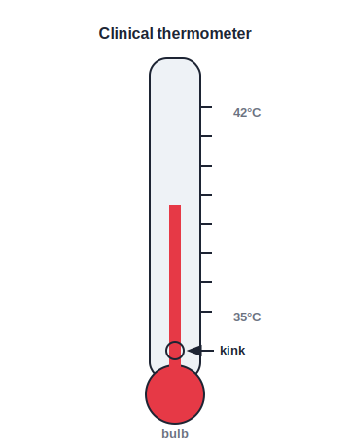
THERMOMETER
Measuring Temperature
0 °C to 100 °C
• A thermometer measures temperature.
• Most use mercury, which expands evenly on heating.
• The Celsius scale runs 0 °C (melting ice) to 100 °C (boiling water).
• A clinical thermometer reads body temperature (around 37 °C).
Mercury expands up the fine tube
Notes:
The thermometer works by the even expansion of mercury. Mention the fixed points 0 °C and 100 °C.

Slide 11
TYPES
Kinds of Thermometers
Laboratory
Clinical
Reads a wide range of temperatures for experiments.
Reads body temperature; has a kink to hold the reading.
Digital
Care
Shows the temperature as numbers on a screen.
Handle the glass gently and never shake a lab thermometer.
Notes:
Compare laboratory, clinical and digital thermometers, and note safe handling of the glass ones.

Slide 12
CHANGE OF STATE
Heat Changes the State of Matter
Melting
A solid becomes a liquid on heating — ice to water.
Boiling
A liquid becomes a gas on strong heating — water to steam.
Condensation
A gas becomes a liquid on cooling — steam to water.
Freezing
A liquid becomes a solid on cooling — water to ice.
Notes:
The changes of state driven by heating and cooling: melting, boiling, condensation and freezing.

Slide 13
HEAT ≠ TEMPERATURE
Heat and Temperature are Different
Temperature is the degree of hotness; heat is the total energy. Two bodies at the same temperature can hold very different amounts of heat.
• A cup and a bucket of water may be equally warm.
• The bucket holds far more water, so far more total heat.
• Temperature is 'how hot'; heat is 'how much energy'.
Notes:
Drive home the heat-vs-temperature distinction with the cup-and-bucket example — same temperature, different total heat.

Slide 14
QUIZ 1
Check — Heat, Temperature & Effects
4 questions • think before the answer reveals on the next slide

Slide 15
QUIZ QUESTION
Q1 — Flow of heat
Heat always flows on its own from a body at:
Lower to higher temperature
Higher to lower temperature
A
B
Equal temperatures only
Larger to smaller size
C
D

Slide 16
ANSWER REVEALED
Q1 — Flow of heat
Heat always flows on its own from a body at:
Lower to higher temperature
Higher to lower temperature
A
✓
Equal temperatures only
Larger to smaller size
C
D
WHY
Heat energy moves by itself from the hotter body to the colder one, until both reach the same temperature.

Slide 17
QUIZ QUESTION
Q2 — Heat vs temperature
A cup and a bucket of water are at the same temperature. Compared with the cup, the bucket has:
The same total heat
More total heat energy
A
B
Less total heat energy
No heat at all
C
D

Slide 18
ANSWER REVEALED
Q2 — Heat vs temperature
A cup and a bucket of water are at the same temperature. Compared with the cup, the bucket has:
The same total heat
More total heat energy
A
✓
Less total heat energy
No heat at all
C
D
WHY
Temperature is the same, but the bucket holds far more water, so it contains much more total heat energy.

Slide 19
QUIZ QUESTION
Q3 — Gaps in rails
Small gaps are left between railway rails so that the rails can:
Contract in summer
Expand in hot weather without buckling
A
B
Carry more trains
Stay cool
C
D

Slide 20
ANSWER REVEALED
Q3 — Gaps in rails
Small gaps are left between railway rails so that the rails can:
Contract in summer
Expand in hot weather without buckling
A
✓
Carry more trains
Stay cool
C
D
WHY
Metals expand when heated. The gaps give the rails room to expand on a hot day, so the track does not bend out of shape.

Slide 21
QUIZ QUESTION
Q4 — Thermometer liquid
Mercury is used in a common thermometer mainly because it:
Is cheap
Expands evenly and is easily seen
A
B
Freezes quickly
Is a gas
C
D

Slide 22
ANSWER REVEALED
Q4 — Thermometer liquid
Mercury is used in a common thermometer mainly because it:
Is cheap
Expands evenly and is easily seen
A
✓
Freezes quickly
Is a gas
C
D
WHY
Mercury expands uniformly with temperature and is shiny, so the thread is easy to read against the scale.

Slide 23
PART 2
How Heat Travels
2
Conduction, convection and radiation

Slide 24
THREE MODES
Conduction, Convection, Radiation
Solid • liquid/gas • no medium
• Conduction: heat passes through a solid, particle to particle.
• Convection: hot liquid or gas rises and cold sinks, carrying heat.
• Radiation: heat travels as rays, needing no medium — as from the Sun.
• Metals are good conductors; air, wood and water are poor conductors.
Three ways heat moves
Notes:
Contrast the three modes: conduction needs a solid medium, convection needs a moving fluid, radiation needs no medium at all.

Slide 25
CONDUCTION
Heat by Conduction
Through solids
Heat passes from particle to particle without them moving away.
A metal spoon
The end in hot tea soon warms the far end.
Good conductors
Metals like copper and iron carry heat quickly.
Poor conductors
Wood, plastic and air carry heat very slowly.
Notes:
Conduction: heat handed particle-to-particle through a solid. Metals conduct well; wood/plastic/air do not.

Slide 26
CONVECTION
Heat by Convection
In fluids
Happens in liquids and gases, which can flow.
Hot rises
Warm fluid becomes lighter and rises; cool fluid sinks.
A current forms
This sets up a circulating convection current.
Sea & land breeze
Day and night breezes at the coast are convection currents of air.
Notes:
Convection: heat carried by the bulk movement of a fluid. Use boiling water and sea/land breezes as examples.

Slide 27
RADIATION
Heat by Radiation
No medium needed
Radiation can travel through empty space.
From the Sun
The Sun's heat reaches us across empty space by radiation.
As rays
It travels as invisible heat rays at the speed of light.
Dark vs shiny
Dark, dull surfaces absorb radiation; shiny ones reflect it.
Notes:
Radiation needs no medium and reaches us from the Sun. Note that dark surfaces absorb and shiny surfaces reflect heat rays.

Slide 28
CONDUCTORS
Good and Poor Conductors in Daily Life
Cooking pans
Handles
Made of metal (good conductor) so heat reaches the food quickly.
Made of wood or plastic (poor conductors) so they stay cool to hold.
Woollen clothes
Sea breeze
Trap air, a poor conductor, keeping body heat in during winter.
A day-time convection current of air from the cool sea to the warm land.
Notes:
Everyday examples of choosing conductors and insulators, plus convection in nature (land and sea breezes).

Slide 29
INSULATORS
Putting Poor Conductors to Work
Warm clothing
Pot holders
Wool and quilts trap air to hold in body heat.
Cloth or wood protects our hands from hot vessels.
Double walls
Birds fluff up
Air between walls keeps rooms and flasks warm.
Fluffed feathers trap air and keep birds warm in winter.
Notes:
Poor conductors (insulators) at work — clothing, holders, double walls, even fluffed feathers — all trap air.

Slide 30
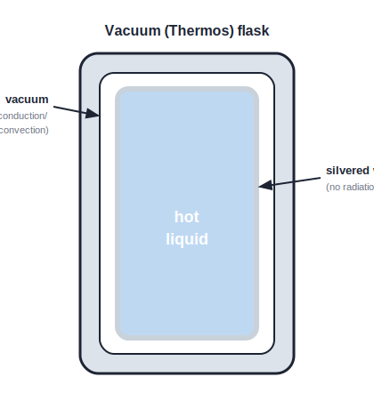
THERMOS FLASK
The Vacuum (Thermos) Flask
Blocks all three
• Keeps hot things hot and cold things cold.
• A vacuum between double walls stops conduction and convection.
• Shiny silvered walls reflect heat back, stopping radiation.
• So all three ways of losing heat are blocked at once.
Vacuum + silvered walls
Notes:
The flask is the classic application: the vacuum stops conduction/convection and the silvering stops radiation.

Slide 31
HOW IT WORKS
How the Flask Blocks Each Mode
Vacuum gap
The empty gap has no particles, so no conduction and no convection.
Silvered walls
Shiny surfaces reflect heat rays back, stopping radiation.
Insulating stopper
The cork or plastic cap stops heat escaping from the top.
Works both ways
It keeps hot drinks hot and cold drinks cold alike.
Notes:
Break down the flask feature by feature against the three modes of heat transfer — a complete real-world design.

Slide 32


APPLICATIONS
Heat Transfer Around Us
Cooking
Coastal climate
Metal pans conduct; boiling water convects the heat through.
Sea and land breezes are giant convection currents.
Room heater
Sunlight
Warms the air, which convects around the room.
Radiation warms the Earth from 150 million km away.
Notes:
A spread of applications tying each everyday case to conduction, convection or radiation.

Slide 33
CHOOSING WISELY
Choosing Conductors and Insulators
We pick a good conductor where heat must pass quickly, and a poor conductor (insulator) where heat must be kept in or out.
• Cooking vessels — good conductors, for fast heating.
• Handles and clothing — poor conductors, to block heat.
• The right choice makes appliances safe and efficient.
Notes:
Sum up Part 2 by the design principle: match the material's conducting ability to the job.

Slide 34
WRAP UP
Quick Recap
✓ Heat — a form of energy; flows hot → cold
✓ Temperature — degree of hotness; measured in °C
✓ Effects — expansion and change of state
✓ Conduction — through solids, particle to particle
✓ Convection — hot fluid rises, cold sinks
✓ Radiation — heat rays, no medium needed
Notes:
Rapid recap of heat, temperature and the three modes of transfer.

Slide 35
QUIZ 2
Final Check — How Heat Travels
4 questions • think before the answer reveals on the next slide

Slide 36
QUIZ QUESTION
Q1 — Mode in solids
Heat travels through a metal spoon placed in hot tea mainly by:
Convection
Radiation
A
B
Conduction
No transfer
C
D

Slide 37
ANSWER REVEALED
Q1 — Mode in solids
Heat travels through a metal spoon placed in hot tea mainly by:
Convection
Radiation
A
B
Conduction
No transfer
✓
D
WHY
In a solid, heat passes from particle to particle without the particles moving from place to place — this is conduction.

Slide 38
QUIZ QUESTION
Q2 — Mode in fluids
Water in a pan gets heated throughout mainly by:
Conduction
Convection currents
A
B
Radiation
Reflection
C
D

Slide 39
ANSWER REVEALED
Q2 — Mode in fluids
Water in a pan gets heated throughout mainly by:
Conduction
Convection currents
A
✓
Radiation
Reflection
C
D
WHY
Hot water near the flame rises and cooler water sinks to take its place, setting up convection currents that heat all the water.

Slide 40
QUIZ QUESTION
Q3 — No medium
Heat from the Sun reaches the Earth through empty space by:
Conduction
Convection
A
B
Radiation
Sound
C
D

Slide 41
ANSWER REVEALED
Q3 — No medium
Heat from the Sun reaches the Earth through empty space by:
Conduction
Convection
A
B
Radiation
Sound
✓
D
WHY
There is no air in space, so the Sun's heat cannot travel by conduction or convection — it comes as radiation, which needs no medium.

Slide 42
QUIZ QUESTION
Q4 — Woollen clothes
Woollen clothes keep us warm in winter because the trapped air is:
A good conductor
A poor conductor of heat
A
B
A source of heat
Very heavy
C
D

Slide 43
ANSWER REVEALED
Q4 — Woollen clothes
Woollen clothes keep us warm in winter because the trapped air is:
A good conductor
A poor conductor of heat
A
✓
A source of heat
Very heavy
C
D
WHY
Wool traps a lot of air, and air is a poor conductor, so it slows the escape of body heat and keeps us warm.

Slide 44
Feeling the Warmth
Heat is energy on the move — understanding how it flows lets us cook, stay warm, and keep a drink hot for hours.

