Slide 1
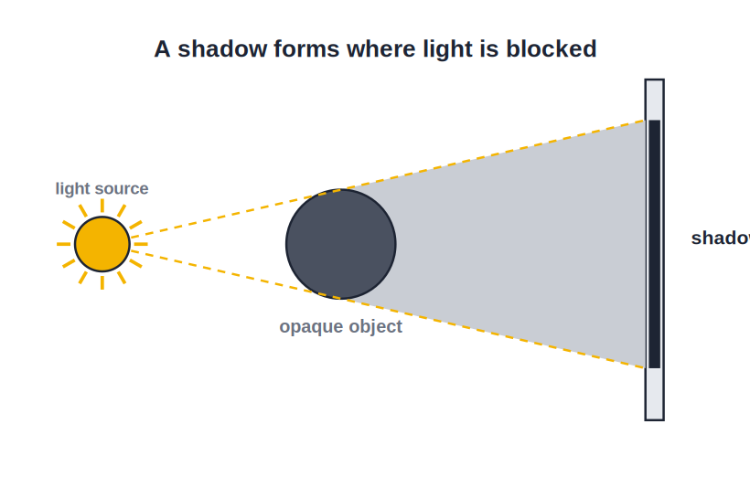
STD 7 • GENERAL SCIENCE • LIGHT
Effects of Light
Light travels straight • Shadows • Scattering • Eclipses

Slide 2
INTRODUCTION
Learning Objectives
1
State that light travels in straight lines
2
Explain how a shadow is formed
3
Describe the scattering of light and a Zero Shadow Day
4
Explain a solar eclipse and a lunar eclipse
5
Tell apart the umbra and the penumbra
6
Relate these effects to everyday sights
Notes:
Open by previewing these objectives so students know what they should be able to do by the end of the session.

Slide 3
PART 1
Straight-Line Light and Shadows
1
Why opaque objects cast shadows

Slide 4
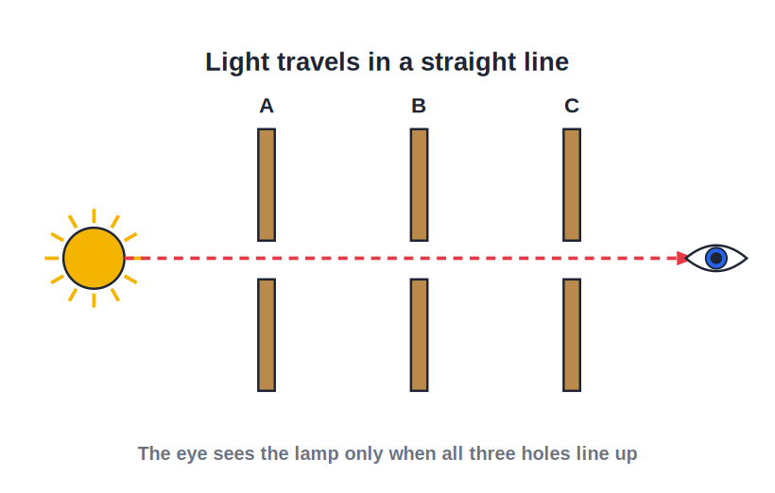
STRAIGHT LINE
Light Travels in Straight Lines
Rectilinear propagation
• Light travels in straight lines, called rays.
• We see this in a sunbeam through a gap or dusty air.
• Because light goes straight, it cannot bend around a corner.
• This straight-line travel is what makes shadows form.
A straight beam of light
Notes:
Establish rectilinear propagation with the sunbeam example — it is the reason shadows and eclipses happen.

Slide 5
EVIDENCE
How We Know Light Goes Straight
A sunbeam
A ray through a window or through leaves is dead straight.
Line up the holes
You see a candle through three cards only when their holes are in line.
No seeing round corners
We cannot see behind a wall — light will not bend to reach us.
Sharp shadow edges
The clean edge of a shadow shows the light came straight.
Notes:
Classic evidence for rectilinear propagation — sunbeams, the three-card experiment, not seeing round corners, sharp shadows.

Slide 6
LIGHT IS ENERGY
Light is a Form of Energy
Light is a form of energy that travels in straight lines and lets us see the world around us.
• It travels extremely fast — faster than anything else.
• It can travel even through the vacuum of space.
• That is how the Sun's light reaches the Earth.
Notes:
Frame light as a fast-travelling form of energy that, unlike sound, can cross empty space.

Slide 7
SHADOWS
How a Shadow Forms
Umbra & penumbra
• A shadow forms where an opaque object blocks the light.
• Needs a light source, an opaque object and a screen.
• The dark centre is the umbra; the lighter edge is the penumbra.
• The shadow's size changes with the distance from the light.
Light blocked → shadow
Notes:
A shadow needs source, opaque object and screen. Distinguish the dark umbra from the softer penumbra.

Slide 8
UMBRA & PENUMBRA
Two Parts of a Shadow
Umbra
The dark central region that gets no light at all.
Penumbra
The lighter border that gets some light.
Small source
A point source gives a sharp shadow, almost all umbra.
Large source
A broad source gives a wide, soft penumbra.
Notes:
Define umbra (full shadow) and penumbra (partial), and how the size of the source changes their proportions.

Slide 9
WHAT IT NEEDS
Three Things a Shadow Needs
A light source
The Sun, a lamp or a torch.
An opaque object
Something that blocks the light.
A screen
A wall or the ground for the shadow to fall on.
Straight light
And, of course, light travelling in straight lines.
Notes:
A shadow needs a source, an opaque object and a screen — and the straight-line travel of light underlies it all.

Slide 10


SHADOW FACTS
More About Shadows
Always dark
Shape, not detail
A shadow is always black — it has no colour of its own.
A shadow shows only the outline of an object, not its colour or features.
Changes through the day
Zero Shadow Day
The Sun's changing position makes shadows long in the morning and short at noon.
Twice a year in the tropics the noon Sun is overhead and vertical objects cast almost no shadow.
Notes:
Shadows are colourless outlines whose length changes with the Sun's height; Zero Shadow Day is the striking special case.

Slide 11
ZERO SHADOW DAY
The Day Shadows Disappear
Twice a year in the tropics, the noon Sun stands exactly overhead, so a vertical object casts almost no shadow at all.
• The Sun's rays fall straight down along the object.
• It happens only between the tropics, not everywhere.
• The two dates depend on the place's latitude.
Notes:
Explain Zero Shadow Day: the overhead noon Sun means vertical objects cast no shadow — a memorable tropical event.

Slide 12
MATERIALS
Transparent, Translucent, Opaque
Transparent
Lets light pass fully — clear glass, water; casts no real shadow.
Translucent
Lets light pass partly — frosted glass; a faint shadow.
Opaque
Blocks light fully — wood, metal; a clear, dark shadow.
Only opaque
A sharp shadow needs an opaque object.
Notes:
Recall the three material types and connect them to shadow formation — only opaque objects give a clear shadow.

Slide 13

SHADOWS IN LIFE
Shadows Around Us
The sundial
Shadow play
Tells time from the moving shadow of a rod.
Hand and puppet shadows on a lit screen.
Long and short
Eclipses
Our shadow is long at dawn, short at noon.
Even eclipses are giant shadows cast in space.
Notes:
Everyday and dramatic shadows — sundial, shadow play, our changing shadow, and eclipses — bridging into Part 2.

Slide 14
QUIZ 1
Check — Straight Light & Shadows
4 questions • think before the answer reveals on the next slide

Slide 15
QUIZ QUESTION
Q1 — Why shadows
Shadows are formed because light:
Bends around objects
Travels in straight lines and is blocked
A
B
Is very fast
Changes colour
C
D

Slide 16
ANSWER REVEALED
Q1 — Why shadows
Shadows are formed because light:
Bends around objects
Travels in straight lines and is blocked
A
✓
Is very fast
Changes colour
C
D
WHY
Because light travels straight, it cannot go around an opaque object, so a dark shadow forms behind it.

Slide 17
QUIZ QUESTION
Q2 — Umbra
The dark, fully shadowed central part of a shadow is called the:
Penumbra
Umbra
A
B
Corona
Ray
C
D

Slide 18
ANSWER REVEALED
Q2 — Umbra
The dark, fully shadowed central part of a shadow is called the:
Penumbra
Umbra
A
✓
Corona
Ray
C
D
WHY
The umbra is the central region that receives no light at all; the lighter border around it is the penumbra.

Slide 19
QUIZ QUESTION
Q3 — Shadow colour
The colour of a shadow is always:
The colour of the object
Black
A
B
White
Red
C
D

Slide 20
ANSWER REVEALED
Q3 — Shadow colour
The colour of a shadow is always:
The colour of the object
Black
A
✓
White
Red
C
D
WHY
A shadow is simply a region where light is blocked, so it is always dark (black), whatever the colour of the object.

Slide 21
QUIZ QUESTION
Q4 — Zero Shadow Day
On a Zero Shadow Day, a vertical pole casts almost no shadow at noon because the Sun is:
Below the horizon
Exactly overhead
A
B
Very far away
Behind a cloud
C
D

Slide 22
ANSWER REVEALED
Q4 — Zero Shadow Day
On a Zero Shadow Day, a vertical pole casts almost no shadow at noon because the Sun is:
Below the horizon
Exactly overhead
A
✓
Very far away
Behind a cloud
C
D
WHY
When the noon Sun is directly overhead, its rays fall straight down along a vertical object, so almost no shadow is cast.

Slide 23
PART 2
Scattering and Eclipses
2
The blue sky and the shadows of worlds

Slide 24
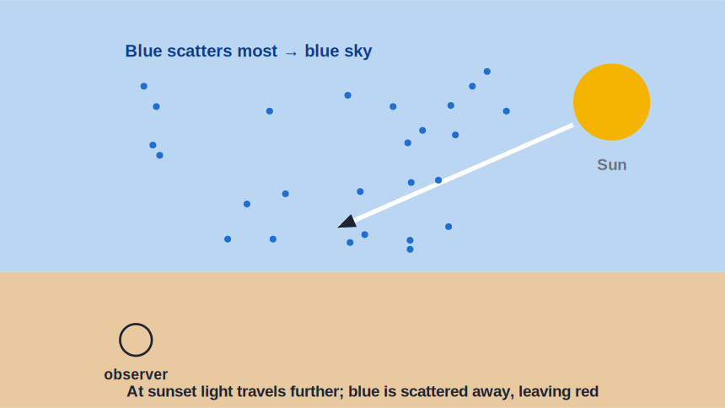
SCATTERING
Scattering of Light
Why the sky is blue
• Tiny particles in the air scatter sunlight in all directions.
• Blue light scatters the most, so the sky looks blue.
• At sunrise and sunset the Sun looks red, as blue is scattered away.
• Scattering is why we see a beam of light in dusty or misty air.
Air scatters blue light most
Notes:
Scattering by air molecules makes the sky blue and sunsets red. A dusty beam is scattered light reaching our eyes.

Slide 25
BLUE SKY, RED SUN
What Scattering Explains
Blue sky
Air scatters blue light most, so the whole sky glows blue.
Red sunrise/sunset
Light travels far through air; blue is scattered away, leaving red.
White clouds
Larger water drops scatter all colours together, so clouds look white.
A visible beam
Dust or mist scatters a torch beam so we can see its path.
Notes:
Scattering explains a family of everyday sights — blue sky, red sunsets, white clouds and visible dusty beams.

Slide 26

SCATTERING IN LIFE
Seeing Scattering Around Us
Daytime sky
Evening sky
Blue overhead because blue scatters most.
Orange and red as the Sun sinks low.
Foggy headlights
Hazy hills
Beams light up the fog by scattering.
Distant hills look bluish through scattered light.
Notes:
More scenes where scattering is at work, reinforcing the idea with familiar observations.

Slide 27
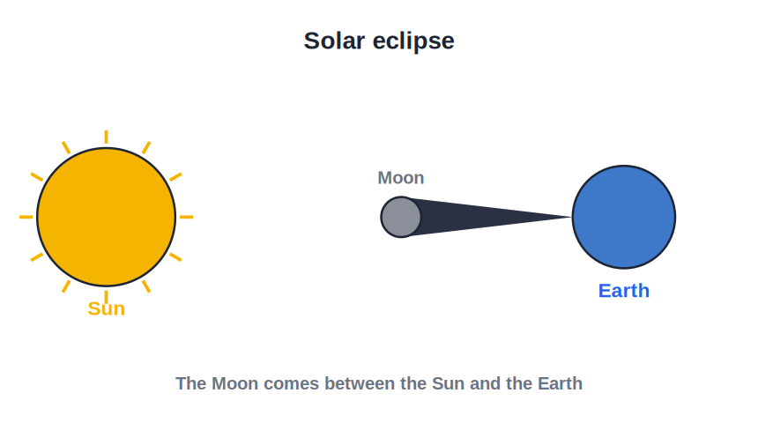
SOLAR ECLIPSE
Solar Eclipse
Moon between Sun & Earth
• Happens on a new-moon day when the Moon comes between the Sun and the Earth.
• The Moon's shadow falls on the Earth, hiding the Sun.
• Seen only from the small region in the Moon's shadow.
• Never look at a solar eclipse with bare eyes.
The Moon hides the Sun
Notes:
Solar eclipse: Sun–Moon–Earth in line at new moon. Stress the safety warning about never looking directly.

Slide 28
SOLAR DETAILS
More on the Solar Eclipse
Only at new moon
The Moon must lie exactly between the Sun and Earth.
A small shadow
Only places in the Moon's shadow see it.
Total or partial
The Sun may be fully or only partly hidden.
Never look directly
Use a proper filter — bare eyes can be harmed.
Notes:
Details of the solar eclipse — its timing, the small viewing region, total/partial, and the crucial safety rule.

Slide 29
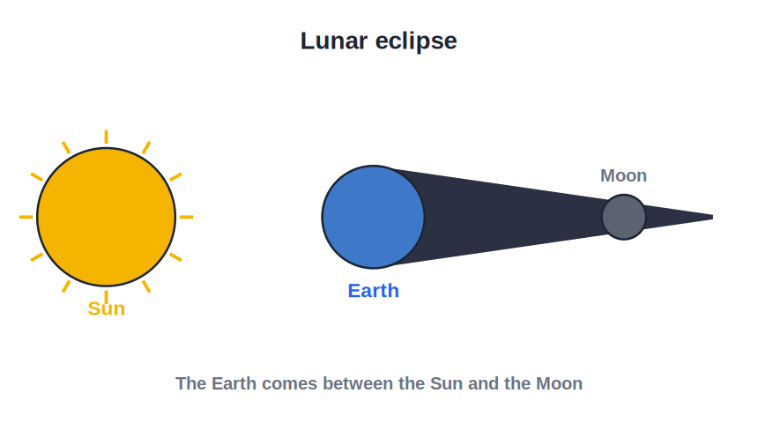
LUNAR ECLIPSE
Lunar Eclipse
Earth between Sun & Moon
• Happens on a full-moon day when the Earth comes between the Sun and the Moon.
• The Earth's shadow falls on the Moon.
• The Moon dims and can look coppery-red.
• It is quite safe to watch a lunar eclipse.
Earth's shadow on the Moon
Notes:
Lunar eclipse: Sun–Earth–Moon in line at full moon. Contrast the geometry and the safety with the solar eclipse.

Slide 30
LUNAR DETAILS
More on the Lunar Eclipse
Only at full moon
The Earth must lie between the Sun and the Moon.
A big shadow
The Earth's shadow is large, so many people see it.
Coppery Moon
Bent red light gives the Moon a coppery glow.
Safe to watch
No harm in watching a lunar eclipse with bare eyes.
Notes:
Details of the lunar eclipse — its timing, the wide viewing region, the red colour, and that it is safe to watch.

Slide 31

COMPARE
Solar vs Lunar Eclipse
When
Line-up
Solar at new moon; lunar at full moon.
Sun–Moon–Earth (solar); Sun–Earth–Moon (lunar).
Seen by
Safety
Solar from a small area; lunar from a wide area.
Never watch a solar eclipse directly; a lunar one is safe.
Notes:
A side-by-side comparison of the two eclipses across timing, geometry, viewing region and safety.

Slide 32
EYE SAFETY
Watching Eclipses Safely
Never look at a solar eclipse with bare eyes or through ordinary glasses — the Sun's light can permanently harm the eyes.
• Use special eclipse glasses or a pinhole projection.
• A lunar eclipse, by contrast, is perfectly safe to watch.
• When in doubt, view the Sun only indirectly.
Notes:
A dedicated safety slide — the single most important practical message of the eclipse topic.

Slide 33
KINDS OF SOLAR
Kinds of Solar Eclipse
Total
The Moon hides the Sun completely for a short while.
Partial
The Moon covers only a part of the Sun's disc.
Annular
The Moon looks small and leaves a bright ring of Sun.
Where you stand
Which kind you see depends on your place in the shadow.
Notes:
The three kinds of solar eclipse — total, partial and annular — and that what you see depends on where you are.

Slide 34
WRAP UP
Quick Recap
✓ Straight light — light travels in straight-line rays
✓ Shadow — opaque object blocks light; umbra + penumbra
✓ Scattering — air scatters blue most → blue sky, red sunset
✓ Zero Shadow Day — overhead noon Sun → no shadow
✓ Solar eclipse — new moon; Moon hides the Sun
✓ Lunar eclipse — full moon; Earth's shadow on the Moon
Notes:
Recap the effects of light from straight-line travel through to the two eclipses.

Slide 35
QUIZ 2
Final Check — Scattering & Eclipses
4 questions • think before the answer reveals on the next slide

Slide 36
QUIZ QUESTION
Q1 — Blue sky
The sky looks blue during the day because air particles scatter:
Red light most
Blue light most
A
B
All colours equally
No light
C
D

Slide 37
ANSWER REVEALED
Q1 — Blue sky
The sky looks blue during the day because air particles scatter:
Red light most
Blue light most
A
✓
All colours equally
No light
C
D
WHY
Blue light is scattered far more than the other colours by the tiny particles in the air, so the sky all around us looks blue.

Slide 38
QUIZ QUESTION
Q2 — Red sunset
The Sun looks red at sunset because the blue light has been:
Absorbed by the Sun
Scattered away, leaving red to reach us
A
B
Reflected by the Moon
Turned into heat
C
D

Slide 39
ANSWER REVEALED
Q2 — Red sunset
The Sun looks red at sunset because the blue light has been:
Absorbed by the Sun
Scattered away, leaving red to reach us
A
✓
Reflected by the Moon
Turned into heat
C
D
WHY
At sunset the light travels a long way through air; most of the blue is scattered out, so mainly red light reaches our eyes.

Slide 40
QUIZ QUESTION
Q3 — Solar eclipse
A solar eclipse can happen only on a:
Full-moon day
New-moon day
A
B
Half-moon day
Cloudy day
C
D

Slide 41
ANSWER REVEALED
Q3 — Solar eclipse
A solar eclipse can happen only on a:
Full-moon day
New-moon day
A
✓
Half-moon day
Cloudy day
C
D
WHY
A solar eclipse needs the Moon between the Sun and Earth, which only happens at new moon.

Slide 42
QUIZ QUESTION
Q4 — Lunar eclipse
During a lunar eclipse, the Moon is dark because it lies in the shadow of the:
Sun
Earth
A
B
Clouds
Another planet
C
D

Slide 43
ANSWER REVEALED
Q4 — Lunar eclipse
During a lunar eclipse, the Moon is dark because it lies in the shadow of the:
Sun
Earth
A
✓
Clouds
Another planet
C
D
WHY
At full moon the Earth can come between the Sun and Moon, so the Earth's shadow falls on the Moon and dims it.

Slide 44
Light, Shadow and Sky
From the blue of the sky to the shadow of the Moon, the simple fact that light travels straight explains it all.

