Slide 1
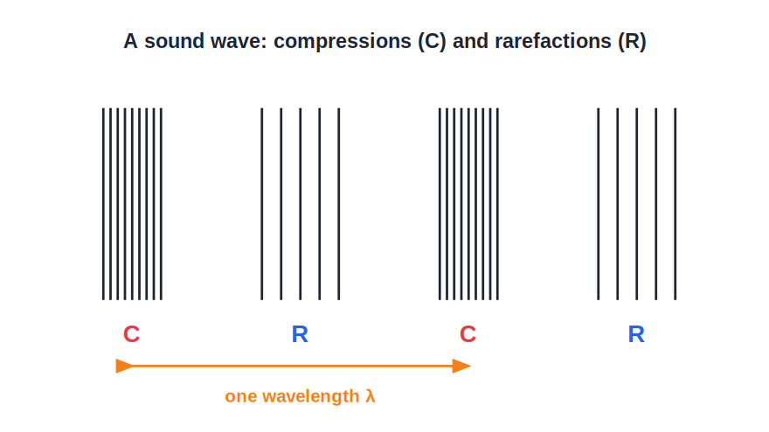
STD 7 • GENERAL SCIENCE • SOUND
Sound
How sound is made • Oscillations • How it travels • Characteristics of sound

Slide 2
INTRODUCTION
Learning Objectives
1
Explain that sound is produced by vibrations
2
Define oscillation, time period and frequency
3
Describe how sound travels as a wave through a medium
4
State that sound needs a medium and cannot travel in vacuum
5
Explain pitch, loudness and quality of sound
6
Tell apart a musical sound and noise
Notes:
Open by previewing these objectives so students know what they should be able to do by the end of the session.

Slide 3
PART 1
Making Sound and How It Travels
1
Vibrations, oscillations and the sound wave

Slide 4
PRODUCTION
Sound is Made by Vibrations
Vibrating bodies
Every sound is produced by a vibrating object — a drum, a string, our vocal cords.
Oscillation
One complete to-and-fro movement of a vibrating body is an oscillation.
Time period
The time taken for one oscillation is the time period.
Frequency
The number of oscillations in one second is the frequency, measured in hertz (Hz).
Notes:
Sound starts with a vibration. Define oscillation, time period and frequency carefully — frequency = oscillations per second.

Slide 5
KEY IDEA
No Vibration, No Sound
A body makes a sound only while it is vibrating. Stop the vibration and the sound stops at once.
• Pluck a stretched wire — it hums while it quivers.
• Touch it to still it, and the sound dies instantly.
• Every source of sound, without exception, is vibrating.
Notes:
Reinforce the tight link between vibration and sound: damping the vibration kills the sound immediately.

Slide 6
OSCILLATION TERMS
Oscillation, Time Period, Frequency
Oscillation
One full to-and-fro swing of the vibrating body.
Time period
The time for a single oscillation, in seconds.
Frequency
How many oscillations happen in one second (in Hz).
They are linked
Frequency = 1 ÷ time period; faster swings, higher frequency.
Notes:
Carefully lay out the three linked quantities. If a body makes 2 oscillations per second, its time period is 0.5 s.

Slide 7
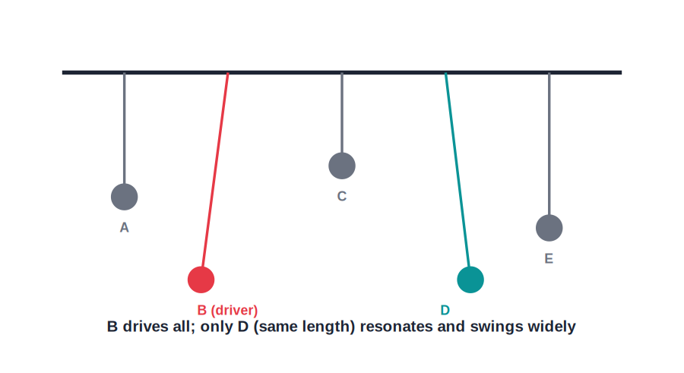
OSCILLATION
Oscillatory Motion
To and fro, again and again
• A swing and a pendulum show oscillatory motion.
• The to-and-fro repeats over equal time periods.
• A faster oscillation means a higher frequency.
• Vibrations too fast to see still make the air carry sound.
Pendulums keeping time
Notes:
Use the familiar pendulum/swing to make oscillation, time period and frequency concrete.

Slide 8
PROPAGATION
How Sound Travels
A wave through matter
• A vibrating body pushes and pulls the air around it.
• This makes the air compress and stretch — a sound wave.
• The wave carries energy outward to our ears.
• Sound needs a medium — it cannot travel through a vacuum.
Compressions and rarefactions
Notes:
Sound travels as a longitudinal wave of compressions and rarefactions. A key point: no medium, no sound.

Slide 9
THE MEDIUM
Sound Needs a Medium
A material to travel
Sound travels through a solid, a liquid or a gas.
Air, water, solids
We hear through air; fish hear through water; sound passes through walls.
Passes it on
Particles pass the vibration from one to the next.
No particles, no sound
With nothing to carry it, sound cannot travel.
Notes:
Sound needs a material medium whose particles pass the vibration along — air, water or solids all work.

Slide 10
VACUUM
No Sound in a Vacuum
A vacuum is empty space with no particles, so there is nothing to carry a sound — a vacuum is completely silent.
• In a bell-jar, the ringing fades as the air is pumped out.
• Outer space is a vacuum, so it is utterly silent.
• This is the great difference between sound and light.
Notes:
Drive home that sound, unlike light, cannot cross a vacuum — hence the silence of space.

Slide 11



SPEED
How Fast Sound Travels
Fastest in solids
Slower in liquids
Closely-packed particles pass the vibration on quickest.
Particles a little farther apart, so sound is slower.
Slowest in gases
Slower than light
Particles far apart in air, so sound is slowest.
We see lightning before we hear the thunder.
Notes:
Sound is fastest in solids, slowest in gases, and much slower than light — hence the lightning-then-thunder gap.

Slide 12
HUMAN VOICE
How We Make Sound
The larynx
Our voice box sits at the top of the windpipe.
Vocal cords
Air from the lungs makes two vocal cords vibrate.
Shaping speech
The mouth, tongue and lips shape it into words.
Pitch of voice
Tighter cords vibrate faster, giving a higher voice.
Notes:
Explain human sound production through the vibrating vocal cords and how the mouth shapes it into speech.

Slide 13
THE EAR
How We Hear
Outer ear
Eardrum
Collects sound and funnels it inward.
A thin skin that vibrates with the incoming sound.
Middle ear
Inner ear
Tiny bones pass the vibrations further in.
Sends the signal to the brain, and we hear.
Notes:
Trace sound through the ear — outer ear, eardrum, middle-ear bones, inner ear, brain.

Slide 14
QUIZ 1
Check — Producing & Carrying Sound
4 questions • think before the answer reveals on the next slide

Slide 15
QUIZ QUESTION
Q1 — Source of sound
Sound is always produced by a body that is:
Hot
Vibrating
A
B
Coloured
Heavy
C
D

Slide 16
ANSWER REVEALED
Q1 — Source of sound
Sound is always produced by a body that is:
Hot
Vibrating
A
✓
Coloured
Heavy
C
D
WHY
Every sound comes from a vibrating object; when the vibration stops, the sound stops too.

Slide 17
QUIZ QUESTION
Q2 — Frequency
The number of oscillations made in one second is called the:
Time period
Frequency
A
B
Amplitude
Wavelength
C
D

Slide 18
ANSWER REVEALED
Q2 — Frequency
The number of oscillations made in one second is called the:
Time period
Frequency
A
✓
Amplitude
Wavelength
C
D
WHY
Frequency is the number of oscillations per second, measured in hertz (Hz). Its opposite, the time for one oscillation, is the time period.

Slide 19
QUIZ QUESTION
Q3 — Needs a medium
Sound cannot travel through:
Air
Water
A
B
Iron
A vacuum
C
D

Slide 20
ANSWER REVEALED
Q3 — Needs a medium
Sound cannot travel through:
Air
Water
A
B
Iron
A vacuum
C
✓
WHY
Sound needs particles of a medium to pass on the vibrations. A vacuum has no particles, so sound cannot travel through it.

Slide 21
QUIZ QUESTION
Q4 — Time period
If a pendulum makes 2 oscillations each second, its time period is:
2 s
1 s
A
B
0.5 s
4 s
C
D

Slide 22
ANSWER REVEALED
Q4 — Time period
If a pendulum makes 2 oscillations each second, its time period is:
2 s
1 s
A
B
0.5 s
4 s
✓
D
WHY
Time period = 1 / frequency = 1 / 2 = 0.5 s. Two oscillations a second means each one takes half a second.

Slide 23
PART 2
The Characteristics of Sound
2
Pitch, loudness, quality — and music versus noise

Slide 24
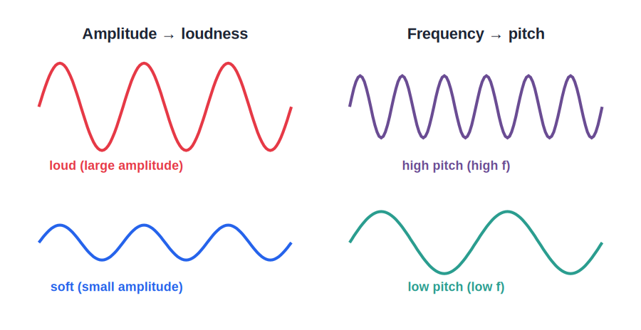
CHARACTERISTICS
Pitch, Loudness and Quality
Three qualities
• Pitch depends on frequency — faster vibration, higher pitch.
• Loudness depends on the size (amplitude) of the vibration.
• Quality lets us tell a violin from a flute at the same note.
• Together they describe every sound we hear.
What makes sounds differ
Notes:
Pitch ← frequency; loudness ← amplitude; quality (timbre) distinguishes instruments. These are the three characteristics of a sound.

Slide 25
PITCH
Pitch — How High or Low
Set by frequency
A faster vibration gives a higher pitch.
High pitch
A whistle and a small bird's chirp are high-pitched.
Low pitch
A drum and a lion's roar are low-pitched.
Shorter, tighter
Shorter or tighter strings vibrate faster and sound higher.
Notes:
Pitch is decided by frequency — high pitch from fast vibrations, low pitch from slow ones.

Slide 26
LOUDNESS
Loudness — How Strong
Set by amplitude
A bigger to-and-fro (amplitude) gives a louder sound.
More energy
A louder sound simply carries more energy.
Hit harder
Strike a drum harder and it booms louder.
Fades with distance
Loudness drops as the sound spreads out.
Notes:
Loudness is decided by amplitude and the energy carried; it grows with a harder push and fades with distance.

Slide 27
QUALITY
Quality (Timbre) — the Character
Tells sources apart
It lets us tell a flute from a violin at the same note.
Same pitch, different feel
Two instruments can share a pitch yet sound different.
Recognising voices
It is how we know a friend's voice on the phone.
Unique blend
Each source adds its own mix of tones.
Notes:
Quality (timbre) is the character of a sound that distinguishes sources at the same pitch and loudness.

Slide 28

AUDIBLE RANGE
What We Can and Cannot Hear
Audible range
Infrasound
Humans hear about 20 Hz to 20,000 Hz.
Below 20 Hz — too low for us; some animals feel it.
Ultrasound
With age
Above 20,000 Hz — too high for us; bats and dogs hear it.
The top of our range drops as we grow older.
Notes:
Introduce the audible range and the inaudible infrasound and ultrasound that some animals can sense.

Slide 29
MUSIC & NOISE
Musical Sound and Noise
Musical sound
Noise
A pleasant, regular sound with a steady pattern — like a flute or a tuned string.
An unpleasant, irregular sound with no steady pattern — like a horn or a crash.
Audible range
Sound pollution
Humans hear roughly 20 Hz to 20,000 Hz; below and above we cannot hear.
Too much loud noise harms hearing and health — a form of pollution to control.
Notes:
Music is regular and pleasant; noise is irregular. Note the audible range and the harm of sound (noise) pollution.

Slide 30

NOISE SOURCES
Where Noise Comes From
Traffic
Loudspeakers
Vehicle horns and roaring engines.
Very loud music at events.
Machines
Crackers
Factories, generators and construction sites.
Sudden, very loud bangs.
Notes:
Common human-made sources of noise pollution, worst in crowded cities.

Slide 31
HARM OF NOISE
Why Noise Pollution is Harmful
Hearing damage
Very loud sound can dull or damage hearing.
Sleep and rest
Continuous noise disturbs sleep and rest.
Stress
It causes headaches, tiredness and irritation.
Poor focus
It makes studying and concentrating harder.
Notes:
The health effects of noise pollution — hearing damage, disturbed sleep, stress and poor concentration.

Slide 32
REDUCING NOISE
Controlling Sound Pollution
Quieter machines
Well-maintained, quieter engines and horns cut noise at the source.
Green cover
Trees along roads absorb and block a lot of noise.
Quiet zones
No-horn zones near hospitals and schools protect people.
Personal care
Avoiding very loud music protects our own hearing.
Notes:
Practical ways to reduce noise pollution — source control, green belts, silence zones and personal habits.

Slide 33
SOUND IS ENERGY
Sound Carries Energy
Sound is a form of energy — the vibrating source hands its energy to the medium, which carries it to our ears.
• A very loud sound can rattle windows and shake our chest.
• The energy spreads outward in all directions as a wave.
• It grows fainter with distance as the energy spreads thin.
Notes:
Frame sound as a form of energy — it can do work (rattle windows), spreads outward, and weakens with distance.

Slide 34
WRAP UP
Quick Recap
✓ Production — sound comes from vibrations
✓ Oscillation — one to-and-fro; time period and frequency
✓ Propagation — a wave through a medium; none in vacuum
✓ Pitch — higher frequency → higher pitch
✓ Loudness — bigger amplitude → louder
✓ Music vs noise — regular & pleasant vs irregular & harsh
Notes:
Recap production, propagation and the characteristics of sound.

Slide 35
QUIZ 2
Final Check — Characteristics of Sound
4 questions • think before the answer reveals on the next slide

Slide 36
QUIZ QUESTION
Q1 — Pitch
The pitch of a sound is decided mainly by its:
Amplitude
Frequency
A
B
Loudness
Quality
C
D

Slide 37
ANSWER REVEALED
Q1 — Pitch
The pitch of a sound is decided mainly by its:
Amplitude
Frequency
A
✓
Loudness
Quality
C
D
WHY
A higher frequency of vibration gives a higher pitch. Amplitude affects loudness, not pitch.

Slide 38
QUIZ QUESTION
Q2 — Loudness
The loudness of a sound depends on the ___ of the vibration.
Frequency
Amplitude (size)
A
B
Colour
Pitch
C
D

Slide 39
ANSWER REVEALED
Q2 — Loudness
The loudness of a sound depends on the ___ of the vibration.
Frequency
Amplitude (size)
A
✓
Colour
Pitch
C
D
WHY
The larger the amplitude of the vibration, the more energy the wave carries and the louder the sound.

Slide 40
QUIZ QUESTION
Q3 — Audible range
The usual range of frequencies a human can hear is about:
2 Hz to 200 Hz
20 Hz to 20,000 Hz
A
B
20,000 Hz to 40,000 Hz
0 Hz to 10 Hz
C
D

Slide 41
ANSWER REVEALED
Q3 — Audible range
The usual range of frequencies a human can hear is about:
2 Hz to 200 Hz
20 Hz to 20,000 Hz
A
✓
20,000 Hz to 40,000 Hz
0 Hz to 10 Hz
C
D
WHY
Human ears can normally hear sounds between about 20 Hz and 20,000 Hz; sounds outside this range are inaudible to us.

Slide 42
QUIZ QUESTION
Q4 — Music vs noise
Which of these is the best description of a musical sound?
Loud and sudden
Regular, pleasant and with a steady pattern
A
B
Irregular and harsh
Always very soft
C
D

Slide 43
ANSWER REVEALED
Q4 — Music vs noise
Which of these is the best description of a musical sound?
Loud and sudden
Regular, pleasant and with a steady pattern
A
✓
Irregular and harsh
Always very soft
C
D
WHY
A musical sound has regular, repeating vibrations that are pleasant to hear, unlike the irregular pattern of noise.

Slide 44
The World of Sound
From a whisper to a song, every sound is a vibration set travelling — and knowing how helps us enjoy it and tame its noise.

