Slide 1
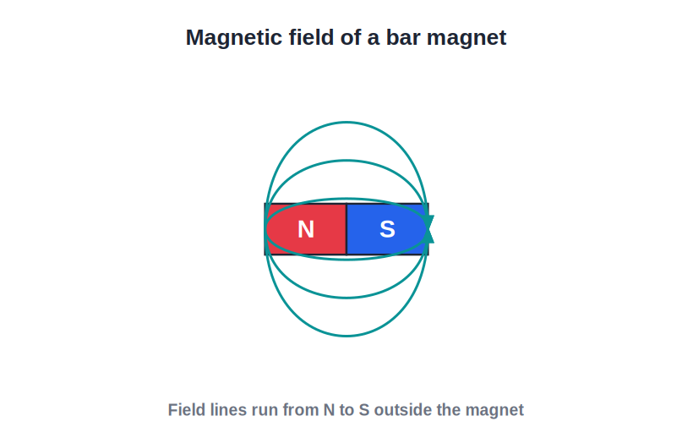
STD 7 • GENERAL SCIENCE • MAGNETISM
Properties of a Magnetic Field
Magnetic field • Lines of force • Poles • The Earth as a magnet

Slide 2
INTRODUCTION
Learning Objectives
1
Describe the magnetic field around a magnet
2
Draw and read magnetic lines of force
3
State the properties of magnetic field lines
4
Explain the force between like and unlike poles
5
Describe an electromagnet and its uses
6
Explain the Earth's magnetism and the compass
Notes:
Open by previewing these objectives so students know what they should be able to do by the end of the session.

Slide 3
PART 1
The Magnetic Field and Its Lines
1
The invisible region of force around a magnet

Slide 4
MAGNETIC FIELD
The Field Around a Magnet
Lines of force
• The region around a magnet where its force is felt is the magnetic field.
• Iron filings near a magnet line up along curved paths.
• These paths are the magnetic lines of force.
• The field is strongest near the poles.
Iron filings reveal the field
Notes:
The magnetic field is the region of influence around a magnet; iron filings map it as lines of force, densest at the poles.

Slide 5
PROPERTIES
Properties of Magnetic Field Lines
Come out of N, into S
Outside the magnet the lines run from the north pole to the south pole.
Closed loops
Each line is a closed curve, continuing inside the magnet from S to N.
Never cross
Two field lines never intersect one another.
Crowded = strong
Where the lines are close together the field is strong — near the poles.
Notes:
The four standard properties of field lines. 'Never cross' and 'crowded means strong' are the commonly tested ones.

Slide 6
MAPPING
Mapping the Field with Iron Filings
Sprinkle filings
Scatter iron filings on a card over a magnet.
Tap gently
A light tap lets them line up along the field.
A pattern appears
They form curved lines from pole to pole.
Or use a compass
A small compass shows the field's direction at each point.
Notes:
Two ways to reveal the field — iron filings for the pattern and a plotting compass for the direction.

Slide 7
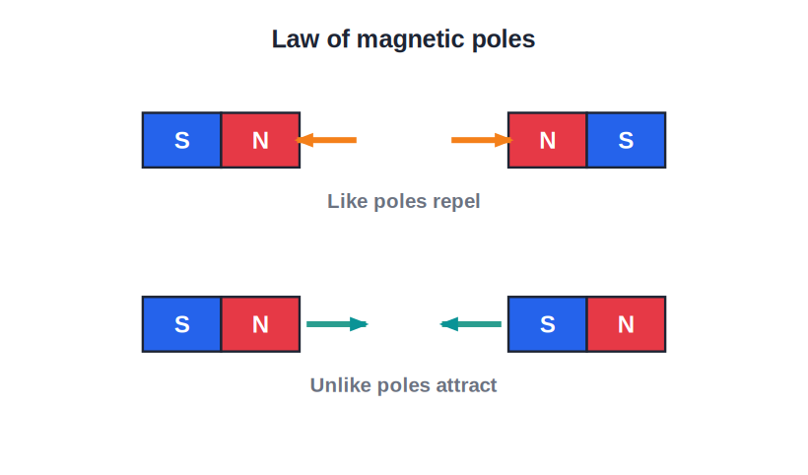
POLES
Force Between Poles
Like repel, unlike attract
• Every magnet has two poles — north and south.
• Like poles (N–N or S–S) repel each other.
• Unlike poles (N–S) attract each other.
• A freely hung magnet always rests pointing north–south.
The basic law of magnets
Notes:
State the law of magnetic poles and the fact that a free magnet aligns north–south — the basis of the compass.

Slide 8
POLES & FREE MAGNET
Poles and the Free Magnet
Two poles
Every magnet has a north and a south pole.
Like repel
N–N and S–S push each other apart.
Unlike attract
N–S pull towards each other.
Rests north–south
A freely hung magnet always settles pointing north–south.
Notes:
Summarise the pole law and the directive property that a free magnet aligns north–south.

Slide 9
SURE TEST
Repulsion is the Real Test
A magnet attracts plain iron too, so attraction is not proof. Only repulsion proves that both objects are magnets.
• If two bars attract, one might just be soft iron.
• If two bars repel, both must certainly be magnets.
• So repulsion is the sure test of magnetism.
Notes:
The classic subtlety: attraction can be due to ordinary iron, so only mutual repulsion proves magnetism.

Slide 10


TYPES OF MAGNETS
Kinds of Magnets
Bar magnet
Horseshoe magnet
A straight bar — the common classroom magnet.
Bent into a U so both poles pull together.
Magnetic needle
Temporary & permanent
A slim magnet that swings freely, as in a compass.
Soft iron loses magnetism easily; steel keeps it.
Notes:
Common magnet shapes and the temporary/permanent distinction based on the material.

Slide 11
MATERIALS
Magnetic and Non-Magnetic Materials
Magnetic
Iron, nickel and cobalt are attracted by a magnet.
Non-magnetic
Wood, plastic, glass and copper are not attracted.
A simple test
Bring a magnet near an object to see which group it is in.
Sorting scrap
Magnets pull iron out of mixed scrap.
Notes:
Separate magnetic (iron, nickel, cobalt) from non-magnetic materials, with the sorting-scrap application.

Slide 12

MAKING MAGNETS
Ways to Make a Magnet
By stroking
By electricity
Rub an iron bar the same way with one pole of a magnet.
A current in a coil around iron makes an electromagnet.
Induction
Losing it
Iron near a strong magnet becomes a magnet for a while.
Heating, hammering or dropping destroys magnetism.
Notes:
Ways to magnetise iron — stroking, electric current, induction — and how magnetism is lost.

Slide 13
POLES IN PAIRS
You Cannot Get a Single Pole
Every magnet has two poles. Break a bar magnet and each piece becomes a full magnet with its own north and south pole.
• Cut it again, and every piece still has both poles.
• A lone north or south pole cannot exist.
• The field lines always run from one pole to the other.
Notes:
Poles come only in pairs — breaking a magnet just makes more complete magnets, never a single pole.

Slide 14
QUIZ 1
Check — Field and Lines of Force
4 questions • think before the answer reveals on the next slide

Slide 15
QUIZ QUESTION
Q1 — Field lines outside
Outside a bar magnet, the magnetic lines of force run from:
South to north pole
North to south pole
A
B
Pole to the middle
In no fixed direction
C
D

Slide 16
ANSWER REVEALED
Q1 — Field lines outside
Outside a bar magnet, the magnetic lines of force run from:
South to north pole
North to south pole
A
✓
Pole to the middle
In no fixed direction
C
D
WHY
By convention, outside the magnet the field lines are drawn coming out of the north pole and going into the south pole.

Slide 17
QUIZ QUESTION
Q2 — Crossing lines
Two magnetic field lines can never:
Curve
Cross each other
A
B
Be close together
Come out of a pole
C
D

Slide 18
ANSWER REVEALED
Q2 — Crossing lines
Two magnetic field lines can never:
Curve
Cross each other
A
✓
Be close together
Come out of a pole
C
D
WHY
If two lines crossed, the field would point in two directions at one place, which is impossible — so field lines never cross.

Slide 19
QUIZ QUESTION
Q3 — Strong field
The magnetic field of a bar magnet is strongest:
At the centre
Near the poles
A
B
Far away
Everywhere the same
C
D

Slide 20
ANSWER REVEALED
Q3 — Strong field
The magnetic field of a bar magnet is strongest:
At the centre
Near the poles
A
✓
Far away
Everywhere the same
C
D
WHY
The lines of force are most crowded near the poles, which is exactly where the field is strongest.

Slide 21
QUIZ QUESTION
Q4 — Like poles
When the north poles of two magnets are brought close, they:
Attract
Repel
A
B
Do nothing
Join together
C
D

Slide 22
ANSWER REVEALED
Q4 — Like poles
When the north poles of two magnets are brought close, they:
Attract
Repel
A
✓
Do nothing
Join together
C
D
WHY
Like poles repel. Two north poles push each other apart; only unlike poles (N and S) attract.

Slide 23
PART 2
Electromagnets and the Earth
2
Magnetism from electricity, and the planet as a magnet

Slide 24
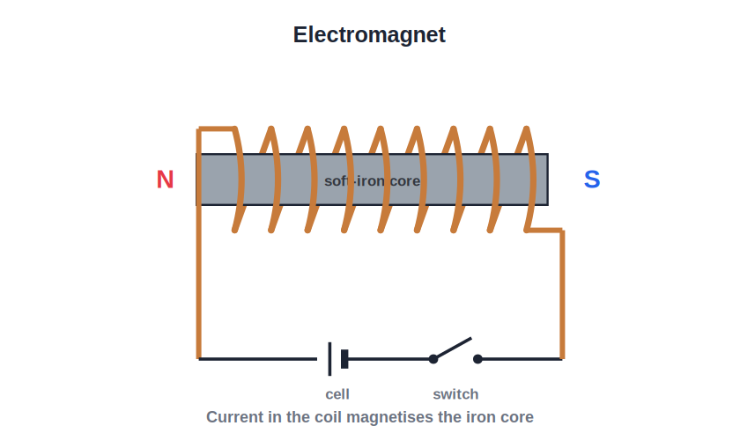
ELECTROMAGNET
The Electromagnet
Magnetism from current
• A current in a coil of wire produces a magnetic field.
• Winding the coil on an iron core makes a strong electromagnet.
• It is magnetic only while the current flows — it can be switched off.
• Used in electric bells, cranes and many machines.
Coil + iron core + current
Notes:
An electromagnet is a temporary magnet made by a current in a coil around iron; its great advantage is that it can be switched on and off.

Slide 25
HOW IT WORKS
How an Electromagnet Works
Current makes a field
An electric current in a wire makes a magnetic field around it.
A coil concentrates it
Winding the wire into a coil makes a stronger field.
Iron core
A soft-iron core inside the coil makes it far stronger.
Stronger current
More turns or more current gives a stronger magnet.
Notes:
Explain the electromagnet step by step: current → field → coil concentrates it → iron core strengthens it.

Slide 26


EM VS PERMANENT
Electromagnet vs Permanent Magnet
Switchable
Adjustable
An electromagnet works only while current flows.
Its strength can be changed by the current.
Permanent magnet
Best use
Keeps its magnetism all the time.
Electromagnets suit cranes and bells that switch on and off.
Notes:
Compare the two: the electromagnet's switchable, adjustable nature versus the always-on permanent magnet.

Slide 27

EM USES
Uses of Electromagnets
Electric bell
Cranes
The electromagnet makes the hammer strike the gong.
Lift and drop heavy iron scrap at the flick of a switch.
Loudspeakers
MRI machines
Turn electrical signals into the sound we hear.
Powerful electromagnets help doctors see inside the body.
Notes:
Where electromagnets are used — bells, cranes, loudspeakers and MRI — all needing a switchable magnet.

Slide 28
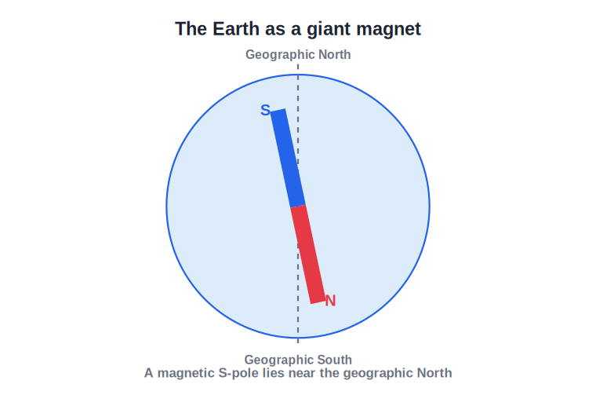
EARTH'S MAGNETISM
The Earth is a Magnet
A planet-sized magnet
• The Earth behaves like a giant bar magnet.
• This is why a freely suspended magnet points north–south.
• A compass needle is a small magnet that lines up with the field.
• Sailors and travellers have used it to find direction for centuries.
The compass follows the field
Notes:
Earth's own magnetism aligns a free magnet or compass needle north–south, giving us a way to find direction.

Slide 29
THE COMPASS
The Magnetic Compass
A tiny magnet
The needle is a small, freely-turning magnet.
Follows the Earth
It lines up with the Earth's magnetic field.
Points north
Its marked end settles pointing north.
Still vital
Hikers, ships and planes rely on it even today.
Notes:
The compass uses the Earth's field: a free needle points north and has guided travellers for centuries.

Slide 30
USES
Magnets at Work
Compass
Electric bell
Finds direction using the Earth's magnetic field.
An electromagnet makes the hammer strike repeatedly.
Cranes
Fridge & gadgets
Powerful electromagnets lift and drop heavy iron scrap.
Small magnets hold doors and run many devices.
Notes:
Everyday and industrial uses of permanent magnets and electromagnets.

Slide 31
CARE
Caring for Magnets
Store in pairs
Keep bar magnets with unlike poles together and keepers across the ends.
Handle gently
Do not heat, hammer or drop a magnet.
Keep apart
Store away from devices magnets could disturb.
Why
Careful handling keeps a magnet strong for years.
Notes:
Care and storage of magnets — pairs with keepers, gentle handling — to preserve their magnetism.

Slide 32
FROM ELECTRICITY
Magnetism and Electricity are Linked
A moving electric current always makes a magnetic field — this deep link between electricity and magnetism runs many of our machines.
• Every electric current is wrapped in a magnetic field.
• This is how motors, bells and cranes work.
• You will meet this link again in higher classes.
Notes:
Close on the big idea: electricity and magnetism are linked, powering motors and many devices — a hook to later grades.

Slide 33
TECHNOLOGY
Magnets in Modern Technology
Electric motors
Loudspeakers
Magnets make the motors in fans, mixers and toys turn.
A magnet and coil turn signals into sound.
Data storage
Maglev trains
Magnetic strips on cards and disks store information.
Powerful magnets can lift and speed a train along a track.
Notes:
Show how magnetism runs modern technology — motors, speakers, data storage and even maglev trains.

Slide 34
WRAP UP
Quick Recap
✓ Magnetic field — region of force around a magnet
✓ Lines of force — N → S outside; never cross
✓ Strength — crowded lines near poles = strong
✓ Poles — like repel, unlike attract
✓ Electromagnet — coil + current; can be switched off
✓ Earth — acts as a magnet; guides the compass
Notes:
Recap the field, its lines, the pole law, the electromagnet and the Earth's magnetism.

Slide 35
QUIZ 2
Final Check — Electromagnets & Earth
4 questions • think before the answer reveals on the next slide

Slide 36
QUIZ QUESTION
Q1 — Making an electromagnet
An electromagnet is made by passing a current through a coil wound on a core of:
Copper
Soft iron
A
B
Plastic
Wood
C
D

Slide 37
ANSWER REVEALED
Q1 — Making an electromagnet
An electromagnet is made by passing a current through a coil wound on a core of:
Copper
Soft iron
A
✓
Plastic
Wood
C
D
WHY
A soft-iron core inside the current-carrying coil greatly strengthens the magnetic field, making a powerful electromagnet.

Slide 38
QUIZ QUESTION
Q2 — Switchable
The main advantage of an electromagnet over a permanent magnet is that it:
Is lighter
Can be switched on and off
A
B
Never loses magnetism
Needs no current
C
D

Slide 39
ANSWER REVEALED
Q2 — Switchable
The main advantage of an electromagnet over a permanent magnet is that it:
Is lighter
Can be switched on and off
A
✓
Never loses magnetism
Needs no current
C
D
WHY
An electromagnet is magnetic only while current flows, so it can be turned on and off — ideal for cranes and bells.

Slide 40
QUIZ QUESTION
Q3 — Compass
A compass needle settles pointing north–south because it lines up with the magnetic field of the:
Sun
Moon
A
B
Earth
Nearest building
C
D

Slide 41
ANSWER REVEALED
Q3 — Compass
A compass needle settles pointing north–south because it lines up with the magnetic field of the:
Sun
Moon
A
B
Earth
Nearest building
✓
D
WHY
The Earth acts as a huge magnet, and the small magnetised compass needle turns to line up with the Earth's magnetic field.

Slide 42
QUIZ QUESTION
Q4 — Crane magnet
Huge electromagnets are used in scrapyards to:
Cut iron
Lift and drop heavy iron pieces
A
B
Paint cars
Weigh trucks
C
D

Slide 43
ANSWER REVEALED
Q4 — Crane magnet
Huge electromagnets are used in scrapyards to:
Cut iron
Lift and drop heavy iron pieces
A
✓
Paint cars
Weigh trucks
C
D
WHY
Switching the electromagnet on lets the crane lift heavy iron scrap; switching it off drops the load exactly where wanted.

Slide 44
The Invisible Field
From iron filings to the whole planet, magnetism reaches out through an invisible field — and switching it on with electricity puts it to work.

