Slide 1
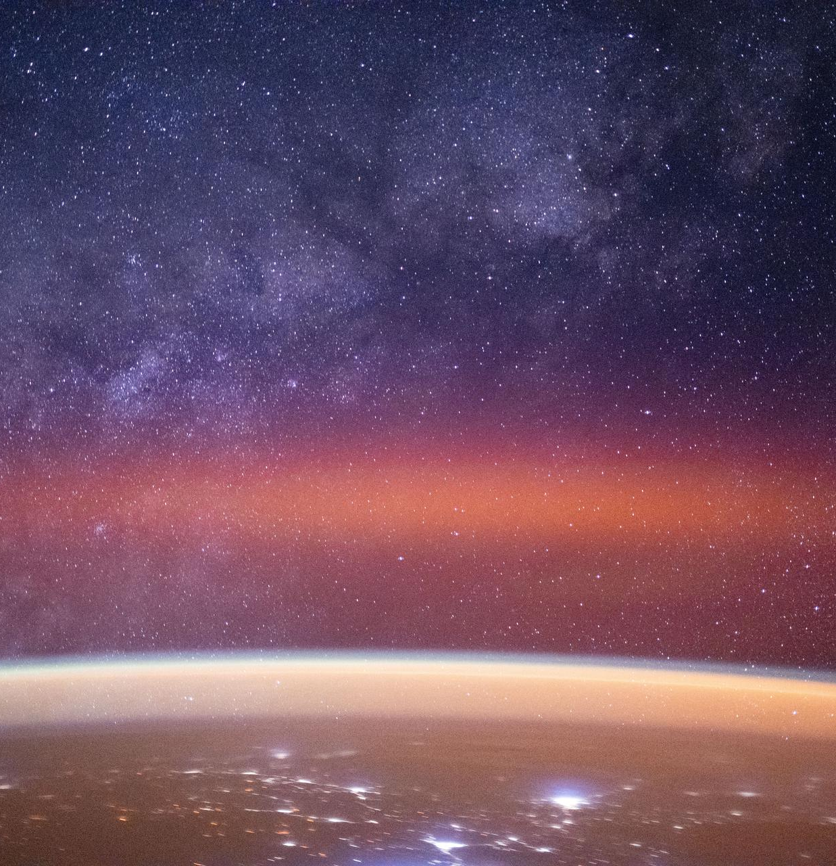
STD 7 • GENERAL SCIENCE • ASTRONOMY
In the World of Stars
The universe • Galaxies • Stars and constellations • Watching the sky

Slide 2
INTRODUCTION
Learning Objectives
1
Describe what the universe contains
2
Explain what a galaxy is and name its types
3
Describe stars and how they differ
4
Explain what a constellation is
5
Understand the vast distances between stars
6
Enjoy and identify sights in the night sky
Notes:
Open by previewing these objectives so students know what they should be able to do by the end of the session.

Slide 3
PART 1
The Universe and Galaxies
1
Everything there is, gathered into great islands of stars

Slide 4
THE UNIVERSE
The Universe
Everything there is
• The universe is everything that exists — space and all it holds.
• It contains countless stars, planets, gas and dust.
• Distances are so huge we measure them in light years.
• A light year is the distance light travels in one year.
The Milky Way arching over Earth
Notes:
Set the scale of the universe and introduce the light year as the unit of astronomical distance.

Slide 5
WHAT IT HOLDS
What the Universe Contains
Stars
Countless glowing balls of hot gas, like our Sun.
Planets & moons
Worlds orbiting stars, and moons orbiting planets.
Galaxies
Vast groups of billions of stars.
Gas and dust
Great clouds from which new stars are born.
Notes:
Inventory the contents of the universe — stars, planets, galaxies and the gas-and-dust clouds.

Slide 6
LIGHT YEAR
Measuring the Vast Distances
Space is so vast that ordinary units are useless — we measure distance in light years, the distance light travels in one year.
• Light is the fastest thing there is.
• In one year it covers a truly enormous distance.
• Even the nearest star beyond the Sun is over four light years away.
Notes:
Introduce the light year and give a sense of scale — the nearest star is several light years off.

Slide 7
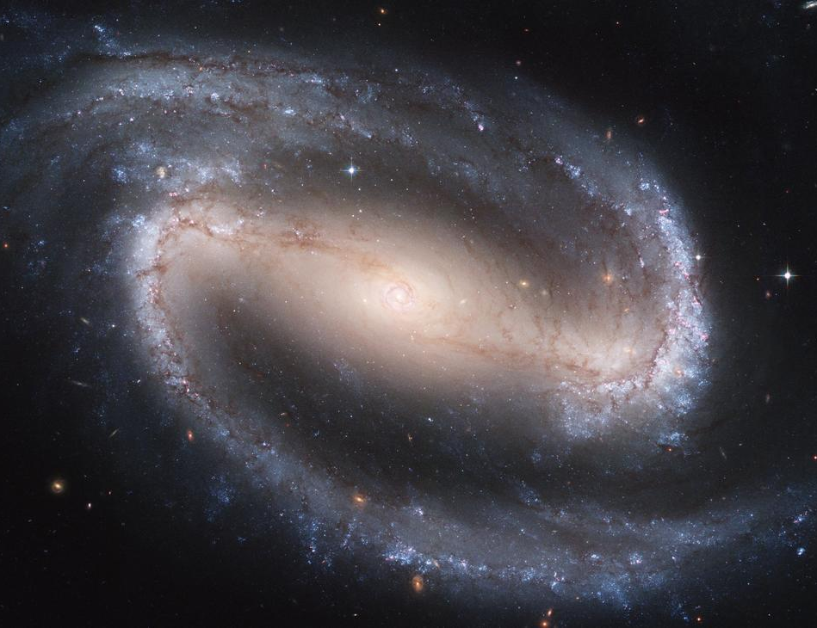
GALAXIES
Galaxies
Islands of stars
• A galaxy is a huge group of stars, gas and dust held by gravity.
• Our galaxy is the Milky Way; our Sun is one of its stars.
• Galaxies come in spiral, elliptical and irregular shapes.
• The universe holds billions of galaxies.
A spiral galaxy
Notes:
A galaxy is a gravitationally bound island of billions of stars. Name the three shapes and place our Sun in the Milky Way.

Slide 8
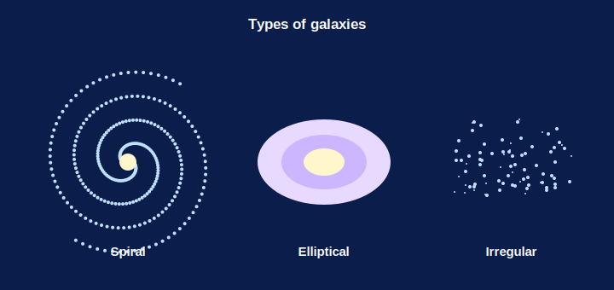
GALAXY SHAPES
The Shapes of Galaxies
Spiral • elliptical • irregular
• Galaxies are seen in several shapes.
• Spiral: a bright centre with curving arms.
• Elliptical: a smooth oval or ball of stars.
• Irregular: no fixed shape at all.
Galaxies come in different shapes
Notes:
Name the galaxy shapes using the diagram — spiral, elliptical and irregular.

Slide 9
OUR GALAXY
The Milky Way
Our home galaxy
The Sun and its planets lie in the Milky Way.
A spiral
It is a huge spiral galaxy of billions of stars.
A band of light
On a dark night it appears as a milky band across the sky.
Andromeda
Our nearest large neighbour galaxy.
Notes:
Place ourselves in the Milky Way — a spiral galaxy, seen as a milky band, with Andromeda as its nearest neighbour.

Slide 10
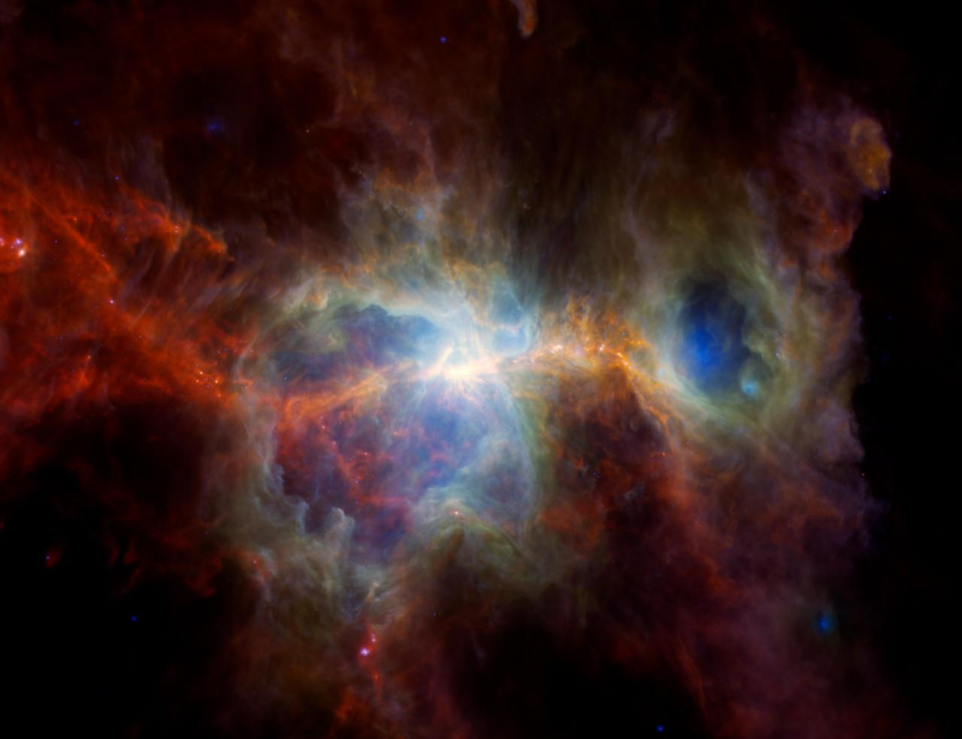
NEBULA
Nebulae — Where Stars are Born
Clouds of gas & dust
• A nebula is a giant cloud of gas and dust in space.
• Under gravity, parts of it clump together and heat up.
• When hot and dense enough, a new star begins to shine.
• So nebulae are the nurseries of stars.
A star-forming nebula
Notes:
Introduce nebulae as the birthplaces of stars — a real NASA image gives a sense of their scale and colour.

Slide 11
BIRTH OF A STAR
How a Star is Born
A giant cloud
It begins in a huge nebula of gas and dust.
Gravity gathers it
Gravity pulls the gas into a dense clump.
It heats up
The shrinking clump grows hotter and hotter.
A star shines
When hot enough, it glows — a new star is born.
Notes:
Walk through star birth: nebula → gravity gathers gas → it heats → it shines.

Slide 12


TYPES OF STARS
Stars Come in Different Kinds
Sun-like stars
Red giants
Medium stars that shine steadily, like our Sun.
Huge, cooler stars that glow red.
Binary stars
Variable stars
Two stars circling around each other.
Stars whose brightness keeps changing.
Notes:
Introduce star types — Sun-like, red giant, binary, variable — to show stars are not all alike.

Slide 13
HEAVENLY BODIES
Objects We See in the Sky
Stars
Planets
Distant suns that make their own light.
Worlds that orbit a star and shine by reflected light.
The Moon
Comets & meteors
Our nearest neighbour, orbiting the Earth.
Icy visitors with tails, and streaks of 'shooting stars'.
Notes:
Survey the objects visible in the night sky — stars, planets, the Moon, comets and meteors — before the quiz.

Slide 14
QUIZ 1
Check — Universe & Galaxies
4 questions • think before the answer reveals on the next slide

Slide 15
QUIZ QUESTION
Q1 — Light year
A light year is a unit of:
Time
Distance
A
B
Mass
Brightness
C
D

Slide 16
ANSWER REVEALED
Q1 — Light year
A light year is a unit of:
Time
Distance
A
✓
Mass
Brightness
C
D
WHY
A light year is the distance that light travels in one year — a convenient way to measure the huge gaps between stars.

Slide 17
QUIZ QUESTION
Q2 — Our galaxy
The galaxy in which our Sun lies is called the:
Andromeda
Milky Way
A
B
Orion
Solar System
C
D

Slide 18
ANSWER REVEALED
Q2 — Our galaxy
The galaxy in which our Sun lies is called the:
Andromeda
Milky Way
A
✓
Orion
Solar System
C
D
WHY
Our Sun is just one of the billions of stars that make up the Milky Way galaxy.

Slide 19
QUIZ QUESTION
Q3 — Galaxy
A galaxy is best described as a huge collection of:
Only planets
Stars, gas and dust held by gravity
A
B
Water
Comets only
C
D

Slide 20
ANSWER REVEALED
Q3 — Galaxy
A galaxy is best described as a huge collection of:
Only planets
Stars, gas and dust held by gravity
A
✓
Water
Comets only
C
D
WHY
A galaxy is an enormous group of stars along with gas and dust, all bound together by gravity.

Slide 21
QUIZ QUESTION
Q4 — Nebula
New stars are born inside a:
Comet
Nebula (cloud of gas and dust)
A
B
Crater
Rainbow
C
D

Slide 22
ANSWER REVEALED
Q4 — Nebula
New stars are born inside a:
Comet
Nebula (cloud of gas and dust)
A
✓
Crater
Rainbow
C
D
WHY
Stars form when parts of a nebula — a vast cloud of gas and dust — collapse under gravity and heat up until they shine.

Slide 23
PART 2
Stars and the Night Sky
2
The Sun, the constellations and sky-watching

Slide 24
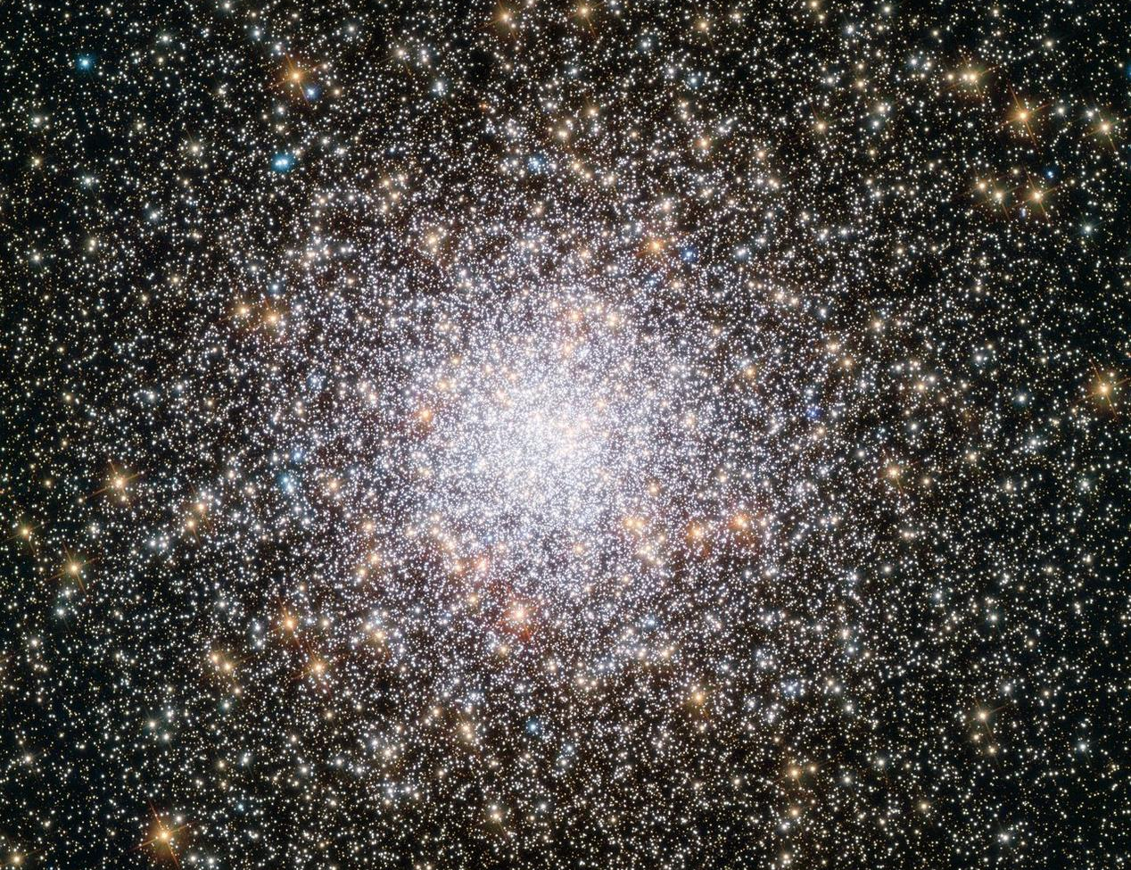
STARS
Stars
Suns beyond counting
• A star is a huge ball of hot, glowing gas.
• The Sun is our nearest star — that is why it looks so big.
• Stars differ in size, brightness and colour.
• They only appear tiny because they are so far away.
A cluster of stars
Notes:
A star is a glowing ball of gas; the Sun is the nearest. Stars vary in size, colour and brightness and look tiny only due to distance.

Slide 25
THE SUN
The Sun — Our Star
Our nearest star
The Sun is the star closest to the Earth.
A medium star
It is an ordinary, medium-sized, Sun-like star.
Light and heat
It gives the Earth the light and heat life needs.
Looks the biggest
It seems huge only because it is so close.
Notes:
The Sun is our nearest, medium-sized star, the source of the light and heat that sustain life on Earth.

Slide 26
STARS DIFFER
How Stars Differ
Size
From small dwarfs to enormous giant stars.
Brightness
Some shine far more brightly than others.
Colour
Hotter stars look bluish; cooler stars look red.
Distance
Even bright stars look tiny because they are so far away.
Notes:
Stars differ in size, brightness and colour; distance makes even giants appear as tiny points.

Slide 27
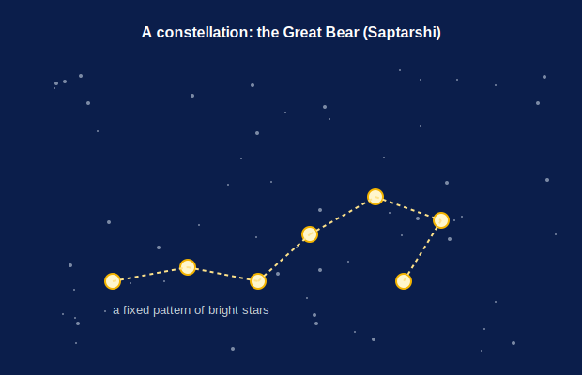
CONSTELLATIONS
Constellations
Patterns in the sky
• A constellation is a group of stars forming a pattern.
• People named them after animals, people and objects.
• The Great Bear (Saptarshi) and Orion are easy to spot.
• They help us find our way around the night sky.
A recognisable star pattern
Notes:
A constellation is a memorable pattern of stars used to navigate the sky. Name a couple visible from India.

Slide 28
FAMOUS PATTERNS
Constellations to Spot
Great Bear
Orion
The Saptarshi — seven bright stars, easy to find.
The hunter, with a striking three-star belt.
Scorpion
Named long ago
A curving line of stars like a scorpion's tail.
Ancient peoples named patterns after animals and heroes.
Notes:
Name a few well-known constellations visible from India and how they got their names.

Slide 29
POLE STAR
The Pole Star and Finding Direction
Stays put
The Pole Star seems fixed while others wheel around it.
Marks north
It lies almost exactly above the North Pole.
Found via Saptarshi
The Great Bear's stars point the way to it.
A natural compass
Travellers have used it to find north for ages.
Notes:
The Pole Star appears fixed above the north and can be found using the Great Bear — a natural direction-finder.

Slide 30


SKY WATCHING
Watching the Night Sky
Best conditions
With the eye
A clear, dark night away from city lights shows the most stars.
Many stars, the Moon and some planets can be seen with the naked eye.
Telescopes
Planets vs stars
A telescope reveals fainter, more distant objects.
Planets shine steadily; stars appear to twinkle.
Notes:
Practical sky-watching tips, and the handy difference that planets shine steadily while stars twinkle.

Slide 31
TWINKLE
Why Stars Twinkle
A tiny point
A star is so far away it is just a point of light.
Through moving air
Its light passes through unsteady layers of air.
Light wobbles
The moving air makes the point seem to twinkle.
Planets are steady
Nearer planets show a small disc and shine steadily.
Notes:
Explain twinkling: a star's pinpoint light is disturbed by moving air, while nearer planets show a steady disc.

Slide 32
STUDYING THE SKY
How We Explore the Stars
From the naked eye to giant telescopes and space missions, people have always reached out to understand the stars.
• Telescopes gather more light to reveal faint objects.
• Observatories study the sky night after night.
• India's ISRO has sent missions to the Moon and Mars.
Notes:
Close Part 2 on how we study the sky — telescopes, observatories and space missions, including India's ISRO.

Slide 33
SKY IN MOTION
Why the Sky Seems to Turn
Stars appear to move
Through the night, stars seem to drift from east to west.
The Earth spins
It is really our Earth turning on its axis.
Day and night
The same spin gives us day and night.
The Pole Star
Stays almost still because it lies above the axis.
Notes:
Explain the apparent nightly motion of the sky as a result of the Earth's rotation, with the Pole Star near the axis staying put.

Slide 34
WRAP UP
Quick Recap
✓ Universe — everything that exists; measured in light years
✓ Galaxy — island of stars, gas and dust; ours is the Milky Way
✓ Nebula — gas-and-dust cloud where stars are born
✓ Star — a huge ball of hot glowing gas; the Sun is nearest
✓ Constellation — a named pattern of stars
✓ Sky watching — dark skies; planets shine, stars twinkle
Notes:
Recap from the universe down to constellations and sky-watching.

Slide 35
QUIZ 2
Final Check — Stars & the Sky
4 questions • think before the answer reveals on the next slide

Slide 36
QUIZ QUESTION
Q1 — What is a star
A star is a huge ball of:
Cold rock
Hot glowing gas
A
B
Ice
Liquid water
C
D

Slide 37
ANSWER REVEALED
Q1 — What is a star
A star is a huge ball of:
Cold rock
Hot glowing gas
A
✓
Ice
Liquid water
C
D
WHY
A star is an enormous ball of hot gas that gives out its own light and heat — just like our Sun.

Slide 38
QUIZ QUESTION
Q2 — Nearest star
The star nearest to the Earth is the:
Pole Star
Sun
A
B
Sirius
Moon
C
D

Slide 39
ANSWER REVEALED
Q2 — Nearest star
The star nearest to the Earth is the:
Pole Star
Sun
A
✓
Sirius
Moon
C
D
WHY
The Sun is our nearest star. It looks far bigger and brighter than the others only because it is so much closer.

Slide 40
QUIZ QUESTION
Q3 — Constellation
A group of stars that appears to form a pattern in the sky is a:
Galaxy
Constellation
A
B
Nebula
Comet
C
D

Slide 41
ANSWER REVEALED
Q3 — Constellation
A group of stars that appears to form a pattern in the sky is a:
Galaxy
Constellation
A
✓
Nebula
Comet
C
D
WHY
A constellation is a recognisable pattern of stars, such as the Great Bear (Saptarshi) or Orion.

Slide 42
QUIZ QUESTION
Q4 — Twinkle
In the night sky, planets can usually be told from stars because planets:
Twinkle strongly
Shine with a steady light
A
B
Are always red
Move very fast
C
D

Slide 43
ANSWER REVEALED
Q4 — Twinkle
In the night sky, planets can usually be told from stars because planets:
Twinkle strongly
Shine with a steady light
A
✓
Are always red
Move very fast
C
D
WHY
Stars twinkle because their tiny points of light are disturbed by the air, while the nearer planets show a small disc and shine steadily.

Slide 44
Looking Up
The night sky is a window on a universe of galaxies and stars — vast beyond imagining, and free for anyone to explore.

