Slide 1
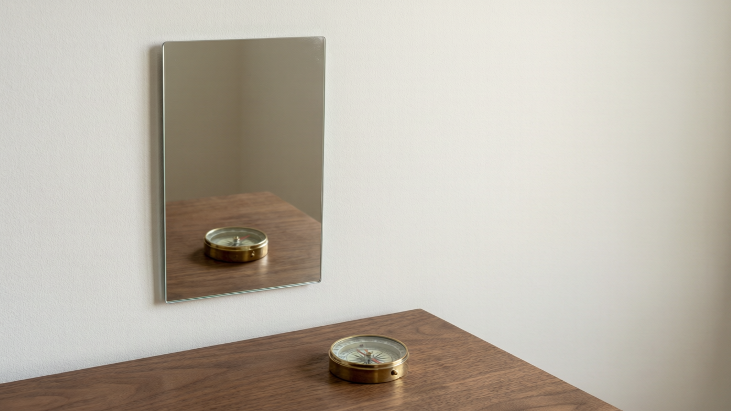
OPTICS
Light & Reflection
How light bounces back • The laws of reflection • Images in a plane mirror

Slide 2
INTRODUCTION
Learning Objectives
1
Recall that light is a form of energy that travels in straight lines
2
Define reflection and the terms used to describe it
3
State the two laws of reflection of light
4
Describe an experiment to verify the laws of reflection
5
Explain what happens at normal incidence
6
Explain how a plane mirror forms an image
Notes:
Open by previewing these objectives so students know what they should be able to do by the end of the session.

Slide 3
PART 1
Reflection of Light
1
How light bounces off a surface, and the rules it obeys

Slide 4
REFLECTION
What Is Reflection?
Reflection is the bouncing back of light into the same medium when it falls on a smooth, polished surface such as a mirror.
• Light is a form of energy that travels in straight lines.
• When light strikes a surface, part of it bounces back — this bouncing back is called reflection.
• A highly polished surface (a mirror) reflects almost all the light that falls on it.
• We see most objects by the light they reflect into our eyes.
Notes:
Open from what students already know: light travels straight and lets us see. Then sharpen 'reflection' as the bouncing back of light at a polished surface. Stress we see non-luminous things by reflected light.

Slide 5
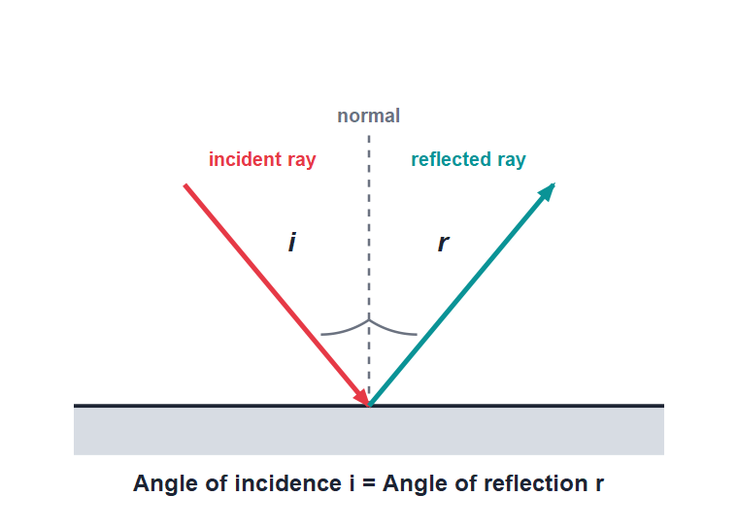
THE TERMS
The Words We Use for Reflection
Key terms
• The ray that strikes the mirror is the incident ray.
• The ray that bounces back is the reflected ray.
• The line drawn at 90° to the mirror at the point of incidence is the normal.
• The angle of incidence (i) and angle of reflection (r) are both measured from the normal.
Incident ray, reflected ray and the normal
Notes:
Point to each part on the diagram: incident ray, point of incidence, normal, reflected ray. Insist that i and r are always measured from the NORMAL, never from the mirror surface — this is the commonest error.

Slide 6



TERMS AT A GLANCE
Four Terms to Remember
Incident ray
Reflected ray
The ray of light that travels toward and strikes the reflecting surface.
The ray of light that bounces back from the surface into the same medium.
Normal
Angles i and r
The line drawn perpendicular (at 90°) to the surface at the point of incidence.
The angle of incidence and angle of reflection, each measured from the normal.
Notes:
Drill the four terms with the diagram still on screen. Ask students to come up and label a fresh ray diagram on the board.

Slide 7
LAWS OF REFLECTION
The Two Laws of Reflection
The angle of incidence is always equal to the angle of reflection.
Angle of incidence (i) = Angle of reflection (r)
• Law 1: The incident ray, the reflected ray and the normal at the point of incidence all lie in the same plane.
• Law 2: The angle of incidence is equal to the angle of reflection (i = r).
• These two laws are obeyed at every reflecting surface, flat or curved.
• Both angles are measured between the ray and the normal.
Notes:
State both laws precisely. Law 2 (i = r) is the one used in numericals; Law 1 is about everything lying in one plane. Emphasise the laws hold for ALL surfaces.

Slide 8
READING THE ANGLES
Measuring i and r
i = r
• First draw the normal at the point where the ray hits.
• Measure the angle of incidence i between the incident ray and the normal.
• Measure the angle of reflection r between the reflected ray and the normal.
• For a plane mirror you will always find i = r.
Both angles are measured from the normal
Notes:
Walk through the measuring steps in order: normal first, then i, then r. A protractor placed against the surface (not the normal) is the classic mistake to warn against.

Slide 9
EXPERIMENT
Verifying the Laws of Reflection
Pin-and-mirror method
• Fix a sheet of white paper on a drawing board and draw a straight line MM′ for the mirror; stand a plane mirror on it.
• Draw a normal at a point O on the mirror line, then draw an incident ray and fix two pins P and Q on it.
• Look into the mirror and fix two more pins R and S so that they appear in a straight line with the images of P and Q.
• Remove the mirror and pins, join the marks to get the reflected ray, and measure the angles i and r with a protractor.
Notes:
Describe the standard ICSE practical. The 'four pins appear in one straight line' condition is the heart of it. The result: i = r within experimental error, verifying the second law.

Slide 10
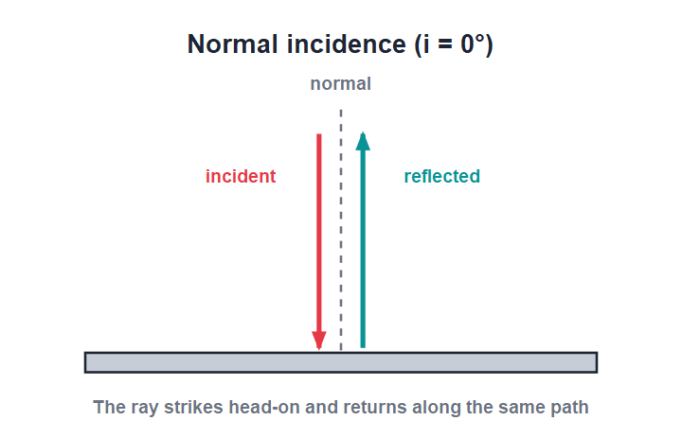
NORMAL INCIDENCE
When Light Hits Head-On
i = r = 0°
• If a ray falls along the normal, the angle of incidence is 0°.
• By the law of reflection the angle of reflection is also 0°.
• So the ray is reflected straight back along its own path.
• This special case is called normal incidence.
A head-on ray returns along the same line
Notes:
Use this as a neat check of the law: with i = 0 the reflected ray must also make 0° with the normal, so it retraces its path. This is how a mirror at the back of a torch sends light straight back.

Slide 11
QUIZ 1
Quick Check — Reflection
4 questions • think before the answer reveals on the next slide

Slide 12
QUIZ QUESTION
Q1 - Definition
Reflection of light is best described as light:
Passing through a medium
Bouncing back from a surface
A
B
Being absorbed by a surface
Bending at a surface
C
D

Slide 13
QUIZ QUESTION
Q1 - Definition
Reflection of light is best described as light:
Passing through a medium
Bouncing back from a surface
A
B
✓
Being absorbed by a surface
Bending at a surface
C
D
Why Reflection is the bouncing back of light into the same medium when it strikes a smooth, polished surface such as a mirror.

Slide 14
QUIZ QUESTION
Q2 - Terms
The angle of incidence is measured between the incident ray and the:
Mirror surface
Reflected ray
A
B
Normal
Horizontal
C
D

Slide 15
QUIZ QUESTION
Q2 - Terms
The angle of incidence is measured between the incident ray and the:
Mirror surface
Reflected ray
A
B
Normal
Horizontal
C
✓
D
Why Both the angle of incidence and the angle of reflection are measured from the normal — the line drawn at 90° to the surface at the point of incidence — never from the surface itself.

Slide 16
QUIZ QUESTION
Q3 - Laws
According to the second law of reflection:
i is greater than r
i is less than r
A
B
i is equal to r
i and r are unrelated
C
D

Slide 17
QUIZ QUESTION
Q3 - Laws
According to the second law of reflection:
i is greater than r
i is less than r
A
B
i is equal to r
i and r are unrelated
C
✓
D
Why The second law of reflection states that the angle of incidence equals the angle of reflection (i = r) at every reflecting surface.

Slide 18
QUIZ QUESTION
Q4 - Normal incidence
A ray of light strikes a plane mirror along the normal. The reflected ray will:
Travel along the mirror
Return along the same path
A
B
Bend by 45°
Be absorbed
C
D

Slide 19
QUIZ QUESTION
Q4 - Normal incidence
A ray of light strikes a plane mirror along the normal. The reflected ray will:
Travel along the mirror
Return along the same path
A
B
✓
Bend by 45°
Be absorbed
C
D
Why At normal incidence i = 0°, so r = 0° too. The ray is reflected straight back along its own path.

Slide 20
PART 2
Images in a Plane Mirror
2
How a flat mirror builds the picture you see

Slide 21



PLANE MIRROR
The Plane Mirror
What it is
Regular reflection
A plane mirror is a flat, smooth reflecting surface — usually a glass sheet silvered on the back.
Its smooth surface reflects parallel rays as parallel rays, so it forms a clear image.
The image
Everyday use
Look into it and you see an image that seems to lie behind the mirror.
The looking-glass on a wall and a dressing-table mirror are plane mirrors.
Notes:
Define the plane mirror and remind students its surface is very smooth, which is why the image is sharp. Set up the question: where exactly is the image and what is it like?

Slide 22
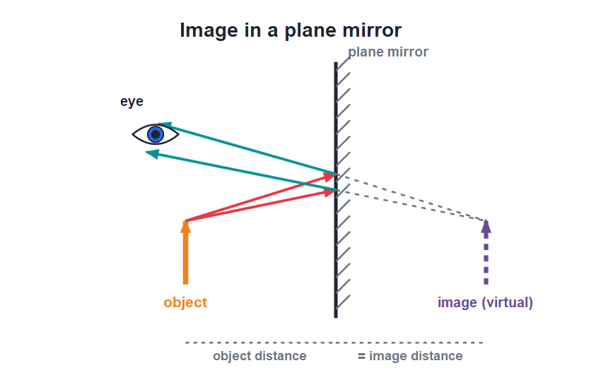
IMAGE FORMATION
How the Image Is Formed
Rays traced back
• Two rays leave a point on the object and reflect from the mirror, obeying i = r.
• The reflected rays spread out (diverge) as they enter the eye.
• Our brain assumes light travels straight, so it traces the rays back behind the mirror.
• The rays appear to meet behind the mirror — that is where the image is seen.
The image lies as far behind as the object is in front
Notes:
Trace two rays from one point of the object. The reflected rays only seem to come from behind the mirror — there is no real light there, so the image is virtual. Measure: image distance equals object distance.

Slide 23
THE IMAGE
Where the Image Is
First look at the image
• As far behind The image is formed as far behind the mirror as the object is in front of it.
• Same size The image is exactly the same size as the object.
• Erect The image is upright (erect), the same way up as the object.
• Virtual The image cannot be caught on a screen, because the rays only appear to meet behind the mirror.
Notes:
Introduce the key facts about the plane-mirror image here; the full list of characteristics, including lateral inversion, comes in the next lesson. Stress 'virtual = cannot be caught on a screen'.

Slide 24
WORKED EXAMPLE
Angle Between the Rays
Problem. A ray of light strikes a plane mirror so that the angle of incidence is 35°. Find (a) the angle of reflection and (b) the angle between the incident and reflected rays.
By the law of reflection, angle of reflection r = i = 35°.
The incident and reflected rays lie on opposite sides of the normal.
Angle between them = i + r = 35° + 35°.
Angle between the rays = 70°.
Answer: (a) r = 35° (b) angle between the rays = 70°
Notes:
Apply i = r, then add the two angles because they sit on either side of the normal. A good follow-up: ask what the angle would be at normal incidence (answer: 0°).

Slide 25
MOVING MIRRORS
A Quick Consequence
Image keeps pace
• If you walk toward a plane mirror, your image walks toward you at the same speed.
• If you move away, the image moves away by the same amount.
• Because image distance always equals object distance.
• The image is always the same size — it never grows or shrinks as you move.
Image distance always equals object distance
Notes:
A nice everyday check: the image keeps pace with you because the equal-distance rule holds at every moment. Many students wrongly think the image gets bigger as you approach — it does not.

Slide 26
WRAP UP
Quick Recap
✓ Reflection — light bounces back from a smooth, polished surface
✓ Terms — incident ray, reflected ray, normal; i and r from the normal
✓ Laws — all rays + normal in one plane; i = r
✓ Verifying — pin-and-mirror method shows i = r
✓ Normal incidence — i = 0° so the ray returns along its own path
✓ Plane-mirror image — virtual, erect, same size, equally far behind
Notes:
Rapid recap; cold-call students for each point. Spend the most time on i = r and the equal-distance rule for the image.

Slide 27
QUIZ 2
Final Check — Mirrors & Images
4 questions • think before the answer reveals on the next slide

Slide 28
QUIZ QUESTION
Q1 - Image distance
An object is placed 8 cm in front of a plane mirror. Its image is formed:
4 cm behind the mirror
8 cm behind the mirror
A
B
8 cm in front of the mirror
16 cm behind the mirror
C
D

Slide 29
QUIZ QUESTION
Q1 - Image distance
An object is placed 8 cm in front of a plane mirror. Its image is formed:
4 cm behind the mirror
8 cm behind the mirror
A
B
✓
8 cm in front of the mirror
16 cm behind the mirror
C
D
Why The image in a plane mirror is formed as far behind the mirror as the object is in front, so it is 8 cm behind the mirror.

Slide 30
QUIZ QUESTION
Q2 - Nature of image
The image formed by a plane mirror is:
Real and inverted
Real and erect
A
B
Virtual and erect
Virtual and inverted
C
D

Slide 31
QUIZ QUESTION
Q2 - Nature of image
The image formed by a plane mirror is:
Real and inverted
Real and erect
A
B
Virtual and erect
Virtual and inverted
C
✓
D
Why A plane mirror forms a virtual image (it cannot be caught on a screen) that is erect and the same size as the object.

Slide 32
QUIZ QUESTION
Q3 - Angles
A ray hits a plane mirror at an angle of incidence of 50°. The angle between the incident and reflected rays is:
50°
90°
A
B
100°
130°
C
D

Slide 33
QUIZ QUESTION
Q3 - Angles
A ray hits a plane mirror at an angle of incidence of 50°. The angle between the incident and reflected rays is:
50°
90°
A
B
100°
130°
C
✓
D
Why The angle of reflection equals the angle of incidence (50°). The rays lie on opposite sides of the normal, so the angle between them is 50° + 50° = 100°.

Slide 34
QUIZ QUESTION
Q4 - Reasoning
We can move a plane-mirror image but never catch it on a screen because the image is:
Real
Virtual
A
B
Larger than the object
Inverted
C
D

Slide 35
QUIZ QUESTION
Q4 - Reasoning
We can move a plane-mirror image but never catch it on a screen because the image is:
Real
Virtual
A
B
✓
Larger than the object
Inverted
C
D
Why The reflected rays only appear to meet behind the mirror, where no real light reaches, so the image is virtual and cannot be formed on a screen.

Slide 36
Light Obeys the Rules
Reflection is simple but exact: i = r at every surface, and a plane mirror builds a virtual, equal-size image just behind the glass.

