Slide 1
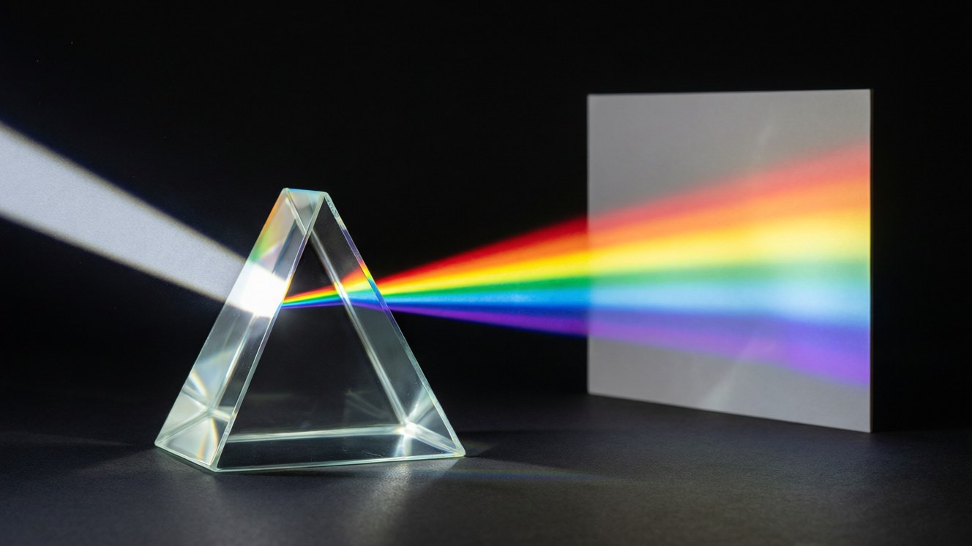
OPTICS
Images & Colour
Real vs virtual images • Lateral inversion • Uses of mirrors • The colours of white light

Slide 2
INTRODUCTION
Learning Objectives
1
Distinguish a real image from a virtual image
2
Explain lateral inversion in a plane mirror
3
List the characteristics of an image in a plane mirror
4
Tell regular reflection apart from irregular reflection
5
State everyday uses of a plane mirror
6
Describe the colours that make up white light
Notes:
Open by previewing these objectives so students know what they should be able to do by the end of the session.

Slide 3
PART 1
Images & Reflection
1
Real vs virtual, lateral inversion and the uses of mirrors

Slide 4


TWO KINDS OF IMAGE
Real and Virtual Images
Real image
Virtual image
Formed where reflected or refracted rays actually meet; it CAN be caught on a screen.
Formed where rays only appear to meet; it CANNOT be caught on a screen.
Real example
Virtual example
The image on a cinema screen and the image in a pinhole camera are real.
The image you see in a plane mirror is virtual — it seems to be behind the glass.
Notes:
Set up the real/virtual distinction with the screen test: a real image can be thrown on a screen, a virtual one cannot. The plane-mirror image is the key example of a virtual image.

Slide 5
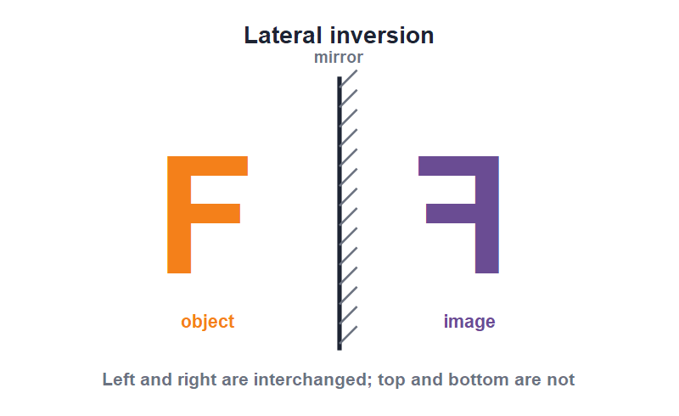
LATERAL INVERSION
Left Becomes Right
Left ↔ right
• In a plane mirror the left and right of the image are swapped over.
• This swapping of left and right is called lateral inversion.
• Your right hand looks like a left hand in the mirror.
• The word AMBULANCE is written reversed on vehicles so it reads correctly in a driver's mirror.
The letter F is flipped left-to-right, not top-to-bottom
Notes:
Demonstrate by holding up a hand or a printed word. Stress that only left and right are swapped — top and bottom stay put. The AMBULANCE example always lands well.

Slide 6
CHARACTERISTICS
The Plane-Mirror Image
Five things to remember
• Virtual It cannot be caught on a screen.
• Erect It is the same way up as the object.
• Same size It is exactly as large as the object.
• Equally far behind Its distance behind the mirror equals the object's distance in front.
• Laterally inverted Its left and right are interchanged.
Notes:
This is the most examined list in the chapter. Have students chant the five characteristics. Link each to the ray diagram from the previous lesson.

Slide 7
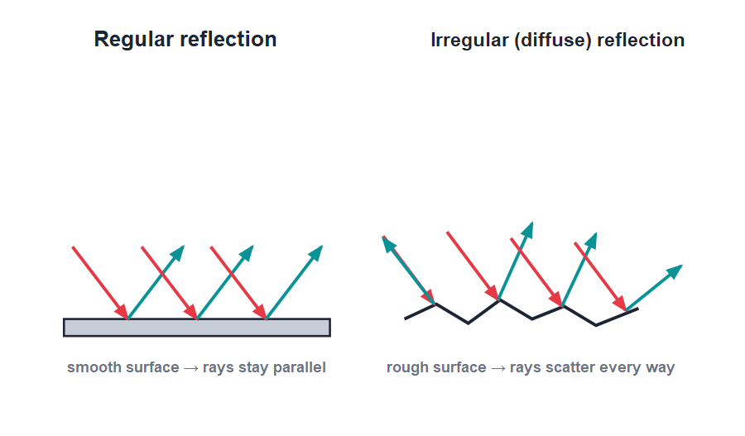
SMOOTH OR ROUGH?
Regular vs Irregular Reflection
Same law, different surface
• A smooth surface reflects parallel rays as parallel rays — this is regular reflection and gives a clear image.
• A rough surface reflects parallel rays in many directions — this is irregular (diffuse) reflection.
• Each tiny part of a rough surface still obeys i = r; the surface itself is just uneven.
• Irregular reflection from walls and paper is how we see non-shiny objects from all around.
Parallel in: parallel out (smooth) or scattered (rough)
Notes:
The crucial point: the laws of reflection are NEVER broken — even a rough wall obeys i = r at each point. It only looks scattered because the surface is uneven. Diffuse reflection is why we can read a page from any angle.

Slide 8


USES
Everyday Uses of a Plane Mirror
Looking glass
Periscope
The common mirror at home for seeing ourselves, erect and life-size.
Two plane mirrors let submarines and soldiers see over obstacles.
Kaleidoscope
Shop & safety
Mirrors set at an angle make beautiful repeated patterns.
Mirrors widen the view in shops, lifts and at blind road corners.
Notes:
Go round the uses, drawing the two-mirror periscope quickly on the board. The kaleidoscope and shop-corner mirror connect the physics to things students have actually used.

Slide 9
REAL OR VIRTUAL?
Telling the Two Apart
A quick test
• Can it land on a screen? If yes, the image is real; if no, it is virtual.
• Which way up? Real images are usually inverted; the plane-mirror virtual image is erect.
• Where do the rays meet? Real images form where rays actually cross; virtual images where rays only seem to cross.
• Plane mirror Always gives a virtual, erect image — never a real one, however far the object is.
Notes:
Give students a simple decision rule — the screen test — and practise it on a few examples (cinema screen, mirror, shadow, pinhole image).

Slide 10
QUIZ 1
Quick Check — Images
4 questions • think before the answer reveals on the next slide

Slide 11
QUIZ QUESTION
Q1 - Images
An image that can be caught on a screen is called:
A virtual image
A real image
A
B
An erect image
A laterally inverted image
C
D

Slide 12
QUIZ QUESTION
Q1 - Images
An image that can be caught on a screen is called:
A virtual image
A real image
A
B
✓
An erect image
A laterally inverted image
C
D
Why A real image is formed where light rays actually meet, so it can be caught on a screen — unlike a virtual image, which cannot.

Slide 13
QUIZ QUESTION
Q2 - Lateral inversion
In a plane mirror, lateral inversion means that:
Top and bottom are swapped
Left and right are swapped
A
B
The image shrinks
The image turns upside down
C
D

Slide 14
QUIZ QUESTION
Q2 - Lateral inversion
In a plane mirror, lateral inversion means that:
Top and bottom are swapped
Left and right are swapped
A
B
✓
The image shrinks
The image turns upside down
C
D
Why Lateral inversion is the interchange of left and right in a plane-mirror image. Top and bottom are not affected.

Slide 15
QUIZ QUESTION
Q3 - Reflection types
Reflection from a rough, uneven surface is called:
Regular reflection
Irregular reflection
A
B
Total reflection
No reflection
C
D

Slide 16
QUIZ QUESTION
Q3 - Reflection types
Reflection from a rough, uneven surface is called:
Regular reflection
Irregular reflection
A
B
✓
Total reflection
No reflection
C
D
Why A rough surface scatters parallel rays in many directions — this is irregular (diffuse) reflection. Each point still obeys i = r.

Slide 17
QUIZ QUESTION
Q4 - Uses
Two plane mirrors are used to see over obstacles in a:
Telescope
Microscope
A
B
Periscope
Camera
C
D

Slide 18
QUIZ QUESTION
Q4 - Uses
Two plane mirrors are used to see over obstacles in a:
Telescope
Microscope
A
B
Periscope
Camera
C
✓
D
Why A periscope uses two plane mirrors, usually at 45°, to let the viewer see over walls or above the water from a submarine.

Slide 19
PART 2
Speed & Colour of Light
2
How fast light travels and the colours hidden in white light

Slide 20
SPEED OF LIGHT
How Fast Does Light Travel?
Light is the fastest thing in the universe; nothing travels faster than light.
Speed of light in air ≈ 3 × 10⁸ metres per second
• At this speed light would circle the Earth about seven times in one second.
• Sunlight takes about 8 minutes to reach the Earth.
• Light travels fastest in vacuum and a little slower in air, water or glass.
• Sound is far slower, which is why we see lightning before we hear thunder.
Notes:
Give a sense of scale (seven times round the Earth a second). The lightning-before-thunder fact compares the speed of light with the speed of sound and previews the Sound chapter.

Slide 21
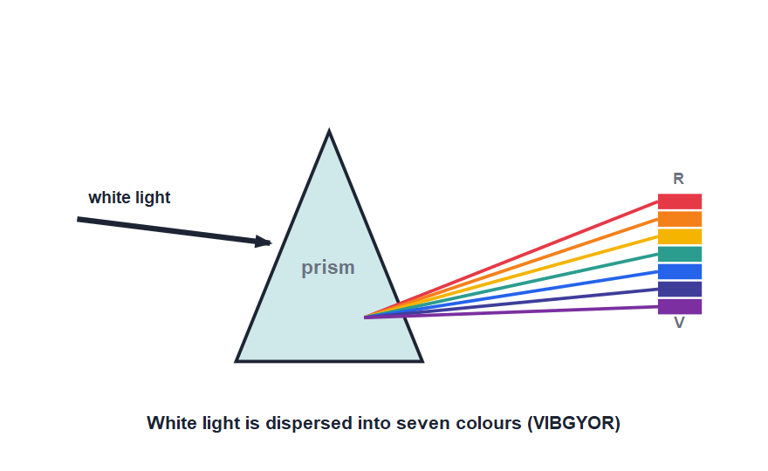
WHITE LIGHT
The Colours of White Light
Dispersion → VIBGYOR
• White light is not a single colour — it is a mixture of several colours.
• A glass prism splits white light into a band of colours called a spectrum.
• The seven colours are red, orange, yellow, green, blue, indigo and violet (VIBGYOR).
• This splitting of white light into its colours is called dispersion.
A prism spreads white light into seven colours
Notes:
Define dispersion and the order VIBGYOR (red bends least, violet most). A rainbow is nature's own dispersion of sunlight by raindrops.

Slide 22
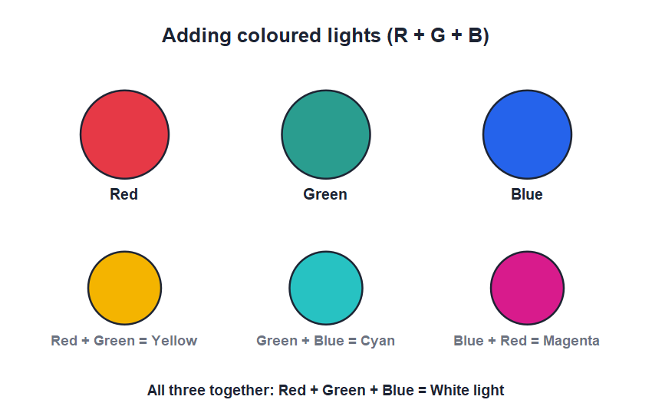
PRIMARY COLOURS
Primary & Secondary Colours of Light
Adding lights
• The three primary colours of light are red, green and blue.
• Mixing (adding) two primary colours gives a secondary colour.
• Red + green = yellow; green + blue = cyan; blue + red = magenta.
• Adding all three primary colours together gives white light.
Red, green and blue add to make white
Notes:
Be careful: these are the primary colours of LIGHT (adding), which differ from the primary colours of paint. Adding all three lights gives white — the opposite of mixing paints.

Slide 23
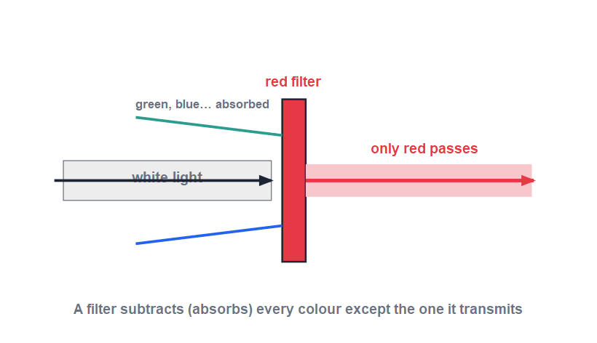
SUBTRACTING COLOUR
How a Filter Makes Colour
Absorb the rest
• A coloured filter lets its own colour pass and absorbs the rest.
• A red filter held up to white light lets only red light through.
• Removing colours from white light this way is called subtraction of colours.
• A red object looks red because it reflects red light and absorbs the other colours.
A red filter transmits red and absorbs other colours
Notes:
Connect filters and coloured objects: both work by absorbing some colours and passing/reflecting others. This 'subtraction' explains why a green leaf looks green in white light but black in pure red light.

Slide 24


COLOUR AROUND US
Colour in Everyday Life
Rainbow
Why things look coloured
Raindrops disperse sunlight into a curved band of seven colours — dispersion in nature.
An object shows the colour it reflects and absorbs the rest of the white light.
Stage & traffic lights
A white object
Coloured filters over white lamps give red, green and other coloured beams.
It reflects all colours equally, so it looks white; a black object absorbs them all.
Notes:
Tie the colour ideas to things students see daily. The rainbow is dispersion; the colour of an object is subtraction by reflection. Invite students to explain the colour of their own clothes.

Slide 25
WRAP UP
Quick Recap
✓ Real vs virtual — real can be caught on a screen; virtual cannot
✓ Lateral inversion — a plane mirror swaps left and right
✓ Plane-mirror image — virtual, erect, same size, equally far behind, laterally inverted
✓ Regular vs irregular — smooth keeps rays parallel; rough scatters them
✓ Speed of light — about 3 × 10⁸ m/s — the fastest in the universe
✓ White light — a mix of seven colours (VIBGYOR); R, G, B are primary
Notes:
Rapid recap; cold-call for each. Spend extra time on the five image characteristics and the primary colours of light.

Slide 26
QUIZ 2
Final Check — Speed & Colour
4 questions • think before the answer reveals on the next slide

Slide 27
QUIZ QUESTION
Q1 - Image
Which of these is the correct list of plane-mirror image characteristics?
Real, inverted, magnified
Virtual, erect, same size
A
B
Real, erect, diminished
Virtual, inverted, same size
C
D

Slide 28
QUIZ QUESTION
Q1 - Image
Which of these is the correct list of plane-mirror image characteristics?
Real, inverted, magnified
Virtual, erect, same size
A
B
✓
Real, erect, diminished
Virtual, inverted, same size
C
D
Why A plane-mirror image is virtual, erect, the same size as the object, equally far behind the mirror and laterally inverted.

Slide 29
QUIZ QUESTION
Q2 - Dispersion
The splitting of white light into seven colours by a prism is called:
Reflection
Refraction
A
B
Dispersion
Absorption
C
D

Slide 30
QUIZ QUESTION
Q2 - Dispersion
The splitting of white light into seven colours by a prism is called:
Reflection
Refraction
A
B
Dispersion
Absorption
C
✓
D
Why Dispersion is the splitting of white light into its seven constituent colours (VIBGYOR) as it passes through a prism.

Slide 31
QUIZ QUESTION
Q3 - Primary colours
The three primary colours of light are:
Red, yellow, blue
Red, green, blue
A
B
Cyan, magenta, yellow
Red, white, black
C
D

Slide 32
QUIZ QUESTION
Q3 - Primary colours
The three primary colours of light are:
Red, yellow, blue
Red, green, blue
A
B
✓
Cyan, magenta, yellow
Red, white, black
C
D
Why The primary colours of light are red, green and blue. Added together in equal amounts they produce white light.

Slide 33
QUIZ QUESTION
Q4 - Filters
A red filter is held in front of white light. The light that passes through is:
White
Green
A
B
Red
Blue
C
D

Slide 34
QUIZ QUESTION
Q4 - Filters
A red filter is held in front of white light. The light that passes through is:
White
Green
A
B
Red
Blue
C
✓
D
Why A red filter transmits only red light and absorbs the other colours, so only red light passes through — an example of the subtraction of colours.

Slide 35
Mirrors, Speed & Colour
A plane mirror gives a virtual, laterally inverted image; light races at 3 × 10⁸ m/s; and white light hides all the colours of the rainbow.

