Slide 1
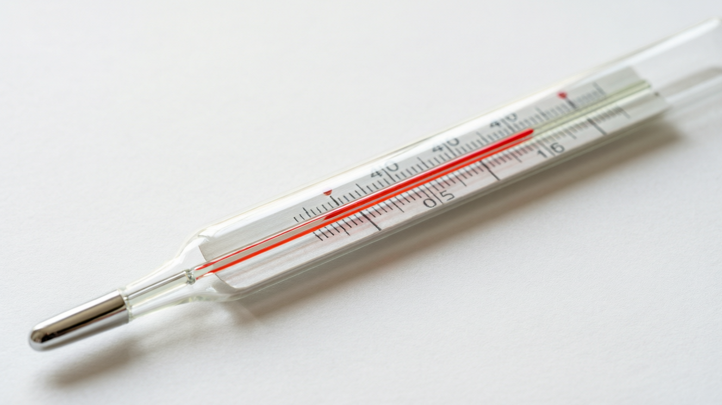
HEAT
Heat & Temperature
Heat as a form of energy • Units of heat • Temperature and its scales • The thermometer

Slide 2
INTRODUCTION
Learning Objectives
1
Explain that heat is a form of energy
2
State the units of heat and relate the calorie to the joule
3
Distinguish clearly between heat and temperature
4
Define temperature as the degree of hotness of a body
5
Name the scales of temperature and their fixed points
6
Convert a temperature between the Celsius and Fahrenheit scales
Notes:
Open by previewing these objectives so students know what they should be able to do by the end of the session.

Slide 3
PART 1
Heat as Energy
1
What heat is, its units, and how it differs from temperature

Slide 4
HEAT
What Is Heat?
Heat is a form of energy that flows from a hotter body to a colder body because of the temperature difference between them.
• Heat always flows on its own from the hotter to the colder body, never the other way.
• When a body is heated, the energy of its particles increases.
• Heat is sometimes called energy 'in transit' because it is energy on the move.
• Adding heat can warm a body, expand it, or change its state.
Notes:
Anchor heat as ENERGY, not a substance. Stress the one-way flow (hot → cold) and that 'in transit' means it is energy being transferred. Foreshadow its effects.

Slide 5
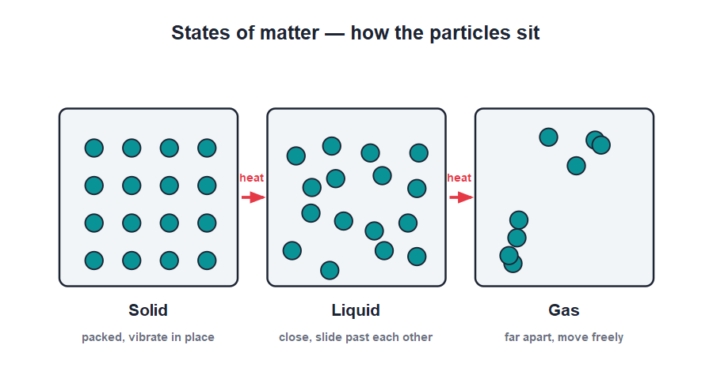
HEAT & PARTICLES
Heat and Moving Particles
Energy of particles
• Every substance is made of tiny particles that are always moving.
• Heating a body makes its particles move (or vibrate) faster.
• The faster the particles move, the hotter the body becomes.
• This is why heat can melt a solid or boil a liquid — the particles gain enough energy to break free.
Particles move faster as a body is heated
Notes:
Link heat to particle motion: more heat → faster particles → higher temperature. This picture explains melting and boiling and prepares the change-of-state ideas of the next lesson.

Slide 6




SOURCES OF HEAT
Where Heat Comes From
The Sun
Burning fuels
Our greatest natural source of heat, reaching us across space as radiation.
Wood, coal, kerosene and gas release heat when they burn.
Electricity
Friction
Heaters, irons and geysers turn electrical energy into heat.
Rubbing two surfaces together produces heat — rub your palms to feel it.
Notes:
List the everyday sources of heat. The friction example is a nice hands-on moment — students rub their palms and feel the warmth they have created.

Slide 7
UNITS OF HEAT
Units of Heat
Because heat is energy, it is measured in the same unit as energy — the joule (J).
1 calorie = 4.2 joule
• The SI unit of heat is the joule (J).
• An older unit is the calorie (cal): the heat needed to raise 1 g of water by 1°C.
• 1 calorie = 4.2 joule, and 1 kilocalorie = 1000 calories.
• Food energy is often given in kilocalories (written Calorie with a capital C).
Notes:
Give the joule as the SI unit, then the calorie and the conversion 1 cal = 4.2 J. The food-Calorie aside makes the unit feel real to students.

Slide 8


HEAT VS TEMPERATURE
Heat Is Not the Same as Temperature
Heat
Temperature
The total energy of all the moving particles in a body; measured in joules.
The degree of hotness of a body — how hot or cold it is; measured in °C.
A big vs small cup
Flow
A bucket of warm water holds more heat than a cup at the same temperature.
Heat flows from high temperature to low temperature until both are equal.
Notes:
This is the most confused pair in the chapter. The bucket-vs-cup example shows two bodies at the SAME temperature can hold very different amounts of heat.

Slide 9
QUIZ 1
Quick Check — Heat & Its Units
4 questions • think before the answer reveals on the next slide

Slide 10
QUIZ QUESTION
Q1 - Nature of heat
Heat is best described as:
A kind of matter
A form of energy
A
B
A type of force
A liquid
C
D

Slide 11
QUIZ QUESTION
Q1 - Nature of heat
Heat is best described as:
A kind of matter
A form of energy
A
B
✓
A type of force
A liquid
C
D
Why Heat is a form of energy that flows from a hotter body to a colder one. It is measured in joules, the unit of energy.

Slide 12
QUIZ QUESTION
Q2 - Direction
Heat always flows on its own from a body at:
Low to high temperature
High to low temperature
A
B
Large to small size
Solid to gas
C
D

Slide 13
QUIZ QUESTION
Q2 - Direction
Heat always flows on its own from a body at:
Low to high temperature
High to low temperature
A
B
✓
Large to small size
Solid to gas
C
D
Why Heat flows by itself from the hotter body (higher temperature) to the colder body (lower temperature) until their temperatures become equal.

Slide 14
QUIZ QUESTION
Q3 - Units
One calorie of heat is equal to:
0.42 J
4.2 J
A
B
42 J
420 J
C
D

Slide 15
QUIZ QUESTION
Q3 - Units
One calorie of heat is equal to:
0.42 J
4.2 J
A
B
✓
42 J
420 J
C
D
Why 1 calorie = 4.2 joule. The calorie is the heat needed to raise the temperature of 1 g of water by 1°C.

Slide 16
QUIZ QUESTION
Q4 - Heat vs temperature
Two bodies at the same temperature may still contain different amounts of:
Temperature
Heat
A
B
Coldness
Hotness
C
D

Slide 17
QUIZ QUESTION
Q4 - Heat vs temperature
Two bodies at the same temperature may still contain different amounts of:
Temperature
Heat
A
B
✓
Coldness
Hotness
C
D
Why Temperature is the degree of hotness, but heat is the total energy of the particles. A larger body at the same temperature holds more heat.

Slide 18
PART 2
Temperature & Its Scales
2
Measuring how hot a body is

Slide 19
TEMPERATURE
What Is Temperature?
Temperature is the degree of hotness or coldness of a body, and it decides the direction in which heat will flow.
• A body at a higher temperature feels hotter than one at a lower temperature.
• Heat flows from the body at higher temperature to the one at lower temperature.
• Temperature is measured with a thermometer.
• Our sense of touch is unreliable, so we need a thermometer to measure temperature accurately.
Notes:
Define temperature as degree of hotness. The hand-in-warm-then-cold-water demo shows why touch is an unreliable judge of temperature and why we need a thermometer.

Slide 20
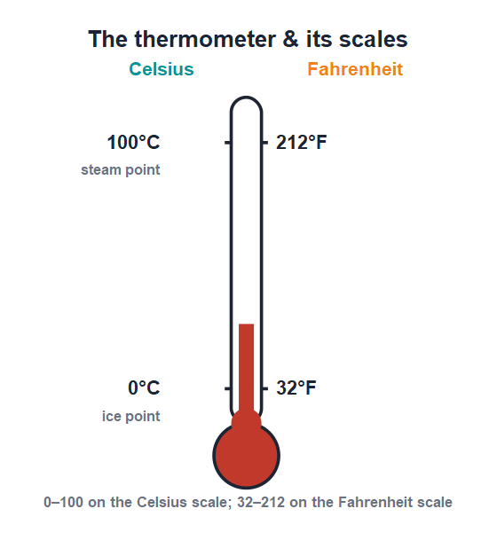
SCALES
Scales of Temperature
Fixed points
• A thermometer is marked using two fixed points: the ice point and the steam point.
• On the Celsius scale the ice point is 0°C and the steam point is 100°C.
• On the Fahrenheit scale they are 32°F and 212°F.
• On the Kelvin (SI) scale they are 273 K and 373 K.
0–100 on Celsius, 32–212 on Fahrenheit
Notes:
Explain that a scale needs two fixed reference temperatures. The ice point and steam point are the same physical temperatures on every scale — only the numbers differ.

Slide 21
CONVERTING
Relating the Scales
The same temperature has different numbers on different scales, but they are linked by a simple relation.
(C / 5) = (F − 32) / 9 = (K − 273) / 5
• There are 100 Celsius degrees between the fixed points, but 180 Fahrenheit degrees.
• To go from Celsius to Kelvin, simply add 273.
• Use the relation to change a reading from one scale to another.
• Normal human body temperature is 37°C, which is 98.6°F.
Notes:
Walk through the relation slowly. The key facts: 100 Celsius divisions equal 180 Fahrenheit divisions, and K = C + 273. The body-temperature numbers anchor it.

Slide 22
WORKED EXAMPLE
Celsius to Fahrenheit
Problem. Normal body temperature is 37°C. Express this on the Fahrenheit scale.
Use C / 5 = (F − 32) / 9
37 / 5 = (F − 32) / 9
(F − 32) = 9 × 37 / 5 = 66.6
F = 66.6 + 32 = 98.6
Answer: 37°C = 98.6°F (normal body temperature)
Notes:
Substitute into the relation and solve for F. Point out the answer is the familiar 98.6°F shown on a clinical thermometer.

Slide 23
WORKED EXAMPLE
Fahrenheit to Celsius
Problem. A hot day reads 104°F on a Fahrenheit thermometer. What is this on the Celsius scale?
Use C / 5 = (F − 32) / 9
C / 5 = (104 − 32) / 9 = 72 / 9 = 8
C = 8 × 5
C = 40
Answer: 104°F = 40°C (a very hot day)
Notes:
Now run the relation the other way: find (F − 32)/9 first, then multiply by 5. Sanity-check that 40°C is a believable hot-day temperature.

Slide 24

THERMOMETERS
Measuring Temperature
Laboratory thermometer
Clinical thermometer
Reads a wide range, about −10°C to 110°C; used in experiments.
Reads a narrow range around body heat (35–42°C) with a kink to hold the reading.
How it works
Reading it
A liquid (mercury or coloured alcohol) expands up a thin tube as the temperature rises.
Place the bulb in contact, wait until the liquid stops moving, then read at eye level.
Notes:
Compare the laboratory and clinical thermometers — range and the clinical kink that holds the reading. Reinforce that a thermometer works by the expansion of a liquid.

Slide 25
WRAP UP
Quick Recap
✓ Heat — a form of energy that flows from hot to cold; unit joule
✓ Calorie — 1 cal = 4.2 J; heat to warm 1 g water by 1°C
✓ Heat vs temperature — total particle energy vs degree of hotness
✓ Temperature — degree of hotness; measured with a thermometer
✓ Scales — Celsius 0–100, Fahrenheit 32–212, Kelvin 273–373
✓ Relating — C/5 = (F−32)/9; K = C + 273
Notes:
Rapid recap; cold-call for each. Spend extra time on heat vs temperature and the scale relation.

Slide 26
QUIZ 2
Final Check — Temperature
4 questions • think before the answer reveals on the next slide

Slide 27
QUIZ QUESTION
Q1 - Definition
Temperature is the measure of the:
Total heat in a body
Degree of hotness of a body
A
B
Mass of a body
Speed of a body
C
D

Slide 28
QUIZ QUESTION
Q1 - Definition
Temperature is the measure of the:
Total heat in a body
Degree of hotness of a body
A
B
✓
Mass of a body
Speed of a body
C
D
Why Temperature is the degree of hotness or coldness of a body. It decides the direction in which heat flows.

Slide 29
QUIZ QUESTION
Q2 - Fixed points
On the Celsius scale, the steam point is marked as:
0°C
32°C
A
B
100°C
273°C
C
D

Slide 30
QUIZ QUESTION
Q2 - Fixed points
On the Celsius scale, the steam point is marked as:
0°C
32°C
A
B
100°C
273°C
C
✓
D
Why The Celsius scale takes the ice point as 0°C and the steam point as 100°C, with 100 equal divisions between them.

Slide 31
QUIZ QUESTION
Q3 - Kelvin
A temperature of 27°C on the Kelvin scale is:
27 K
246 K
A
B
300 K
327 K
C
D

Slide 32
QUIZ QUESTION
Q3 - Kelvin
A temperature of 27°C on the Kelvin scale is:
27 K
246 K
A
B
300 K
327 K
C
✓
D
Why K = C + 273 = 27 + 273 = 300 K. To convert Celsius to Kelvin we simply add 273.

Slide 33
QUIZ QUESTION
Q4 - Clinical thermometer
A clinical thermometer has a narrow range of about:
−10°C to 110°C
0°C to 100°C
A
B
35°C to 42°C
0°C to 500°C
C
D

Slide 34
QUIZ QUESTION
Q4 - Clinical thermometer
A clinical thermometer has a narrow range of about:
−10°C to 110°C
0°C to 100°C
A
B
35°C to 42°C
0°C to 500°C
C
✓
D
Why A clinical thermometer reads only around body temperature (35–42°C) and has a kink that keeps the reading until it is shaken down.

Slide 35
Heat on the Move
Heat is energy flowing from hot to cold; temperature, measured on the Celsius, Fahrenheit or Kelvin scale, tells us how hot a body is.

