Slide 1

HEAT
Effects of Heat
What heat does to a body • Change of state • Thermal expansion of solids, liquids and gases

Slide 2
INTRODUCTION
Learning Objectives
1
List the main effects produced when a body is heated
2
Explain change of state in terms of heating and cooling
3
State that solids, liquids and gases expand on heating
4
Compare the expansion of solids, liquids and gases
5
Describe the ball-and-ring and bimetallic-strip experiments
6
Give everyday applications and problems of thermal expansion
Notes:
Open by previewing these objectives so students know what they should be able to do by the end of the session.

Slide 3
PART 1
Effects of Heat
1
How adding heat changes a body

Slide 4
EFFECTS
What Heat Does to a Body
When a body is heated it can change in several ways — its temperature, its size and even its state can change.
• The temperature of the body usually rises.
• The body expands — it increases in size.
• The state may change: a solid can melt, a liquid can boil into vapour.
• Heating can also change properties such as colour, or drive a chemical change.
Notes:
Give the big picture of heat's effects before the details. The three you will test most are: temperature rise, expansion, and change of state.

Slide 5




THREE MAIN EFFECTS
Three Effects to Know Well
Rise in temperature
Expansion
Heating a body usually makes it hotter — its temperature goes up.
Almost every substance gets a little bigger when heated and shrinks when cooled.
Change of state
Reversible by cooling
A solid melts to a liquid, and a liquid boils to a gas, on strong heating.
Cooling reverses these: a gas condenses, a liquid freezes, a body contracts.
Notes:
Walk the three effects with examples — a warming spoon, a melting ice cube, boiling water. Stress that cooling reverses each effect.

Slide 6
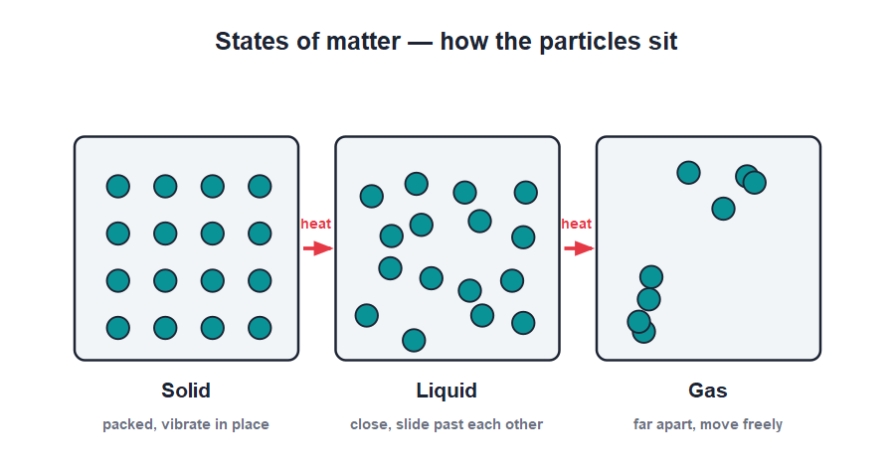
CHANGE OF STATE
Melting, Boiling and Back Again
Solid → liquid → gas
• Heating a solid gives its particles enough energy to break free, so it melts into a liquid.
• Heating the liquid further turns it into a gas (boiling or evaporation).
• Cooling reverses the journey: a gas condenses and a liquid freezes.
• During a change of state the heat goes into changing the state, not raising the temperature.
Particles gain energy and break apart on heating
Notes:
Use the particle picture: heat loosens the particles until they can flow (liquid) or fly free (gas). The subtle point — temperature pauses during melting and boiling — can be mentioned simply.

Slide 7

NAMING THE CHANGES
Changes of State Have Names
Melting
Boiling / evaporation
Solid → liquid on heating, as ice becomes water.
Liquid → gas on heating, as water becomes steam.
Condensation
Freezing
Gas → liquid on cooling, as steam wets a cold lid.
Liquid → solid on cooling, as water becomes ice.
Notes:
Give each change its proper name and a homely example. Heating drives the forward changes (melting, boiling); cooling drives the reverse ones (condensation, freezing).

Slide 8
EVERYDAY EFFECTS
Effects of Heat Around Us
Heat at work every day
• Cooking Heat changes food by raising its temperature and causing chemical changes.
• Ice to water A warm day melts ice and snow — a change of state.
• Drying clothes Heat from the Sun turns water into vapour, drying wet clothes.
• Cracking glass Sudden, uneven heating can expand glass unevenly and crack it.
Notes:
Connect the effects to daily life. The cracked-glass example previews why uneven expansion matters — the theme of Part 2.

Slide 9
QUIZ 1
Quick Check — Effects of Heat
4 questions • think before the answer reveals on the next slide

Slide 10
QUIZ QUESTION
Q1 - Effects
Which of these is NOT a usual effect of heating a body?
Rise in temperature
Expansion
A
B
Change of state
Decrease in size
C
D

Slide 11
QUIZ QUESTION
Q1 - Effects
Which of these is NOT a usual effect of heating a body?
Rise in temperature
Expansion
A
B
Change of state
Decrease in size
C
D
✓
Why Heating usually makes a body expand (increase in size), not shrink. A body contracts only when it is cooled.

Slide 12
QUIZ QUESTION
Q2 - Change of state
When a solid is heated strongly it first:
Freezes
Melts into a liquid
A
B
Condenses
Contracts
C
D

Slide 13
QUIZ QUESTION
Q2 - Change of state
When a solid is heated strongly it first:
Freezes
Melts into a liquid
A
B
✓
Condenses
Contracts
C
D
Why Heating gives the particles of a solid enough energy to break free of their fixed positions, so the solid melts into a liquid.

Slide 14
QUIZ QUESTION
Q3 - Particles
On heating, the particles of a substance:
Stop moving
Move faster
A
B
Get heavier
Disappear
C
D

Slide 15
QUIZ QUESTION
Q3 - Particles
On heating, the particles of a substance:
Stop moving
Move faster
A
B
✓
Get heavier
Disappear
C
D
Why Heat is energy, so the particles move or vibrate faster when a body is heated. This is what raises its temperature and can change its state.

Slide 16
QUIZ QUESTION
Q4 - Reversing
The change of state from gas back to liquid on cooling is called:
Melting
Boiling
A
B
Condensation
Expansion
C
D

Slide 17
QUIZ QUESTION
Q4 - Reversing
The change of state from gas back to liquid on cooling is called:
Melting
Boiling
A
B
Condensation
Expansion
C
✓
D
Why Cooling a gas removes energy from its particles until they come together as a liquid — this is condensation, the reverse of boiling.

Slide 18
PART 2
Thermal Expansion
2
Why heated things grow, and how we use it

Slide 19
THERMAL EXPANSION
Heat Makes Things Expand
Almost all substances — solids, liquids and gases — expand on heating and contract on cooling.
• Heating makes the particles move more and take up more space, so the body expands.
• For the same rise in temperature, gases expand the most and solids the least.
• So the order of expansion is: gases > liquids > solids.
• The expansion is small for solids but large enough to matter in bridges and railway lines.
Notes:
State the rule and the order gas > liquid > solid. Explain it through particle spacing: the freer the particles, the more room the extra motion needs.

Slide 20
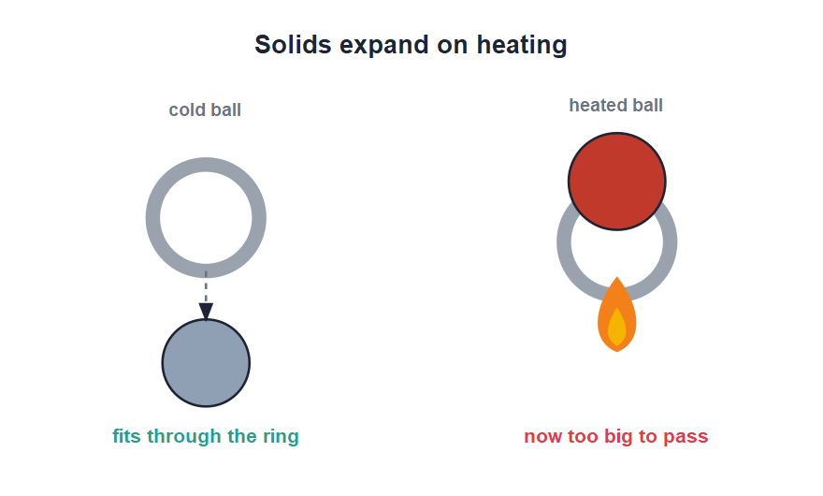
BALL & RING
The Ball-and-Ring Experiment
Solids expand
• When cold, a metal ball just passes through a metal ring.
• Heat the ball and it expands, becoming slightly larger.
• Now the same ball will no longer pass through the ring.
• Cool the ball again and it contracts, so it passes through once more — proving solids expand on heating.
The heated ball is too large for the ring
Notes:
Describe the classic demonstration. The fairness of the test (same ball, same ring) makes it convincing. It proves a solid really does grow when heated.

Slide 21


WHICH EXPANDS MOST?
Comparing Solids, Liquids and Gases
Solids
Liquids
Expand the least; the particles are tightly held in place.
Expand more than solids; their particles are looser.
Gases
The order
Expand the most; their particles are far apart and move freely.
For the same heating: gases > liquids > solids.
Notes:
Reinforce the order with the particle picture. A gas in a warmed flask pushes a liquid index along a tube far more than a solid rod lengthens — a quick way to compare.

Slide 22
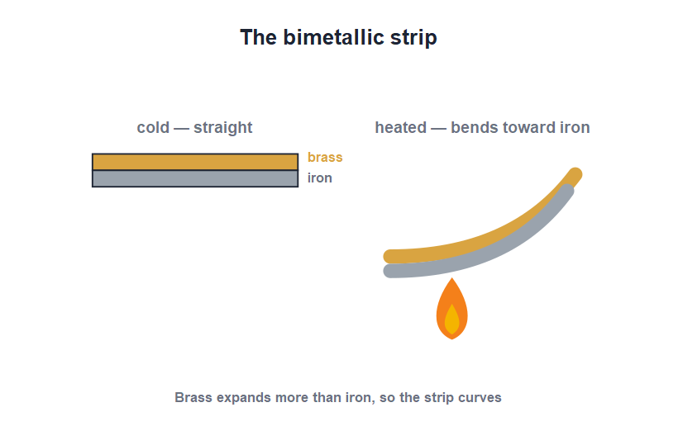
BIMETALLIC STRIP
The Bimetallic Strip
Two metals, unequal expansion
• Two different metals, such as brass and iron, are riveted together into one strip.
• When heated, brass expands more than iron.
• The unequal expansion makes the strip bend, with brass on the outside of the curve.
• This bending is used in thermostats and fire alarms to switch a circuit on or off.
Brass expands more, so the strip curls
Notes:
Explain the cause: different metals expand by different amounts, so a bonded strip must bend. The thermostat and fire-alarm uses make it relevant.

Slide 23




USES & PROBLEMS
Expansion in Everyday Life
Railway lines
Bridges
Small gaps are left between rails so they can expand in summer without buckling.
One end of a bridge rests on rollers to allow for expansion and contraction.
Overhead wires
Fitting metal
Telephone and power wires are left slightly slack so they do not snap when they contract in winter.
A hot iron rim shrinks tightly onto a wooden wheel as it cools — used in carts and wheels.
Notes:
These are the standard ICSE applications. Each one either makes room for expansion (gaps, rollers, slack) or uses contraction on cooling (shrink-fitting). Have students spot rail gaps near home.

Slide 24
EXPANSION AT WORK
Putting Expansion to Use
Liquid thermometer
Hot-air balloon
A thermometer works because its liquid expands up the tube as it warms.
Heated air expands, becomes lighter and lifts the balloon.
Gaps and rollers
Shrink-fitting
Builders leave room so expansion does not crack or buckle structures.
A heated metal ring slipped on, then cooled, grips tightly as it contracts.
Notes:
Show expansion is not just a problem to design around but also something useful — thermometers and hot-air balloons both rely on it.

Slide 25
WRAP UP
Quick Recap
✓ Effects of heat — temperature rise, expansion, change of state
✓ Change of state — solid → liquid → gas on heating; reversed on cooling
✓ Expansion — almost everything expands on heating, contracts on cooling
✓ Order — gases expand most, solids least
✓ Bimetallic strip — two metals bend on heating — thermostats, alarms
✓ Applications — rail gaps, bridge rollers, slack wires, shrink-fitting
Notes:
Rapid recap; cold-call for each. The order of expansion and the bimetallic strip are the most examined points.

Slide 26
QUIZ 2
Final Check — Thermal Expansion
4 questions • think before the answer reveals on the next slide

Slide 27
QUIZ QUESTION
Q1 - Order
For the same rise in temperature, the greatest expansion is shown by:
Solids
Liquids
A
B
Gases
All equally
C
D

Slide 28
QUIZ QUESTION
Q1 - Order
For the same rise in temperature, the greatest expansion is shown by:
Solids
Liquids
A
B
Gases
All equally
C
✓
D
Why Gas particles are far apart and move freely, so for the same heating a gas expands the most. The order is gases > liquids > solids.

Slide 29
QUIZ QUESTION
Q2 - Ball and ring
In the ball-and-ring experiment, the heated ball does not pass through the ring because it has:
Shrunk
Expanded
A
B
Melted
Cooled
C
D

Slide 30
QUIZ QUESTION
Q2 - Ball and ring
In the ball-and-ring experiment, the heated ball does not pass through the ring because it has:
Shrunk
Expanded
A
B
✓
Melted
Cooled
C
D
Why Heating makes the metal ball expand, so it becomes slightly too large to pass through the ring — proof that solids expand on heating.

Slide 31
QUIZ QUESTION
Q3 - Bimetallic strip
A bimetallic strip bends on heating because the two metals:
Have the same length
Expand by different amounts
A
B
Do not expand at all
Melt together
C
D

Slide 32
QUIZ QUESTION
Q3 - Bimetallic strip
A bimetallic strip bends on heating because the two metals:
Have the same length
Expand by different amounts
A
B
✓
Do not expand at all
Melt together
C
D
Why The two metals expand unequally for the same heating, so the bonded strip must bend — with the metal that expands more on the outside of the curve.

Slide 33
QUIZ QUESTION
Q4 - Applications
Gaps are left between railway lines mainly to:
Save metal
Allow for expansion in summer
A
B
Reduce noise
Make joining easier
C
D

Slide 34
QUIZ QUESTION
Q4 - Applications
Gaps are left between railway lines mainly to:
Save metal
Allow for expansion in summer
A
B
✓
Reduce noise
Make joining easier
C
D
Why On a hot day the steel rails expand. The gaps give them room to lengthen without buckling and bending out of shape.

Slide 35
Heat Changes Everything
Heat warms, expands and even melts a body — and the small expansion of solids is large enough to shape how we build rails, bridges and wheels.

