Slide 1
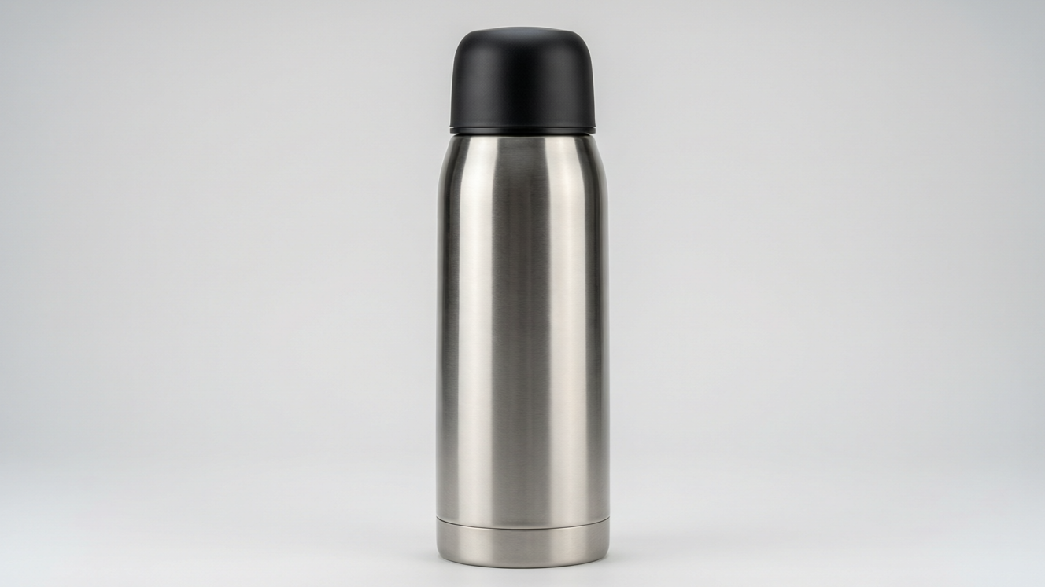
HEAT
Transfer of Heat
Conduction • Convection • Radiation • Conductors and insulators • The vacuum flask

Slide 2
INTRODUCTION
Learning Objectives
1
Name the three ways in which heat travels
2
Explain conduction and tell conductors from insulators
3
Explain convection and give everyday examples
4
Explain radiation and how it differs from the other two
5
Describe how surface colour affects absorbing and emitting heat
6
Explain how a vacuum flask reduces all three kinds of heat loss
Notes:
Open by previewing these objectives so students know what they should be able to do by the end of the session.

Slide 3
PART 1
Conduction & Convection
1
How heat travels through solids and fluids

Slide 4
THREE MODES
Three Ways Heat Travels
Heat can travel from one place to another in three ways: conduction, convection and radiation.
• Conduction: heat passes through a solid without the solid moving as a whole.
• Convection: heat is carried by the actual movement of a heated liquid or gas.
• Radiation: heat travels as waves and needs no medium at all.
• More than one mode can act at the same time, as in a pan of water on a flame.
Notes:
Preview all three modes so students have a map. The key distinction to build: conduction and convection need a material, radiation does not.

Slide 5
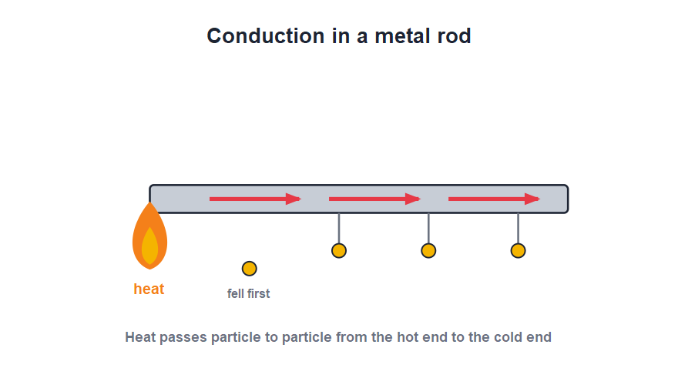
CONDUCTION
Heat Through Solids: Conduction
Particle to particle
• In conduction, heat passes from particle to particle through a solid.
• The particles vibrate faster and pass the energy along, but do not move from their places.
• Hold a metal spoon in hot tea and the handle soon feels hot — that is conduction.
• Metals are good conductors; this is why a metal rod heats along its length.
Heat flows along the rod from the hot end
Notes:
Explain conduction with the rod-and-pins picture: pins fall off in order from the hot end as heat travels along. Stress the particles stay put — only energy moves.

Slide 6




CONDUCTORS & INSULATORS
Good and Poor Conductors
Conductors
Insulators
Materials that let heat pass easily — metals such as copper, aluminium and iron.
Materials that hardly let heat pass — wood, plastic, air, wool and glass.
In the kitchen
Keeping warm
Pans are metal to conduct heat, but handles are plastic or wood so they stay cool.
Woollen clothes and air gaps trap heat by being poor conductors.
Notes:
Sort everyday materials into conductors and insulators. The metal-pan-with-plastic-handle example shows both used together for a sensible reason.

Slide 7
CONDUCTION AT HOME
Conductors and Insulators in Daily Life
Choosing the right material
• Cooking pans Metal bases conduct heat to the food; handles of wood or plastic stay cool.
• Warm clothes Wool and quilts trap air, a poor conductor, so body heat is not lost.
• Tiles feel cold A tiled floor conducts heat away from your feet faster than a carpet does.
• Handles & holders We use cloth or plastic holders to lift hot vessels because they do not conduct heat.
Notes:
Reinforce conductors vs insulators with familiar choices. The tile-vs-carpet point explains why the same-temperature floor can feel colder underfoot.

Slide 8
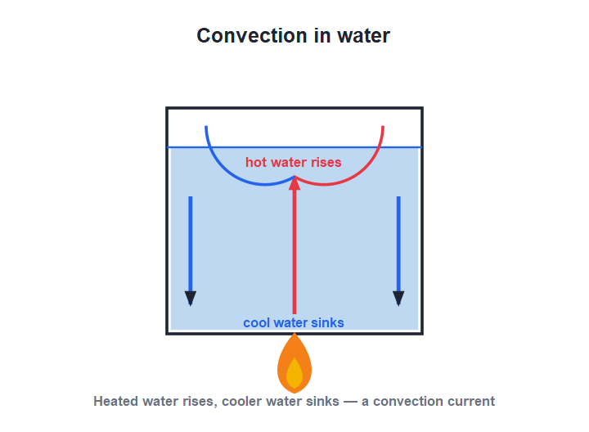
CONVECTION
Heat Through Fluids: Convection
The fluid carries the heat
• In a liquid or gas, the heated part expands, becomes lighter and rises.
• Cooler, denser fluid sinks to take its place and is heated in turn.
• This sets up a circulating convection current that carries heat through the fluid.
• Convection cannot happen in a solid, because the particles cannot move about.
Hot fluid rises; cool fluid sinks
Notes:
Trace the convection current in the beaker. The essential idea: the heated fluid itself moves, carrying heat with it — unlike conduction.

Slide 9


CONVECTION AROUND US
Everyday Convection
Sea breeze
Land breeze
By day, land heats faster than the sea, so cool air blows in from the sea.
By night, the sea stays warmer, so the breeze blows from land out to sea.
Room heating
Ventilators
Warm air from a heater rises and circulates, warming the whole room.
Hot, stale air rises and escapes through high windows and ventilators.
Notes:
Sea and land breezes are the classic convection examples — explain them with day/night heating of land vs sea. Ventilators placed high let hot air escape.

Slide 10
QUIZ 1
Quick Check — Conduction
4 questions • think before the answer reveals on the next slide

Slide 11
QUIZ QUESTION
Q1 - Modes
Heat travels through a solid metal mainly by:
Convection
Conduction
A
B
Radiation
Evaporation
C
D

Slide 12
QUIZ QUESTION
Q1 - Modes
Heat travels through a solid metal mainly by:
Convection
Conduction
A
B
✓
Radiation
Evaporation
C
D
Why In a solid, heat passes from particle to particle by conduction. The particles vibrate faster and pass energy along without leaving their places.

Slide 13
QUIZ QUESTION
Q2 - Insulators
Which of these is the best heat insulator?
Copper
Aluminium
A
B
Wood
Iron
C
D

Slide 14
QUIZ QUESTION
Q2 - Insulators
Which of these is the best heat insulator?
Copper
Aluminium
A
B
Wood
Iron
C
✓
D
Why Wood is a poor conductor (a good insulator) of heat, which is why pan handles are made of wood or plastic. The others are metals and conduct heat well.

Slide 15
QUIZ QUESTION
Q3 - Convection
Convection currents can be set up in:
Solids only
Liquids and gases
A
B
Vacuum only
Metals only
C
D

Slide 16
QUIZ QUESTION
Q3 - Convection
Convection currents can be set up in:
Solids only
Liquids and gases
A
B
✓
Vacuum only
Metals only
C
D
Why Convection needs particles that are free to move and carry heat with them, so it happens in fluids (liquids and gases), not in solids.

Slide 17
QUIZ QUESTION
Q4 - Sea breeze
A cool sea breeze blows toward the land during the:
Night
Day
A
B
Winter only
Rain
C
D

Slide 18
QUIZ QUESTION
Q4 - Sea breeze
A cool sea breeze blows toward the land during the:
Night
Day
A
B
✓
Winter only
Rain
C
D
Why By day the land heats faster than the sea. The warm air over the land rises and cooler air flows in from the sea — the sea breeze.

Slide 19
PART 2
Radiation & the Flask
2
Heat that needs no medium, and how to trap it

Slide 20
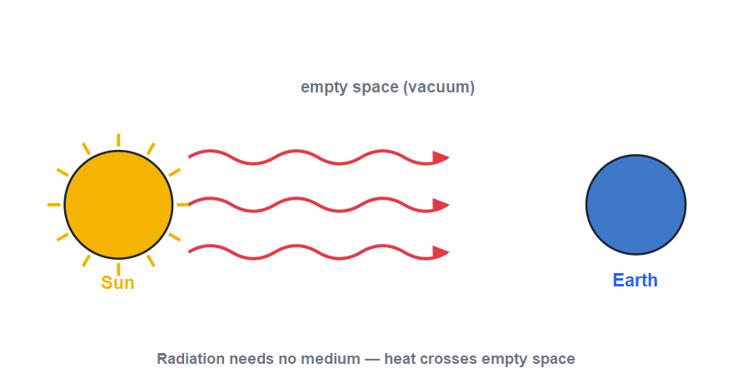
RADIATION
Heat as Waves: Radiation
No medium needed
• Radiation is the transfer of heat as waves, without any medium.
• This is how the Sun's heat reaches us across empty space.
• Radiation travels in straight lines at the speed of light and warms whatever absorbs it.
• We feel it instantly when we stand near a fire or in sunshine.
The Sun's heat crosses empty space by radiation
Notes:
Radiation is the odd one out — it needs no material. The Sun-to-Earth example is the clincher, since space is a vacuum. It travels at the speed of light.

Slide 21
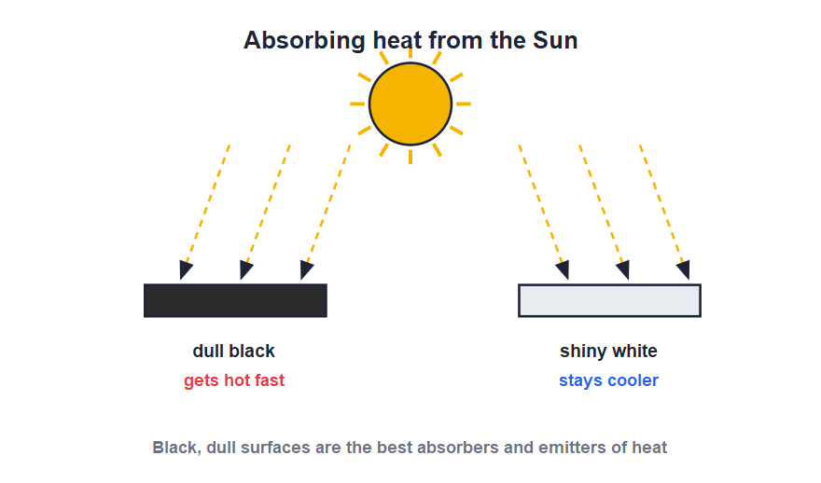
SURFACES
Black and White Surfaces
Colour matters
• Dull, black surfaces are the best absorbers of heat radiation.
• Shiny, white surfaces are poor absorbers; they reflect most radiation away.
• A good absorber is also a good emitter, so black surfaces also radiate heat fastest.
• This is why we wear light colours in summer and why radiators are often painted dull black.
Black absorbs and emits best; white least
Notes:
The rule: good absorbers are good emitters. Light summer clothes (reflect) and black radiators/cooking vessels (absorb and emit) bring it home.

Slide 22

RADIATION AROUND US
Radiation in Everyday Life
Solar water heater
Light summer clothes
A black absorbing panel soaks up the Sun's radiation to heat water.
Pale clothes reflect heat radiation and keep us cooler in the Sun.
Cooling fins & radiators
A parked car
Painted dull black to radiate away unwanted heat quickly.
Sunlight radiated in through the glass makes the inside very hot.
Notes:
Each example is the absorb/emit rule in action: black absorbs (solar heater) or emits (radiator) well, while pale, shiny surfaces reflect.

Slide 23
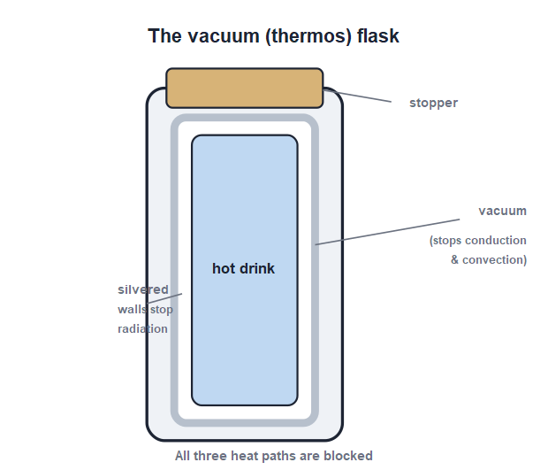
THE FLASK
The Vacuum (Thermos) Flask
Blocking all three
• A vacuum flask keeps a drink hot or cold by stopping all three kinds of heat transfer.
• The vacuum between its double walls stops conduction and convection.
• The silvered walls reflect radiation back, stopping heat loss by radiation.
• The stopper on top stops convection and conduction through the mouth.
Vacuum, silvering and a stopper cut every heat path
Notes:
The flask is the perfect summary of the chapter: each feature blocks one mode of heat transfer. Ask students to match each feature to the mode it stops.

Slide 24
APPLICATIONS
Using What We Know About Heat
Cooking vessels
Warm clothing
Made of metal (good conductors) with insulating handles that stay cool to hold.
Wool and layered clothes trap air, a poor conductor, to keep body heat in.
Room comfort
Land & sea breezes
Ventilators high on walls let hot air escape; light-coloured roofs stay cooler.
Convection of air between land and sea gives coastal places their daily winds.
Notes:
Pull the chapter together with applications. Each one chooses a conductor, an insulator, or a convection/radiation effect for a sensible reason.

Slide 25
WRAP UP
Quick Recap
✓ Three modes — conduction, convection and radiation
✓ Conduction — particle to particle through a solid; metals are best
✓ Convection — heated fluid rises, cool sinks — only in liquids/gases
✓ Radiation — heat as waves, needs no medium; Sun to Earth
✓ Surfaces — dull black absorbs and emits best; shiny white least
✓ Vacuum flask — vacuum, silvering and stopper block all three
Notes:
Rapid recap; cold-call for each. The flask is a great closing question — name the feature that blocks each mode.

Slide 26
QUIZ 2
Final Check — Radiation
4 questions • think before the answer reveals on the next slide

Slide 27
QUIZ QUESTION
Q1 - Radiation
The mode of heat transfer that needs no medium is:
Conduction
Convection
A
B
Radiation
All three
C
D

Slide 28
QUIZ QUESTION
Q1 - Radiation
The mode of heat transfer that needs no medium is:
Conduction
Convection
A
B
Radiation
All three
C
✓
D
Why Radiation transfers heat as waves and needs no material medium. That is how the Sun's heat reaches the Earth across empty space.

Slide 29
QUIZ QUESTION
Q2 - Surfaces
The best absorber of heat radiation is a surface that is:
Shiny and white
Dull and black
A
B
Smooth and silver
Polished and bright
C
D

Slide 30
QUIZ QUESTION
Q2 - Surfaces
The best absorber of heat radiation is a surface that is:
Shiny and white
Dull and black
A
B
✓
Smooth and silver
Polished and bright
C
D
Why Dull, black surfaces absorb radiation best (and also emit it best). Shiny, white surfaces reflect most radiation away.

Slide 31
QUIZ QUESTION
Q3 - The flask
The vacuum between the double walls of a thermos flask stops heat loss by:
Radiation only
Conduction and convection
A
B
Radiation and convection
None of these
C
D

Slide 32
QUIZ QUESTION
Q3 - The flask
The vacuum between the double walls of a thermos flask stops heat loss by:
Radiation only
Conduction and convection
A
B
✓
Radiation and convection
None of these
C
D
Why There are no particles in a vacuum to carry heat, so the vacuum stops both conduction and convection. The silvering deals with radiation.

Slide 33
QUIZ QUESTION
Q4 - Everyday
A cooking pan is made of metal but its handle of plastic because metal is a good:
Insulator
Conductor of heat
A
B
Reflector
Radiator
C
D

Slide 34
QUIZ QUESTION
Q4 - Everyday
A cooking pan is made of metal but its handle of plastic because metal is a good:
Insulator
Conductor of heat
A
B
✓
Reflector
Radiator
C
D
Why Metal conducts heat well, so it heats the food quickly. The plastic handle is an insulator and stays cool enough to hold.

Slide 35
Heat on the Move — Three Ways
Conduction, convection and radiation carry heat everywhere — and a vacuum flask shows real mastery by blocking all three at once.

