Slide 1
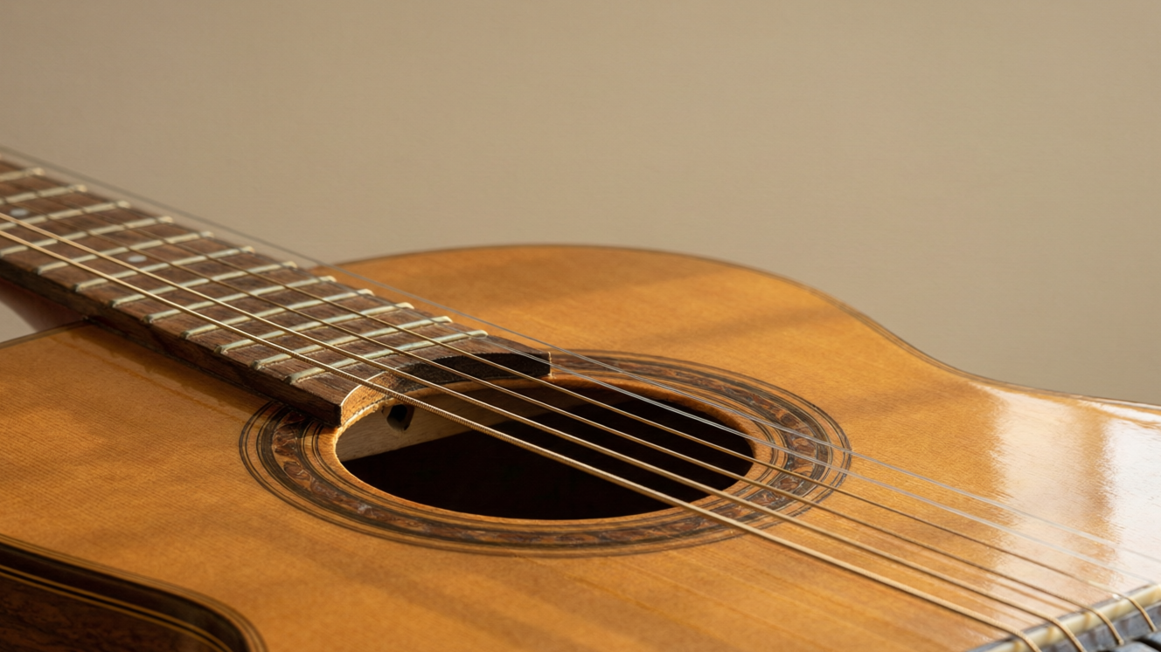
SOUND
How Sound Is Made
Sound from vibrations • Sources of sound • Sound needs a medium • Longitudinal waves

Slide 2
INTRODUCTION
Learning Objectives
1
Explain that sound is a form of energy produced by vibrations
2
Identify the vibrating part in everyday sources of sound
3
Show that sound needs a material medium to travel
4
Describe the bell-jar experiment and its conclusion
5
Explain how sound travels through air as a longitudinal wave
6
Compare how fast sound travels in solids, liquids and gases
Notes:
Open by previewing these objectives so students know what they should be able to do by the end of the session.

Slide 3
PART 1
Producing Sound
1
How vibrations make the sound we hear

Slide 4
SOUND
What Is Sound?
Sound is a form of energy that produces in us the sensation of hearing.
• Sound is always produced by a vibrating body — something moving rapidly to and fro.
• When the vibration stops, the sound stops too.
• Sound, like all energy, can do work — a loud sound can rattle a window.
• Our ears detect sound and the brain lets us hear it.
Notes:
Establish sound as energy linked to vibration. The simple test: touch a ringing bell or your throat while humming — feel the vibration, and it stops when the sound stops.

Slide 5
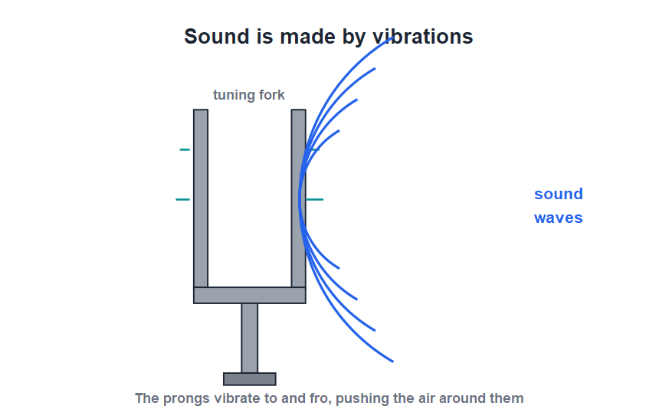
VIBRATIONS
Sound Comes From Vibrations
To and fro
• Strike a tuning fork and its prongs vibrate quickly to and fro.
• The vibrating prongs push and pull the air next to them.
• This sends out a sound wave that travels to our ears.
• Touch the vibrating fork to water and it splashes — proof that it is moving.
A vibrating tuning fork disturbs the air around it
Notes:
Use the tuning fork as the cleanest example: you can see and feel the vibration, and dipping it in water throws up a splash. The vibration is the source of the sound.

Slide 6
ENERGY
Sound Carries Energy
Because sound is a form of energy, it can travel outward from its source and make other things move.
• A very loud sound can rattle window panes and even crack glass.
• Standing near a large loudspeaker, you can feel the sound thump in your chest.
• The energy of sound spreads out in all directions from the source.
• The energy came originally from whatever set the source vibrating.
Notes:
Reinforce that sound is energy by its effects — rattling windows, the thump of a bass speaker. The energy spreads out, getting weaker with distance.

Slide 7


SOURCES
Sources of Sound
Stringed instruments
Wind instruments
A vibrating string makes the sound in a guitar, sitar or violin.
A vibrating column of air makes the sound in a flute or whistle.
Drums & membranes
Our voice
A stretched, vibrating skin makes the sound of a drum or tabla.
Vibrating vocal cords in the throat produce the human voice.
Notes:
For each source, name the part that actually vibrates — string, air column, membrane or vocal cords. Ask students to find the vibrating part of instruments they know.

Slide 8
FIND THE VIBRATION
Spotting the Vibrating Part
Vibration is always there
• Bell The metal body of the bell vibrates when struck.
• Loudspeaker Its paper cone vibrates in and out very fast.
• Insects A mosquito's buzz comes from its rapidly beating wings.
• Your throat Place a hand on your throat and hum — you feel the vocal cords vibrating.
Notes:
Drive home the universal rule: wherever there is sound, something is vibrating. The throat-humming check is a memorable, personal demonstration.

Slide 9
QUIZ 1
Quick Check — Making Sound
4 questions • think before the answer reveals on the next slide

Slide 10
QUIZ QUESTION
Q1 - Source
Sound is always produced by a body that is:
At rest
Vibrating
A
B
Hot
Charged
C
D

Slide 11
QUIZ QUESTION
Q1 - Source
Sound is always produced by a body that is:
At rest
Vibrating
A
B
✓
Hot
Charged
C
D
Why Every sound is produced by a vibrating body. When the vibration stops, the sound stops too.

Slide 12
QUIZ QUESTION
Q2 - Nature
Sound is a form of:
Matter
Energy
A
B
Force
Light
C
D

Slide 13
QUIZ QUESTION
Q2 - Nature
Sound is a form of:
Matter
Energy
A
B
✓
Force
Light
C
D
Why Sound is a form of energy that produces the sensation of hearing and can do work, such as rattling a window pane.

Slide 14
QUIZ QUESTION
Q3 - Instruments
In a flute, the sound is produced by the vibration of:
A string
A column of air
A
B
A membrane
A metal bar
C
D

Slide 15
QUIZ QUESTION
Q3 - Instruments
In a flute, the sound is produced by the vibration of:
A string
A column of air
A
B
✓
A membrane
A metal bar
C
D
Why In wind instruments like the flute, it is the column of air inside that vibrates to produce the sound.

Slide 16
QUIZ QUESTION
Q4 - Voice
The human voice is produced by the vibration of the:
Tongue
Teeth
A
B
Vocal cords
Lips
C
D

Slide 17
QUIZ QUESTION
Q4 - Voice
The human voice is produced by the vibration of the:
Tongue
Teeth
A
B
Vocal cords
Lips
C
✓
D
Why Air from the lungs makes the vocal cords in the throat vibrate, producing the human voice — you can feel it with a hand on your throat.

Slide 18
PART 2
How Sound Travels
2
Why sound needs a medium and how it moves through air

Slide 19
A MEDIUM
Sound Needs a Material Medium
Sound can travel only through a material medium — a solid, a liquid or a gas. It cannot travel through a vacuum.
• Sound needs particles of matter to pass the vibration along.
• In empty space (a vacuum) there are no particles, so sound cannot travel.
• Light, however, can travel through a vacuum — which is why we see the Sun but hear nothing from space.
• Astronauts in space must use radios because their voices cannot carry.
Notes:
Contrast sound with light: sound must have a medium, light need not. The 'no sound in space' fact and the astronaut radio example make the point vividly.

Slide 20
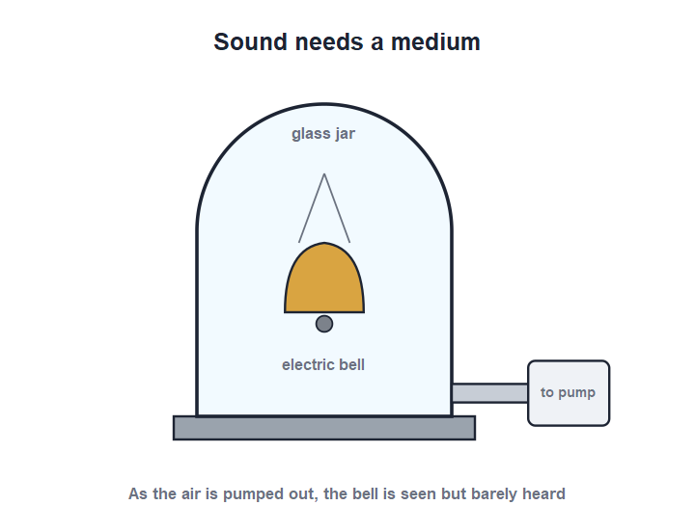
BELL-JAR
The Bell-Jar Experiment
Pump out the air
• An electric bell is hung inside a glass jar and switched on; we hear it ringing.
• Air is slowly pumped out of the jar.
• As the air thins, the sound grows fainter and fainter.
• When almost all the air is gone the bell is seen striking but is barely heard — proving sound needs a medium.
The bell is seen but not heard in a vacuum
Notes:
Walk through the experiment: the bell is visible (light needs no medium) but inaudible (sound does). This is the classic proof that sound requires matter to travel through.

Slide 21
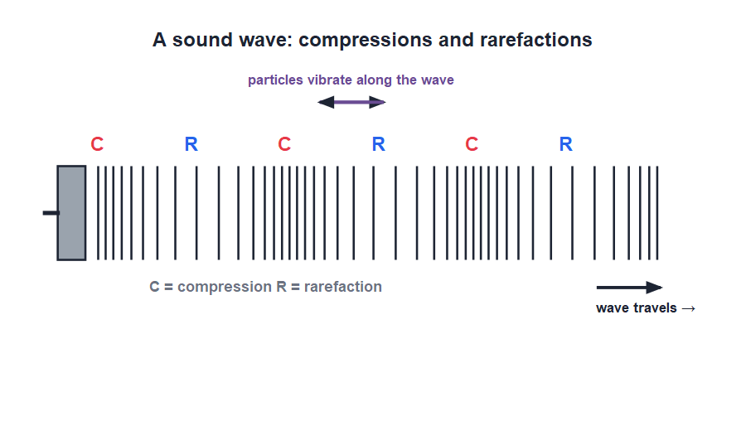
LONGITUDINAL
Sound as a Longitudinal Wave
Compressions & rarefactions
• A vibrating body pushes the air into regions where particles crowd together — compressions.
• In between, the particles spread apart — rarefactions.
• These compressions and rarefactions move outward, carrying the sound.
• The air particles vibrate back and forth along the same line the wave travels — a longitudinal wave.
Particles vibrate along the direction of travel
Notes:
Define compression and rarefaction, then the key idea: in a longitudinal wave the particles move along the same direction as the wave, unlike the up-and-down of a water (transverse) wave.

Slide 22



SPEED IN MEDIA
Sound Travels at Different Speeds
Fastest in solids
Slower in liquids
Particles are packed close, so they pass the vibration on quickly (steel ≈ 5000 m/s).
Particles are a little further apart (water ≈ 1500 m/s).
Slowest in gases
Rule
Particles are far apart, so sound is slowest in air (≈ 340 m/s).
The closer the particles, the faster sound travels: solids > liquids > gases.
Notes:
The order solids > liquids > gases follows from particle spacing. A nice example: putting your ear to a rail lets you hear a train through the steel before you hear it through the air.

Slide 23


THROUGH SOLIDS & LIQUIDS
Hearing Through Other Media
String telephone
Ear to the rail
Two cups joined by a taut string carry your voice as vibrations along the string.
Put an ear to a steel rail and you hear an approaching train sooner than through the air.
Underwater sound
Knock on a table
Whales and dolphins call to each other across huge distances through water.
A gentle tap heard with your ear on the table is louder than through the air.
Notes:
These everyday examples show sound travels — often better — through solids and liquids, because their particles are closer together than in air.

Slide 24
LIGHT VS SOUND
Sound Compared With Light
Two kinds of energy
• Needs a medium? Sound must have a medium; light can travel through empty space.
• Speed Light (3 × 10⁸ m/s) is about a million times faster than sound (≈ 340 m/s).
• Type of wave Sound is a longitudinal wave; light behaves as a transverse wave.
• Everyday clue We see lightning first and hear the thunder later, because light far outruns sound.
Notes:
A compare-and-contrast slide that ties the Sound chapter back to Light. The thunder-and-lightning gap is the memorable takeaway.

Slide 25
WRAP UP
Quick Recap
✓ Sound — a form of energy produced by a vibrating body
✓ Sources — string, air column, membrane or vocal cords vibrate
✓ Needs a medium — travels through solids, liquids, gases — not vacuum
✓ Bell jar — bell seen but not heard when the air is removed
✓ Longitudinal wave — compressions and rarefactions along the direction of travel
✓ Speed — fastest in solids, slowest in gases
Notes:
Rapid recap; cold-call for each. The two essentials: sound comes from vibration, and sound needs a medium.

Slide 26
QUIZ 2
Final Check — How Sound Travels
4 questions • think before the answer reveals on the next slide

Slide 27
QUIZ QUESTION
Q1 - Medium
Sound cannot travel through:
Air
Water
A
B
Steel
A vacuum
C
D

Slide 28
QUIZ QUESTION
Q1 - Medium
Sound cannot travel through:
Air
Water
A
B
Steel
A vacuum
C
D
✓
Why Sound needs particles of matter to pass on the vibration. A vacuum has no particles, so sound cannot travel through it.

Slide 29
QUIZ QUESTION
Q2 - Bell jar
In the bell-jar experiment, as air is pumped out the sound of the bell:
Grows louder
Stays the same
A
B
Grows fainter
Changes pitch
C
D

Slide 30
QUIZ QUESTION
Q2 - Bell jar
In the bell-jar experiment, as air is pumped out the sound of the bell:
Grows louder
Stays the same
A
B
Grows fainter
Changes pitch
C
✓
D
Why With fewer air particles to carry the sound, it grows fainter and almost disappears in a vacuum — though the bell is still seen striking.

Slide 31
QUIZ QUESTION
Q3 - Wave type
A sound wave in air is a:
Transverse wave
Longitudinal wave
A
B
Water wave
Light wave
C
D

Slide 32
QUIZ QUESTION
Q3 - Wave type
A sound wave in air is a:
Transverse wave
Longitudinal wave
A
B
✓
Water wave
Light wave
C
D
Why Sound travels as a longitudinal wave: the air particles vibrate back and forth along the same direction in which the wave travels, forming compressions and rarefactions.

Slide 33
QUIZ QUESTION
Q4 - Speed
Sound travels fastest in:
Air
Water
A
B
Steel
A vacuum
C
D

Slide 34
QUIZ QUESTION
Q4 - Speed
Sound travels fastest in:
Air
Water
A
B
Steel
A vacuum
C
✓
D
Why Sound travels fastest in solids because their particles are packed closely and pass the vibration on quickly. The order is solids > liquids > gases.

Slide 35
Good Vibrations
Sound is energy from a vibrating body, and it needs a medium — travelling as compressions and rarefactions, fastest where the particles are closest.

