Slide 1
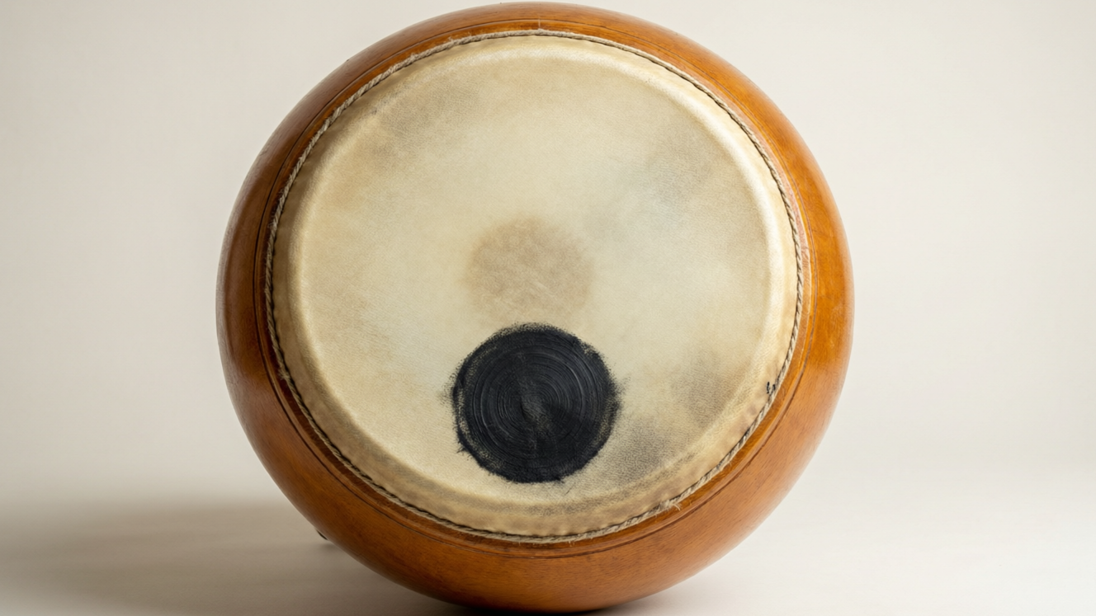
SOUND
Describing Sound
Wave terms • Audible range • Loudness, pitch & quality • Speed, echo and absorption

Slide 2
INTRODUCTION
Learning Objectives
1
Define wavelength, amplitude, frequency and time period
2
State the audible range and define ultrasonic and infrasonic sound
3
Relate loudness to amplitude and pitch to frequency
4
State the speed of sound and compare it with the speed of light
5
Explain the reflection of sound and how an echo forms
6
Describe absorption of sound and its everyday uses
Notes:
Open by previewing these objectives so students know what they should be able to do by the end of the session.

Slide 3
PART 1
Describing a Sound Wave
1
The words that measure a wave, and what we hear

Slide 4
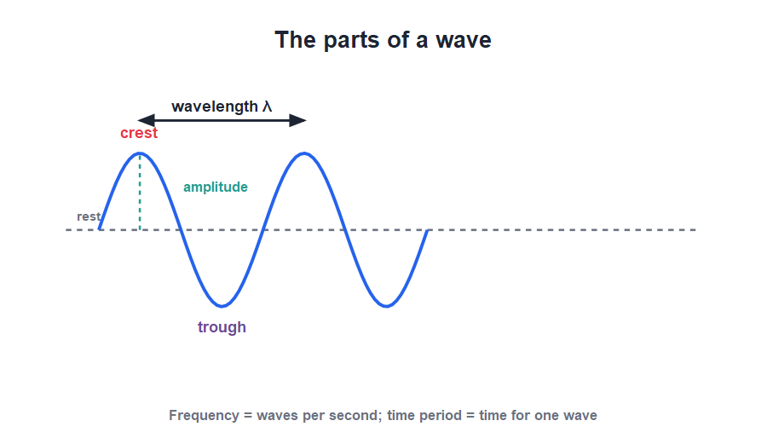
WAVE TERMS
The Language of Waves
Wavelength, amplitude, frequency
• A wave has crests (highest points) and troughs (lowest points).
• Wavelength is the distance between two successive compressions (or two crests).
• Amplitude is the maximum displacement of a particle from its rest position.
• Frequency is the number of waves produced per second, measured in hertz (Hz).
Crest, trough, amplitude and wavelength on a wave
Notes:
Define each term against the diagram. Use a graph of a wave to make the longitudinal sound wave easier to picture; the same words apply.

Slide 5
FREQUENCY & PERIOD
Frequency and Time Period
Frequency tells us how many vibrations happen each second; the time period is the time taken for one vibration.
frequency f = 1 / time period (T)
• Frequency is measured in hertz (Hz); 1 Hz means one vibration per second.
• The time period T is the time for one complete vibration, measured in seconds.
• Frequency and time period are reciprocals: a high frequency means a short period.
• A sound of 256 Hz means the source makes 256 vibrations every second.
Notes:
Establish f = 1/T with the 256 Hz example (middle C-ish on a tuning fork). High frequency ↔ short period is the idea to lock in.

Slide 6
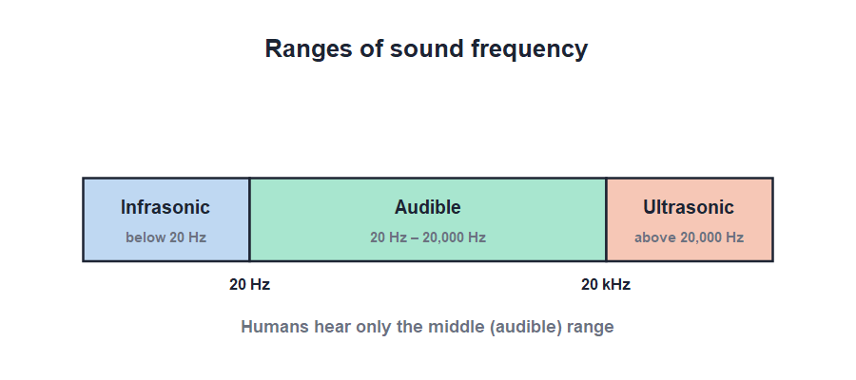
WHAT WE HEAR
Audible, Ultrasonic & Infrasonic
20 Hz to 20 kHz
• The human ear can hear sounds between about 20 Hz and 20,000 Hz — the audible range.
• Sounds below 20 Hz are infrasonic; we cannot hear them.
• Sounds above 20,000 Hz are ultrasonic; we cannot hear them either.
• Dogs, bats and dolphins can hear ultrasonic sounds that we cannot.
Humans hear only the middle, audible band
Notes:
Fix the audible range 20 Hz–20 kHz, then define infrasonic (below) and ultrasonic (above). Animals such as bats and dogs hear beyond our range — a favourite exam point.

Slide 7




CHARACTERISTICS
Loudness, Pitch and Quality
Loudness
Pitch
How loud or soft a sound is; it depends on the amplitude — bigger amplitude, louder sound.
How shrill or flat a sound is; it depends on the frequency — higher frequency, higher pitch.
Quality (timbre)
Examples
What lets us tell a flute from a violin playing the same note.
A drum is loud (large amplitude); a whistle is high-pitched (high frequency).
Notes:
Separate the two commonly confused ideas: loudness ↔ amplitude, pitch ↔ frequency. Quality (timbre) explains why instruments sound different on the same note.

Slide 8


MUSIC VS NOISE
Pleasant and Unpleasant Sounds
Musical sound
Noise
A pleasant sound made by regular, smooth vibrations — a flute or a sitar.
An unpleasant sound made by irregular, sudden vibrations — a slamming door or traffic.
The difference
Noise pollution
Music has a steady pattern of vibration; noise does not.
Too much loud, unwanted sound harms hearing and should be reduced.
Notes:
Distinguish musical sound (regular vibrations, pleasant) from noise (irregular, unpleasant). Touch on noise pollution as a real-world concern students will recognise.

Slide 9
QUIZ 1
Quick Check — Wave Terms
4 questions • think before the answer reveals on the next slide

Slide 10
QUIZ QUESTION
Q1 - Frequency
The number of vibrations made in one second is the:
Amplitude
Wavelength
A
B
Frequency
Time period
C
D

Slide 11
QUIZ QUESTION
Q1 - Frequency
The number of vibrations made in one second is the:
Amplitude
Wavelength
A
B
Frequency
Time period
C
✓
D
Why Frequency is the number of vibrations (or waves) per second, measured in hertz (Hz). It is the reciprocal of the time period.

Slide 12
QUIZ QUESTION
Q2 - Audible range
The audible range of the human ear is about:
2 Hz to 200 Hz
20 Hz to 20,000 Hz
A
B
200 Hz to 2000 Hz
20,000 Hz to 200,000 Hz
C
D

Slide 13
QUIZ QUESTION
Q2 - Audible range
The audible range of the human ear is about:
2 Hz to 200 Hz
20 Hz to 20,000 Hz
A
B
✓
200 Hz to 2000 Hz
20,000 Hz to 200,000 Hz
C
D
Why Humans can normally hear frequencies from about 20 Hz to 20,000 Hz. Below this is infrasonic and above it is ultrasonic.

Slide 14
QUIZ QUESTION
Q3 - Loudness
The loudness of a sound depends mainly on its:
Frequency
Amplitude
A
B
Speed
Wavelength
C
D

Slide 15
QUIZ QUESTION
Q3 - Loudness
The loudness of a sound depends mainly on its:
Frequency
Amplitude
A
B
✓
Speed
Wavelength
C
D
Why A larger amplitude means the source vibrates through a bigger distance, carrying more energy and producing a louder sound.

Slide 16
QUIZ QUESTION
Q4 - Pitch
A sound of higher frequency is heard as one of higher:
Loudness
Pitch
A
B
Speed
Quality
C
D

Slide 17
QUIZ QUESTION
Q4 - Pitch
A sound of higher frequency is heard as one of higher:
Loudness
Pitch
A
B
✓
Speed
Quality
C
D
Why Pitch depends on frequency: the higher the frequency, the higher (more shrill) the pitch of the sound.

Slide 18
PART 2
Speed, Echo & Absorption
2
How fast sound goes and what happens when it hits a surface

Slide 19
SPEED OF SOUND
The Speed of Sound
Sound travels much more slowly than light — about 340 metres per second in air at room temperature.
speed = distance / time (v = d / t)
• In air the speed of sound is roughly 330–340 m/s.
• It is far faster in water (≈ 1500 m/s) and in solids (steel ≈ 5000 m/s).
• Light is about a million times faster than sound.
• That is why we see a lightning flash before we hear the thunder.
Notes:
Anchor 340 m/s in air and the much higher speeds in water and steel. The lightning-before-thunder gap is the everyday proof that light far outruns sound.

Slide 20
WORKED EXAMPLE
How Far Is the Cliff?
Problem. A boy claps his hands and hears the echo from a cliff 1.5 s later. If the speed of sound is 340 m/s, how far away is the cliff?
The sound travels to the cliff and back, so it covers 2 × d.
Total distance = speed × time = 340 × 1.5 = 510 m
This is the to-and-fro distance, so 2 × d = 510 m
d = 510 / 2 = 255 m
Answer: The cliff is 255 m away
Notes:
Stress the to-and-fro point: the sound covers twice the distance to the cliff. Find the total path first, then halve it to get the distance to the cliff.

Slide 21
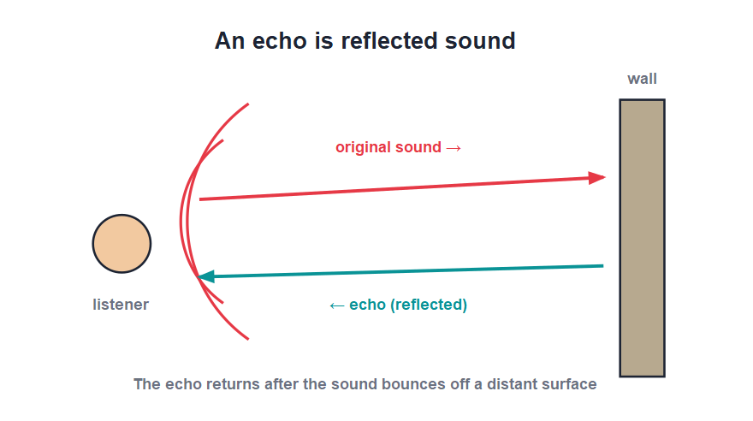
ECHO
Reflection of Sound and the Echo
Reflected sound
• Sound bounces back (reflects) when it strikes a hard, distant surface.
• A reflected sound heard separately from the original is called an echo.
• To hear a clear echo the reflecting surface must be far enough away (at least about 17 m).
• Echoes are used in ships' SONAR to measure the depth of the sea.
Sound returns from a distant wall as an echo
Notes:
Define an echo as a distinctly heard reflected sound, and give the minimum-distance condition (~17 m so the echo arrives at least 0.1 s after the original). SONAR is the standard application.

Slide 22
A CLEAR ECHO
When Do We Hear an Echo?
Conditions for an echo
• Far enough away The reflecting surface must be at least about 17 m away.
• Why 17 m The ear keeps a sound for about 0.1 s, so the echo must arrive at least that much later.
• Hard surface A hard, smooth surface like a cliff or wall reflects sound well; soft surfaces absorb it.
• Loud enough The original sound must be loud enough for the reflected sound to still be heard.
Notes:
Spell out the conditions: minimum ~17 m (from the 0.1 s persistence of hearing) and a hard reflecting surface. This is a common short-answer question.

Slide 23



ULTRASOUND AT WORK
Uses of Reflected Sound
SONAR
Medical scans
Ships send sound pulses to the seabed and time the echo to measure the sea's depth.
Ultrasound echoes build images of a baby or organs inside the body.
Cleaning
Megaphone
Ultrasonic vibrations shake dirt off delicate parts and jewellery.
A cone reflects sound forward into a narrow beam so it carries further.
Notes:
Show how reflection and ultrasound are put to work — SONAR, medical scanning, cleaning and the megaphone. Each relies on sending and reflecting sound.

Slide 24


REFLECTION & ABSORPTION
Bouncing and Soaking Up Sound
Echo
Reverberation
A single reflected sound heard after the original, as from a cliff or empty hall.
Many quick reflections in a room make the sound drag on; soft surfaces reduce it.
Absorption
Soundproofing
Soft, porous materials like curtains and carpets soak up sound instead of reflecting it.
Cinemas and studios use soft panels to absorb sound and stop echoes.
Notes:
Contrast hard surfaces (reflect → echo, reverberation) with soft, porous ones (absorb). This is why a bare hall echoes but a curtained cinema does not.

Slide 25
WRAP UP
Quick Recap
✓ Wave terms — wavelength, amplitude, frequency (Hz), time period
✓ f and T — f = 1/T; high frequency means short period
✓ Audible range — 20 Hz–20 kHz; below = infrasonic, above = ultrasonic
✓ Loudness & pitch — loudness ↔ amplitude; pitch ↔ frequency
✓ Speed — ≈ 340 m/s in air; far faster in water and solids
✓ Echo — reflected sound; needs a far, hard surface; used in SONAR
Notes:
Rapid recap; cold-call for each. The two pairs to nail: loudness/amplitude and pitch/frequency.

Slide 26
QUIZ 2
Final Check — Speed & Echo
4 questions • think before the answer reveals on the next slide

Slide 27
QUIZ QUESTION
Q1 - Speed
The speed of sound in air at room temperature is about:
34 m/s
340 m/s
A
B
3400 m/s
3 × 10⁸ m/s
C
D

Slide 28
QUIZ QUESTION
Q1 - Speed
The speed of sound in air at room temperature is about:
34 m/s
340 m/s
A
B
✓
3400 m/s
3 × 10⁸ m/s
C
D
Why Sound travels at roughly 340 m/s in air — far slower than light (3 × 10⁸ m/s), which is why we see lightning before we hear thunder.

Slide 29
QUIZ QUESTION
Q2 - Echo
A reflected sound heard separately from the original sound is called:
A vibration
An echo
A
B
A frequency
An overtone
C
D

Slide 30
QUIZ QUESTION
Q2 - Echo
A reflected sound heard separately from the original sound is called:
A vibration
An echo
A
B
✓
A frequency
An overtone
C
D
Why An echo is sound reflected from a distant hard surface and heard clearly after the original sound.

Slide 31
QUIZ QUESTION
Q3 - Echo distance
A boy hears the echo of his clap from a wall after 2 s. If sound travels at 340 m/s, the wall is:
170 m away
340 m away
A
B
680 m away
1360 m away
C
D

Slide 32
QUIZ QUESTION
Q3 - Echo distance
A boy hears the echo of his clap from a wall after 2 s. If sound travels at 340 m/s, the wall is:
170 m away
340 m away
A
B
✓
680 m away
1360 m away
C
D
Why Total distance = 340 × 2 = 680 m. This is to the wall and back, so the wall is 680 / 2 = 340 m away.

Slide 33
QUIZ QUESTION
Q4 - Absorption
Curtains and carpets are used in halls to:
Reflect sound
Absorb sound
A
B
Speed up sound
Increase echoes
C
D

Slide 34
QUIZ QUESTION
Q4 - Absorption
Curtains and carpets are used in halls to:
Reflect sound
Absorb sound
A
B
✓
Speed up sound
Increase echoes
C
D
Why Soft, porous materials such as curtains and carpets absorb sound, reducing echoes and reverberation in a room.

Slide 35
Sound, Measured
Frequency sets the pitch and amplitude the loudness; sound travels at about 340 m/s and returns from far surfaces as an echo.

