Slide 1
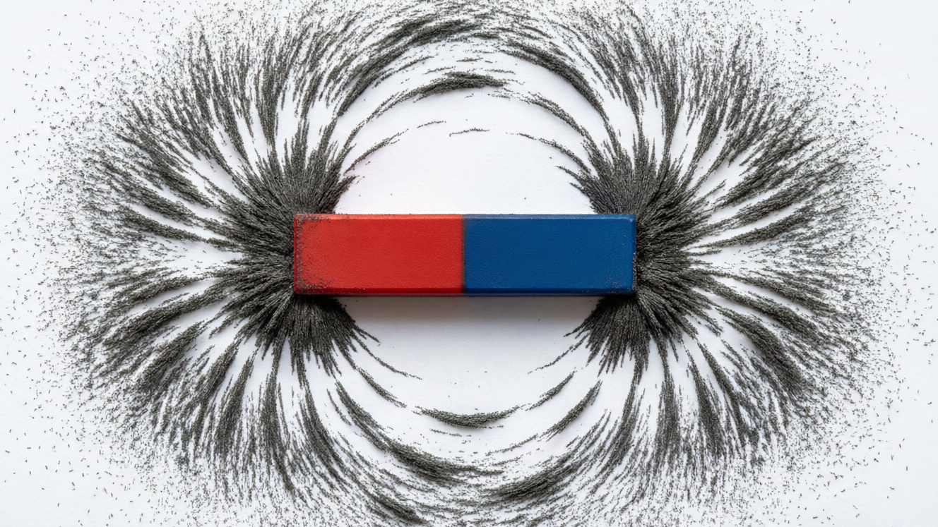
MAGNETISM
Magnets & Electromagnets
The law of magnetism • Magnetic fields • Making an electromagnet • Its uses

Slide 2
INTRODUCTION
Learning Objectives
1
State the law of magnetism for like and unlike poles
2
Explain why repulsion is the only sure test of a magnet
3
Describe the magnetic field and its lines of force
4
Explain how an electric current can produce magnetism
5
Describe how to make an electromagnet and increase its strength
6
List important uses of electromagnets
Notes:
Open by previewing these objectives so students know what they should be able to do by the end of the session.

Slide 3
PART 1
Magnets & Their Field
1
Poles, the law of magnetism and lines of force

Slide 4
MAGNETS
Magnets and Their Poles
A magnet is a body that attracts magnetic materials like iron and points north–south when freely suspended.
• Every magnet has two poles: a north (N) pole and a south (S) pole.
• The poles are where the magnetism is strongest.
• A freely hanging magnet always comes to rest pointing north–south.
• The two poles always occur together — you cannot have a single pole on its own.
Notes:
Recall the idea of a magnet from earlier grades. The two key facts: a magnet has two poles, and freely suspended it points north–south, which is why it is called a 'magnet' (and how a compass works).

Slide 5




MAGNETIC MATERIALS
What a Magnet Attracts
Magnetic materials
Non-magnetic materials
Iron, steel, nickel and cobalt are attracted by a magnet.
Wood, plastic, copper, glass and paper are not attracted.
Test it
Use it
Pass a magnet over a mixture and only the magnetic pieces jump to it.
This is how scrap iron is separated from rubbish with a magnet.
Notes:
Sort materials into magnetic (iron, steel, nickel, cobalt) and non-magnetic. The separation of iron from a mixture is a neat demonstration and links to scrap recycling.

Slide 6
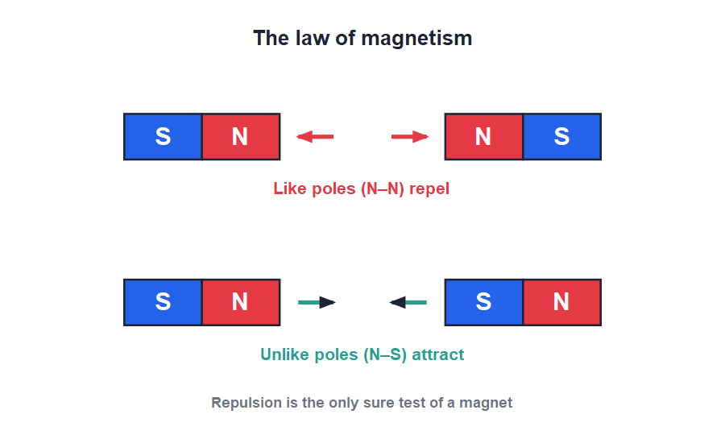
LAW OF MAGNETISM
Like Repel, Unlike Attract
Like repel, unlike attract
• Bring two north poles close and they push apart — they repel.
• Bring a north pole near a south pole and they pull together — they attract.
• So: like poles repel, and unlike poles attract.
• This is the law of magnetism, the basic rule for how magnets behave.
N–N and S–S repel; N–S attract
Notes:
State the law clearly and show it with two bar magnets. Like poles repel, unlike poles attract — the single most important rule of the chapter.

Slide 7
THE SURE TEST
Repulsion Is the Sure Test
Repulsion — not attraction — is the only sure test of whether a bar is a magnet.
• A magnet attracts both another magnet and an unmagnetised iron bar.
• So attraction alone cannot prove the other bar is a magnet.
• Only another magnet can be repelled.
• If a bar repels a known magnet, it must itself be a magnet.
Notes:
This is a classic exam point. Attraction is ambiguous (iron is also attracted), but repulsion happens only between two magnets — so repulsion is the sure test.

Slide 8
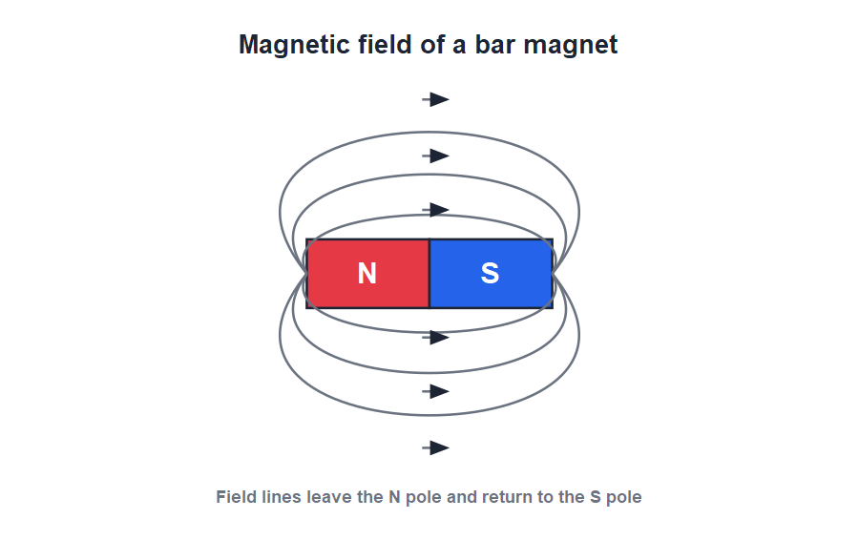
MAGNETIC FIELD
The Magnetic Field
Lines of force
• The space around a magnet where its force can be felt is its magnetic field.
• We picture the field using magnetic lines of force.
• Outside the magnet, these lines run from the north pole to the south pole.
• The lines are closest together near the poles, where the field is strongest.
Field lines run from N to S outside the magnet
Notes:
Define the magnetic field and lines of force. Iron filings sprinkled around a magnet line up along these lines — a demonstration worth describing.

Slide 9

FIELD LINES
Properties of Magnetic Field Lines
Direction
Never cross
Outside the magnet they run from the north pole to the south pole.
Two field lines never cross each other.
Crowding
Closed loops
They are crowded near the poles, where the field is strongest.
Each line forms a closed loop, passing through the magnet from S to N inside.
Notes:
List the properties of field lines. The 'never cross' and 'crowded at the poles' points are commonly tested. Iron filings reveal the pattern beautifully.

Slide 10
QUIZ 1
Quick Check — Magnets & Fields
4 questions • think before the answer reveals on the next slide

Slide 11
QUIZ QUESTION
Q1 - Law of magnetism
When two north poles are brought close together, they:
Attract
Repel
A
B
Do nothing
Join into one
C
D

Slide 12
QUIZ QUESTION
Q1 - Law of magnetism
When two north poles are brought close together, they:
Attract
Repel
A
B
✓
Do nothing
Join into one
C
D
Why Like poles repel. Two north poles (or two south poles) push each other apart, while unlike poles attract.

Slide 13
QUIZ QUESTION
Q2 - Sure test
The only sure test of whether a bar is a magnet is that it shows:
Attraction
Repulsion
A
B
Rusting
Heating
C
D

Slide 14
QUIZ QUESTION
Q2 - Sure test
The only sure test of whether a bar is a magnet is that it shows:
Attraction
Repulsion
A
B
✓
Rusting
Heating
C
D
Why A magnet attracts both magnets and unmagnetised iron, so attraction is not proof. Only two magnets repel, so repulsion is the sure test.

Slide 15
QUIZ QUESTION
Q3 - Field lines
Outside a bar magnet, the magnetic field lines run from:
South to north pole
North to south pole
A
B
Pole to pole inside only
Nowhere
C
D

Slide 16
QUIZ QUESTION
Q3 - Field lines
Outside a bar magnet, the magnetic field lines run from:
South to north pole
North to south pole
A
B
✓
Pole to pole inside only
Nowhere
C
D
Why Outside the magnet, field lines are taken to run from the north pole to the south pole; inside, they run from S to N to form closed loops.

Slide 17
QUIZ QUESTION
Q4 - Poles
How many poles does a single bar magnet have?
One
Two
A
B
Three
Four
C
D

Slide 18
QUIZ QUESTION
Q4 - Poles
How many poles does a single bar magnet have?
One
Two
A
B
✓
Three
Four
C
D
Why Every magnet has two poles, a north and a south. They always occur in pairs — a single isolated pole does not exist.

Slide 19
PART 2
Electromagnets
2
Magnetism made from an electric current

Slide 20
ELECTROMAGNET
Magnetism From Electricity
An electric current flowing through a coil of wire produces a magnetic field; with a soft-iron core this makes an electromagnet.
• A current-carrying wire behaves like a magnet around it.
• Winding the wire into a coil (solenoid) makes the field much stronger.
• Placing a soft-iron core inside the coil makes a powerful electromagnet.
• Switch the current off and the magnetism almost completely disappears.
Notes:
Introduce the link between electricity and magnetism: a current makes a magnetic field. A coil concentrates it, and an iron core boosts it — that is an electromagnet.

Slide 21
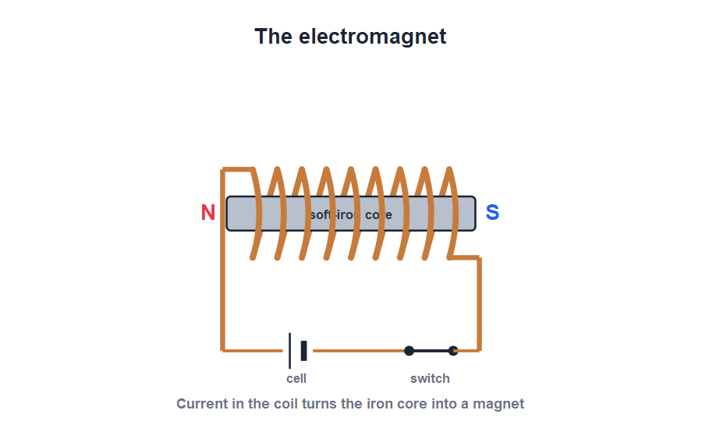
MAKING ONE
Making an Electromagnet
Coil + core + cell
• Wind insulated copper wire into many turns around a soft-iron nail or rod.
• Connect the ends of the coil to a cell through a switch.
• When the switch is closed, the iron becomes a strong magnet and picks up pins.
• Open the switch and the iron loses almost all its magnetism.
Current in the coil magnetises the iron core
Notes:
Walk through building one: coil, soft-iron core, cell, switch. The fact that it switches on and off is its great advantage over a permanent magnet.

Slide 22


STRENGTH
Making an Electromagnet Stronger
More turns
More current
Increasing the number of turns in the coil makes the electromagnet stronger.
Using a larger current through the coil increases the strength.
Soft-iron core
Shorter, thicker
A soft-iron core greatly increases the strength and loses magnetism when switched off.
A short, thick coil gives a stronger field than a long, thin one.
Notes:
Three controllable factors: number of turns, size of current, and the soft-iron core. These are standard short-answer points.

Slide 23

USES
Uses of Electromagnets
Lifting cranes
Electric bell
Powerful electromagnets lift heavy iron scrap and drop it by switching off.
An electromagnet repeatedly pulls an iron armature to strike the gong.
Separating iron
Relays & devices
Electromagnets pull iron pieces out of mixed scrap and rubbish.
They switch circuits in relays, and work in motors, loudspeakers and maglev trains.
Notes:
Connect each use to the switch-on/switch-off advantage. The scrap-yard crane is the clearest example of why an electromagnet beats a permanent magnet.

Slide 24
TWO KINDS OF MAGNET
Electromagnet vs Permanent Magnet
Compare and choose
• Switchable An electromagnet can be turned on and off; a permanent magnet is always magnetic.
• Strength An electromagnet's strength can be changed; a permanent magnet's cannot.
• Needs power An electromagnet works only while current flows; a permanent magnet needs none.
• Reversible poles Reversing the current swaps an electromagnet's poles; a permanent magnet's poles are fixed.
Notes:
Draw out the trade-offs: the electromagnet is controllable but needs power; the permanent magnet is simple but fixed. The right choice depends on the job.

Slide 25
WRAP UP
Quick Recap
✓ Poles — every magnet has N and S poles; points north–south
✓ Law of magnetism — like poles repel, unlike poles attract
✓ Sure test — repulsion is the only sure test of a magnet
✓ Magnetic field — space around a magnet; lines run N to S outside
✓ Electromagnet — coil + current + soft-iron core
✓ Strength & uses — more turns/current/iron; cranes, bells, relays
Notes:
Rapid recap; cold-call for each. The sure test and the recipe for a strong electromagnet are the must-know points.

Slide 26
QUIZ 2
Final Check — Electromagnets
4 questions • think before the answer reveals on the next slide

Slide 27
QUIZ QUESTION
Q1 - Source
An electromagnet produces magnetism from:
A permanent magnet
An electric current
A
B
Heat
Sunlight
C
D

Slide 28
QUIZ QUESTION
Q1 - Source
An electromagnet produces magnetism from:
A permanent magnet
An electric current
A
B
✓
Heat
Sunlight
C
D
Why An electromagnet works only while a current flows through its coil. The current's magnetic field magnetises the soft-iron core.

Slide 29
QUIZ QUESTION
Q2 - Core
The core of a strong electromagnet is made of:
Steel
Soft iron
A
B
Copper
Plastic
C
D

Slide 30
QUIZ QUESTION
Q2 - Core
The core of a strong electromagnet is made of:
Steel
Soft iron
A
B
✓
Copper
Plastic
C
D
Why Soft iron is used because it becomes strongly magnetic when the current flows and loses almost all its magnetism when the current is switched off.

Slide 31
QUIZ QUESTION
Q3 - Strength
The strength of an electromagnet can be increased by:
Fewer turns
A smaller current
A
B
More turns in the coil
Removing the core
C
D

Slide 32
QUIZ QUESTION
Q3 - Strength
The strength of an electromagnet can be increased by:
Fewer turns
A smaller current
A
B
More turns in the coil
Removing the core
C
✓
D
Why More turns, a larger current and a soft-iron core all make an electromagnet stronger. Fewer turns or a smaller current weaken it.

Slide 33
QUIZ QUESTION
Q4 - Uses
Electromagnets are preferred over permanent magnets in cranes because they:
Are cheaper
Can be switched on and off
A
B
Never lose strength
Are lighter
C
D

Slide 34
QUIZ QUESTION
Q4 - Uses
Electromagnets are preferred over permanent magnets in cranes because they:
Are cheaper
Can be switched on and off
A
B
✓
Never lose strength
Are lighter
C
D
Why An electromagnet can be switched on to grip iron scrap and switched off to release it — something a permanent magnet cannot do.

Slide 35
Magnets, Made to Order
Magnets obey one rule — like repel, unlike attract — and a current-carrying coil lets us switch magnetism on and off at will.

