Slide 1
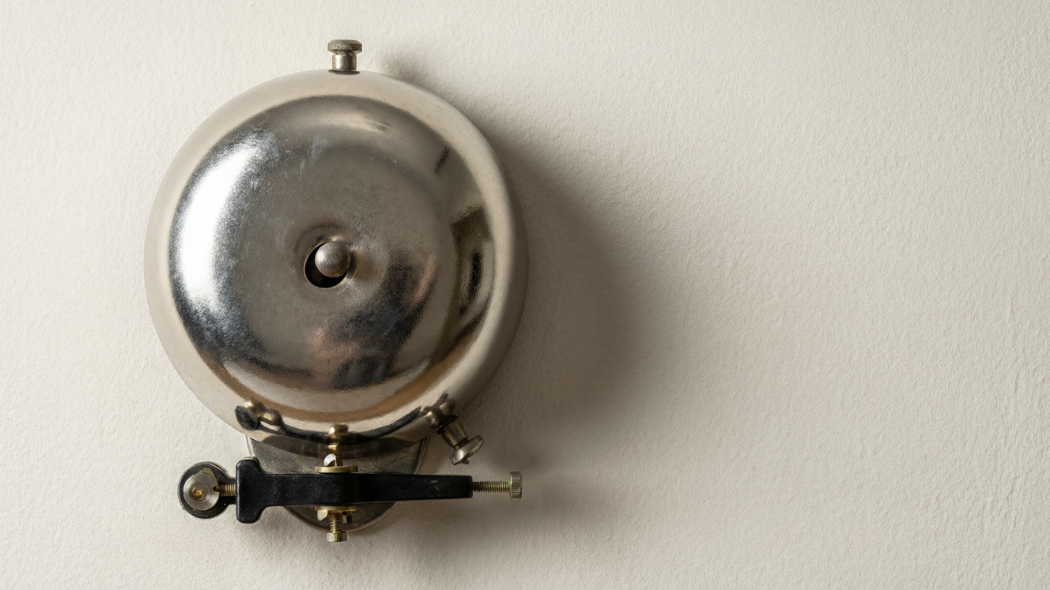
ELECTRICITY
Electricity in Use
The electric bell • Earth's magnetism • Sources of electricity • Cells and circuits

Slide 2
INTRODUCTION
Learning Objectives
1
Explain how an electric bell works
2
Describe Earth's magnetism and magnetic declination
3
Name the main sources and uses of electricity
4
Explain how dry cells are connected in a torch
5
Describe the flow of current in a simple circuit
6
Distinguish electrical conductors from insulators
Notes:
Open by previewing these objectives so students know what they should be able to do by the end of the session.

Slide 3
PART 1
The Bell & the Earth
1
An electromagnet at work and the Earth as a magnet

Slide 4
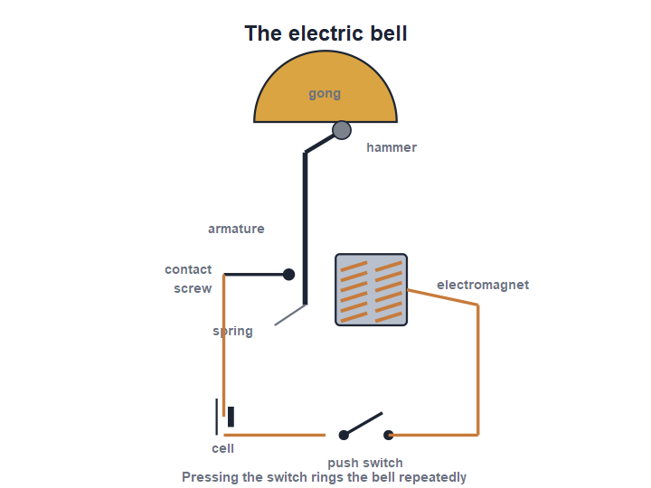
ELECTRIC BELL
How an Electric Bell Works
Make and break
• Pressing the switch completes the circuit, so current flows through the electromagnet.
• The electromagnet pulls the soft-iron armature, and the hammer strikes the gong.
• Moving across breaks the contact, the current stops and the spring pulls the armature back.
• Contact is made again, so the hammer strikes repeatedly and the bell rings.
The armature vibrates, striking the gong again and again
Notes:
Trace the make-and-break cycle: current → magnet pulls armature → contact breaks → spring returns it → contact remakes. This rapid cycle makes the continuous ringing.

Slide 5
EARTH'S MAGNETISM
The Earth Is a Magnet
The Earth behaves as if it has a huge bar magnet inside it, which is why a compass needle points north–south.
• A freely suspended magnet (a compass) sets itself along the Earth's field.
• The Earth's magnetic poles are close to, but not exactly at, its geographic poles.
• This lets travellers and sailors find direction with a compass.
• The compass has guided explorers for hundreds of years.
Notes:
Introduce the Earth as a giant magnet. The compass works because the needle aligns with the Earth's field. Lead into the small offset between magnetic and geographic north.

Slide 6
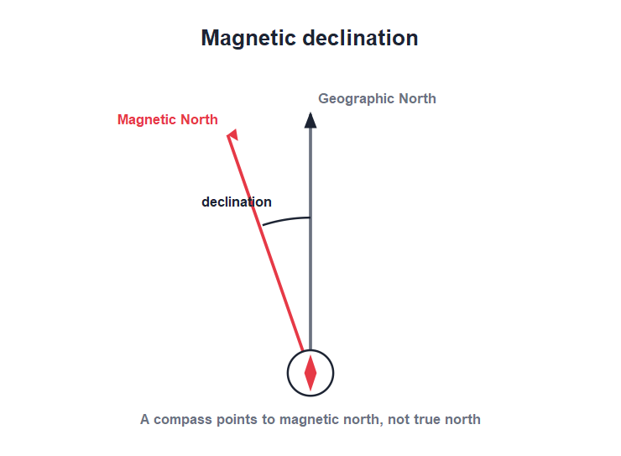
DECLINATION
Magnetic Declination
True vs magnetic north
• A compass points to the magnetic north, not the true (geographic) north.
• The angle between the magnetic north and the geographic north is the magnetic declination.
• Its value is small and differs from place to place on the Earth.
• Sailors and pilots must allow for declination to steer an accurate course.
Declination is the angle between the two norths
Notes:
Define declination as the angle between magnetic and geographic north. It is small but matters for accurate navigation, so maps note the local declination.

Slide 7




MAGNETS AT WORK
Where Magnets Help Us
Compass
Fridge & catches
A tiny pivoted magnet that always points north–south for finding direction.
Small magnets hold doors shut and stick notes to the fridge.
Recording & cards
Motors & speakers
Magnetic strips store information on cards and tapes.
Magnets are vital parts of electric motors and loudspeakers.
Notes:
A quick tour of everyday magnet uses to broaden the picture before moving on to electricity. The compass links back to Earth's magnetism.

Slide 8
THE COMPASS
More About the Compass
Finding the way
• What it is A small magnetised needle balanced on a pivot so it can turn freely.
• How it works The needle lines up with the Earth's magnetic field, pointing north–south.
• Marking north The north-seeking end is usually coloured or marked to show direction.
• Keep it away Keep iron and other magnets away from a compass, or it will give a wrong reading.
Notes:
Explain the compass as a tiny pivoted magnet aligning with the Earth's field. Warn that nearby iron or magnets disturb it — a practical point for using one.

Slide 9
QUIZ 1
Quick Check — Bell & Compass
4 questions • think before the answer reveals on the next slide

Slide 10
QUIZ QUESTION
Q1 - Electric bell
The electric bell rings continuously because the armature:
Stays still
Vibrates back and forth
A
B
Melts
Heats up
C
D

Slide 11
QUIZ QUESTION
Q1 - Electric bell
The electric bell rings continuously because the armature:
Stays still
Vibrates back and forth
A
B
✓
Melts
Heats up
C
D
Why The make-and-break of the contact makes the armature vibrate rapidly, so the hammer strikes the gong again and again.

Slide 12
QUIZ QUESTION
Q2 - Bell part
The part of an electric bell that becomes magnetic when current flows is the:
Gong
Hammer
A
B
Electromagnet
Spring
C
D

Slide 13
QUIZ QUESTION
Q2 - Bell part
The part of an electric bell that becomes magnetic when current flows is the:
Gong
Hammer
A
B
Electromagnet
Spring
C
✓
D
Why When current flows, the electromagnet becomes magnetic and pulls the soft-iron armature toward it, swinging the hammer to the gong.

Slide 14
QUIZ QUESTION
Q3 - Compass
A compass needle comes to rest pointing roughly:
East–west
North–south
A
B
Up–down
In a circle
C
D

Slide 15
QUIZ QUESTION
Q3 - Compass
A compass needle comes to rest pointing roughly:
East–west
North–south
A
B
✓
Up–down
In a circle
C
D
Why A compass is a small freely pivoted magnet. It aligns with the Earth's magnetic field and so points north–south.

Slide 16
QUIZ QUESTION
Q4 - Declination
The angle between the geographic north and the magnetic north is called:
The latitude
The magnetic declination
A
B
The longitude
The dip
C
D

Slide 17
QUIZ QUESTION
Q4 - Declination
The angle between the geographic north and the magnetic north is called:
The latitude
The magnetic declination
A
B
✓
The longitude
The dip
C
D
Why Magnetic declination is the angle between the direction a compass points (magnetic north) and true geographic north.

Slide 18
PART 2
Electricity & Circuits
2
Where electricity comes from and how it flows

Slide 19



SOURCES
Sources of Electricity
Cells & batteries
Generators
Chemical cells, like the dry cell in a torch, give a steady small supply.
Power stations spin huge generators to make the mains electricity we use at home.
Solar cells
Mains supply
Solar panels turn sunlight directly into electricity.
Electricity reaches homes through wires from the power station.
Notes:
Sort sources into chemical cells, generators (mains) and solar. The dry cell is the portable source; the mains is generated far away and carried by wires.

Slide 20




USES
Uses of Electricity
Light
Heat
Bulbs and tube lights turn electrical energy into light.
Irons, geysers and heaters turn electricity into heat.
Motion
Sound & screens
Fans, mixers and pumps use electric motors to make things move.
Radios, televisions and phones run on electricity.
Notes:
Show the variety of energy changes electricity makes possible — light, heat, motion and sound. Ask students to name an appliance for each.

Slide 21
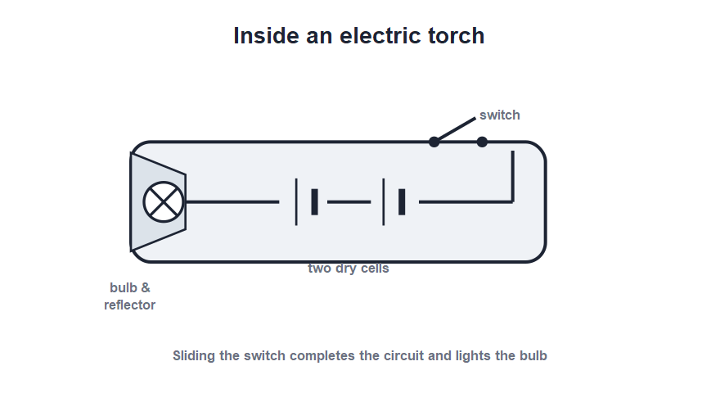
DRY CELLS
Dry Cells in a Torch
Cells in series
• A torch is powered by one or more dry cells.
• The cells are joined in a line, the (+) of one touching the (−) of the next — this is a series connection.
• Connecting cells in series gives a larger total voltage to light the bulb brightly.
• Sliding the switch completes the circuit and the bulb lights.
Two dry cells in series power the torch bulb
Notes:
Show how the cells stack in series (+ to −) to add their voltages. The torch is a complete everyday circuit: cells, switch, bulb and connecting strips.

Slide 22
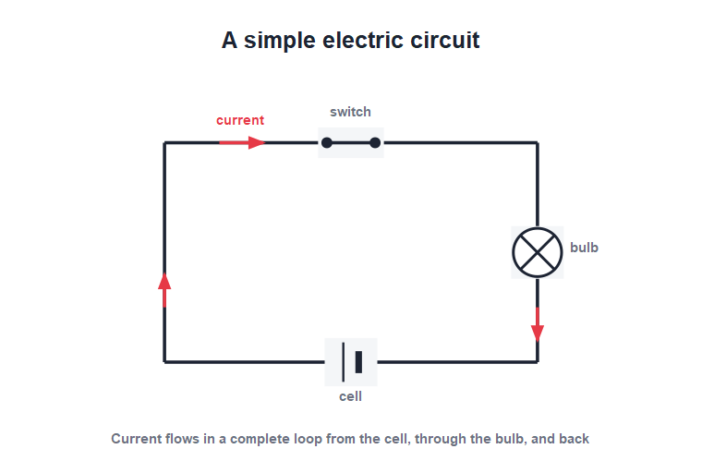
THE CIRCUIT
Flow of Current in a Circuit
A complete loop
• An electric current is a flow of charge around a complete (closed) circuit.
• The cell pushes the current through the connecting wires, switch and bulb.
• If there is any break in the circuit, the current stops and the bulb goes out.
• The conventional current is taken to flow from the (+) terminal of the cell, round to the (−).
Current flows only in a complete circuit
Notes:
Stress that the circuit must be complete for current to flow — a single break (an open switch) stops everything. Introduce the conventional direction (+ to −).

Slide 23


CONDUCTORS & INSULATORS
Conductors and Insulators of Electricity
Conductors
Insulators
Let current pass easily — metals such as copper, aluminium and iron.
Hardly let current pass — rubber, plastic, glass, dry wood and air.
In the home
Why it matters
Wires are copper (a conductor) coated in plastic (an insulator) for safety.
Insulators on plugs and tools protect us from electric shock.
Notes:
Sort materials into conductors and insulators of electricity. The copper-wire-in-plastic-sheath example shows both used together — one to carry current, one to protect us.

Slide 24
USE IT WISELY
Using Electricity Wisely
Save energy, save money
• Switch off Turn off lights and fans when leaving a room to save electricity.
• Efficient devices Use LED bulbs and efficient appliances that do the same job with less energy.
• Don't waste Electricity from the mains costs money and uses up fuel at the power station.
• Use daylight Make the most of sunlight during the day instead of switching on lights.
Notes:
End Part 2 with the responsible-use message: saving electricity saves money and the fuel burned to generate it. Simple habits make a real difference.

Slide 25
WRAP UP
Quick Recap
✓ Electric bell — an electromagnet makes the armature vibrate and ring
✓ Earth's magnetism — the Earth acts as a magnet; a compass points N–S
✓ Declination — angle between magnetic north and true north
✓ Sources — cells, generators (mains) and solar cells
✓ Circuit — current flows only in a complete loop, + to −
✓ Conductors/insulators — metals carry current; plastic and rubber do not
Notes:
Rapid recap; cold-call for each. The complete-circuit idea and the conductor/insulator pairing are key for the next lesson.

Slide 26
QUIZ 2
Final Check — Sources & Circuits
4 questions • think before the answer reveals on the next slide

Slide 27
QUIZ QUESTION
Q1 - Sources
Which of these is a portable chemical source of electricity?
A generator
A dry cell
A
B
A solar panel
The mains
C
D

Slide 28
QUIZ QUESTION
Q1 - Sources
Which of these is a portable chemical source of electricity?
A generator
A dry cell
A
B
✓
A solar panel
The mains
C
D
Why A dry cell is a chemical source of electricity that is small and portable, used in torches, clocks and remote controls.

Slide 29
QUIZ QUESTION
Q2 - Cells in a torch
The dry cells in a torch are usually joined:
In series
In parallel
A
B
Side by side
Not connected
C
D

Slide 30
QUIZ QUESTION
Q2 - Cells in a torch
The dry cells in a torch are usually joined:
In series
In parallel
A
✓
B
Side by side
Not connected
C
D
Why The cells are joined end to end, the (+) of one to the (−) of the next — a series connection that adds their voltages.

Slide 31
QUIZ QUESTION
Q3 - Circuit
A bulb will light only when the circuit is:
Broken
Open
A
B
Complete (closed)
Very long
C
D

Slide 32
QUIZ QUESTION
Q3 - Circuit
A bulb will light only when the circuit is:
Broken
Open
A
B
Complete (closed)
Very long
C
✓
D
Why Current flows only around a complete, unbroken loop. Any break — such as an open switch — stops the current and the bulb goes out.

Slide 33
QUIZ QUESTION
Q4 - Conductors
Which material is the best conductor of electricity?
Rubber
Copper
A
B
Glass
Plastic
C
D

Slide 34
QUIZ QUESTION
Q4 - Conductors
Which material is the best conductor of electricity?
Rubber
Copper
A
B
✓
Glass
Plastic
C
D
Why Copper is a metal and a very good conductor of electricity, which is why connecting wires are made of it. The others are insulators.

Slide 35
Electricity at Your Command
From the electric bell to the torch in your hand, electricity and magnetism work together — and current flows only when the circuit is complete.

