Slide 1
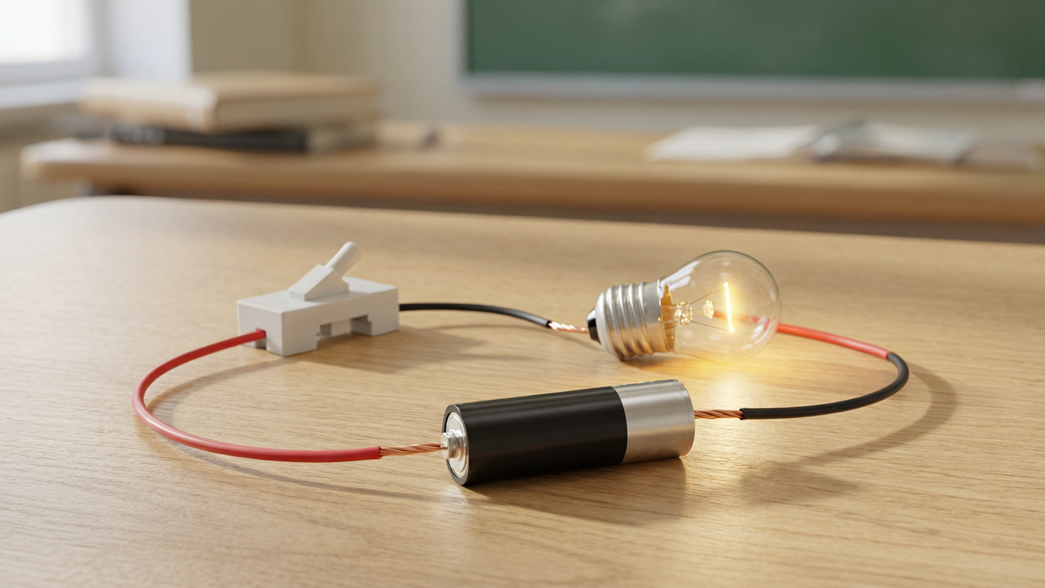
ELECTRICITY
Current & Circuits
Charges and current • Circuit symbols • Series and parallel • Electrical safety

Slide 2
INTRODUCTION
Learning Objectives
1
Explain that an electric current is a flow of charge
2
State the direction of conventional current
3
Recognise the standard circuit symbols and their functions
4
Draw a simple circuit using symbols
5
Compare series and parallel circuits
6
List safety precautions when using electricity
Notes:
Open by previewing these objectives so students know what they should be able to do by the end of the session.

Slide 3
PART 1
Current & Symbols
1
What flows in a circuit, and how we draw it

Slide 4
ELECTRIC CURRENT
Charges Make the Current
An electric current is the flow of tiny electric charges through a conductor.
• Metals contain charges that are free to move.
• When a cell is connected, it pushes these charges around the circuit — that flow is the current.
• The conventional current is taken to flow from the (+) terminal of the cell to the (−) terminal.
• Current is measured in amperes (A) with an ammeter.
Notes:
Define current as a flow of charge. Keep it simple at Class 7: charges in the metal move when the cell pushes them. Give the conventional direction (+ to −) and the unit, the ampere.

Slide 5
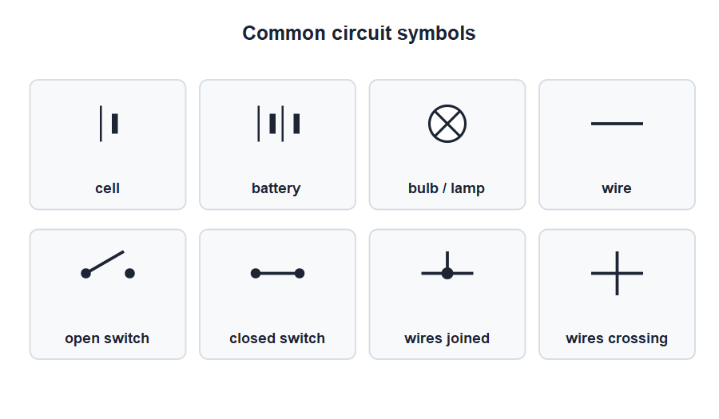
SYMBOLS
Circuit Symbols
A shared language
• Drawing real cells and bulbs is slow, so we use simple symbols instead.
• Each component has its own standard symbol.
• A circuit diagram drawn with these symbols is quick to draw and easy to read.
• Everyone uses the same symbols, so a diagram means the same thing to all.
Standard symbols for cell, bulb, switch and wires
Notes:
Introduce circuit symbols as a shared shorthand. Have students copy the cell, bulb, switch and wire symbols into their notebooks — they will use them constantly.

Slide 6




FUNCTIONS
What Each Component Does
Cell / battery
Bulb / lamp
Pushes the current around the circuit — the source of electrical energy.
Glows when current passes, turning electrical energy into light and heat.
Switch
Connecting wires
Opens or closes the circuit to stop or start the current.
Carry the current from one component to the next, usually copper.
Notes:
Match each symbol to its job. The cell is the 'pump', the switch the 'tap', the wires the 'pipes' and the bulb the device that uses the energy.

Slide 7
WHAT CURRENT DOES
Effects of an Electric Current
Current at work
• Heating effect Current heats a wire — used in heaters, irons and the filament of a bulb.
• Lighting effect A heated filament glows white-hot and gives out light.
• Magnetic effect A current produces a magnetic field — the basis of the electromagnet and bell.
• Chemical effect Current passed through some liquids causes chemical changes, as in electroplating.
Notes:
List the effects of a current: heating, lighting, magnetic and chemical. Each is the basis of useful devices, from the heater to the electromagnet.

Slide 8
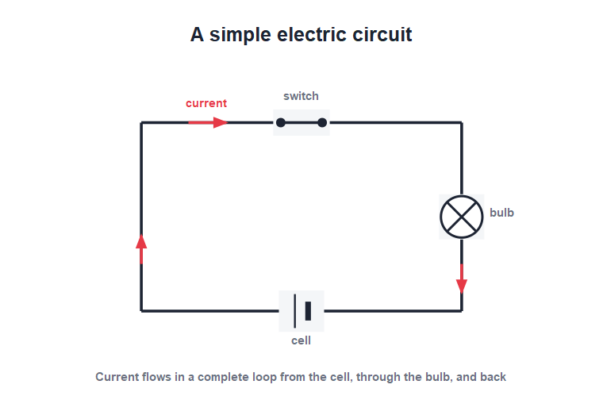
DRAWING A CIRCUIT
Reading a Circuit Diagram
From symbols to circuit
• A simple circuit needs a cell, a switch, a bulb and connecting wires.
• Close the switch and the circuit is complete, so the bulb lights.
• Open the switch and the circuit is broken, so the bulb goes off.
• The same diagram can be built with real components on the bench.
A cell, switch and bulb in a complete loop
Notes:
Read the diagram together: trace the loop from the cell through the switch and bulb and back. Open and closed switch decide whether the bulb lights.

Slide 9
QUIZ 1
Quick Check — Current & Symbols
4 questions • think before the answer reveals on the next slide

Slide 10
QUIZ QUESTION
Q1 - Current
An electric current is a flow of:
Heat
Light
A
B
Electric charge
Air
C
D

Slide 11
QUIZ QUESTION
Q1 - Current
An electric current is a flow of:
Heat
Light
A
B
Electric charge
Air
C
✓
D
Why An electric current is the flow of tiny electric charges through a conductor when a cell pushes them around the circuit.

Slide 12
QUIZ QUESTION
Q2 - Direction
The conventional current flows from the cell's:
(−) to (+) terminal
(+) to (−) terminal
A
B
Middle outwards
It does not flow
C
D

Slide 13
QUIZ QUESTION
Q2 - Direction
The conventional current flows from the cell's:
(−) to (+) terminal
(+) to (−) terminal
A
B
✓
Middle outwards
It does not flow
C
D
Why By convention, current is taken to flow from the positive terminal of the cell, around the circuit, back to the negative terminal.

Slide 14
QUIZ QUESTION
Q3 - Symbol
A circle with a cross inside it is the symbol for a:
Cell
Switch
A
B
Bulb / lamp
Wire
C
D

Slide 15
QUIZ QUESTION
Q3 - Symbol
A circle with a cross inside it is the symbol for a:
Cell
Switch
A
B
Bulb / lamp
Wire
C
✓
D
Why A circle with a cross inside is the standard symbol for a bulb or lamp in a circuit diagram.

Slide 16
QUIZ QUESTION
Q4 - Switch
The job of a switch in a circuit is to:
Store energy
Light up
A
B
Open or close the circuit
Measure current
C
D

Slide 17
QUIZ QUESTION
Q4 - Switch
The job of a switch in a circuit is to:
Store energy
Light up
A
B
Open or close the circuit
Measure current
C
✓
D
Why A switch opens the circuit to stop the current or closes it to let the current flow, turning the device on or off.

Slide 18
PART 2
Series, Parallel & Safety
2
Two ways to connect, and how to stay safe

Slide 19
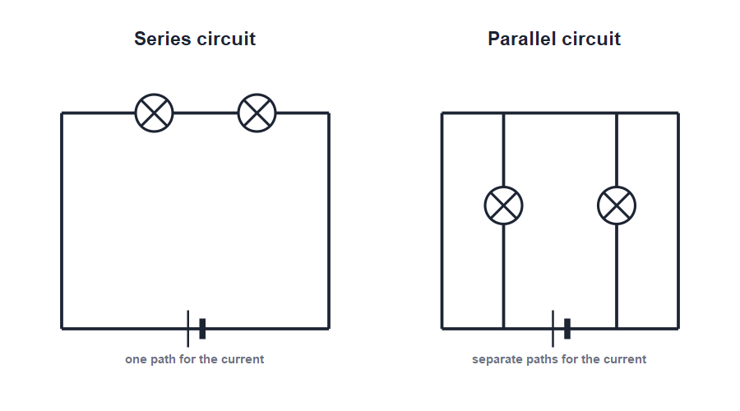
SERIES VS PARALLEL
Series and Parallel Circuits
One loop vs many branches
• In a series circuit the components are joined one after another in a single loop.
• The same current flows through every part, so if one bulb fails they all go out.
• In a parallel circuit the components are on separate branches.
• Each branch works on its own, so if one bulb fails the others stay lit.
Series: one path. Parallel: separate paths
Notes:
Contrast the two clearly: series = one path (one failure stops all); parallel = separate paths (others keep working). This explains why house wiring is parallel.

Slide 20


COMPARING
Series vs Parallel at a Glance
Series path
Series fault
One single path; the same current passes through every component.
If one component fails or is removed, the whole circuit breaks.
Parallel path
Parallel fault
Several branches; each gets its own share of the current.
If one branch fails, the others keep working — so homes are wired in parallel.
Notes:
Summarise the comparison in a table-like grid. The headline reason homes use parallel wiring: each light and socket works independently of the others.

Slide 21

IN USE
Where Series and Parallel Are Used
Series — torch
Series — old lights
Cells in a torch are in series so their voltages add up to light the bulb.
Some decorative light strings are in series; one failed bulb darkens them all.
Parallel — homes
Parallel — appliances
House lights and sockets are in parallel so each can be used on its own.
Every appliance gets the full supply voltage and switches independently.
Notes:
Give real examples of each connection. The torch (series) and house wiring (parallel) make the abstract comparison concrete.

Slide 22


SAFETY
Staying Safe With Electricity
Dry hands
Insulation
Never touch switches or appliances with wet hands — water helps electricity flow through you.
Use plugs and tools with sound plastic or rubber insulation; replace frayed wires.
Don't overload
Mains is dangerous
Avoid plugging too many appliances into one socket.
Never poke fingers or metal into a socket; mains electricity can be fatal.
Notes:
Stress real safety rules: dry hands, good insulation, no overloading and never tamper with sockets. These can save a life — give the rules seriously.

Slide 23
THE FUSE
The Fuse — A Safety Device
A fuse is a short piece of thin wire that melts and breaks the circuit if too large a current flows through it.
• Too large a current overheats the wires and can start a fire.
• The thin fuse wire melts first, breaking the circuit before any harm is done.
• After the fault is fixed, the blown fuse is replaced with one of the correct rating.
• A fuse must always be connected in the live wire of the circuit.
Notes:
Explain the fuse as a deliberate weak link: it melts first to protect the rest of the circuit. Stress using the correct rating — too high a fuse gives no protection.

Slide 24
GOLDEN RULES
Electrical Safety — Golden Rules
Stay safe, always
• Switch off first Turn off the supply before touching or repairing anything electrical.
• No water near electricity Keep water and wet hands away from electrical points.
• Use the right fuse A correct fuse breaks the circuit safely if too much current flows.
• Earth metal appliances Earthing carries away dangerous leakage current and prevents shocks.
Notes:
End with a memorable set of golden rules. The fuse and earthing points preview the Class 8 work on household electricity.

Slide 25
WRAP UP
Quick Recap
✓ Current — a flow of electric charge; conventional flow + to −
✓ Symbols — standard signs for cell, bulb, switch and wires
✓ Functions — cell pushes, switch opens/closes, bulb lights
✓ Series — one path; one failure breaks the whole circuit
✓ Parallel — separate branches; others keep working — used in homes
✓ Safety — dry hands, good insulation, correct fuse, earthing
Notes:
Rapid recap; cold-call for each. Series vs parallel and the safety rules are the most important takeaways.

Slide 26
QUIZ 2
Final Check — Circuits & Safety
4 questions • think before the answer reveals on the next slide

Slide 27
QUIZ QUESTION
Q1 - Series
In a series circuit of two bulbs, if one bulb fuses, the other:
Glows brighter
Also goes out
A
B
Stays the same
Explodes
C
D

Slide 28
QUIZ QUESTION
Q1 - Series
In a series circuit of two bulbs, if one bulb fuses, the other:
Glows brighter
Also goes out
A
B
✓
Stays the same
Explodes
C
D
Why A series circuit has a single path. If one bulb fails, the path is broken and the current stops, so the other bulb goes out too.

Slide 29
QUIZ QUESTION
Q2 - Parallel
Homes are wired in parallel mainly so that:
Less wire is used
Each appliance works independently
A
B
The current is larger
The bill is higher
C
D

Slide 30
QUIZ QUESTION
Q2 - Parallel
Homes are wired in parallel mainly so that:
Less wire is used
Each appliance works independently
A
B
✓
The current is larger
The bill is higher
C
D
Why In a parallel circuit each branch works on its own, so one light can be switched off or fail without affecting the others.

Slide 31
QUIZ QUESTION
Q3 - Safety
Why should you never touch a switch with wet hands?
Water is a good insulator
Water helps electricity flow through you
A
B
It wastes water
It is bad manners
C
D

Slide 32
QUIZ QUESTION
Q3 - Safety
Why should you never touch a switch with wet hands?
Water is a good insulator
Water helps electricity flow through you
A
B
✓
It wastes water
It is bad manners
C
D
Why Wet skin conducts electricity far more easily than dry skin, so touching a switch with wet hands risks a dangerous shock.

Slide 33
QUIZ QUESTION
Q4 - Symbols
Two long-and-short plate symbols joined together represent a:
Single cell
Battery
A
B
Bulb
Switch
C
D

Slide 34
QUIZ QUESTION
Q4 - Symbols
Two long-and-short plate symbols joined together represent a:
Single cell
Battery
A
B
✓
Bulb
Switch
C
D
Why A battery is two or more cells joined together, shown as several long-and-short plate symbols in a row.

Slide 35
Circuits, Understood
Current is moving charge, circuit symbols are its shorthand, and choosing series or parallel — safely — puts electricity to work for us.

