Slide 1
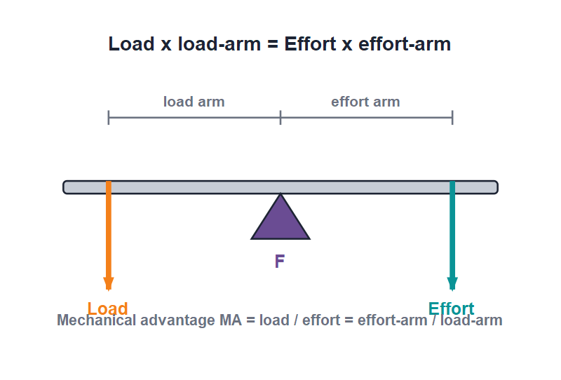
MECHANICS
Simple Machines — 1
Work and energy • What a machine does • Mechanical advantage • Efficiency • Levers

Slide 2
INTRODUCTION
Learning Objectives
1
Explain what work means in science and give its unit
2
Say what a machine is and the jobs a machine can do for us
3
Define mechanical advantage and use MA = load / effort
4
Explain efficiency and why no real machine is perfect
5
Tell an ideal machine apart from an actual machine
6
Identify the three orders (classes) of levers
2
Notes:
Open by previewing these objectives so students know what they should be able to do by the end of the session.

Slide 3
PART 1
Work, Energy & Machines
1
What 'work' really means and how a machine helps
3

Slide 4
WORK
What Is Work?
Work is done only when a force makes a body move in the direction of the force.
Work = Force × distance moved (W = F × d)
• If you push a wall and it does not move, no work is done — there is force but no movement.
• The SI unit of work is the joule (J).
• 1 joule of work is done when a force of 1 newton moves a body through 1 metre.
• Both a force AND movement in the force's direction are needed for work to be done.
4
Notes:
Start from the everyday meaning of 'work', then sharpen it. Use the pushing-a-wall example to show force alone is not enough — there must be movement. Keep the unit (joule) concrete with the 1 N × 1 m picture.

Slide 5


ENERGY
Energy — the Ability to Do Work
What energy is
Same unit as work
Energy is the capacity (ability) to do work. A body that can do work is said to have energy.
Energy is also measured in joules (J), because doing work transfers energy.
Everyday energy
Work needs energy
Food gives our muscles energy; petrol gives a car energy; a stretched rubber band stores energy.
To do work, a body must spend energy. The more work done, the more energy used.
5
Notes:
Link energy directly to work: anything that can do work has energy, and both share the joule. Give a few stores of energy the children already know — food, fuel, a wound spring.

Slide 6
MACHINES
What Is a Machine?
Effort and load
• A machine is a device that lets us do work more easily or more conveniently.
• We apply a small force called the effort; the machine moves a large load.
• The effort is the force we put in; the load is the resistance the machine overcomes.
• Simple machines like the lever, pulley and ramp are the building blocks of bigger machines.
A machine turns a small effort into a large load
6
Notes:
Define machine in plain terms — it makes our work easier. Introduce the two key words effort (input) and load (output) here; they recur all session.

Slide 7




FUNCTIONS
Four Jobs a Machine Can Do
Lift a big load
Change direction
It lets a small effort move a large load — a force multiplier, like a crowbar lifting a rock.
It can change the direction of the force — a fixed pulley lets us pull down to lift a load up.
Change the speed
Reach a better point
It can make something move faster — the wheels of a bicycle are a speed multiplier.
It can apply the force at a more convenient place, like the pedals of a bicycle.
7
Notes:
Walk through the four ways machines help. Stress that not every machine multiplies force — some trade force for speed, some just change direction or the point of application.

Slide 8
MECHANICAL ADVANTAGE
Mechanical Advantage (MA)
Mechanical advantage tells us how many times a machine multiplies our effort.
MA = Load / Effort
• MA is just a ratio of two forces, so it has no unit.
• If MA is more than 1, the machine is a force multiplier — the load is bigger than the effort.
• If MA is less than 1, we gain speed or distance instead of force.
• Example: lifting a 100 N load with a 25 N effort gives MA = 100 / 25 = 4.
8
Notes:
Define MA as load over effort. Make the 'how many times' idea concrete with the worked number. Note MA has no unit because it is force divided by force.

Slide 9
EFFICIENCY
Efficiency of a Machine
Efficiency tells us how much of the work we put in actually comes out as useful work.
Efficiency = (useful work output / work input) × 100%
• Some effort is always wasted against friction and in moving the machine's own parts.
• So the useful work we get out is always less than the work we put in.
• A real machine therefore always has an efficiency less than 100%.
• Oiling the parts reduces friction and raises the efficiency.
9
Notes:
Explain efficiency as the fraction of input work that is useful. Connect the 'lost' part to friction and the weight of the machine. Lead into the ideal-vs-actual comparison next.

Slide 10

IDEAL VS ACTUAL
Ideal Machine vs Actual Machine
Ideal machine
Actual machine
An imaginary machine with no friction and weightless parts. Its efficiency would be 100%.
A real machine has friction and its parts have weight, so its efficiency is always below 100%.
Where work goes
Getting closer
In a real machine some input work is wasted against friction and in lifting the moving parts.
Good design and regular oiling cut friction and make a real machine behave more like an ideal one.
10
Notes:
Contrast the perfect (ideal) machine with real ones. The key reason real machines fall short is friction plus the weight of their own parts.

Slide 11
WORKED EXAMPLE
Finding Mechanical Advantage
Problem. A boy uses a crowbar to lift a stone of weight 200 N by applying an effort of 50 N. Find the mechanical advantage.
MA = Load / Effort
Load = 200 N, Effort = 50 N
MA = 200 / 50
MA = 4
Answer: MA = 4 (the crowbar multiplies the effort 4 times)
11
Notes:
Identify load and effort first, then substitute into MA = load / effort. Reinforce that MA has no unit and that MA = 4 means the effort is multiplied four times.

Slide 12
QUIZ 1
Quick Check — Work & Machines
4 questions • think before the answer reveals on the next slide
12

Slide 13
QUIZ QUESTION
Q1 - Work
Work is said to be done only when:
A force is applied
A body moves in the direction of the force
A
B
A body is at rest
Energy is stored
C
D
13

Slide 14
QUIZ QUESTION
Q1 - Work
Work is said to be done only when:
A force is applied
A body moves in the direction of the force
A
B
✓
A body is at rest
Energy is stored
C
D
Why Work needs both a force and movement in the direction of that force. Pushing a wall that does not move means no work is done, however hard you push.
14

Slide 15
QUIZ QUESTION
Q2 - Units
The SI unit of work and energy is the:
Newton
Joule
A
B
Watt
Metre
C
D
15

Slide 16
QUIZ QUESTION
Q2 - Units
The SI unit of work and energy is the:
Newton
Joule
A
B
✓
Watt
Metre
C
D
Why Work and energy are both measured in joules (J). One joule is the work done when a force of one newton moves a body one metre.
16

Slide 17
QUIZ QUESTION
Q3 - Mechanical Advantage
Mechanical advantage is the ratio:
Effort / Load
Load / Effort
A
B
Work out / Work in
Speed / Force
C
D
17

Slide 18
QUIZ QUESTION
Q3 - Mechanical Advantage
Mechanical advantage is the ratio:
Effort / Load
Load / Effort
A
B
✓
Work out / Work in
Speed / Force
C
D
Why MA = Load / Effort. It tells us how many times a machine multiplies our effort. Because it is force ÷ force, MA has no unit.
18

Slide 19
QUIZ QUESTION
Q4 - Efficiency
The efficiency of a real machine is always:
Equal to 100%
More than 100%
A
B
Less than 100%
Exactly zero
C
D
19

Slide 20
QUIZ QUESTION
Q4 - Efficiency
The efficiency of a real machine is always:
Equal to 100%
More than 100%
A
B
Less than 100%
Exactly zero
C
✓
D
Why Some input work is always wasted against friction and in moving the machine's own parts, so a real machine can never be 100% efficient.
20

Slide 21
PART 2
Levers
2
The simplest machine, and its three orders
21

Slide 22
LEVER
What Is a Lever?
Three points
• A lever is a rigid bar that can turn freely about a fixed point.
• The fixed point about which it turns is called the fulcrum.
• The load is the resistance to be overcome; the effort is the force we apply.
• A lever is the simplest of all machines.
Every lever has a fulcrum, a load and an effort
22
Notes:
Introduce the lever and its three points — fulcrum, load, effort. Point each one out on the diagram. These labels decide the lever's class later.

Slide 23
PRINCIPLE OF A LEVER
The Principle of a Lever
When a lever is balanced, the turning effect of the load equals the turning effect of the effort.
Load × load-arm = Effort × effort-arm
• The load-arm is the distance from the fulcrum to the load.
• The effort-arm is the distance from the fulcrum to the effort.
• A longer effort-arm lets a smaller effort balance a bigger load.
• For a lever, MA = effort-arm / load-arm.
23
Notes:
State the principle (the law of moments in words). The practical message: the longer the effort arm, the less effort needed — this is why a long crowbar is so helpful.

Slide 24
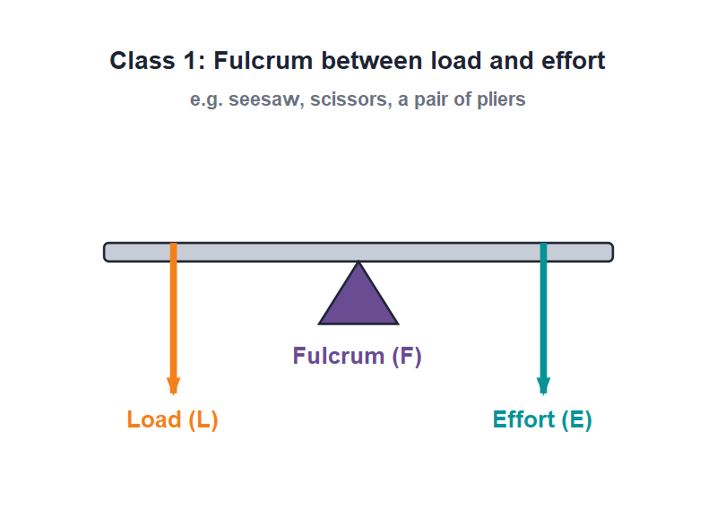
CLASS 1
First-Order Levers
F between L and E
• The fulcrum lies between the load and the effort.
• Pressing down on the effort side lifts the load on the other side.
• The mechanical advantage can be more than, equal to, or less than 1.
• Examples: a seesaw, a pair of scissors, pliers and a crowbar.
Class 1: fulcrum in the middle
24
Notes:
Class 1: fulcrum in the middle. Have students mime a seesaw. Note the MA can be anything depending on where the fulcrum sits.

Slide 25
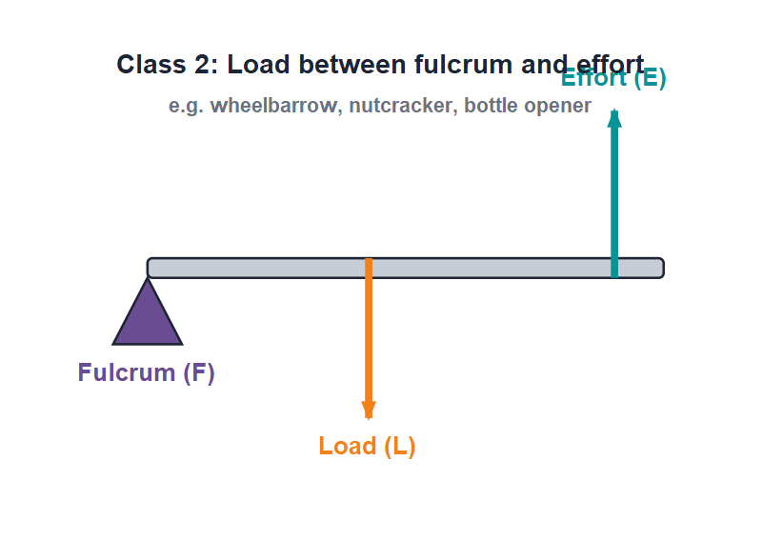
CLASS 2
Second-Order Levers
L between F and E
• The load lies between the fulcrum and the effort.
• The effort-arm is always longer than the load-arm.
• So the mechanical advantage is always more than 1 — a force multiplier.
• Examples: a wheelbarrow, a nutcracker and a bottle opener.
Class 2: load in the middle
25
Notes:
Class 2: load in the middle. Because the effort arm is always longer, these always multiply force (MA > 1). A wheelbarrow is the classic example.

Slide 26
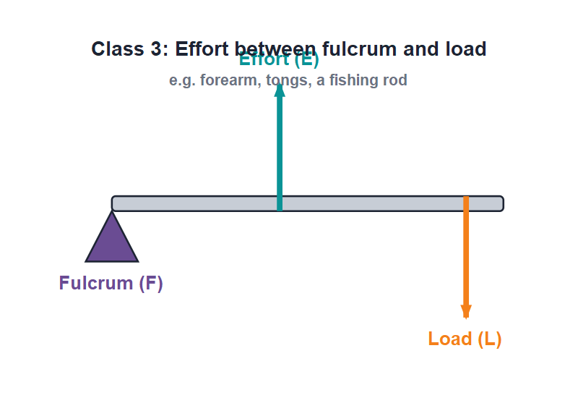
CLASS 3
Third-Order Levers
E between F and L
• The effort lies between the fulcrum and the load.
• The effort-arm is always shorter than the load-arm.
• So the mechanical advantage is always less than 1 — we gain speed, not force.
• Examples: the human forearm, sugar tongs and a fishing rod.
Class 3: effort in the middle
26
Notes:
Class 3: effort in the middle. Here effort is greater than load (MA < 1) but we gain speed and a wider range of movement — like the forearm flicking the hand.

Slide 27


EXAMPLES
Spotting the Class of a Lever
Class 1
Class 2
Seesaw, scissors, pliers, beam balance, a crowbar — fulcrum in the middle.
Wheelbarrow, nutcracker, bottle opener, lemon squeezer — load in the middle.
Class 3
How to decide
Forearm, sugar tongs, fishing rod, a broom — effort in the middle.
Find the fulcrum, the load and the effort, then see which one is in the middle.
27
Notes:
Give a quick method: locate F, L and E, then ask which is in the middle — that names the class. Practise with a few tools held up in class.

Slide 28
WORKED EXAMPLE
Balancing a Lever
Problem. On a seesaw, a load of 300 N sits 1 m from the fulcrum. How much effort is needed 3 m from the fulcrum to balance it?
Principle: Load × load-arm = Effort × effort-arm
300 × 1 = Effort × 3
300 = Effort × 3
Effort = 300 / 3 = 100 N
Answer: Effort = 100 N (a longer effort-arm needs less effort)
28
Notes:
Apply the lever principle. The lesson: tripling the effort arm cuts the effort to a third. This is why we sit far from the pivot on a seesaw.

Slide 29
WRAP UP
Quick Recap
✓ Work — done only when a force moves a body; unit is the joule
✓ Machine — makes work easier — small effort moves a large load
✓ Functions — multiply force or speed, change direction or point
✓ MA — Load / Effort, no unit; efficiency is always below 100%
✓ Lever — rigid bar turning about a fulcrum; load × load-arm = effort × effort-arm
✓ Three classes — by what lies in the middle: fulcrum, load or effort
29
Notes:
Rapid recap. Cold-call students to give each point, especially the lever principle and how the three classes differ.

Slide 30
QUIZ 2
Final Check — Machines & Levers
4 questions • think before the answer reveals on the next slide
30

Slide 31
QUIZ QUESTION
Q1 - Levers
In a first-order lever, what lies between the load and the effort?
The load
The effort
A
B
The fulcrum
Nothing
C
D
31

Slide 32
QUIZ QUESTION
Q1 - Levers
In a first-order lever, what lies between the load and the effort?
The load
The effort
A
B
The fulcrum
Nothing
C
✓
D
Why A first-order (class 1) lever has the fulcrum in the middle, between the load and the effort — like a seesaw or a pair of scissors.
32

Slide 33
QUIZ QUESTION
Q2 - Class 2
Which of these is a second-order lever?
A seesaw
A wheelbarrow
A
B
Sugar tongs
A fishing rod
C
D
33

Slide 34
QUIZ QUESTION
Q2 - Class 2
Which of these is a second-order lever?
A seesaw
A wheelbarrow
A
B
✓
Sugar tongs
A fishing rod
C
D
Why In a wheelbarrow the load sits between the fulcrum (the wheel) and the effort (your hands), so it is a class 2 lever and always has MA greater than 1.
34

Slide 35
QUIZ QUESTION
Q3 - Lever principle
A load of 100 N is 2 m from the fulcrum. What effort balances it 4 m from the fulcrum?
25 N
50 N
A
B
200 N
400 N
C
D
35

Slide 36
QUIZ QUESTION
Q3 - Lever principle
A load of 100 N is 2 m from the fulcrum. What effort balances it 4 m from the fulcrum?
25 N
50 N
A
B
✓
200 N
400 N
C
D
Why Load × load-arm = Effort × effort-arm → 100 × 2 = Effort × 4, so Effort = 200 / 4 = 50 N. The longer effort-arm needs less effort.
36

Slide 37
QUIZ QUESTION
Q4 - Class 3
Why do third-order levers have a mechanical advantage less than 1?
The fulcrum is in the middle
The effort-arm is shorter than the load-arm
A
B
They have no fulcrum
The load is always zero
C
D
37

Slide 38
QUIZ QUESTION
Q4 - Class 3
Why do third-order levers have a mechanical advantage less than 1?
The fulcrum is in the middle
The effort-arm is shorter than the load-arm
A
B
✓
They have no fulcrum
The load is always zero
C
D
Why With the effort in the middle, its arm is always shorter than the load-arm, so effort must be greater than load (MA < 1). In return we gain speed and range of movement.
38

Slide 39
Work Made Easy
A machine never gives us something for nothing — it just lets a small effort do a big job in a smarter way.

