Slide 1
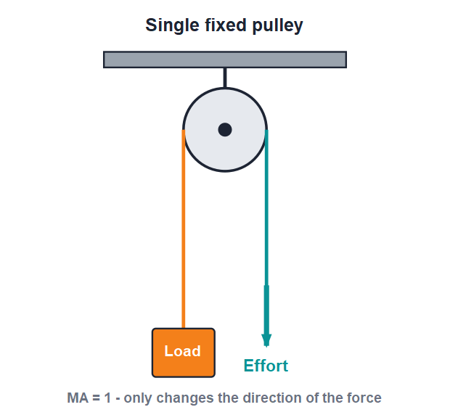
MECHANICS
Simple Machines — 2
Pulleys • Wheel and axle • Inclined plane • Wedge • Screw • Caring for machines

Slide 2
INTRODUCTION
Learning Objectives
1
Describe a single fixed and a single movable pulley
2
State the mechanical advantage of each kind of pulley
3
Explain how a wheel and axle multiplies effort
4
Use MA = length / height for an inclined plane
5
Recognise the wedge and the screw as simple machines
6
List sensible ways to take care of machines
2
Notes:
Open by previewing these objectives so students know what they should be able to do by the end of the session.

Slide 3
PART 1
Pulleys & the Wheel and Axle
1
Lifting loads with ropes and wheels
3

Slide 4
PULLEY
What Is a Pulley?
A grooved wheel
• A pulley is a wheel with a grooved rim over which a rope or string passes.
• Pulling one end of the rope raises a load tied to the other end.
• A pulley fixed to a support is a fixed pulley.
• A pulley whose axle is free to move up and down is a movable pulley.
A single fixed pulley
4
Notes:
Introduce the pulley as a grooved wheel and a rope. Distinguish fixed (stays put) from movable (rises with the load) — this difference decides the MA.

Slide 5




FIXED PULLEY
The Single Fixed Pulley
How it works
Mechanical advantage
The wheel is fixed to a beam; you pull down on one side and the load rises on the other.
Its ideal MA is 1 — the effort equals the load, so it does not reduce the force.
Why use it then?
Everyday use
It changes the direction of the force, letting you pull downward, which is far more convenient.
Drawing water from a well and hoisting a flag up a pole.
5
Notes:
The fixed pulley's whole value is convenience — pulling down is easier than lifting up, even though MA = 1. Use the well and the flagpole as examples.

Slide 6
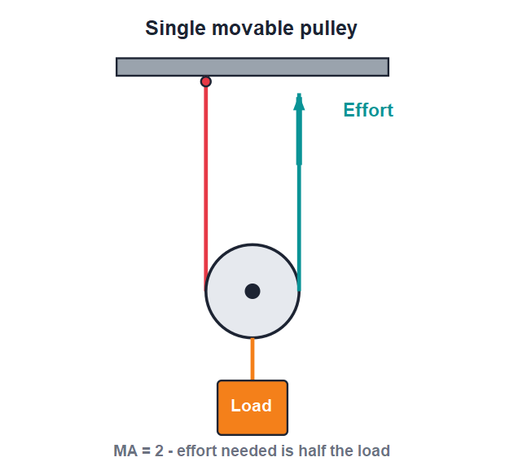
MOVABLE PULLEY
The Single Movable Pulley
MA = 2
• Here the pulley itself moves up with the load.
• The load is shared by two strands of rope, so the effort is only half the load.
• Its ideal mechanical advantage is therefore 2.
• It does not change the direction of the force — you pull upward.
A single movable pulley halves the effort
6
Notes:
The movable pulley actually reduces effort (MA = 2) because two rope strands share the load. Its drawback is you must pull upward. This motivates combining pulleys.

Slide 7
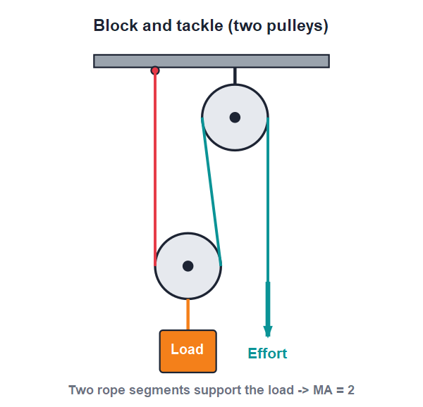
BLOCK & TACKLE
Combining Pulleys
Many strands, big MA
• We can combine fixed and movable pulleys into a block and tackle.
• The more rope strands that support the load, the greater the mechanical advantage.
• A fixed pulley in the set also lets us pull downward comfortably.
• Cranes and lifts use such pulley systems to raise very heavy loads.
Two strands support the load → MA = 2
7
Notes:
Explain that combining pulleys multiplies the MA — it equals the number of strands supporting the load. This is how cranes lift tonnes with a manageable effort.

Slide 8
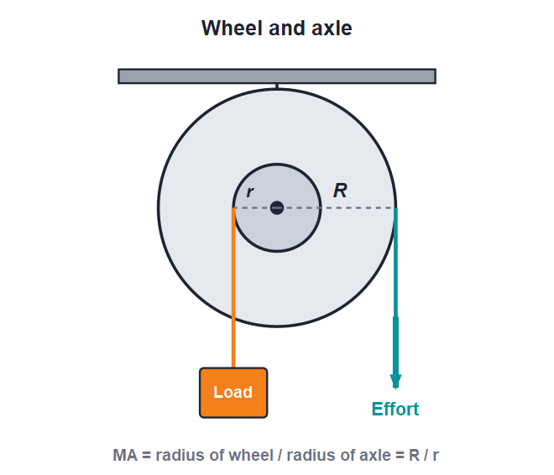
WHEEL & AXLE
The Wheel and Axle
A large wheel is fixed to a smaller axle so that both turn together; the effort turns the wheel and the load is raised by the axle.
MA = radius of wheel (R) / radius of axle (r)
8
Notes:
Stress that the wheel and axle are rigidly joined and turn together. The larger the ratio R/r, the greater the force multiplication. Point out everyday examples they use daily.

Slide 9
WORKED EXAMPLE
Mechanical Advantage of a Wheel & Axle
Problem. A wheel of radius 50 cm is fixed to an axle of radius 10 cm. Find the mechanical advantage.
MA = radius of wheel / radius of axle = R / r
R = 50 cm, r = 10 cm
MA = 50 / 10
MA = 5
Answer: MA = 5 (a small effort on the wheel raises 5 times the load)
9
Notes:
Substitute the two radii into MA = R/r. Reinforce that a bigger wheel compared with the axle gives a larger mechanical advantage.

Slide 10
QUIZ 1
Quick Check — Pulleys & Wheels
4 questions • think before the answer reveals on the next slide
10

Slide 11
QUIZ QUESTION
Q1 - Fixed pulley
The main use of a single fixed pulley is to:
Halve the effort
Change the direction of the force
A
B
Double the load
Increase the speed
C
D
11

Slide 12
QUIZ QUESTION
Q1 - Fixed pulley
The main use of a single fixed pulley is to:
Halve the effort
Change the direction of the force
A
B
✓
Double the load
Increase the speed
C
D
Why A single fixed pulley has MA = 1, so it does not reduce effort. Its value is that it lets us pull downward to raise a load upward — much more convenient.
12

Slide 13
QUIZ QUESTION
Q2 - Movable pulley
The ideal mechanical advantage of a single movable pulley is:
1
2
A
B
3
0.5
C
D
13

Slide 14
QUIZ QUESTION
Q2 - Movable pulley
The ideal mechanical advantage of a single movable pulley is:
1
2
A
B
✓
3
0.5
C
D
Why Two strands of rope share the load in a single movable pulley, so the effort is half the load and the ideal MA is 2.
14

Slide 15
QUIZ QUESTION
Q3 - Wheel & axle
In a wheel and axle, the mechanical advantage is given by:
r / R
R / r
A
B
R × r
R + r
C
D
15

Slide 16
QUIZ QUESTION
Q3 - Wheel & axle
In a wheel and axle, the mechanical advantage is given by:
r / R
R / r
A
B
✓
R × r
R + r
C
D
Why MA = radius of wheel ÷ radius of axle = R / r. As the wheel is larger than the axle, R/r is greater than 1, so it multiplies the effort.
16

Slide 17
QUIZ QUESTION
Q4 - Identify
A steering wheel is an example of which simple machine?
A lever
A pulley
A
B
A wheel and axle
A wedge
C
D
17

Slide 18
QUIZ QUESTION
Q4 - Identify
A steering wheel is an example of which simple machine?
A lever
A pulley
A
B
A wheel and axle
A wedge
C
✓
D
Why Turning the large steering wheel turns the smaller steering column (axle), so it is a wheel-and-axle machine.
18

Slide 19
PART 2
Inclined Plane, Wedge & Screw
2
Sloping surfaces that make lifting easier
19

Slide 20
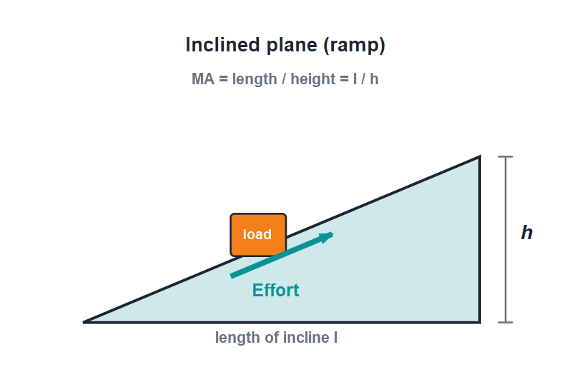
INCLINED PLANE
The Inclined Plane
An inclined plane is a sloping surface used to raise a heavy load with less effort than lifting it straight up.
MA = length of slope (l) / height (h)
20
Notes:
The trade-off is the key idea: a ramp needs less effort but you move through a greater distance. A gentler (and so longer) slope means a bigger MA.

Slide 21
WORKED EXAMPLE
Mechanical Advantage of a Ramp
Problem. A ramp is 8 m long and lifts a load to a height of 2 m. Find its ideal mechanical advantage.
MA = length of slope / height = l / h
l = 8 m, h = 2 m
MA = 8 / 2
MA = 4
Answer: MA = 4 (the effort is one-fourth of lifting straight up)
21
Notes:
Apply MA = l/h. Remind students the load travels the full 8 m along the slope, so we trade a longer distance for a smaller effort.

Slide 22
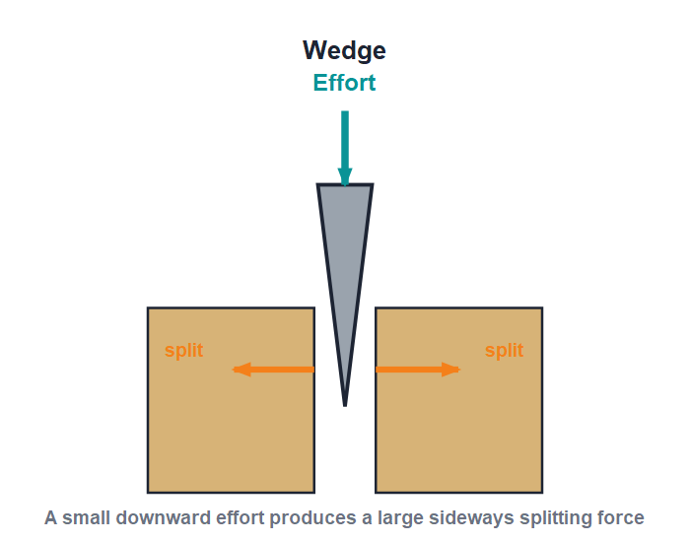
WEDGE
The Wedge
Two inclined planes
• A wedge is two inclined planes joined back to back to give a sharp edge.
• A downward effort on the wedge produces a large sideways force that splits or cuts.
• It is used to separate, cut or fasten objects.
• Examples: an axe, a knife, a chisel, a nail and a needle.
A wedge turns a small push into a big splitting force
22
Notes:
A wedge is a moving inclined plane (two of them). The small downward effort becomes a large sideways force — that is how an axe splits wood and a knife cuts.

Slide 23
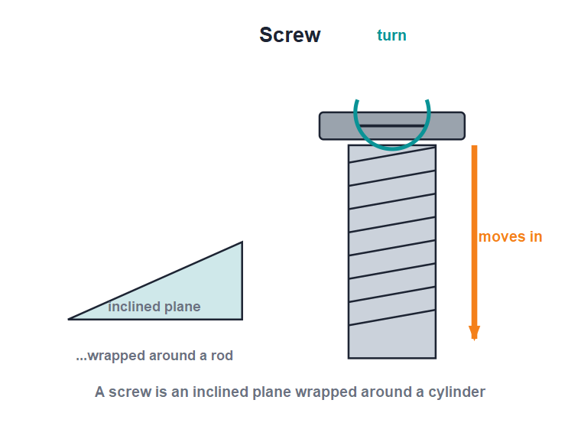
SCREW
The Screw
A wrapped-up ramp
• A screw is an inclined plane wrapped around a cylinder.
• The ridges going round the screw are called the threads.
• Turning the screw makes it move forward into the material — rotation becomes straight-line motion.
• Examples: a screw, a bolt and nut, a screw jack and a vice.
A screw is an inclined plane around a cylinder
23
Notes:
Show that the thread is just a ramp wrapped round a rod. Each full turn drives the screw forward by the thread spacing, giving a large mechanical advantage in a screw jack.

Slide 24


CARE OF MACHINES
Taking Care of Machines
Reduce friction
Keep them clean
Oil and grease the moving parts so they rub less and the machine works more efficiently.
Dust and dirt increase friction and wear, so keep machines clean and dry.
Prevent rust
Use and store well
Wipe metal parts and keep them dry, or paint them, to stop rusting.
Sharpen cutting edges, handle parts gently and replace worn-out parts in time.
24
Notes:
Tie care back to efficiency: less friction and rust means more of our effort does useful work and the machine lasts longer.

Slide 25
WRAP UP
Quick Recap
✓ Fixed pulley — MA = 1; only changes the direction of the force
✓ Movable pulley — MA = 2; effort is half the load
✓ Wheel & axle — MA = R / r; a big wheel turns a small axle
✓ Inclined plane — MA = l / h; less effort over a longer distance
✓ Wedge & screw — moving and wrapped inclined planes that cut and fasten
✓ Care — oil, clean and protect machines to keep them efficient
25
Notes:
Rapid recap of each machine and its MA. Cold-call students to match a real tool to its machine type.

Slide 26
QUIZ 2
Final Check — Slopes, Wedges & Screws
4 questions • think before the answer reveals on the next slide
26

Slide 27
QUIZ QUESTION
Q1 - Inclined plane
Using a ramp instead of lifting straight up means you apply:
More effort over a shorter distance
Less effort over a longer distance
A
B
The same effort
No effort at all
C
D
27

Slide 28
QUIZ QUESTION
Q1 - Inclined plane
Using a ramp instead of lifting straight up means you apply:
More effort over a shorter distance
Less effort over a longer distance
A
B
✓
The same effort
No effort at all
C
D
Why An inclined plane trades distance for force: you push a smaller effort but move the load through a greater distance along the slope.
28

Slide 29
QUIZ QUESTION
Q2 - Inclined plane MA
A ramp is 6 m long and 2 m high. Its ideal mechanical advantage is:
2
3
A
B
8
12
C
D
29

Slide 30
QUIZ QUESTION
Q2 - Inclined plane MA
A ramp is 6 m long and 2 m high. Its ideal mechanical advantage is:
2
3
A
B
✓
8
12
C
D
Why MA = length / height = 6 / 2 = 3. A longer, gentler slope would give an even greater mechanical advantage.
30

Slide 31
QUIZ QUESTION
Q3 - Wedge
A wedge is best described as:
A wheel and a rope
Two inclined planes joined together
A
B
A bar turning about a fulcrum
A grooved wheel
C
D
31

Slide 32
QUIZ QUESTION
Q3 - Wedge
A wedge is best described as:
A wheel and a rope
Two inclined planes joined together
A
B
✓
A bar turning about a fulcrum
A grooved wheel
C
D
Why A wedge is two inclined planes back to back forming a sharp edge. A small downward effort gives a large sideways force, as in an axe or a knife.
32

Slide 33
QUIZ QUESTION
Q4 - Screw
A screw is really which simple machine in disguise?
A lever
A pulley
A
B
An inclined plane wrapped around a cylinder
A wheel and axle
C
D
33

Slide 34
QUIZ QUESTION
Q4 - Screw
A screw is really which simple machine in disguise?
A lever
A pulley
A
B
An inclined plane wrapped around a cylinder
A wheel and axle
C
✓
D
Why The thread of a screw is an inclined plane coiled around a rod. Each turn drives the screw forward, giving a large mechanical advantage.
34

Slide 35
Simple Machines, Smarter Work
Levers, pulleys, ramps, wedges and screws all do one thing — they let a small effort handle a big job.

