Slide 1
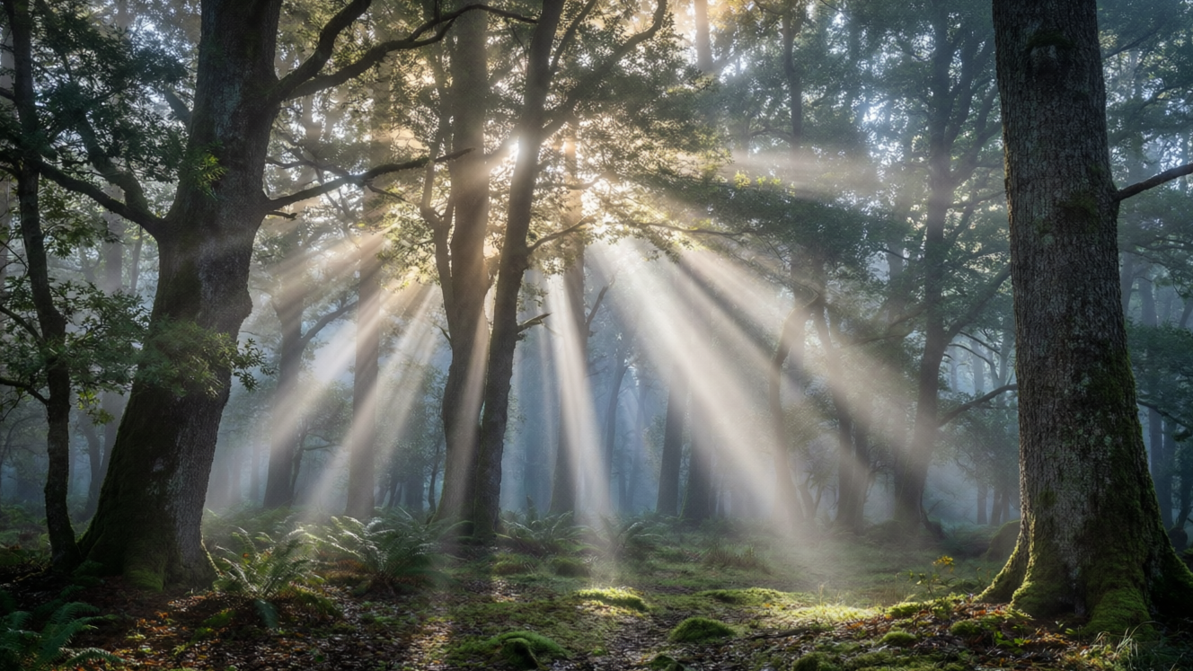
OPTICS
Light — 1
What light is • Sources of light • Luminous & non-luminous • How light travels

Slide 2
INTRODUCTION
Learning Objectives
1
Explain that light is a form of energy that lets us see
2
Name natural and artificial sources of light
3
Tell luminous bodies apart from non-luminous bodies
4
Classify objects as transparent, translucent or opaque
5
Use the terms ray, beam and medium correctly
6
State that light travels in straight lines and give proofs
2
Notes:
Open by previewing these objectives so students know what they should be able to do by the end of the session.

Slide 3
PART 1
What Light Is
1
A form of energy, and where it comes from
3

Slide 4
LIGHT
What Is Light?
Light is a form of energy that produces in us the sensation of sight — it lets us see things.
• We see an object only when light from it enters our eyes.
• Some objects give out their own light; most objects are seen by the light they reflect.
• Light travels extremely fast — about 3 × 10⁸ metres per second.
• In a dark room with no light, we cannot see anything at all.
4
Notes:
Open by asking why we cannot see in the dark. Establish that seeing needs light entering the eye, and that light is a form of energy. Keep the speed as an awe-fact.

Slide 5


SOURCES
Sources of Light
Natural sources
Artificial sources
Light that comes from nature — the Sun, the stars, lightning, fireflies and glowing deep-sea creatures.
Light made by humans — an electric bulb, a tube light, a candle, a torch and a kerosene lamp.
The Sun
Hot vs cool light
Our most important natural source; almost all light on Earth comes first from the Sun.
Some sources glow because they are very hot (bulb, flame); others glow without much heat (a firefly).
5
Notes:
Sort sources into natural and artificial. Stress the Sun's importance. Mention that not all light needs great heat — the firefly is a 'cool' light.

Slide 6
LUMINOUS OR NOT
Luminous and Non-luminous Bodies
Luminous bodies
Non-luminous bodies
Give out their own light — the Sun, stars, a lit bulb, a burning candle and red-hot iron.
Do not make their own light — a book, a table, a wall, and most things around us.
How we see them
The Moon
We see non-luminous bodies only by the light they reflect from a luminous source into our eyes.
The Moon is non-luminous; it shines only by reflecting sunlight — it makes no light of its own.
6
Notes:
Define luminous (own light) vs non-luminous (seen by reflected light). The Moon is the classic trick example — it looks bright but only reflects the Sun's light.

Slide 7
LET LIGHT THROUGH?
Transparent, Translucent & Opaque
Transparent
Translucent
Let almost all light pass through, so we can see clearly through them — clear glass, water and air.
Let only some light pass, and scatter it, so we see blurred shapes — frosted glass, butter paper, oiled paper.
Opaque
Why it matters
Let no light pass through at all — wood, stone, metal and cardboard. These cast clear shadows.
How much light passes decides whether we can see through an object and whether it makes a sharp shadow.
7
Notes:
Three-way sort by how much light passes. Hold up examples: a clear bottle (transparent), tracing paper (translucent), a book (opaque). Link opaque objects to shadows for later.

Slide 8
HOW WE SEE
How We See Things
Source → object → eye
• Light leaves a source Light starts at a luminous source such as the Sun or a lamp.
• It falls on the object The light travels out and lands on the object we are looking at.
• It reflects to our eyes The object reflects some light, which travels in a straight line into our eyes.
• The eye senses it Our eyes receive the light and the brain lets us 'see' the object.
• No light, no sight In total darkness no light reaches our eyes, so we cannot see anything.
8
Notes:
Walk the chain source → object → eye. This explains why we see non-luminous things by reflected light, and why a dark room leaves us blind even though the objects are still there.

Slide 9
QUIZ 1
Quick Check — Light & Its Sources
4 questions • think before the answer reveals on the next slide
9

Slide 10
QUIZ QUESTION
Q1 - Light
Light is best described as:
A kind of matter
A form of energy that lets us see
A
B
A type of force
A liquid
C
D
10

Slide 11
QUIZ QUESTION
Q1 - Light
Light is best described as:
A kind of matter
A form of energy that lets us see
A
B
✓
A type of force
A liquid
C
D
Why Light is a form of energy. We see an object only when light from it enters our eyes; in complete darkness we cannot see anything.
11

Slide 12
QUIZ QUESTION
Q2 - Luminous
Which of these is a luminous body?
The Moon
A mirror
A
B
The Sun
A white wall
C
D
12

Slide 13
QUIZ QUESTION
Q2 - Luminous
Which of these is a luminous body?
The Moon
A mirror
A
B
The Sun
A white wall
C
✓
D
Why The Sun gives out its own light, so it is luminous. The Moon, a mirror and a wall are non-luminous — they are seen only by reflected light.
13

Slide 14
QUIZ QUESTION
Q3 - Materials
An object you can see through clearly is said to be:
Opaque
Translucent
A
B
Transparent
Luminous
C
D
14

Slide 15
QUIZ QUESTION
Q3 - Materials
An object you can see through clearly is said to be:
Opaque
Translucent
A
B
Transparent
Luminous
C
✓
D
Why Transparent materials such as clear glass and water let almost all light pass through, so we can see clearly through them.
15

Slide 16
QUIZ QUESTION
Q4 - Materials
Frosted (ground) glass is an example of a material that is:
Transparent
Translucent
A
B
Opaque
Luminous
C
D
16

Slide 17
QUIZ QUESTION
Q4 - Materials
Frosted (ground) glass is an example of a material that is:
Transparent
Translucent
A
B
✓
Opaque
Luminous
C
D
Why Frosted glass lets only part of the light through and scatters it, so we see only blurred shapes — that makes it translucent.
17

Slide 18
PART 2
How Light Travels
2
Rays, beams and straight-line travel
18

Slide 19
KEY TERMS
Rays, Beams and Medium
The language of light
• Ray of light The straight-line path along which light travels, shown by a line with an arrow.
• Beam of light A bunch of light rays travelling together.
• Parallel beam Rays that travel side by side, like the beam from a torch far away or the Sun's rays.
• Convergent / divergent A convergent beam comes together to a point; a divergent beam spreads out from a point.
• Medium The substance through which light travels, such as air, water or glass.
19
Notes:
Define ray, beam and medium. Draw a ray with an arrow on the board, then show parallel, convergent and divergent beams with your fingers. These words recur in every light chapter.

Slide 20

BEAMS
Three Kinds of Beam
Parallel beam
Convergent beam
Rays travel side by side and never meet — like the Sun's rays reaching the Earth or a searchlight.
Rays come together to a single point — like light passing through a magnifying glass.
Divergent beam
Why it matters
Rays spread out from a point — like light spreading from a small bulb or a candle flame.
Lenses and mirrors work by turning one kind of beam into another.
20
Notes:
Give a clear everyday example of each beam type. Foreshadow that lenses and mirrors (later grades) change one beam into another.

Slide 21
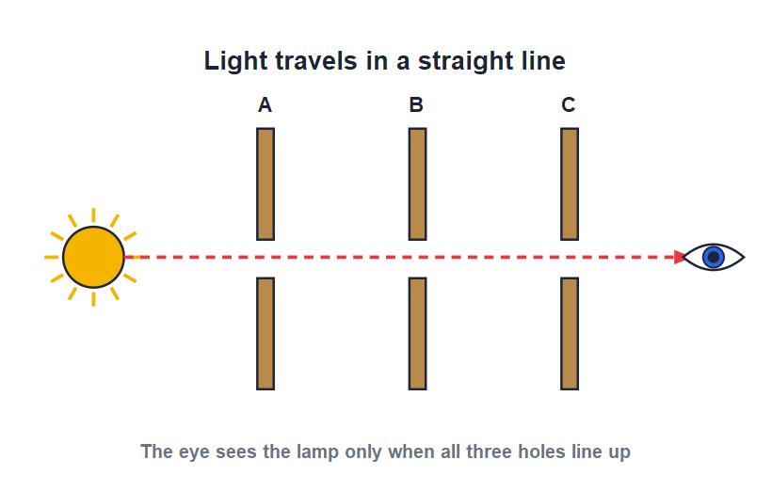
STRAIGHT LINES
Light Travels in a Straight Line
Rectilinear propagation
• In a single clear medium, light always travels in straight lines.
• This is called the rectilinear propagation of light.
• You can check it: light from a lamp is seen through three holes only when the holes are in one straight line.
• Move one card sideways and the light is blocked — proof that light does not bend around corners.
The lamp is seen only when the holes line up
21
Notes:
Describe the classic three-cardboard experiment. The key conclusion: light goes straight, so it is blocked the moment the holes no longer line up.

Slide 22

PROOFS
Everyday Proofs of Straight-Line Travel
Shadows
Pinhole images
An opaque object blocks light and casts a shadow with the same outline — light cannot bend around it.
A pinhole camera forms an image because rays travel straight through the hole.
Eclipses
Sunbeams
Solar and lunar eclipses happen because light from the Sun travels straight and is blocked.
Straight shafts of sunlight through clouds or trees show the rays travelling in straight lines.
22
Notes:
List the four everyday proofs; we study shadows, pinhole cameras and eclipses in detail next lesson. Sunbeams through trees are the most visible everyday proof.

Slide 23
AROUND US
Seeing Straight-Line Light
Light around us
• Shafts of sunlight breaking through clouds or trees are straight, never curved.
• A laser pointer makes a perfectly straight bright line.
• Car headlights and a torch send out straight beams.
• Because light goes straight, we cannot see around corners.
Sunbeams travel in straight lines
23
Notes:
Connect the physics to things students have seen — sunbeams, lasers, headlights. End on the everyday consequence: we cannot see around a corner.

Slide 24
FAST!
The Speed of Light
Light is the fastest thing in the universe — nothing travels faster than light.
Speed of light ≈ 3 × 10⁸ metres per second
• At this speed light could go around the Earth about seven times in one second.
• Sunlight takes about 8 minutes to reach the Earth.
• Light travels fastest in vacuum (empty space) and a little slower in air, water or glass.
24
Notes:
Give a sense of scale: seven times round the Earth in a second, 8 minutes from the Sun. Note light slows a little in glass or water — a hook for later grades.

Slide 25
WRAP UP
Quick Recap
✓ Light — a form of energy that lets us see; travels very fast
✓ Sources — natural (Sun, stars) and artificial (bulb, candle)
✓ Luminous / non-luminous — make own light vs seen by reflected light
✓ Materials — transparent, translucent or opaque
✓ Ray & beam — straight path of light; a bundle of rays
✓ Rectilinear — light travels in straight lines — shadows, pinhole, eclipses
25
Notes:
Rapid recap. Cold-call students for each, especially luminous vs non-luminous and the meaning of rectilinear propagation.

Slide 26
QUIZ 2
Final Check — How Light Travels
4 questions • think before the answer reveals on the next slide
26

Slide 27
QUIZ QUESTION
Q1 - Propagation
Light travelling in straight lines is called:
Reflection
Rectilinear propagation
A
B
Refraction
Dispersion
C
D
27

Slide 28
QUIZ QUESTION
Q1 - Propagation
Light travelling in straight lines is called:
Reflection
Rectilinear propagation
A
B
✓
Refraction
Dispersion
C
D
Why The straight-line travel of light is called rectilinear propagation. It is shown by shadows, pinhole images and eclipses.
28

Slide 29
QUIZ QUESTION
Q2 - Beams
A beam of light in which the rays come together to a point is a:
Parallel beam
Divergent beam
A
B
Convergent beam
Reflected beam
C
D
29

Slide 30
QUIZ QUESTION
Q2 - Beams
A beam of light in which the rays come together to a point is a:
Parallel beam
Divergent beam
A
B
Convergent beam
Reflected beam
C
✓
D
Why In a convergent beam the rays come together to a point. A divergent beam spreads out, and a parallel beam stays side by side.
30

Slide 31
QUIZ QUESTION
Q3 - Reasoning
We cannot see around corners because light:
Travels in straight lines
Travels in curves
A
B
Is too slow
Is a form of matter
C
D
31

Slide 32
QUIZ QUESTION
Q3 - Reasoning
We cannot see around corners because light:
Travels in straight lines
Travels in curves
A
✓
B
Is too slow
Is a form of matter
C
D
Why Since light travels in straight lines and cannot bend around an obstacle, we cannot see objects hidden around a corner.
32

Slide 33
QUIZ QUESTION
Q4 - Speed
The speed of light is about:
3 × 10³ m/s
3 × 10⁵ m/s
A
B
3 × 10⁸ m/s
3 × 10¹⁰ m/s
C
D
33

Slide 34
QUIZ QUESTION
Q4 - Speed
The speed of light is about:
3 × 10³ m/s
3 × 10⁵ m/s
A
B
3 × 10⁸ m/s
3 × 10¹⁰ m/s
C
✓
D
Why Light travels at about 3 × 10⁸ metres per second in vacuum — the fastest speed in the universe. Sunlight takes about 8 minutes to reach us.
34

Slide 35
Light Travels Straight
Light is energy that lets us see — and it always travels in straight lines, which is why we get shadows, images and eclipses.

