Slide 1
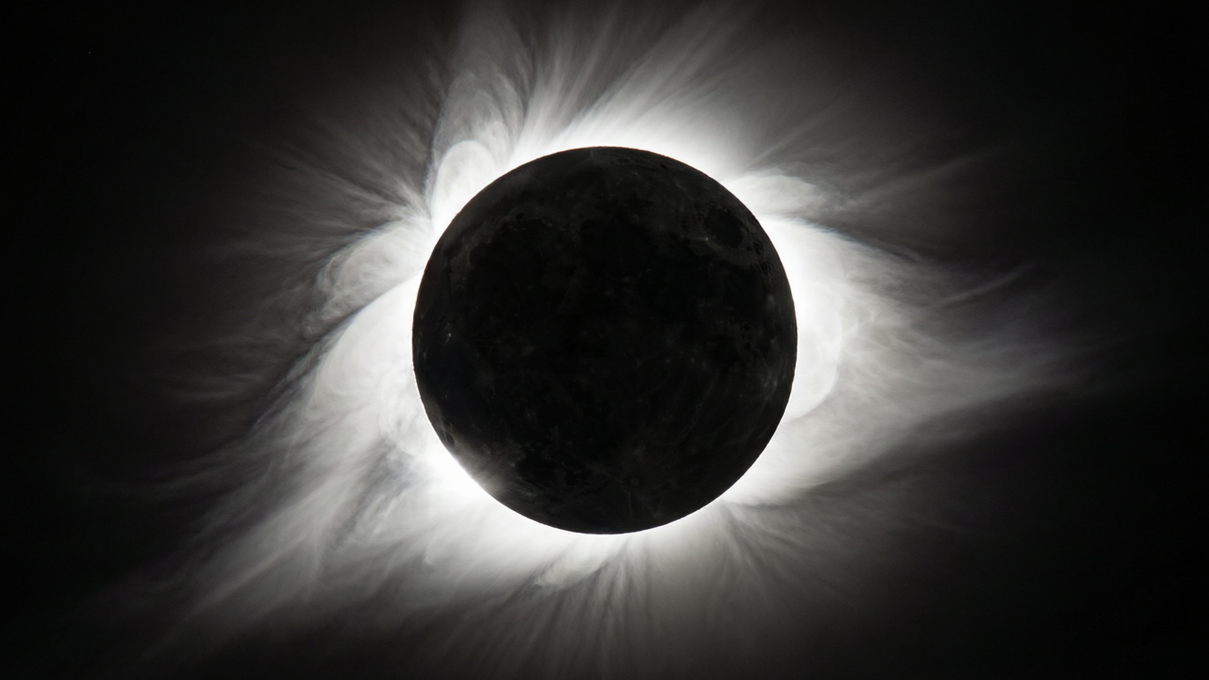
OPTICS
Light — 2
The pinhole camera • Shadows • Solar and lunar eclipses

Slide 2
INTRODUCTION
Learning Objectives
1
Describe how a pinhole camera forms an image
2
State the nature of the image in a pinhole camera
3
List the three things needed to form a shadow
4
Explain the dark umbra and the lighter penumbra
5
Explain how a solar eclipse forms
6
Explain how a lunar eclipse forms
2
Notes:
Open by previewing these objectives so students know what they should be able to do by the end of the session.

Slide 3
PART 1
Pinhole Camera & Shadows
1
Making images and shadows with straight light
3

Slide 4
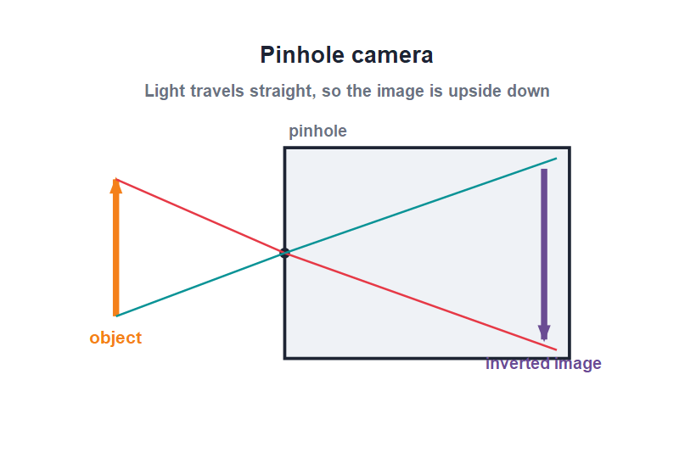
PINHOLE CAMERA
How a Pinhole Camera Works
A box with a tiny hole
• It is a closed box with a tiny hole on one side and a screen on the opposite side.
• Rays from the top of the object travel straight through the hole to the bottom of the screen, and vice versa.
• So the rays cross at the hole and the image is turned upside down (inverted).
• The image forms only because light travels in straight lines.
Rays cross at the hole, so the image is inverted
4
Notes:
Trace one ray from the top and one from the bottom of the object. Because they cross at the pinhole, the image is inverted — a direct result of straight-line travel.

Slide 5
THE IMAGE
Nature of the Pinhole Image
A real, inverted image
• Inverted The image is always upside down compared with the object.
• Real It can be caught on a screen, so it is a real image.
• Coloured The image is in the same colours as the object.
• Size depends on distance Moving the screen further from the hole makes the image larger; moving the object closer also enlarges it.
• Small hole A small hole gives a sharp but dim image; a large hole gives a bright but blurred one.
5
Notes:
List the characteristics. Emphasise real + inverted. Explain the trade-off of hole size: sharpness versus brightness.

Slide 6


MAKE & USE
More About the Pinhole Camera
Make your own
Bigger image
Use a closed box with a tiny hole on one side and a butter-paper screen on the opposite side.
The further the screen is from the hole, the larger (but dimmer) the image becomes.
One hole only
Where it helps
Several holes give several overlapping images, one from each hole.
The pinhole idea led to the modern camera and lets us view the Sun safely by projection.
6
Notes:
Turn the theory into an activity — students can build one from a shoebox. The projection use is a safe way to watch a solar eclipse, linking to Part 2.

Slide 7
SHADOW
What Makes a Shadow?
A shadow is the dark patch formed when an opaque object blocks the path of light.
• Three things are needed: a source of light, an opaque object, and a screen or surface.
• The shadow forms on the side of the object away from the light.
• A shadow has the same outline (shape) as the object.
• A shadow is always black, whatever the colour of the object, because it is simply the absence of light.
7
Notes:
Stress the three requirements. The key misconception to fix: a shadow takes its shape from the object but its colour is always black — it is just missing light.

Slide 8
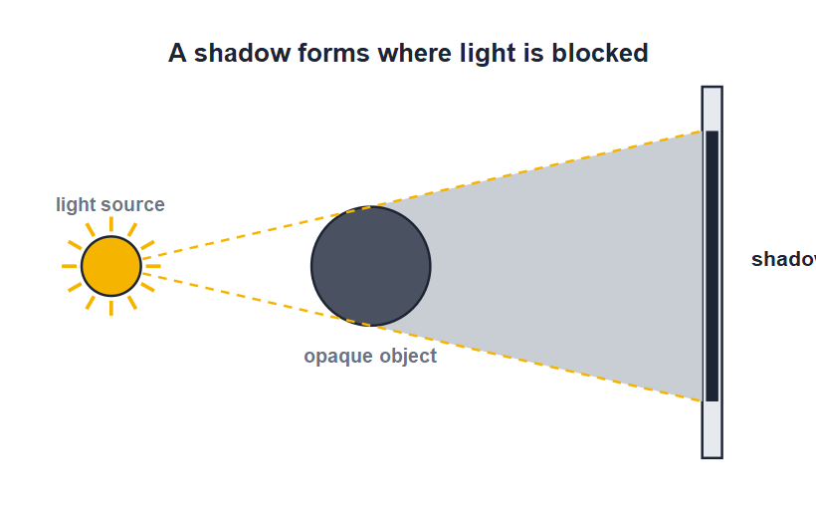
UMBRA & PENUMBRA
Two Parts of a Shadow
Umbra and penumbra
• From a small (point) source the shadow is sharp and fully dark.
• From a large (extended) source the shadow has two parts.
• The umbra is the central, fully dark region where all light is blocked.
• The penumbra is the lighter border where only part of the light is blocked.
A point source gives a sharp, fully dark shadow
8
Notes:
Contrast point and extended sources. Define umbra (full dark) and penumbra (partial). These same words describe the shadows in eclipses, coming up next.

Slide 9
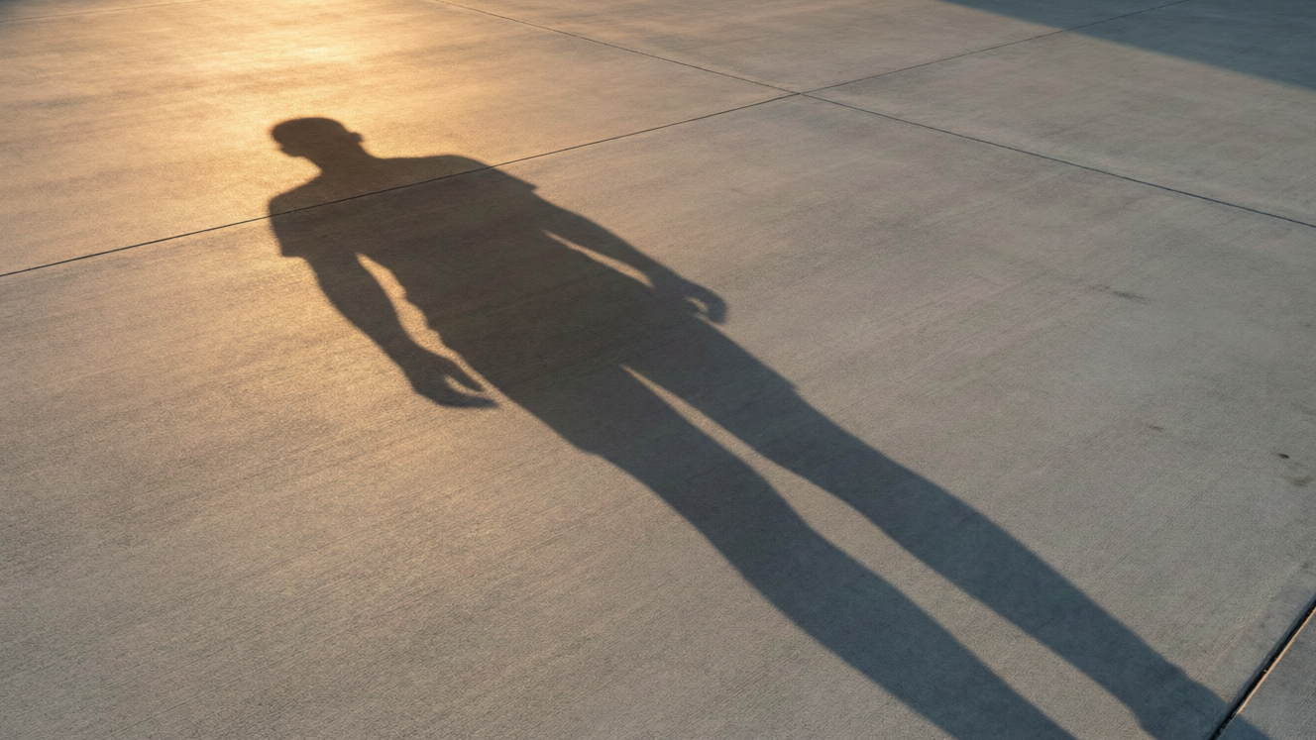
SHADOWS AROUND US
Shadows in Daily Life
Long and short shadows
• Your shadow is longest in the early morning and late evening, when the Sun is low.
• At noon, with the Sun overhead, your shadow is shortest.
• A shadow shows the shape of the object but none of its detail or colour.
• Shadow puppets use opaque hands to make shapes on a screen.
Low evening Sun casts a long shadow
9
Notes:
Relate shadow length to the Sun's height through the day. A nice activity: shadow puppets show that only the outline is reproduced.

Slide 10
QUIZ 1
Quick Check — Images & Shadows
4 questions • think before the answer reveals on the next slide
10

Slide 11
QUIZ QUESTION
Q1 - Pinhole
The image formed by a pinhole camera is always:
Upright and real
Inverted and real
A
B
Upright and virtual
Inverted and virtual
C
D
11

Slide 12
QUIZ QUESTION
Q1 - Pinhole
The image formed by a pinhole camera is always:
Upright and real
Inverted and real
A
B
✓
Upright and virtual
Inverted and virtual
C
D
Why Rays cross at the pinhole, so the image is inverted. It can be caught on a screen, so it is a real image.
12

Slide 13
QUIZ QUESTION
Q2 - Shadow
Which three things are needed to form a shadow?
Source, mirror, screen
Source, opaque object, screen
A
B
Source, lens, screen
Source, water, screen
C
D
13

Slide 14
QUIZ QUESTION
Q2 - Shadow
Which three things are needed to form a shadow?
Source, mirror, screen
Source, opaque object, screen
A
B
✓
Source, lens, screen
Source, water, screen
C
D
Why A shadow needs a source of light, an opaque object to block the light, and a screen or surface for the shadow to fall on.
14

Slide 15
QUIZ QUESTION
Q3 - Shadow colour
The colour of a shadow is always:
The colour of the object
Black
A
B
The colour of the light
White
C
D
15

Slide 16
QUIZ QUESTION
Q3 - Shadow colour
The colour of a shadow is always:
The colour of the object
Black
A
B
✓
The colour of the light
White
C
D
Why A shadow is simply a region where light is blocked, so it is always black, whatever the colour of the object.
16

Slide 17
QUIZ QUESTION
Q4 - Umbra
The fully dark central part of a shadow is the:
Penumbra
Umbra
A
B
Corona
Image
C
D
17

Slide 18
QUIZ QUESTION
Q4 - Umbra
The fully dark central part of a shadow is the:
Penumbra
Umbra
A
B
✓
Corona
Image
C
D
Why The umbra is the central region where all the light is blocked. The lighter border, where only some light is blocked, is the penumbra.
18

Slide 19
PART 2
Eclipses
2
When one body's shadow falls on another
19

Slide 20
ECLIPSE
What Is an Eclipse?
An eclipse happens when one heavenly body moves into the shadow of another, because light from the Sun travels in straight lines.
• The Sun, the Earth and the Moon must line up almost in a straight line.
• A shadow is cast because the blocking body is opaque.
• There are two kinds: the solar eclipse and the lunar eclipse.
• Eclipses are direct, dramatic proof that light travels in straight lines.
20
Notes:
Set up eclipses as large-scale shadows. The essential condition is the near-straight-line alignment of Sun, Earth and Moon.

Slide 21
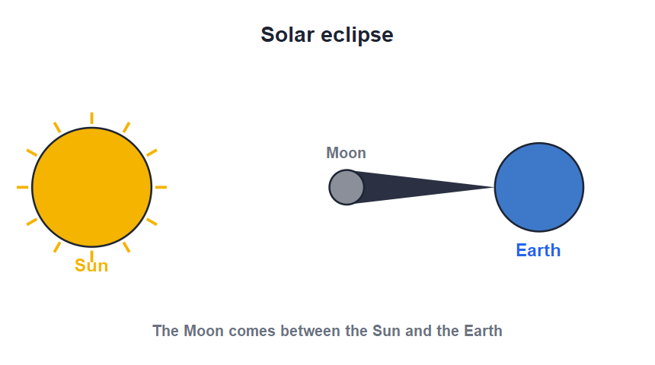
SOLAR ECLIPSE
The Solar Eclipse
Moon between Sun and Earth
• A solar eclipse happens when the Moon comes between the Sun and the Earth.
• The Moon's shadow then falls on a small part of the Earth.
• People standing in the dark umbra see a total solar eclipse; the Sun is hidden.
• It can only happen on a new-moon day, and the day briefly goes dark.
The Moon's shadow falls on the Earth
21
Notes:
Walk through the line-up: Sun, Moon, Earth. The Moon's shadow is small, so only a narrow strip sees totality. Warn never to look directly at the Sun.

Slide 22
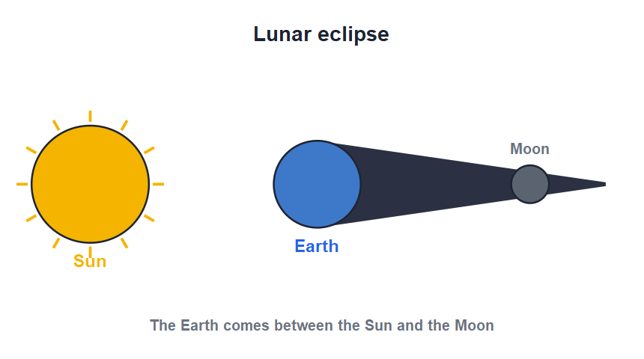
LUNAR ECLIPSE
The Lunar Eclipse
Earth between Sun and Moon
• A lunar eclipse happens when the Earth comes between the Sun and the Moon.
• The Earth's shadow then falls on the Moon, and the Moon darkens.
• It can only happen on a full-moon day.
• Because the Earth's shadow is large, a lunar eclipse lasts much longer and is seen from a whole half of the Earth.
The Earth's shadow falls on the Moon
22
Notes:
Contrast with the solar eclipse: now the Earth blocks the light. Because Earth is bigger, the lunar eclipse lasts longer and is widely visible — and is safe to watch.

Slide 23

SOLAR VS LUNAR
Comparing the Two Eclipses
Who is in the middle
Whose shadow
Solar: the Moon is in the middle. Lunar: the Earth is in the middle.
Solar: the Moon's shadow on the Earth. Lunar: the Earth's shadow on the Moon.
When
How long & safe
Solar happens on a new-moon day; lunar happens on a full-moon day.
A solar eclipse is brief; a lunar eclipse lasts longer and is safe to watch with the naked eye.
23
Notes:
Use this side-by-side table to lock in the difference. The most tested points: who is in the middle and whose shadow falls where.

Slide 24



FACTS & SAFETY
Eclipse Facts & Safety
Not every month
Solar safety
The Moon's orbit is slightly tilted, so the three bodies line up only a few times a year — not at every new or full moon.
Never look at a solar eclipse with bare eyes; use a proper filter or a pinhole projection.
Lunar safety
Blood moon
A lunar eclipse is completely safe to watch directly with the naked eye.
During a total lunar eclipse the Moon can glow coppery-red — sometimes called a 'blood moon'.
24
Notes:
Clear the common doubt of why eclipses are not monthly (tilted orbit). Stress solar-viewing safety. The red 'blood moon' is a memorable hook.

Slide 25
WRAP UP
Quick Recap
✓ Pinhole camera — tiny hole; real, inverted image; light goes straight
✓ Shadow — needs source, opaque object and screen; always black
✓ Umbra / penumbra — fully dark centre and lighter border
✓ Solar eclipse — Moon between Sun and Earth; new-moon day
✓ Lunar eclipse — Earth between Sun and Moon; full-moon day
✓ Why — all because light travels in straight lines
25
Notes:
Rapid recap; cold-call for each. Finish by tying everything back to rectilinear propagation.

Slide 26
QUIZ 2
Final Check — Eclipses
4 questions • think before the answer reveals on the next slide
26

Slide 27
QUIZ QUESTION
Q1 - Solar eclipse
A solar eclipse occurs when:
The Earth is between the Sun and the Moon
The Moon is between the Sun and the Earth
A
B
The Sun is between the Earth and the Moon
The Moon is full
C
D
27

Slide 28
QUIZ QUESTION
Q1 - Solar eclipse
A solar eclipse occurs when:
The Earth is between the Sun and the Moon
The Moon is between the Sun and the Earth
A
B
✓
The Sun is between the Earth and the Moon
The Moon is full
C
D
Why In a solar eclipse the Moon comes between the Sun and the Earth, and the Moon's shadow falls on the Earth. It happens on a new-moon day.
28

Slide 29
QUIZ QUESTION
Q2 - Lunar eclipse
A lunar eclipse occurs on a:
New-moon day
Full-moon day
A
B
Half-moon day
Any day
C
D
29

Slide 30
QUIZ QUESTION
Q2 - Lunar eclipse
A lunar eclipse occurs on a:
New-moon day
Full-moon day
A
B
✓
Half-moon day
Any day
C
D
Why A lunar eclipse happens when the Earth comes between the Sun and the Moon — only possible at full moon, when the Earth's shadow can fall on the Moon.
30

Slide 31
QUIZ QUESTION
Q3 - Shadows
In a lunar eclipse, whose shadow falls on the Moon?
The Moon's own shadow
The Sun's shadow
A
B
The Earth's shadow
A cloud's shadow
C
D
31

Slide 32
QUIZ QUESTION
Q3 - Shadows
In a lunar eclipse, whose shadow falls on the Moon?
The Moon's own shadow
The Sun's shadow
A
B
The Earth's shadow
A cloud's shadow
C
✓
D
Why During a lunar eclipse the Earth is in the middle, so the Earth's shadow falls on the Moon and darkens it.
32

Slide 33
QUIZ QUESTION
Q4 - Duration
Compared with a solar eclipse, a lunar eclipse:
Is much shorter
Lasts longer and is seen from more places
A
B
Cannot be seen
Happens at new moon
C
D
33

Slide 34
QUIZ QUESTION
Q4 - Duration
Compared with a solar eclipse, a lunar eclipse:
Is much shorter
Lasts longer and is seen from more places
A
B
✓
Cannot be seen
Happens at new moon
C
D
Why The Earth's shadow is large, so a lunar eclipse lasts longer and is visible from a whole half of the Earth — and it is safe to watch.
34

Slide 35
Shadows in the Sky
Pinhole images, shadows and eclipses are all the same idea — light travelling in straight lines and being blocked.

