Slide 1
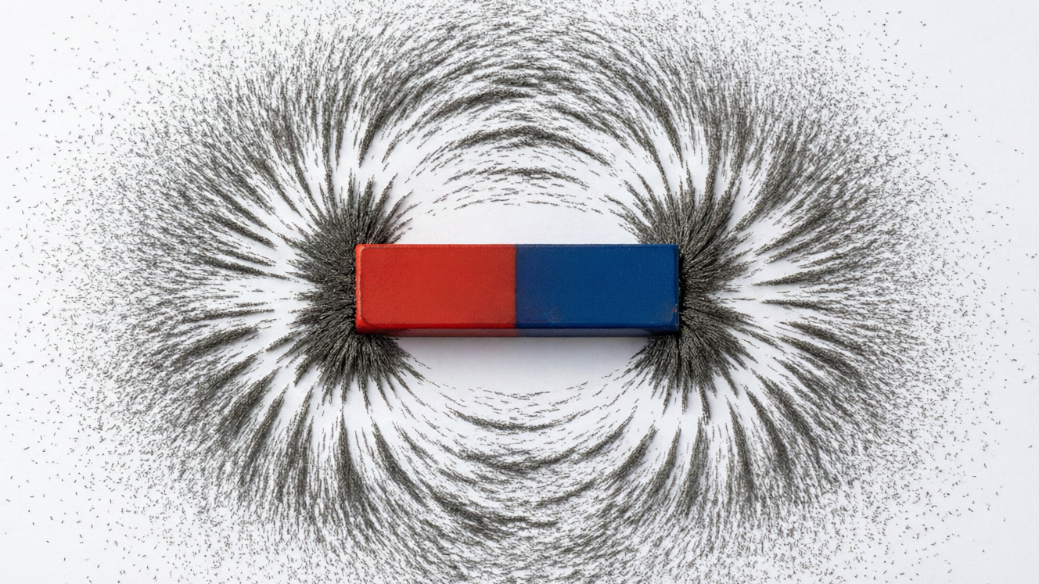
MAGNETISM
Magnetism — 1
Natural & artificial magnets • Magnetic materials • Properties of a magnet • The Earth as a magnet

Slide 2
INTRODUCTION
Learning Objectives
1
Describe how magnets were discovered and name their kinds
2
Tell magnetic materials apart from non-magnetic ones
3
List the main properties of a magnet
4
State the law of magnetic poles and the sure test of magnetism
5
Explain what a magnetic field is and draw its field lines
6
Describe the Earth's magnetism and how a compass works
2
Notes:
Open by previewing these objectives so students know what they should be able to do by the end of the session.

Slide 3
PART 1
Magnets & Their Properties
1
What magnets are and how they behave
3

Slide 4
MAGNET
What Is a Magnet?
A magnet is a substance that attracts magnetic materials like iron and points north–south when hung freely.
• Magnets were first found as a natural rock called lodestone (magnetite) that attracted iron.
• The word 'magnet' comes from Magnesia, the place where lodestone was discovered.
• Every magnet has two poles — a north pole and a south pole.
• Magnets are used in compasses, fridge doors, loudspeakers, motors and many machines.
4
Notes:
Begin with the story of lodestone — a natural rock that pulled iron. Establish the two defining behaviours: it attracts iron and it points north–south. These lead into the properties later.

Slide 5


KINDS
Natural and Artificial Magnets
Natural magnets
Artificial magnets
Found in nature as lodestone (magnetite). They are irregular in shape and rather weak.
Made by people from steel or other materials. They are stronger and made in useful shapes.
Common shapes
Why artificial?
Bar magnet, horseshoe (U-shaped) magnet, cylindrical magnet, magnetic needle and the ring magnet.
We can make them strong, give them any shape and make them last — so they are far more useful.
5
Notes:
Contrast natural lodestone with artificial magnets. Show or name the common shapes. Stress why artificial magnets are preferred — strength and a chosen shape.

Slide 6

MATERIALS
Magnetic and Non-magnetic Materials
Magnetic materials
Non-magnetic materials
Attracted by a magnet — iron, steel, nickel and cobalt.
Not attracted — wood, plastic, rubber, glass, paper, copper and aluminium.
A simple test
In daily life
Bring a magnet close: if the object is pulled towards it, the material is magnetic.
Pins and nails (iron) stick to a magnet, but a wooden pencil or a plastic ruler does not.
6
Notes:
Sort materials into magnetic and non-magnetic. Let students predict, then test, a few classroom objects. Iron, nickel and cobalt are the key magnetic metals.

Slide 7
PROPERTIES
Properties of a Magnet
Attracts iron
Points north–south
A magnet attracts magnetic materials, and the pull is strongest at its two poles.
A freely suspended magnet always comes to rest pointing north–south (the directive property).
Two poles
Poles and forces
Every magnet has a north and a south pole; break a magnet and each piece is a new magnet with both poles.
Like poles repel each other and unlike poles attract each other.
7
Notes:
Run through the four properties. Demonstrate the directive property with a suspended magnet. The 'break a magnet' idea — you can never get a single pole — surprises students.

Slide 8
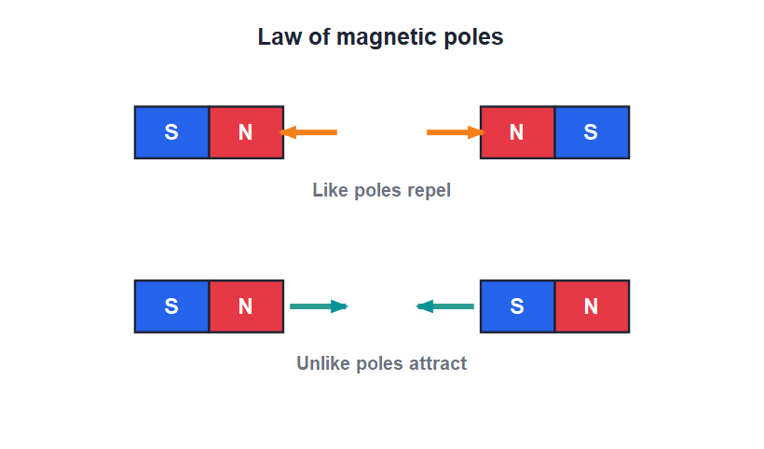
LAW OF POLES
Like Repels, Unlike Attracts
The sure test
• Bring two north poles together and they push apart — they repel.
• Bring a north pole near a south pole and they pull together — they attract.
• Repulsion happens only between two magnets, so repulsion is the sure test of magnetism.
• Attraction alone is not a sure test, because a magnet also attracts ordinary iron.
Like poles repel; unlike poles attract
8
Notes:
Drill the law of poles, then the key exam point: only repulsion proves an object is a magnet, because both a magnet and plain iron will show attraction.

Slide 9


EVERYDAY MAGNETS
Magnets in Everyday Life
Compass
Fridge & cupboards
A tiny magnet that always points north–south and helps us find direction.
Small magnets in the door seal hold the door shut, and fridge magnets stick notes up.
Sound & motion
Sorting & lifting
Magnets make loudspeakers, earphones and electric motors work.
Big magnets lift and separate iron and steel in scrapyards and recycling plants.
9
Notes:
Show how widely magnets are used so the topic feels real. Ask students to spot magnets at home — the fridge door and earphones are good starting points.

Slide 10
QUIZ 1
Quick Check — Magnets & Materials
4 questions • think before the answer reveals on the next slide
10

Slide 11
QUIZ QUESTION
Q1 - Materials
Which of these is a magnetic material?
Wood
Iron
A
B
Plastic
Glass
C
D
11

Slide 12
QUIZ QUESTION
Q1 - Materials
Which of these is a magnetic material?
Wood
Iron
A
B
✓
Plastic
Glass
C
D
Why Iron is attracted by a magnet, so it is a magnetic material. Wood, plastic and glass are non-magnetic — a magnet does not attract them.
12

Slide 13
QUIZ QUESTION
Q2 - Poles
When the north poles of two magnets are brought close, they:
Attract
Repel
A
B
Do nothing
Join together
C
D
13

Slide 14
QUIZ QUESTION
Q2 - Poles
When the north poles of two magnets are brought close, they:
Attract
Repel
A
B
✓
Do nothing
Join together
C
D
Why Like poles repel each other. Two north poles are like poles, so they push apart.
14

Slide 15
QUIZ QUESTION
Q3 - Sure test
The sure test of whether an object is a magnet is:
Attraction
Repulsion
A
B
Its colour
Its weight
C
D
15

Slide 16
QUIZ QUESTION
Q3 - Sure test
The sure test of whether an object is a magnet is:
Attraction
Repulsion
A
B
✓
Its colour
Its weight
C
D
Why Only two magnets repel. A magnet also attracts ordinary iron, so attraction is not a sure test — but repulsion proves the object is a magnet.
16

Slide 17
QUIZ QUESTION
Q4 - Poles
If a bar magnet is broken into two pieces, each piece will have:
Only a north pole
Only a south pole
A
B
Both north and south poles
No poles
C
D
17

Slide 18
QUIZ QUESTION
Q4 - Poles
If a bar magnet is broken into two pieces, each piece will have:
Only a north pole
Only a south pole
A
B
Both north and south poles
No poles
C
✓
D
Why You can never get a single pole. Each broken piece becomes a complete new magnet with its own north and south pole.
18

Slide 19
PART 2
Magnetic Field & the Earth
2
The space around a magnet, and our planet's magnetism
19

Slide 20
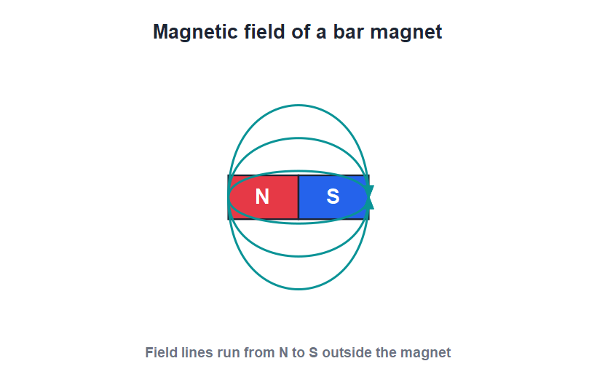
MAGNETIC FIELD
The Magnetic Field
Field lines
• The magnetic field is the region around a magnet where its force can be felt.
• We picture it using magnetic field lines.
• Outside the magnet the field lines run from the north pole to the south pole.
• The lines are closest together near the poles, where the field is strongest.
Field lines run from N to S outside the magnet
20
Notes:
Define the magnetic field as the region of influence. Introduce field lines as a way to picture it. Crowded lines near the poles mean a stronger field there.

Slide 21
FIELD LINES
Properties of Magnetic Field Lines
Reading a field pattern
• Direction Outside the magnet they point from the north pole to the south pole.
• They never cross Two field lines never cut across each other.
• Crowding shows strength Where the lines are closer together, the magnetic field is stronger — that is near the poles.
• Closed loops Each field line is a closed loop, continuing from S back to N inside the magnet.
21
Notes:
List the rules for field lines. The two most tested: lines go N to S outside, and they never cross. Crowding near the poles = a stronger field.

Slide 22
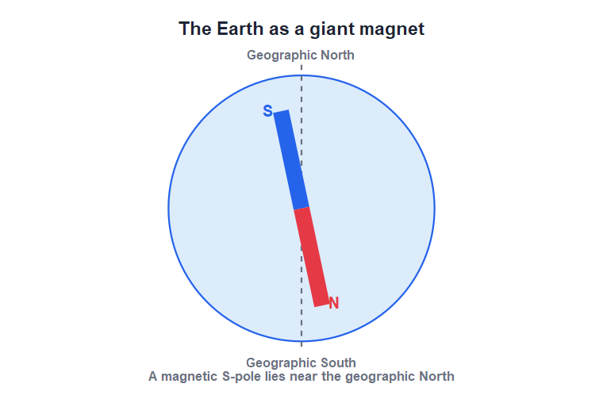
EARTH
The Earth Is a Giant Magnet
Earth's magnetism
• The Earth behaves as if a huge bar magnet lies inside it.
• This is why a freely suspended magnet always points north–south.
• The Earth's magnetic south pole lies near the geographic north, so a compass needle's north end points north.
• The Earth's magnetism shields us and helps us find direction.
A magnetic S-pole lies near the geographic North
22
Notes:
Explain that the Earth itself acts like a bar magnet, which is why compasses work. Clarify the neat twist: a magnetic south pole sits near the geographic north.

Slide 23
COMPASS
The Magnetic Compass
What it is
Why it works
A small magnetised needle, free to turn, that always settles pointing north–south.
It lines up with the Earth's magnetic field, just like any freely suspended magnet.
Finding direction
Keep it away from
Sailors, pilots and trekkers use it to know which way is north.
Iron objects and other magnets, which disturb the needle and give a wrong reading.
23
Notes:
The compass is the everyday use of the directive property. Note that nearby iron or magnets spoil the reading.

Slide 24
PLOTTING THE FIELD
Mapping a Magnetic Field
Compass-and-paper method
• Use a small compass Place a plotting compass near a bar magnet on paper and mark where its needle points.
• Move and mark Move the compass a little, mark again, and join the marks to trace one field line.
• Build the pattern Start from different points to draw the whole field-line pattern around the magnet.
• Read the strength Where your lines come out close together, the field is strong; where they spread out, it is weak.
24
Notes:
Describe the standard practical of plotting field lines with a small compass. It links the abstract field lines to something students can actually do and see.

Slide 25
WRAP UP
Quick Recap
✓ Magnet — attracts iron and points north–south; first found as lodestone
✓ Materials — iron, steel, nickel, cobalt are magnetic; most others are not
✓ Properties — attracts at poles, directive, two inseparable poles
✓ Law of poles — like repel, unlike attract; repulsion is the sure test
✓ Field — region of force; lines run N to S, never cross
✓ Earth — acts like a giant magnet, so a compass points north
25
Notes:
Rapid recap. Cold-call for the law of poles and the sure test, which are the most examined points.

Slide 26
QUIZ 2
Final Check — Fields & the Earth
4 questions • think before the answer reveals on the next slide
26

Slide 27
QUIZ QUESTION
Q1 - Field lines
Outside a magnet, the magnetic field lines run from:
South pole to north pole
North pole to south pole
A
B
Pole to the middle
They do not move
C
D
27

Slide 28
QUIZ QUESTION
Q1 - Field lines
Outside a magnet, the magnetic field lines run from:
South pole to north pole
North pole to south pole
A
B
✓
Pole to the middle
They do not move
C
D
Why By convention, magnetic field lines outside a magnet are drawn from the north pole to the south pole.
28

Slide 29
QUIZ QUESTION
Q2 - Field strength
The magnetic field of a bar magnet is strongest:
At its centre
At its two poles
A
B
Far away from it
It is the same everywhere
C
D
29

Slide 30
QUIZ QUESTION
Q2 - Field strength
The magnetic field of a bar magnet is strongest:
At its centre
At its two poles
A
B
✓
Far away from it
It is the same everywhere
C
D
Why The field is strongest at the poles, where the field lines are most crowded; it is weakest near the middle of the magnet.
30

Slide 31
QUIZ QUESTION
Q3 - Earth
A compass needle points north–south because:
It is blown by the wind
The Earth acts like a giant magnet
A
B
It is made of gold
It is very light
C
D
31

Slide 32
QUIZ QUESTION
Q3 - Earth
A compass needle points north–south because:
It is blown by the wind
The Earth acts like a giant magnet
A
B
✓
It is made of gold
It is very light
C
D
Why The Earth behaves like a huge bar magnet, so the compass needle lines up with the Earth's magnetic field and points north–south.
32

Slide 33
QUIZ QUESTION
Q4 - Field lines
Two magnetic field lines can never:
Be curved
Cross each other
A
B
Be close together
Point to a pole
C
D
33

Slide 34
QUIZ QUESTION
Q4 - Field lines
Two magnetic field lines can never:
Be curved
Cross each other
A
B
✓
Be close together
Point to a pole
C
D
Why Field lines never cross. If they did, the field would point in two directions at one place, which is impossible.
34

Slide 35
The Pull of Magnets
Magnets attract iron, always seek north and fill the space around them with an invisible field — even our planet is one.

