Slide 1
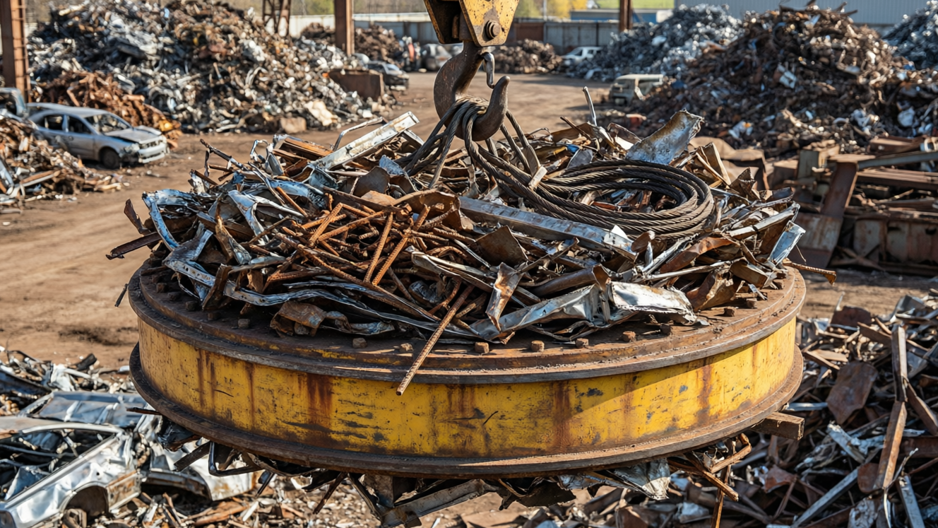
MAGNETISM
Magnetism — 2
Making a magnet • Electromagnets • Care & storage • Losing magnetism

Slide 2
INTRODUCTION
Learning Objectives
1
Describe ways of making a magnet
2
Explain the single-touch (stroking) method
3
Describe an electromagnet and how to make one stronger
4
Tell temporary magnets apart from permanent magnets
5
State how magnets should be stored and cared for
6
List the ways a magnet can lose its magnetism
2
Notes:
Open by previewing these objectives so students know what they should be able to do by the end of the session.

Slide 3
PART 1
Making Magnets
1
Turning steel and iron into magnets
3

Slide 4



HOW TO MAGNETISE
Ways to Make a Magnet
Single touch
Double touch
Stroke a steel bar again and again in one direction with one pole of a magnet.
Stroke the bar from the middle outwards using two unlike poles together.
By induction
By electricity
Simply bringing a magnet near a piece of iron makes the iron a temporary magnet.
Pass an electric current through a coil wound around the bar — this makes an electromagnet.
4
Notes:
Introduce the four ways to magnetise. Single touch is the one to know in detail. Induction is temporary; the electrical method is the strongest and is used in electromagnets.

Slide 5
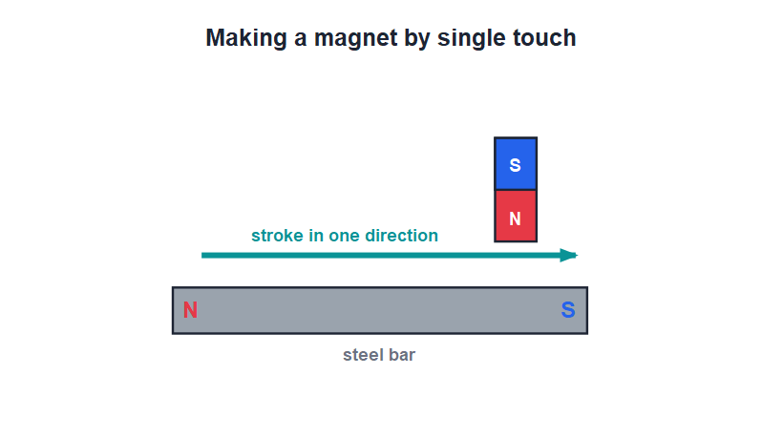
SINGLE TOUCH
The Single-Touch Method
Stroke one way
• Place the steel bar flat on the table.
• Stroke it from one end to the other with one pole of a magnet.
• Lift the magnet high at the end of each stroke and repeat many times in the same direction.
• The bar becomes a magnet; the end where the stroking pole leaves it gets the opposite polarity.
Stroke in one direction, again and again
5
Notes:
Demonstrate the stroking action. Two rules: always stroke in the SAME direction, and lift the pole well clear between strokes. The finishing end takes the polarity opposite to the stroking pole.

Slide 6
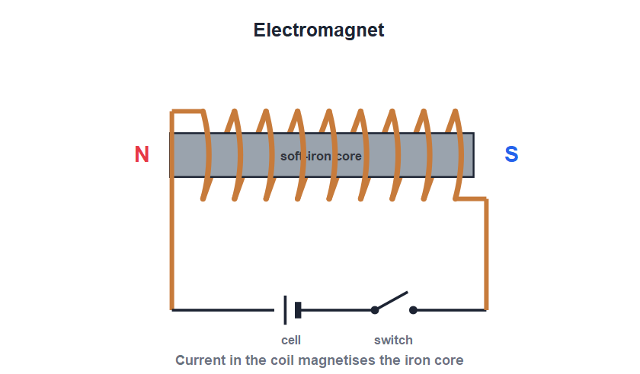
ELECTROMAGNET
Making an Electromagnet
Coil + iron core
• Wind insulated copper wire into a coil around a soft-iron core.
• Connect the ends of the coil to a cell through a switch.
• When current flows, the iron core becomes a strong magnet.
• Switch the current off and the magnetism almost completely disappears — it is a temporary magnet.
Current in the coil magnetises the iron core
6
Notes:
Build the electromagnet step by step. The headline idea: its magnetism can be switched on and off with the current — that is what makes it so useful.

Slide 7

STRONGER
Making an Electromagnet Stronger
More turns
More current
Winding more turns of wire on the coil makes the electromagnet stronger.
Increasing the current through the coil increases its strength.
A soft-iron core
Switchable
A soft-iron core becomes strongly magnetic and boosts the field.
Its magnetism can be turned on and off and even reversed — a permanent magnet cannot do this.
7
Notes:
Three ways to strengthen: more turns, more current, soft-iron core. End on the big advantage — it can be switched and reversed.

Slide 8
TEMPORARY VS PERMANENT
Temporary and Permanent Magnets
Temporary magnets
Permanent magnets
Made of soft iron; magnetic only while the current flows. Used in electromagnets.
Made of steel; keep their magnetism for a long time. Used in compasses and fridge magnets.
Soft iron
Steel
Is easy to magnetise and easy to demagnetise.
Is harder to magnetise but holds its magnetism well.
8
Notes:
Contrast soft iron (temporary, for electromagnets) with steel (permanent). Tie the choice of material to the job the magnet must do.

Slide 9
INDUCTION
Magnetism by Induction
A magnet makes more magnets
• No touching needed Simply bringing a magnet near a piece of iron turns the iron into a temporary magnet.
• Chains of pins A nail clinging to a magnet can itself pick up more nails, which hang in a chain.
• It is temporary Take the magnet away and the induced magnetism almost completely disappears.
• Why attraction works A magnet first induces magnetism in the iron, and that is what lets it then pull the iron in.
9
Notes:
Demonstrate induction with a chain of pins hanging from one magnet. The key idea: induction comes first, and that is the real reason a magnet can attract a piece of iron.

Slide 10
QUIZ 1
Quick Check — Making Magnets
4 questions • think before the answer reveals on the next slide
10

Slide 11
QUIZ QUESTION
Q1 - Method
In the single-touch method, the steel bar is stroked:
In both directions
In one direction only
A
B
Very gently once
Without a magnet
C
D
11

Slide 12
QUIZ QUESTION
Q1 - Method
In the single-touch method, the steel bar is stroked:
In both directions
In one direction only
A
B
✓
Very gently once
Without a magnet
C
D
Why In single touch you stroke the bar repeatedly in the same direction with one pole, lifting the magnet clear between strokes.
12

Slide 13
QUIZ QUESTION
Q2 - Electromagnet
An electromagnet is made by passing current through a coil wound on a core of:
Steel
Soft iron
A
B
Copper
Plastic
C
D
13

Slide 14
QUIZ QUESTION
Q2 - Electromagnet
An electromagnet is made by passing current through a coil wound on a core of:
Steel
Soft iron
A
B
✓
Copper
Plastic
C
D
Why A soft-iron core becomes strongly magnetic when current flows and loses it when the current stops, making a good electromagnet.
14

Slide 15
QUIZ QUESTION
Q3 - Strength
Which change makes an electromagnet stronger?
Fewer turns of wire
Less current
A
B
More turns of wire
A plastic core
C
D
15

Slide 16
QUIZ QUESTION
Q3 - Strength
Which change makes an electromagnet stronger?
Fewer turns of wire
Less current
A
B
More turns of wire
A plastic core
C
✓
D
Why More turns of wire (and more current, and a soft-iron core) make an electromagnet stronger.
16

Slide 17
QUIZ QUESTION
Q4 - Type
A permanent magnet is usually made of:
Soft iron
Steel
A
B
Copper
Aluminium
C
D
17

Slide 18
QUIZ QUESTION
Q4 - Type
A permanent magnet is usually made of:
Soft iron
Steel
A
B
✓
Copper
Aluminium
C
D
Why Steel is hard to magnetise but holds its magnetism for a long time, so it is used to make permanent magnets.
18

Slide 19
PART 2
Uses, Care & Demagnetisation
2
Where electromagnets help, and how magnetism is kept or lost
19

Slide 20
USES
Uses of Electromagnets
Lifting cranes
Electric bell
Powerful electromagnets on cranes lift heavy iron and steel scrap, then drop it by switching off.
An electromagnet makes the hammer strike the gong again and again.
Machines
Separating metals
Electromagnets are used in electric motors, loudspeakers, telephones and many devices.
They pull magnetic metals out of mixed waste for recycling.
20
Notes:
Connect electromagnets to real machines. The crane (switch on to lift, off to drop) best shows why a switchable magnet is so useful.

Slide 21
CARE
Caring For and Storing Magnets
Looking after magnets
• Store in pairs Keep bar magnets in pairs with unlike poles together.
• Use keepers Place soft-iron pieces (keepers) across the ends to preserve their magnetism.
• Keep them safe Do not drop, hammer or heat magnets — this weakens them.
• Keep apart Store magnets away from watches, mobile phones and other magnets.
21
Notes:
Explain why magnets need care. Keepers give the field a closed path and stop the magnet weakening. Heat, shock and stray fields are the enemies.

Slide 22
DEMAGNETISATION
How a Magnet Loses Its Magnetism
A magnet can lose its magnetism if it is treated roughly or heated — this is called demagnetisation.
• Heating a magnet strongly and then cooling it makes it lose its magnetism.
• Hammering or dropping a magnet again and again weakens it.
• Placing it in a coil carrying alternating current (AC) removes its magnetism.
• Careless storage near other magnets also makes a magnet weaker over time.
22
Notes:
List the three deliberate ways to demagnetise — heating, rough handling, and an AC coil — and tie them back to the care rules from the previous slide.

Slide 23

PERMANENT VS TEMPORARY
Choosing the Right Magnet
Need it to last?
Need to switch it?
Use a permanent (steel) magnet — for a compass or a fridge magnet.
Use an electromagnet — for a crane or an electric bell.
Need it strong?
Keep it safe
An electromagnet can be made very strong with more turns and more current.
Either kind weakens with heat, shock and careless storage, so handle with care.
23
Notes:
Wrap the chapter by matching the magnet to the job: permanent for lasting magnetism, electromagnet for switchable strength.

Slide 24
KEEPERS
Why Magnets Need Keepers
Storing bar magnets safely
• Free poles weaken Left on their own, the free poles of a magnet slowly lose their strength.
• Store in pairs Place two bar magnets side by side with unlike poles next to each other.
• Add soft-iron keepers Lay small soft-iron bars across the ends to link the poles together.
• A complete loop The keepers give the magnetism a closed path, so the magnets stay strong for much longer.
24
Notes:
Explain how keepers work: by completing the magnetic loop they stop the poles weakening. This ties the storage rule back to the idea of field lines forming closed loops.

Slide 25
WRAP UP
Quick Recap
✓ Making magnets — single touch, double touch, induction, electricity
✓ Single touch — stroke one way, lift between strokes
✓ Electromagnet — coil + soft-iron core; magnetism while current flows
✓ Stronger — more turns, more current, soft-iron core
✓ Care — store in pairs with keepers; avoid heat, shock, stray fields
✓ Demagnetise — heating, hammering/dropping, an AC coil
25
Notes:
Rapid recap. Cold-call students for the ways to make a magnet and the ways to demagnetise one.

Slide 26
QUIZ 2
Final Check — Using & Losing Magnetism
4 questions • think before the answer reveals on the next slide
26

Slide 27
QUIZ QUESTION
Q1 - Uses
A crane in a scrapyard lifts heavy iron using a:
Permanent magnet
Wooden hook
A
B
An electromagnet
A plastic clamp
C
D
27

Slide 28
QUIZ QUESTION
Q1 - Uses
A crane in a scrapyard lifts heavy iron using a:
Permanent magnet
Wooden hook
A
B
An electromagnet
A plastic clamp
C
✓
D
Why A crane uses an electromagnet: switch the current on to lift the iron, and off to drop it. A permanent magnet could not let go.
28

Slide 29
QUIZ QUESTION
Q2 - Care
The soft-iron pieces placed across the ends of stored magnets are called:
Poles
Keepers
A
B
Cores
Coils
C
D
29

Slide 30
QUIZ QUESTION
Q2 - Care
The soft-iron pieces placed across the ends of stored magnets are called:
Poles
Keepers
A
B
✓
Cores
Coils
C
D
Why Keepers are soft-iron pieces placed across the poles of stored magnets to preserve their magnetism.
30

Slide 31
QUIZ QUESTION
Q3 - Demagnetise
Which of these will make a magnet lose its magnetism?
Storing it with keepers
Strongly heating it
A
B
Keeping it dry
Handling it gently
C
D
31

Slide 32
QUIZ QUESTION
Q3 - Demagnetise
Which of these will make a magnet lose its magnetism?
Storing it with keepers
Strongly heating it
A
B
✓
Keeping it dry
Handling it gently
C
D
Why Strong heating, repeated hammering or dropping, and an AC coil all destroy magnetism. Careful storage with keepers preserves it.
32

Slide 33
QUIZ QUESTION
Q4 - Electromagnet
The magnetism of an electromagnet lasts:
For ever
Only while current flows
A
B
Only at night
Only when it is hot
C
D
33

Slide 34
QUIZ QUESTION
Q4 - Electromagnet
The magnetism of an electromagnet lasts:
For ever
Only while current flows
A
B
✓
Only at night
Only when it is hot
C
D
Why An electromagnet is a temporary magnet — it is magnetic only while current flows through its coil, and loses it when switched off.
34

Slide 35
Magnets On Demand
From a stroked steel bar to a switchable electromagnet, we can make, use and even switch off magnetism whenever we need it.

