Slide 1
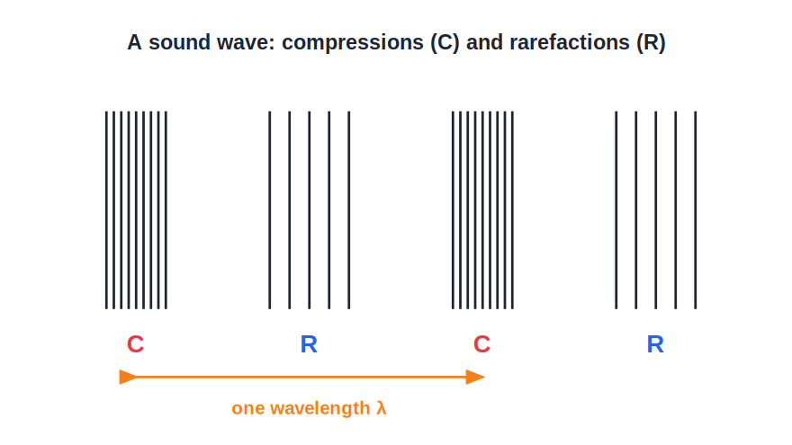
ICSE • CLASS 8 • SOUND
How Sound is Made & Travels
Vibrations • A medium to travel • Longitudinal waves • Picturing a wave

Slide 2
INTRODUCTION
Learning Objectives
1
Explain that sound is produced by vibrating bodies
2
Show that sound needs a material medium to travel
3
Explain why sound cannot travel through a vacuum
4
Describe a sound wave as a longitudinal wave
5
Identify compressions and rarefactions in a sound wave
6
Represent a wave and compare speeds of sound in different media
Notes:
Open by previewing these objectives so students know what they should be able to do by the end of the session.

Slide 3
PART 1
Producing & Carrying Sound
1
Vibrations and the medium they travel through

Slide 4


PRODUCTION
Sound Comes From Vibrations
Vibration
Every sound source
The rapid to-and-fro motion of a body is called vibration.
A plucked string, a struck drum, a ringing bell — all are vibrating.
Feel it
Stop the vibration
Touch your throat while you speak — the vibrating vocal cords can be felt.
Hold a struck tuning fork or bell and the sound dies at once.
Notes:
Core idea: sound is produced by vibrating bodies. Demonstrations: throat, tuning fork, drum, bell. Stop the vibration → stop the sound.

Slide 5
A MEDIUM
Sound Needs a Material Medium
Sound cannot travel on its own — it needs particles of a solid, liquid or gas to pass the vibration along.
• The vibrating source pushes the particles next to it, which push the next, and so on.
• The disturbance travels outward, but the particles only move to and fro about their places.
• Solids carry sound best, then liquids, then gases.
Notes:
Sound is a mechanical wave: it needs a medium. Particles pass the disturbance along without travelling themselves.

Slide 6
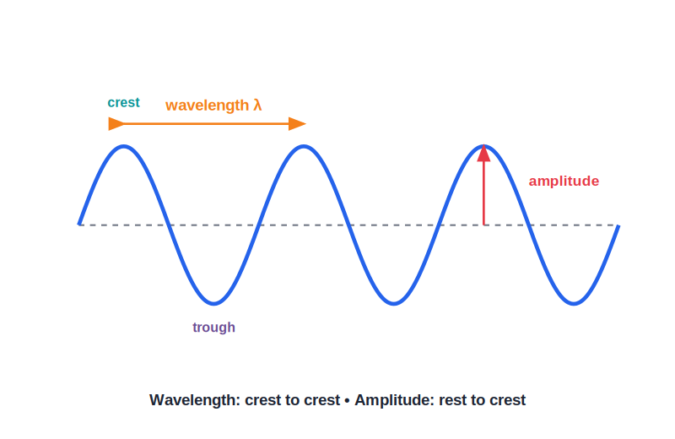
NO VACUUM
Why There Is No Sound in a Vacuum
The bell-jar experiment
• A vacuum has no particles to carry the vibration.
• In the classic bell-jar experiment, an electric bell rings inside a jar.
• As the air is pumped out, the sound grows fainter and fainter.
• When the jar is nearly empty, the bell is seen striking but is no longer heard.
No medium, no sound
Notes:
Bell-jar experiment proves sound needs a medium: remove the air and the sound fades to nothing, even though the bell still moves.

Slide 7
LONGITUDINAL
A Sound Wave is a Longitudinal Wave
Compressions & rarefactions
• The particles vibrate back and forth along the same direction the sound travels.
• Where particles crowd together we get a compression (high pressure).
• Where they spread apart we get a rarefaction (low pressure).
• A sound wave is a moving pattern of compressions and rarefactions.
Particles vibrate along the direction of travel
Notes:
Longitudinal wave: particle motion is parallel to the direction of travel. Compressions (crowded) and rarefactions (spread out) alternate.

Slide 8

MANY MEDIA
Sound Through Solids, Liquids and Gases
Through air
Through water
We hear most everyday sounds carried to us by the air.
A swimmer underwater can hear sounds; whales call across the sea.
Through solids
Why it differs
Put an ear to a desk and a gentle tap at the far end is heard clearly.
Closely packed particles in solids pass the vibration on best, gases the least.
Notes:
Sound travels through all three states of matter. Solids carry it best because their particles are closely packed.

Slide 9
QUIZ 1
Check Your Understanding
4 questions • think before the answer reveals on the next slide

Slide 10
QUIZ QUESTION
Q1 — Silent Bell
An electric bell rings inside a glass jar. As the air is slowly pumped out, the sound:
Grows louder
Fades until it can no longer be heard
A
B
Stays the same
Turns into an echo
C
D

Slide 11
ANSWER REVEALED
Q1 — Silent Bell
An electric bell rings inside a glass jar. As the air is slowly pumped out, the sound:
Grows louder
Fades until it can no longer be heard
A
✓
Stays the same
Turns into an echo
C
D
WHY
Sound needs particles to travel. As the air is removed there are fewer particles to carry the vibration, so the sound fades — even though the bell is still seen striking.

Slide 12
QUIZ QUESTION
Q2 — Source of Sound
Every source of sound has one thing in common — it is:
Hot
Vibrating
A
B
Glowing
Heavy
C
D

Slide 13
ANSWER REVEALED
Q2 — Source of Sound
Every source of sound has one thing in common — it is:
Hot
Vibrating
A
✓
Glowing
Heavy
C
D
WHY
Whether it is a string, a drum skin or vocal cords, a body must vibrate to make sound. Stop the vibration and the sound stops instantly.

Slide 14
QUIZ QUESTION
Q3 — Particle Motion
In a sound wave travelling through air, the air particles:
Travel all the way with the sound
Vibrate to and fro about fixed positions
A
B
Stay perfectly still
Move at right angles to the wave
C
D

Slide 15
ANSWER REVEALED
Q3 — Particle Motion
In a sound wave travelling through air, the air particles:
Travel all the way with the sound
Vibrate to and fro about fixed positions
A
✓
Stay perfectly still
Move at right angles to the wave
C
D
WHY
The disturbance moves forward, but each particle only swings back and forth about its own place, passing the energy to the next particle. That is why it is a longitudinal wave.

Slide 16
QUIZ QUESTION
Q4 — Best Carrier
Through which medium does sound usually travel fastest?
Air
Water
A
B
Steel
Vacuum
C
D

Slide 17
ANSWER REVEALED
Q4 — Best Carrier
Through which medium does sound usually travel fastest?
Air
Water
A
B
Steel
Vacuum
✓
D
WHY
Particles in a solid are packed tightly and pass vibrations on quickly, so sound travels fastest in solids like steel, slower in liquids, and slowest in gases.

Slide 18
PART 2
Picturing & Speeding Sound
2
Representing a wave and how fast it moves

Slide 19
REPRESENTATION
Representing a Wave
A wave on paper
• A sound wave is hard to draw, so we picture it as a smooth curve.
• The crests stand for compressions and the troughs for rarefactions.
• This makes it easy to mark the wavelength and amplitude.
• The curve is only a picture — the real sound is still a longitudinal wave.
Crest = compression, trough = rarefaction
Notes:
We represent the longitudinal sound wave as a curve so wavelength and amplitude are easy to mark. Remind students it is only a representation.

Slide 20

SPEED
The Speed of Sound
Depends on the medium
Fastest in solids
Sound travels at different speeds in solids, liquids and gases.
Tightly packed particles pass on the vibration quickly.
In air
Much slower than light
About 330–340 m/s at ordinary temperature.
We see lightning before we hear the thunder, though both start together.
Notes:
Speed of sound: fastest in solids, slowest in gases, ~340 m/s in air. Far slower than light — hence the lightning-then-thunder gap.

Slide 21
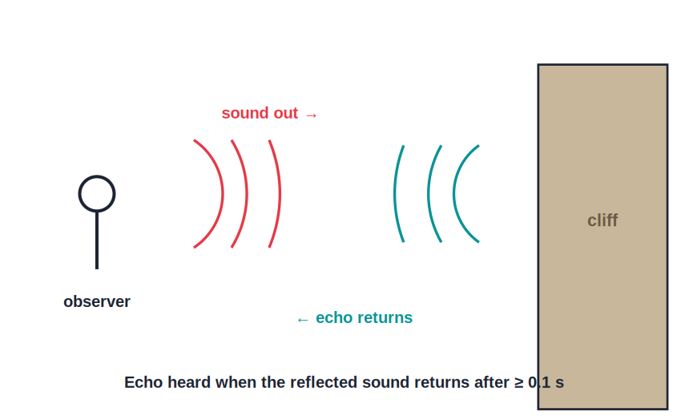
ECHO
Reflection of Sound — the Echo
Sound that comes back
• Sound bounces off a hard surface just as a ball bounces off a wall.
• A reflected sound heard separately from the original is called an echo.
• We hear a distinct echo only if the reflecting surface is far enough away.
• Echoes are used to find the depth of the sea and to locate objects under water.
The reflected sound returns to the listener
Notes:
Reflection of sound gives an echo. A distinct echo needs a distant surface. Used in depth-sounding and locating underwater objects.

Slide 22
EVERYDAY
Sound in Everyday Life
Talking & music
Telephones
Vocal cords and instruments turn vibrations into the sounds we share.
Speech is changed to signals, sent far away, then turned back into sound.
Warnings
Finding things
Horns, bells and sirens use loud sound to alert us.
Ships use reflected sound (sonar) to measure depth and spot objects.
Notes:
Everyday roles of sound: communication, music, warnings and sonar. Connects the physics to students' lives.

Slide 23
WRAP UP
Quick Recap
✓ Production — sound is made by vibrating bodies
✓ Medium — sound needs particles — solid, liquid or gas
✓ Vacuum — no particles, so no sound
✓ Longitudinal — compressions and rarefactions along the travel
✓ Representation — drawn as a curve: crest = compression
✓ Speed — fastest in solids, ~340 m/s in air, slower than light
Notes:
Rapid recap of production, the need for a medium, the longitudinal nature and the speed of sound.

Slide 24
QUIZ 2
Final Check — Producing & Carrying Sound
5 questions • think before the answer reveals on the next slide

Slide 25
QUIZ QUESTION
Q1 — Thunder Delay
We see a flash of lightning several seconds before we hear the thunder because:
Light is louder
Light travels much faster than sound
A
B
Sound is blocked by clouds
Thunder starts later
C
D

Slide 26
ANSWER REVEALED
Q1 — Thunder Delay
We see a flash of lightning several seconds before we hear the thunder because:
Light is louder
Light travels much faster than sound
A
✓
Sound is blocked by clouds
Thunder starts later
C
D
WHY
Light reaches us almost instantly, while sound crawls along at about 340 m/s. Both begin together, but the sound arrives noticeably later, giving the delay.

Slide 27
QUIZ QUESTION
Q2 — Crowded Particles
The region of a sound wave where the air particles are crowded together is called a:
Rarefaction
Compression
A
B
Crest
Vacuum
C
D

Slide 28
ANSWER REVEALED
Q2 — Crowded Particles
The region of a sound wave where the air particles are crowded together is called a:
Rarefaction
Compression
A
✓
Crest
Vacuum
C
D
WHY
Where the particles bunch up the air pressure is high — this is a compression. Where they spread apart the pressure is low — that is a rarefaction.

Slide 29
QUIZ QUESTION
Q3 — Astronauts Talk
Two astronauts in open space cannot hear each other speak directly because space is:
Too cold
A vacuum with no medium to carry sound
A
B
Too bright
Too far
C
D

Slide 30
ANSWER REVEALED
Q3 — Astronauts Talk
Two astronauts in open space cannot hear each other speak directly because space is:
Too cold
A vacuum with no medium to carry sound
A
✓
Too bright
Too far
C
D
WHY
Open space has almost no particles, so there is nothing to carry the vibrations of speech. The astronauts must use radio, which travels as electromagnetic waves needing no medium.

Slide 31
QUIZ QUESTION
Q4 — Direction of Vibration
In a longitudinal wave the particles of the medium vibrate:
At right angles to the wave
Along the same direction the wave travels
A
B
In circles
Not at all
C
D

Slide 32
ANSWER REVEALED
Q4 — Direction of Vibration
In a longitudinal wave the particles of the medium vibrate:
At right angles to the wave
Along the same direction the wave travels
A
✓
In circles
Not at all
C
D
WHY
A longitudinal wave has its particle motion parallel to the direction of travel, producing compressions and rarefactions. Sound in air is exactly this kind of wave.

Slide 33
QUIZ QUESTION
Q5 — Ear to the Rail
Putting an ear to a steel railway track lets us hear an approaching train sooner than through the air because sound travels:
Slower in steel
Faster in steel than in air
A
B
Only in air
Backwards
C
D

Slide 34
ANSWER REVEALED
Q5 — Ear to the Rail
Putting an ear to a steel railway track lets us hear an approaching train sooner than through the air because sound travels:
Slower in steel
Faster in steel than in air
A
✓
Only in air
Backwards
C
D
WHY
Sound travels much faster through a solid like steel than through air, so the vibrations along the rail reach the ear before the sound carried by the air.

Slide 35
Sound on the Move
A vibration sets the particles of matter dancing — passing the sound from one to the next, but never through empty space.

