Slide 1
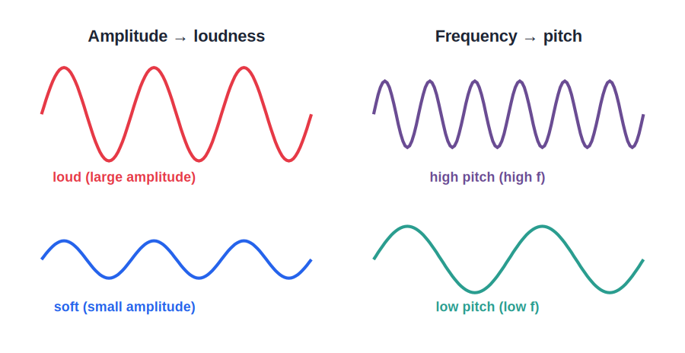
ICSE • CLASS 8 • SOUND
Characteristics of Sound
Amplitude & loudness • Frequency & pitch • Quality • Noise vs music

Slide 2
INTRODUCTION
Learning Objectives
1
Define amplitude, frequency, time period and wavelength
2
Relate amplitude to the loudness of a sound
3
Relate frequency to the pitch of a sound
4
Explain quality (timbre) and why instruments sound different
5
Distinguish a musical note from noise
6
Give everyday examples of the characteristics of sound
Notes:
Open by previewing these objectives so students know what they should be able to do by the end of the session.

Slide 3
PART 1
Measuring a Wave
1
Amplitude, frequency, time period and wavelength

Slide 4
WAVE QUANTITIES
Quantities That Describe a Wave
The four key terms
• Amplitude The greatest distance a particle moves from its rest position.
• Frequency The number of vibrations made in one second, measured in hertz (Hz).
• Time period The time taken for one complete vibration; it is 1 ÷ frequency.
• Wavelength The distance covered by one complete wave.
Notes:
Define the four wave quantities. Stress frequency (Hz) and that time period = 1/frequency.

Slide 5
AMPLITUDE
Amplitude Decides Loudness
Bigger swing = louder
• A bigger vibration carries more energy.
• Larger amplitude means a louder sound.
• Striking a drum harder makes a bigger vibration and a louder beat.
• Loudness also falls off as we move away from the source.
Loud and soft waves have the same pitch but different amplitude
Notes:
Amplitude → loudness. Harder strike = bigger amplitude = louder. Loudness also depends on distance from the source.

Slide 6
INTENSITY
Loudness and Intensity
Loudness is how loud a sound seems to our ears, while intensity is the sound energy actually arriving each second on a given area.
• Greater amplitude → greater intensity → louder sound.
• Loudness depends on intensity but also on how sensitive the listener's ear is.
• Loudness is measured in a unit called the decibel (dB).
Notes:
Distinguish loudness (perceived) from intensity (energy/area). Decibel is the unit of loudness.

Slide 7

HOW LOUD?
Everyday Sound Levels
Whisper
Normal talk
A soft rustle of about 10–20 dB, barely heard across a quiet room.
Ordinary conversation is around 60 dB.
Busy traffic
Jet engine
City traffic reaches roughly 80–90 dB.
A jet taking off is well over 120 dB — painfully loud and harmful.
Notes:
Give a feel for the decibel scale with familiar examples. Sounds above about 85 dB for long periods can damage hearing.

Slide 8
QUIZ 1
Check Your Understanding
4 questions • think before the answer reveals on the next slide

Slide 9
QUIZ QUESTION
Q1 — Louder Drum
Hitting a drum harder makes a louder sound because it increases the vibration's:
Frequency
Amplitude
A
B
Pitch
Speed
C
D

Slide 10
ANSWER REVEALED
Q1 — Louder Drum
Hitting a drum harder makes a louder sound because it increases the vibration's:
Frequency
Amplitude
A
✓
Pitch
Speed
C
D
WHY
A harder strike makes the drum skin swing further from its rest position — a larger amplitude. More amplitude carries more energy, so the sound is louder. The pitch is unchanged.

Slide 11
QUIZ QUESTION
Q2 — Time Period
A vibrating body has a frequency of 50 Hz. Its time period is:
50 s
1/50 s = 0.02 s
A
B
100 s
5 s
C
D

Slide 12
ANSWER REVEALED
Q2 — Time Period
A vibrating body has a frequency of 50 Hz. Its time period is:
50 s
1/50 s = 0.02 s
A
✓
100 s
5 s
C
D
WHY
Time period is the time for one vibration and equals 1 ÷ frequency. With 50 vibrations each second, one vibration takes 1/50 s, which is 0.02 s.

Slide 13
QUIZ QUESTION
Q3 — Same Note, Softer
Two sounds have the same pitch but one is much softer. The softer one has a smaller:
Frequency
Amplitude
A
B
Wavelength
Speed
C
D

Slide 14
ANSWER REVEALED
Q3 — Same Note, Softer
Two sounds have the same pitch but one is much softer. The softer one has a smaller:
Frequency
Amplitude
A
✓
Wavelength
Speed
C
D
WHY
Same pitch means the same frequency. The difference in loudness must come from amplitude — the softer sound is made by a smaller vibration.

Slide 15
QUIZ QUESTION
Q4 — Unit of Loudness
The loudness of a sound is measured in:
Hertz
Decibel
A
B
Metre
Second
C
D

Slide 16
ANSWER REVEALED
Q4 — Unit of Loudness
The loudness of a sound is measured in:
Hertz
Decibel
A
✓
Metre
Second
C
D
WHY
Loudness is measured in decibels (dB). Hertz measures frequency, not loudness. A whisper is a few decibels; a jet engine is well over a hundred.

Slide 17
PART 2
Pitch, Quality & Noise
2
What makes sounds high, low and different

Slide 18
PITCH
Frequency Decides Pitch
Faster vibration = higher pitch
• Pitch is how high or low a sound seems.
• A higher frequency gives a higher pitch.
• A thin, tight or short string vibrates faster and sounds shrill.
• A woman's voice is usually higher-pitched than a man's.
High and low pitch waves have the same amplitude but different frequency
Notes:
Pitch → frequency. Higher frequency = higher pitch. Thin/short/tight strings vibrate faster and sound shriller.

Slide 19
QUALITY
Quality (Timbre)
What it is
Why it differs
The characteristic that lets us tell two sources apart, even at the same pitch and loudness.
Each source adds its own mix of extra frequencies, giving a different wave shape.
Recognising voices
Instruments
Quality lets us know a friend's voice on the phone without seeing them.
A flute and a violin playing the same note still sound clearly different.
Notes:
Quality / timbre distinguishes sources at the same pitch and loudness, because each has a different waveform. Lets us tell voices and instruments apart.

Slide 20

NOISE VS MUSIC
Musical Note and Noise
Musical note
Noise
A pleasant sound with a regular, smooth pattern of vibrations.
An unpleasant sound with an irregular, jumbled pattern.
Monotone
Noise pollution
A sound of a single unchanging frequency.
Too much loud, unwanted sound that can harm hearing and health.
Notes:
Music = regular waveform (pleasant); noise = irregular (unpleasant). Monotone = single frequency. Mention noise pollution.

Slide 21
RANGE OF HEARING
Sounds We Can and Cannot Hear
20 Hz to 20,000 Hz
• Audible range A healthy human ear hears from about 20 Hz to 20,000 Hz.
• Infrasonic Sounds below 20 Hz are too low for us — elephants use them to communicate.
• Ultrasonic Sounds above 20,000 Hz are too high for us — dogs and bats can hear them.
• Uses of ultrasound Cleaning, medical scans and sonar all use ultrasonic sound.
Notes:
Audible range 20–20,000 Hz. Below = infrasonic, above = ultrasonic. Ultrasound has many practical uses.

Slide 22

NOISE CONTROL
Noise Pollution and Its Control
What it is
Effects
Unwanted, excessive sound that disturbs and can harm health.
It causes stress, poor sleep, and can damage hearing over time.
At the source
Around us
Quieter machines, silencers on vehicles and bans on needless horns help.
Trees, sound barriers and thick walls absorb and block unwanted sound.
Notes:
Noise pollution: causes and control. Tackle it at the source and by absorbing/blocking sound. Plant trees, use barriers.

Slide 23
WRAP UP
Quick Recap
✓ Amplitude — decides loudness — bigger swing, louder sound
✓ Frequency — decides pitch — faster vibration, higher pitch
✓ Time period — time for one vibration = 1 / frequency
✓ Quality — tells two sources apart at the same pitch
✓ Loudness — measured in decibels; depends on intensity
✓ Music vs noise — regular pattern vs irregular jumble
Notes:
Rapid recap of the three characteristics — loudness, pitch, quality — plus music vs noise.

Slide 24
QUIZ 2
Final Check — Characteristics of Sound
5 questions • think before the answer reveals on the next slide

Slide 25
QUIZ QUESTION
Q1 — Two Flutes
A flute and a violin play exactly the same note at the same loudness, yet we can still tell them apart because they differ in:
Pitch
Loudness
A
B
Quality (timbre)
Speed
C
D

Slide 26
ANSWER REVEALED
Q1 — Two Flutes
A flute and a violin play exactly the same note at the same loudness, yet we can still tell them apart because they differ in:
Pitch
Loudness
A
B
Quality (timbre)
Speed
✓
D
WHY
Same note means same pitch; same loudness means same amplitude. The remaining difference is quality — each instrument produces a different waveform, so they sound distinct.

Slide 27
QUIZ QUESTION
Q2 — Higher Pitch
Tightening a guitar string and plucking it raises the pitch because the string now vibrates with a higher:
Amplitude
Frequency
A
B
Wavelength
Loudness
C
D

Slide 28
ANSWER REVEALED
Q2 — Higher Pitch
Tightening a guitar string and plucking it raises the pitch because the string now vibrates with a higher:
Amplitude
Frequency
A
✓
Wavelength
Loudness
C
D
WHY
A tighter string vibrates faster — more vibrations per second, a higher frequency. Since pitch rises with frequency, the note sounds higher.

Slide 29
QUIZ QUESTION
Q3 — Shrill Voice
A child's voice sounds shriller than an adult's mainly because the child's vocal cords vibrate at a:
Lower frequency
Higher frequency
A
B
Larger amplitude
Slower speed
C
D

Slide 30
ANSWER REVEALED
Q3 — Shrill Voice
A child's voice sounds shriller than an adult's mainly because the child's vocal cords vibrate at a:
Lower frequency
Higher frequency
A
✓
Larger amplitude
Slower speed
C
D
WHY
Shrillness is high pitch, and pitch rises with frequency. A child's shorter, thinner vocal cords vibrate faster, giving a higher frequency and a shriller voice.

Slide 31
QUIZ QUESTION
Q4 — Jumbled Sound
A sound made of an irregular, jumbled pattern of vibrations is best described as:
A musical note
Noise
A
B
A monotone
An echo
C
D

Slide 32
ANSWER REVEALED
Q4 — Jumbled Sound
A sound made of an irregular, jumbled pattern of vibrations is best described as:
A musical note
Noise
A
✓
A monotone
An echo
C
D
WHY
Pleasant musical notes come from regular, repeating vibrations. An irregular, jumbled pattern is heard as noise, which is generally unpleasant.

Slide 33
QUIZ QUESTION
Q5 — 100 Hz vs 200 Hz
Two strings sound at 100 Hz and 200 Hz with equal amplitude. Compared with the 100 Hz string, the 200 Hz string sounds:
Louder
Higher in pitch
A
B
Softer
Exactly the same
C
D

Slide 34
ANSWER REVEALED
Q5 — 100 Hz vs 200 Hz
Two strings sound at 100 Hz and 200 Hz with equal amplitude. Compared with the 100 Hz string, the 200 Hz string sounds:
Louder
Higher in pitch
A
✓
Softer
Exactly the same
C
D
WHY
Equal amplitude means equal loudness, so the difference is pitch. The 200 Hz string vibrates twice as fast, so it sounds higher in pitch than the 100 Hz string.

Slide 35
The Colours of Sound
Amplitude sets how loud, frequency sets how high, and quality gives each voice and instrument its own signature.

