Slide 1
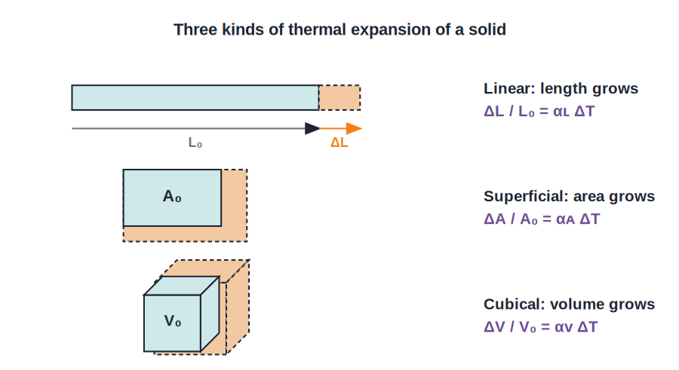
CLASS 10 • THERMAL PHYSICS
Heat & Expansion
Temperature & the kelvin scale • Thermal equilibrium • Thermal energy • Expansion of substances

Slide 2
INTRODUCTION
Learning Objectives
1
Define temperature and the absolute (kelvin) scale
2
Convert between Celsius, Kelvin and Fahrenheit
3
Explain thermal equilibrium and thermal energy
4
State the characteristic features of heat transfer
5
Classify the thermal expansion of solids, liquids and gases
6
Distinguish real expansion from apparent expansion
Notes:
Open by previewing these objectives so students know what they should be able to do by the end of the session.

Slide 3
PART 1
Temperature & Thermal Energy
1
Hotness, the kelvin scale and the flow of heat

Slide 4
TEMPERATURE
What Is Temperature?
Temperature is the degree of hotness of a body — the property that decides the direction in which heat flows.
• It tells us whether a body is in thermal equilibrium with its surroundings.
• It is a scalar quantity related to the average kinetic energy of the molecules.
• SI unit: the kelvin (K); other units are °C and °F.
Notes:
Temperature = degree of hotness and decides heat-flow direction. SI unit kelvin; relate to average molecular kinetic energy.

Slide 5
ABSOLUTE SCALE
The Absolute (Kelvin) Scale
Temperature measured from absolute zero on the kelvin scale is the absolute or thermodynamic temperature.
0 K = −273 °C (absolute zero) • a change of 1 °C = a change of 1 K
• Each kelvin is 1/273.16 of the thermodynamic temperature of the triple point of water.
• Absolute zero (0 K) is the lowest possible temperature.
• Because the degree size is the same, ΔT is identical in °C and K.
Notes:
Kelvin scale starts at absolute zero (−273 °C). Same degree size as Celsius, so temperature DIFFERENCES are equal in both.

Slide 6
CONVERTING
Relating the Temperature Scales
The three scales are connected by simple relations.
K = °C + 273 • K = (°F + 460) × 5/9
• Celsius → Kelvin: add 273.
• Fahrenheit → Kelvin: add 460, then multiply by 5/9.
• 0 K corresponds to −273 °C.
Notes:
Give the two conversion relations from the text. Most numericals just need K = °C + 273.

Slide 7
WORKED EXAMPLE
Celsius to Kelvin
Problem. Normal human body temperature is about 37 °C. Express it on the kelvin scale.
K = °C + 273
K = 37 + 273
K = 310 K
Answer: Body temperature ≈ 310 K
Notes:
Straight application of K = °C + 273. Remind students kelvin values are never negative for real bodies.

Slide 8
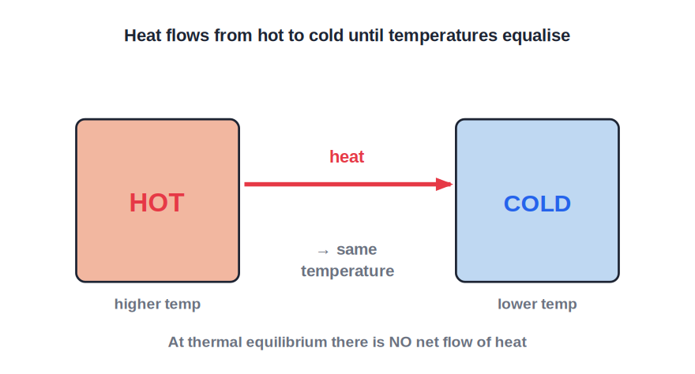
THERMAL EQUILIBRIUM
Thermal Equilibrium
No net heat flow
• Two bodies are in thermal equilibrium if there is no net flow of heat between them.
• Place a hot and a cold body in contact: heat flows from hot to cold.
• The hot body cools and the cold body warms until both reach the same temperature.
• At that point they are in thermal equilibrium.
Heat flows hot → cold until temperatures are equal
Notes:
Thermal equilibrium = equal temperatures, no net heat flow. Build it from the hot-and-cold-block picture.

Slide 9
THERMAL ENERGY
Thermal Energy (Heat)
Thermal energy is the form of energy that is transferred between two bodies because of a difference in their temperatures.
SI unit of heat energy: the joule (J)
• It is also called heat energy or simply 'heat'.
• The process of transferring it from a hotter to a colder body is called heating.
• Heat is a scalar quantity.
Notes:
Thermal energy (heat) flows due to a temperature difference; SI unit joule; the transfer is 'heating'.

Slide 10


KEY FEATURES
Characteristic Features of Heat Transfer
Hot to cold
Mass unchanged
Heat always flows from a body at higher temperature to one at lower temperature.
The mass of a body is not altered when it is heated or cooled.
Heat gained = heat lost
Conservation
In any exchange, the heat gained by the cold body equals the heat lost by the hot body.
This balance is simply the conservation of energy applied to heat.
Notes:
Three features from the text. 'Heat gained = heat lost' is the basis of calorimetry problems.

Slide 11
UNITS OF HEAT
Units of Heat Energy
Joule (J)
Calorie
The SI unit of heat energy.
The heat needed to raise the temperature of 1 g of water by 1 °C.
Kilocalorie
Link
The heat needed to raise the temperature of 1 kg of water by 1 °C.
1 kilocalorie = 1000 calories; the calorie is still used for food energy.
Notes:
Joule (SI), calorie (1 g water, 1 °C) and kilocalorie (1 kg water, 1 °C). 1 kcal = 1000 cal.

Slide 12
QUIZ 1
Check Your Understanding
5 questions • think before the answer reveals on the next slide

Slide 13
QUIZ QUESTION
Q1 — To Kelvin
A liquid is at 27 °C. Its temperature on the kelvin scale is:
27 K
246 K
A
B
300 K
−246 K
C
D

Slide 14
ANSWER REVEALED
Q1 — To Kelvin
A liquid is at 27 °C. Its temperature on the kelvin scale is:
27 K
246 K
A
B
300 K
−246 K
✓
D
WHY
K = °C + 273 = 27 + 273 = 300 K. The kelvin reading is just the Celsius value plus 273.

Slide 15
QUIZ QUESTION
Q2 — Equilibrium
Two bodies at different temperatures are placed in contact. Heat stops flowing between them when they:
Have equal masses
Reach the same temperature
A
B
Have equal volumes
Are both frozen
C
D

Slide 16
ANSWER REVEALED
Q2 — Equilibrium
Two bodies at different temperatures are placed in contact. Heat stops flowing between them when they:
Have equal masses
Reach the same temperature
A
✓
Have equal volumes
Are both frozen
C
D
WHY
Heat flows from hot to cold until both bodies are at the same temperature — thermal equilibrium — after which there is no net flow, whatever their masses.

Slide 17
QUIZ QUESTION
Q3 — Heat Balance
When a hot metal is dropped into cool water (no heat lost to the surroundings):
The water loses heat to the metal
Heat gained by the water equals heat lost by the metal
A
B
Both gain heat
No heat moves
C
D

Slide 18
ANSWER REVEALED
Q3 — Heat Balance
When a hot metal is dropped into cool water (no heat lost to the surroundings):
The water loses heat to the metal
Heat gained by the water equals heat lost by the metal
A
✓
Both gain heat
No heat moves
C
D
WHY
By conservation of energy, every joule the hotter metal loses is gained by the cooler water until they reach a common temperature.

Slide 19
QUIZ QUESTION
Q4 — Define a Calorie
One calorie is the heat needed to raise the temperature of:
1 kg of water by 1 °C
1 g of water by 1 °C
A
B
1 g of any liquid by 1 K
1 litre of water by 10 °C
C
D

Slide 20
ANSWER REVEALED
Q4 — Define a Calorie
One calorie is the heat needed to raise the temperature of:
1 kg of water by 1 °C
1 g of water by 1 °C
A
✓
1 g of any liquid by 1 K
1 litre of water by 10 °C
C
D
WHY
A calorie raises 1 gram of water through 1 °C; a kilocalorie does the same for 1 kilogram. The SI unit, though, is the joule.

Slide 21
QUIZ QUESTION
Q5 — Absolute Zero
The lowest possible temperature, 0 K, is equal to:
0 °C
−100 °C
A
B
−273 °C
273 °C
C
D

Slide 22
ANSWER REVEALED
Q5 — Absolute Zero
The lowest possible temperature, 0 K, is equal to:
0 °C
−100 °C
A
B
−273 °C
273 °C
✓
D
WHY
Absolute zero is 0 on the kelvin scale, which corresponds to −273 °C. No body can be cooled below this temperature.

Slide 23
PART 2
Effects of Heat & Expansion
2
What heat does to matter, and how things expand

Slide 24
EFFECTS OF HEAT
What Heat Energy Does to a Body
Temperature rises
Change of state
Supplying heat usually makes a body hotter.
Heat can melt a solid or boil a liquid.
Expansion
Proportional
Almost all substances expand when heated.
The temperature rise is proportional to the heat supplied, and depends on the mass and nature of the substance.
Notes:
The three effects of heat: temperature rise, change of state, expansion. This chapter focuses on expansion.

Slide 25
WHY EXPAND
Thermal Expansion
When a substance is heated, its particles vibrate or move more and push a little further apart, so the substance expands.
• For the same temperature rise, gases expand most, then liquids, then solids.
• Solids expand least because of their rigid structure.
• On cooling, substances contract again.
Notes:
Molecular cause of expansion. Order: gases > liquids > solids for the same temperature rise.

Slide 26
EXPANSION OF SOLIDS
Three Kinds of Expansion in Solids
Length, area and volume
• Linear expansion: a change in length (a rod gets longer).
• Superficial expansion: a change in area (a plate grows).
• Cubical expansion: a change in volume (a block grows).
• Each is described by its own coefficient of expansion, with unit K⁻¹.
Linear, superficial and cubical expansion
Notes:
Three kinds of solid expansion. Each has a coefficient (per kelvin) that differs by material.

Slide 27
LINEAR EXPANSION
Linear (Longitudinal) Expansion
When a body is heated, the change in its length per unit length per degree rise is its coefficient of linear expansion.
ΔL / L₀ = αʟ ΔT (αʟ in K⁻¹)
• ΔL = change in length, L₀ = original length.
• ΔT = change in temperature.
• αʟ depends on the material of the rod.
Notes:
Linear expansion ΔL/L₀ = αʟΔT. Define each term; αʟ is a material property measured per kelvin.

Slide 28
AREA & VOLUME
Superficial and Cubical Expansion
Area and volume expand in the same way, each with its own coefficient.
ΔA / A₀ = αᴀ ΔT ΔV / V₀ = αᴠ ΔT
• αᴀ = coefficient of superficial (area) expansion.
• αᴠ = coefficient of cubical (volume) expansion.
• Both have the unit K⁻¹, like the linear coefficient.
Notes:
Same form for area and volume. All three coefficients are in K⁻¹.

Slide 29

VALUES
Coefficient of Cubical Expansion (per K)
Aluminium
Brass / Glass
7 × 10⁻⁵
6 × 10⁻⁵ / 2.5 × 10⁻⁵
Water
Mercury
20.7 × 10⁻⁵
18.2 × 10⁻⁵ — used in thermometers
Notes:
Representative values from Table 3.1. Liquids (water, mercury) have much larger coefficients than solids.

Slide 30
WORKED EXAMPLE
Linear Expansion of a Rod
Problem. A metal rod 2 m long has αʟ = 1.2 × 10⁻⁵ K⁻¹. Find the increase in its length when heated through 50 °C.
ΔL = αʟ L₀ ΔT
ΔL = (1.2 × 10⁻⁵) × 2 × 50
ΔL = 1.2 × 10⁻³ m
Answer: ΔL = 1.2 × 10⁻³ m = 1.2 mm
Notes:
Apply ΔL = αʟL₀ΔT. A small but important expansion — why rails and bridges are given gaps.

Slide 31
LIQUIDS & GASES
Expansion of Liquids and Gases
Liquids and gases also expand on heating — by more than solids.
• A liquid expands more than a solid for the same temperature rise.
• A gas expands the most of the three.
• Heating a liquid in a container expands both the container and the liquid.
Notes:
Liquids expand more than solids; gases most. Heating a liquid also expands its container — leading to real vs apparent expansion.

Slide 32
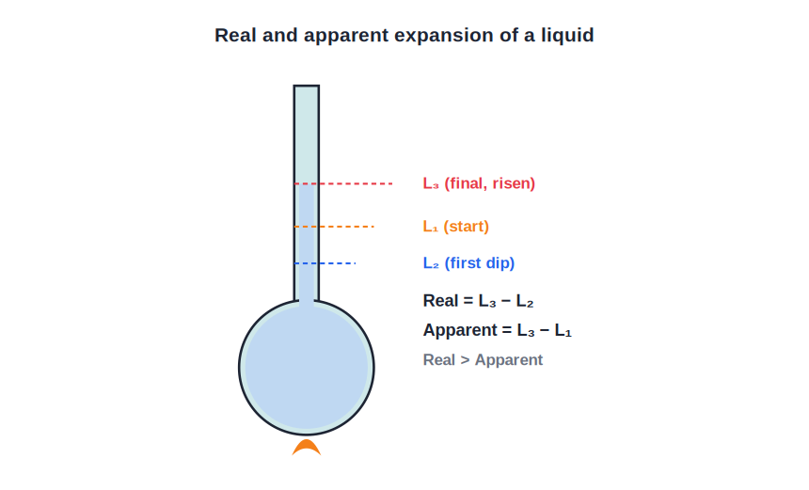
REAL VS APPARENT
Real and Apparent Expansion of a Liquid
Real > Apparent
• Heated in a container, the container expands first, so the liquid level first DIPS to L₂.
• On further heating the liquid itself expands and rises to L₃.
• Apparent expansion = L₃ − L₁ (ignores the container).
• Real expansion = L₃ − L₂, and is always greater than the apparent expansion.
The level dips, then rises past the start
Notes:
Real vs apparent expansion: container expands first (dip to L₂), then liquid rises to L₃. Real = L₃−L₂ > apparent = L₃−L₁.

Slide 33
WORKED EXAMPLE
Real and Apparent Expansion
Problem. A container of capacity 70 ml is filled with liquid to 50 ml and heated. The level first falls to 48.5 ml, then rises to 51.2 ml. Find the apparent and real expansion.
L₁ = 50 ml, L₂ = 48.5 ml, L₃ = 51.2 ml
Apparent expansion = L₃ − L₁ = 51.2 − 50 = 1.2 ml
Real expansion = L₃ − L₂ = 51.2 − 48.5 = 2.7 ml
Answer: Apparent = 1.2 ml, Real = 2.7 ml (real > apparent)
Notes:
Worked Example 1 from the chapter. The dip (L₂) is the container expanding first; real expansion uses L₂, not L₁.

Slide 34
WRAP UP
Quick Recap
✓ Temperature — degree of hotness; SI unit kelvin; 0 K = −273 °C
✓ Conversions — K = °C + 273; K = (°F + 460) × 5/9
✓ Thermal equilibrium — equal temperature, no net heat flow
✓ Heat features — hot→cold; mass unchanged; heat gained = heat lost
✓ Solid expansion — linear ΔL/L₀, area ΔA/A₀, volume ΔV/V₀ = αΔT
✓ Liquids — real = L₃−L₂ > apparent = L₃−L₁
Notes:
Rapid recap; the conversions and the real-vs-apparent result are the key exam points.

Slide 35
QUIZ 2
Final Check — Expansion
5 questions • think before the answer reveals on the next slide

Slide 36
QUIZ QUESTION
Q1 — Find ΔL
A 3 m rod (αʟ = 2 × 10⁻⁵ K⁻¹) is heated through 100 °C. Its increase in length is:
6 × 10⁻³ m
6 × 10⁻⁵ m
A
B
0.6 m
6 m
C
D

Slide 37
ANSWER REVEALED
Q1 — Find ΔL
A 3 m rod (αʟ = 2 × 10⁻⁵ K⁻¹) is heated through 100 °C. Its increase in length is:
6 × 10⁻³ m
6 × 10⁻⁵ m
✓
B
0.6 m
6 m
C
D
WHY
ΔL = αʟ L₀ ΔT = (2 × 10⁻⁵) × 3 × 100 = 6 × 10⁻³ m (6 mm). Multiply the coefficient, length and temperature change.

Slide 38
QUIZ QUESTION
Q2 — Expands Most
For the same rise in temperature, which expands the most?
A solid
A liquid
A
B
A gas
All equally
C
D

Slide 39
ANSWER REVEALED
Q2 — Expands Most
For the same rise in temperature, which expands the most?
A solid
A liquid
A
B
A gas
All equally
✓
D
WHY
Gases expand far more than liquids, and liquids more than solids, because gas molecules are free to move much further apart on heating.

Slide 40
QUIZ QUESTION
Q3 — Real vs Apparent
When a liquid is heated in a container, the real expansion of the liquid is:
Less than the apparent expansion
Equal to the apparent expansion
A
B
Greater than the apparent expansion
Always zero
C
D

Slide 41
ANSWER REVEALED
Q3 — Real vs Apparent
When a liquid is heated in a container, the real expansion of the liquid is:
Less than the apparent expansion
Equal to the apparent expansion
A
B
Greater than the apparent expansion
Always zero
✓
D
WHY
The apparent expansion ignores the container's expansion. Adding back the container's share gives the real expansion, which is always the larger of the two.

Slide 42
QUIZ QUESTION
Q4 — Why the Dip?
On heating a liquid in a glass container, its level first falls slightly before rising. This is because:
The liquid contracts first
The container expands first, lowering the level
A
B
The liquid evaporates
The thermometer is wrong
C
D

Slide 43
ANSWER REVEALED
Q4 — Why the Dip?
On heating a liquid in a glass container, its level first falls slightly before rising. This is because:
The liquid contracts first
The container expands first, lowering the level
A
✓
The liquid evaporates
The thermometer is wrong
C
D
WHY
Heat reaches the container first, so it expands and its capacity grows, dropping the level to L₂. Then the liquid itself expands and rises to L₃.

Slide 44
QUIZ QUESTION
Q5 — Unit of α
The coefficient of cubical expansion has the SI unit:
m³
K⁻¹
A
B
J/kg
no unit
C
D

Slide 45
ANSWER REVEALED
Q5 — Unit of α
The coefficient of cubical expansion has the SI unit:
m³
K⁻¹
A
✓
J/kg
no unit
C
D
WHY
Every coefficient of expansion (linear, superficial or cubical) is a fractional change per degree, so its unit is per kelvin, K⁻¹.

Slide 46
Heat Changes Matter
Heat sets particles moving — raising temperature, changing state and expanding solids, liquids and gases in measurable ways.

