Slide 1
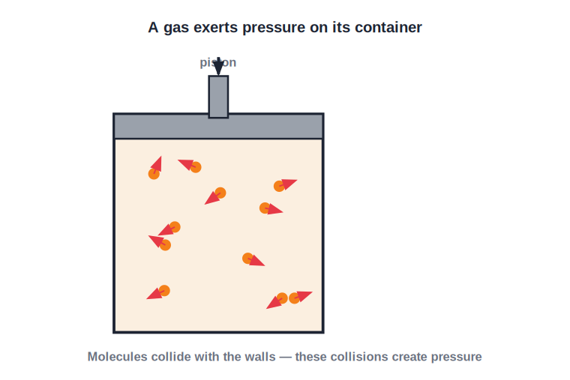
CLASS 10 • THERMAL PHYSICS
Gas Laws & the Ideal Gas
Boyle's law • Charles's law • Avogadro's law • Real & ideal gases • PV = RT

Slide 2
INTRODUCTION
Learning Objectives
1
State Boyle's law and read its P–V graph
2
State Charles's law and its link to absolute zero
3
State Avogadro's law
4
Distinguish a real gas from an ideal gas
5
Combine the gas laws into the ideal gas equation
6
Identify the Boltzmann and universal gas constants
Notes:
Open by previewing these objectives so students know what they should be able to do by the end of the session.

Slide 3
PART 1
The Fundamental Gas Laws
1
How pressure, volume and temperature are linked

Slide 4
GAS PRESSURE
A Gas Exerts Pressure
Collisions make pressure
• A gas is made of fast-moving molecules with almost no forces between them.
• They constantly collide with the walls of the container.
• These countless collisions produce the gas pressure.
• Pressure (P), volume (V), temperature (T) and amount (n) describe the state of a gas.
Molecules bouncing off the walls
Notes:
Set up the state variables P, V, T, n. Pressure comes from molecular collisions — leads into the gas laws.

Slide 5
BOYLE'S LAW
Boyle's Law
At constant temperature, the volume of a fixed mass of gas is inversely proportional to its pressure.
P × V = constant (T, mass constant)
• Squeeze the gas (volume down) and its pressure rises.
• Let it expand (volume up) and its pressure falls.
• So P₁V₁ = P₂V₂ for the same gas at the same temperature.
Notes:
Boyle: at constant T, PV = constant. The P₁V₁ = P₂V₂ form is the workhorse for numericals.

Slide 6
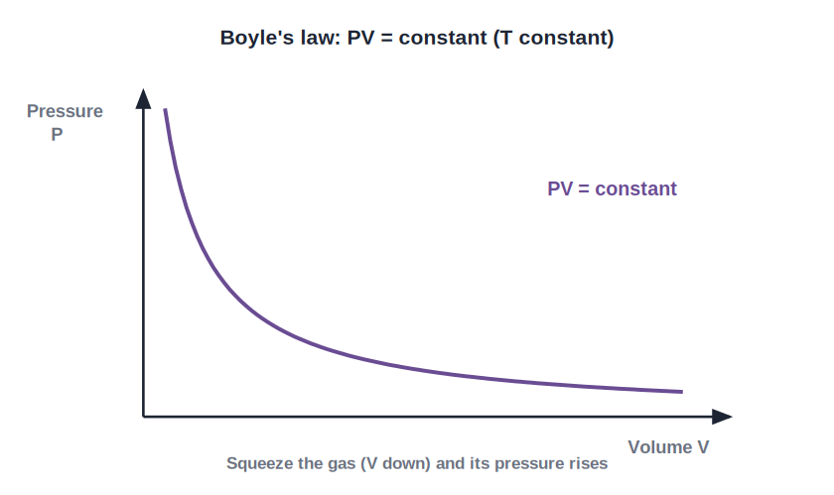
BOYLE GRAPH
The Pressure–Volume Graph
PV = constant
• Plotting pressure against volume gives a smooth curve (a rectangular hyperbola).
• As volume increases, pressure decreases.
• Every point on the curve has the same product P × V.
• A different temperature gives a different curve.
P–V curve at constant temperature
Notes:
Read the hyperbola: P falls as V rises, PV constant along it. Each temperature has its own curve.

Slide 7
WORKED EXAMPLE
Applying Boyle's Law
Problem. A gas occupies 2 litres at a pressure of 1 atmosphere. At the same temperature it is compressed to 0.5 litre. Find its new pressure.
Boyle's law: P₁V₁ = P₂V₂
1 × 2 = P₂ × 0.5
P₂ = 2 / 0.5
Answer: P₂ = 4 atmospheres
Notes:
Use P₁V₁ = P₂V₂. Quartering the volume's... here volume drops to a quarter, so pressure rises four-fold.

Slide 8
CHARLES'S LAW
Charles's Law (Law of Volume)
At constant pressure, the volume of a fixed mass of gas is directly proportional to its absolute (kelvin) temperature.
V / T = constant (P, mass constant)
• Temperature MUST be in kelvin, not °C.
• Heat a gas at constant pressure and it expands.
• So V₁ / T₁ = V₂ / T₂ for the same gas.
Notes:
Charles: at constant P, V/T = constant, with T in KELVIN. Stress the kelvin requirement — a classic slip.

Slide 9
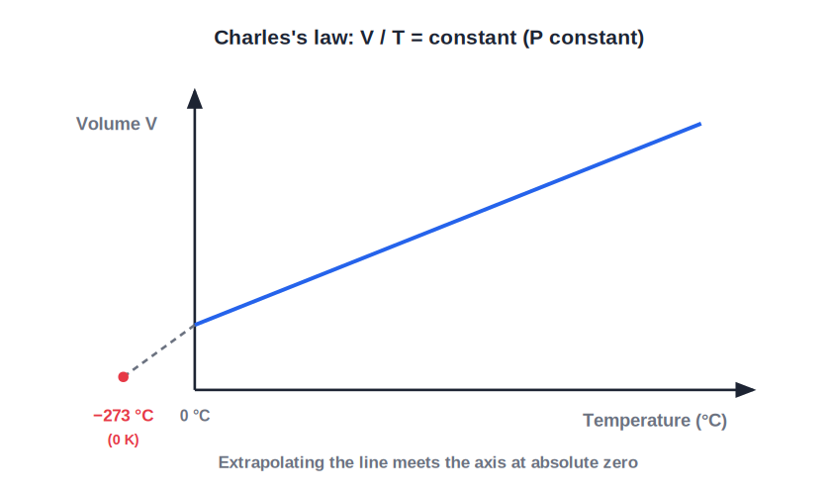
CHARLES GRAPH
Volume–Temperature Graph
Straight line to −273 °C
• Plotting volume against temperature gives a straight line.
• Extending the line backwards, it meets the temperature axis at −273 °C.
• At this point the volume would become zero — absolute zero.
• This is why the kelvin scale starts at −273 °C.
Extrapolating to absolute zero
Notes:
The V–T line extrapolates to −273 °C (0 K), linking Charles's law to the absolute scale of the first deck.

Slide 10
WORKED EXAMPLE
Applying Charles's Law
Problem. A gas has a volume of 300 cm³ at 27 °C. At constant pressure it is heated to 127 °C. Find its new volume.
Convert: T₁ = 27 + 273 = 300 K, T₂ = 127 + 273 = 400 K
Charles's law: V₁ / T₁ = V₂ / T₂
300 / 300 = V₂ / 400
V₂ = 400 cm³
Answer: New volume = 400 cm³
Notes:
Convert to kelvin FIRST, then apply V₁/T₁ = V₂/T₂. Using °C here would give a wrong answer.

Slide 11
AVOGADRO'S LAW
Avogadro's Law
At constant pressure and temperature, the volume of a gas is directly proportional to the number of molecules (amount) of gas.
V / n = constant (P, T constant)
• Equal volumes of gases at the same P and T contain equal numbers of molecules.
• Avogadro's number N_A = 6.023 × 10²³ per mole.
• It is the number of particles in one mole of any substance.
Notes:
Avogadro: V ∝ n at constant P, T. N_A = 6.023 × 10²³ /mol — particles per mole.

Slide 12
QUIZ 1
Check Your Understanding
5 questions • think before the answer reveals on the next slide

Slide 13
QUIZ QUESTION
Q1 — Boyle Numerical
A gas at 1 atm occupies 4 L. At constant temperature it is compressed to 1 L. Its new pressure is:
0.25 atm
1 atm
A
B
4 atm
16 atm
C
D

Slide 14
ANSWER REVEALED
Q1 — Boyle Numerical
A gas at 1 atm occupies 4 L. At constant temperature it is compressed to 1 L. Its new pressure is:
0.25 atm
1 atm
A
B
4 atm
16 atm
✓
D
WHY
P₁V₁ = P₂V₂, so 1 × 4 = P₂ × 1, giving P₂ = 4 atm. Reducing the volume to a quarter multiplies the pressure four-fold.

Slide 15
QUIZ QUESTION
Q2 — Use Kelvin
Before applying Charles's law (V/T = constant), the temperature must always be converted to:
Degrees Celsius
Degrees Fahrenheit
A
B
Kelvin
Calories
C
D

Slide 16
ANSWER REVEALED
Q2 — Use Kelvin
Before applying Charles's law (V/T = constant), the temperature must always be converted to:
Degrees Celsius
Degrees Fahrenheit
A
B
Kelvin
Calories
✓
D
WHY
Charles's law uses the absolute temperature. Using °C (which can be zero or negative) gives wrong ratios, so temperatures must be in kelvin.

Slide 17
QUIZ QUESTION
Q3 — Boyle Graph
At constant temperature, the graph of pressure against volume for a fixed mass of gas is:
A straight line through the origin
A curve (rectangular hyperbola)
A
B
A horizontal line
A parabola opening upward
C
D

Slide 18
ANSWER REVEALED
Q3 — Boyle Graph
At constant temperature, the graph of pressure against volume for a fixed mass of gas is:
A straight line through the origin
A curve (rectangular hyperbola)
A
✓
A horizontal line
A parabola opening upward
C
D
WHY
Because PV is constant, as V rises P must fall in proportion, tracing a rectangular hyperbola — not a straight line.

Slide 19
QUIZ QUESTION
Q4 — Avogadro
Equal volumes of oxygen and nitrogen at the same temperature and pressure contain:
Equal masses
Equal numbers of molecules
A
B
More oxygen molecules
More nitrogen molecules
C
D

Slide 20
ANSWER REVEALED
Q4 — Avogadro
Equal volumes of oxygen and nitrogen at the same temperature and pressure contain:
Equal masses
Equal numbers of molecules
A
✓
More oxygen molecules
More nitrogen molecules
C
D
WHY
Avogadro's law: at the same P and T, equal volumes hold equal numbers of molecules — regardless of the gas or its mass.

Slide 21
QUIZ QUESTION
Q5 — Double the Temp
A fixed mass of gas at constant pressure has its kelvin temperature doubled. Its volume:
Halves
Doubles
A
B
Stays the same
Becomes zero
C
D

Slide 22
ANSWER REVEALED
Q5 — Double the Temp
A fixed mass of gas at constant pressure has its kelvin temperature doubled. Its volume:
Halves
Doubles
A
✓
Stays the same
Becomes zero
C
D
WHY
By Charles's law V ∝ T (in kelvin). Doubling the absolute temperature at constant pressure doubles the volume.

Slide 23
PART 2
Real, Ideal Gases & PV = RT
2
From the three laws to the equation of state

Slide 24


REAL GASES
Real Gases
Definition
In practice
Gases whose molecules attract one another with a definite intermolecular force.
All actual gases are real gases.
Behave ideally when
Then
At very high temperature or very low pressure, the forces become negligible.
A real gas behaves almost like an ideal gas.
Notes:
Real gases have intermolecular forces. At high T or low P those forces are negligible, so they behave nearly ideally.

Slide 25

IDEAL GASES
Ideal (Perfect) Gases
Definition
Also called
A gas whose molecules do not interact with one another at all.
A perfect gas.
Obeys
Reality
Boyle's, Charles's and Avogadro's laws exactly.
No real gas is truly ideal, but many are close at low pressure / high temperature.
Notes:
Ideal gas = no intermolecular forces; obeys all three laws exactly. A useful idealisation, not a real substance.

Slide 26
COMBINED LAW
Combining the Three Laws
Boyle's, Charles's and Avogadro's laws can be combined into a single relation between P, V, n and T.
P V / (n T) = constant (the combined gas law)
• From Boyle: PV = constant (T, n fixed).
• From Charles: V/T = constant (P, n fixed).
• From Avogadro: V/n = constant (P, T fixed).
Notes:
The three laws merge into PV/nT = constant. Each law is a special case holding two quantities fixed.

Slide 27
IDEAL GAS EQUATION
The Ideal Gas Equation (PV = RT)
Writing the combined-law constant in terms of fundamental constants gives the equation of state of an ideal gas.
PV = μ N_A k_B T → PV = RT (R = N_A k_B)
• k_B = Boltzmann constant = 1.38 × 10⁻²³ J K⁻¹.
• R = universal gas constant = 8.31 J mol⁻¹ K⁻¹.
• PV = RT is called the equation of state — it describes the state of any ideal gas.
Notes:
PV/μN_A T = k_B leads to PV = RT with R = N_A k_B. Name the equation of state and the two constants.

Slide 28
THE CONSTANTS
Boltzmann and Universal Gas Constants
Two key constants
• Boltzmann constant k_B 1.38 × 10⁻²³ J K⁻¹ — energy per molecule per kelvin.
• Universal gas constant R 8.31 J mol⁻¹ K⁻¹ — the same for all ideal gases.
• They are linked R = N_A × k_B (per mole = per molecule × molecules per mole).
• Equation of state PV = RT relates all the state variables of an ideal gas.
Notes:
k_B (per molecule) and R (per mole) are linked by Avogadro's number: R = N_A k_B.

Slide 29
WORKED EXAMPLE
Linking the Constants
Problem. Show that the universal gas constant R follows from Avogadro's number and the Boltzmann constant. (N_A = 6.023 × 10²³ mol⁻¹, k_B = 1.38 × 10⁻²³ J K⁻¹)
R = N_A × k_B
R = (6.023 × 10²³) × (1.38 × 10⁻²³)
R ≈ 8.31 J mol⁻¹ K⁻¹
Answer: R ≈ 8.31 J mol⁻¹ K⁻¹ — the universal gas constant
Notes:
Multiplying per-molecule k_B by molecules-per-mole N_A gives the per-mole constant R. The powers of ten cancel neatly.

Slide 30
REAL VS IDEAL
Real and Ideal Gases at a Glance
Forces
Gas laws
Real: molecules attract; Ideal: no forces between molecules.
Real: obeyed only approximately; Ideal: obeyed exactly.
When alike
Existence
A real gas acts ideal at high temperature and low pressure.
Real gases exist; the ideal gas is a useful model.
Notes:
Summary comparison. The key practical point: real ≈ ideal at high T and low P.

Slide 31
WRAP UP
Quick Recap
✓ Boyle — PV = constant at constant T (P₁V₁ = P₂V₂)
✓ Charles — V/T = constant at constant P (T in kelvin)
✓ Avogadro — V/n = constant; N_A = 6.023 × 10²³ /mol
✓ Real gas — has intermolecular forces; ideal at high T, low P
✓ Ideal gas — no forces; obeys all three laws exactly
✓ Equation of state — PV = RT, with R = N_A k_B = 8.31 J mol⁻¹ K⁻¹
Notes:
Rapid recap; the three laws and PV = RT are the key results.

Slide 32
QUIZ 2
Final Check — Ideal Gases
5 questions • think before the answer reveals on the next slide

Slide 33
QUIZ QUESTION
Q1 — Ideal Assumption
An ideal gas is one in which the molecules:
Are very large
Exert no force on one another
A
B
Never move
Are all the same colour
C
D

Slide 34
ANSWER REVEALED
Q1 — Ideal Assumption
An ideal gas is one in which the molecules:
Are very large
Exert no force on one another
A
✓
Never move
Are all the same colour
C
D
WHY
An ideal (perfect) gas is defined as one whose molecules do not interact — there are no intermolecular forces, so it obeys the gas laws exactly.

Slide 35
QUIZ QUESTION
Q2 — When Ideal?
A real gas behaves most like an ideal gas at:
Low temperature and high pressure
High temperature and low pressure
A
B
Low temperature and low pressure
Its boiling point
C
D

Slide 36
ANSWER REVEALED
Q2 — When Ideal?
A real gas behaves most like an ideal gas at:
Low temperature and high pressure
High temperature and low pressure
A
✓
Low temperature and low pressure
Its boiling point
C
D
WHY
At high temperature and low pressure the molecules are far apart and fast-moving, so their weak attractions barely matter and the gas behaves almost ideally.

Slide 37
QUIZ QUESTION
Q3 — Universal Constant
The value of the universal gas constant R is about:
1.38 × 10⁻²³ J K⁻¹
6.023 × 10²³ mol⁻¹
A
B
8.31 J mol⁻¹ K⁻¹
273 J
C
D

Slide 38
ANSWER REVEALED
Q3 — Universal Constant
The value of the universal gas constant R is about:
1.38 × 10⁻²³ J K⁻¹
6.023 × 10²³ mol⁻¹
A
B
8.31 J mol⁻¹ K⁻¹
273 J
✓
D
WHY
R = 8.31 J mol⁻¹ K⁻¹ and is the same for all ideal gases. 1.38 × 10⁻²³ J K⁻¹ is the Boltzmann constant, and 6.023 × 10²³ is Avogadro's number.

Slide 39
QUIZ QUESTION
Q4 — Equation of State
Which equation is the ideal gas equation (equation of state)?
PV = RT
V = IR
A
B
P = hρg
Q = mcΔT
C
D

Slide 40
ANSWER REVEALED
Q4 — Equation of State
Which equation is the ideal gas equation (equation of state)?
PV = RT
V = IR
✓
B
P = hρg
Q = mcΔT
C
D
WHY
PV = RT relates the pressure, volume and absolute temperature of an ideal gas and is called its equation of state. The others are from electricity, fluids and calorimetry.

Slide 41
QUIZ QUESTION
Q5 — Linking Constants
The universal gas constant R and the Boltzmann constant k_B are related by Avogadro's number N_A through:
R = k_B / N_A
R = N_A × k_B
A
B
R = N_A + k_B
R = N_A − k_B
C
D

Slide 42
ANSWER REVEALED
Q5 — Linking Constants
The universal gas constant R and the Boltzmann constant k_B are related by Avogadro's number N_A through:
R = k_B / N_A
R = N_A × k_B
A
✓
R = N_A + k_B
R = N_A − k_B
C
D
WHY
k_B is the constant per molecule and R is per mole, so multiplying by the molecules-per-mole N_A converts one to the other: R = N_A k_B ≈ 8.31 J mol⁻¹ K⁻¹.

Slide 43
The Behaviour of Gases
Three simple laws combine into one equation, PV = RT — the elegant rule that captures how every ideal gas behaves.

