Slide 1
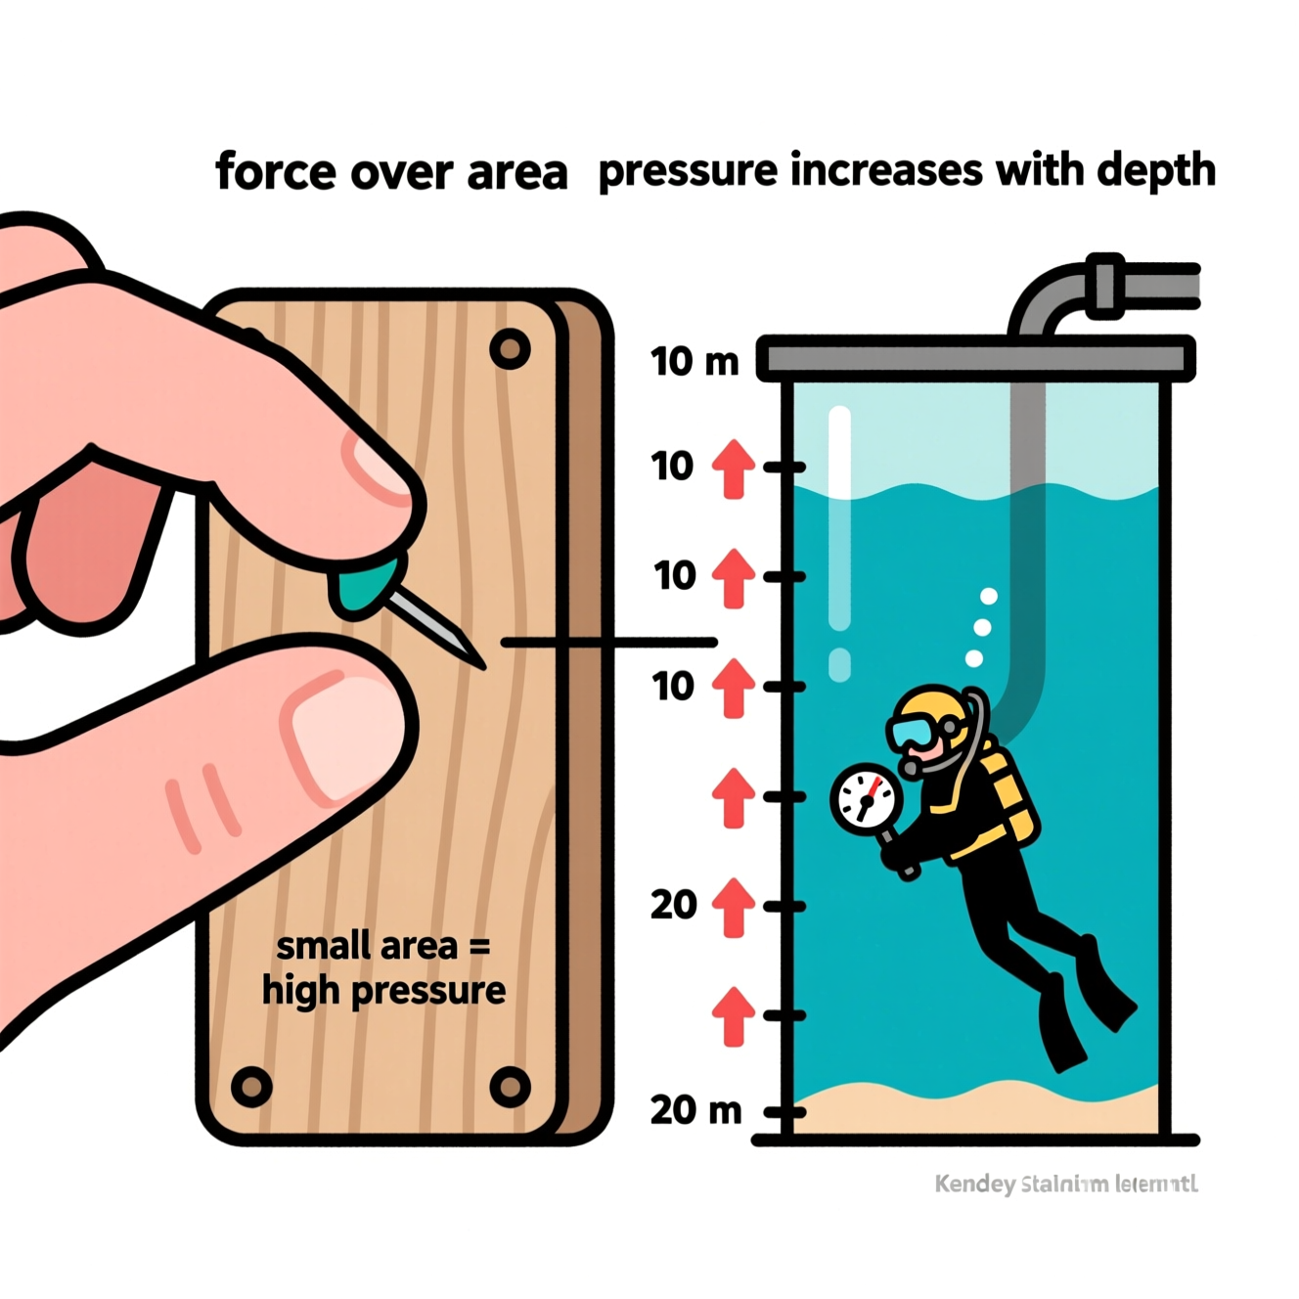
ICSE • CLASS 9 • CHAPTER 4
Pressure in Fluids
Thrust & pressure • Units • Pressure in a liquid (P = hρg) • Laws of liquid pressure

Slide 2
INTRODUCTION
Learning Objectives
1
Define thrust and pressure and state their units
2
Explain how area and thrust decide the pressure
3
Give everyday ways of increasing and decreasing pressure
4
Show that a fluid exerts pressure in all directions
5
Derive and use the relation P = h ρ g
6
State the five laws of liquid pressure
Notes:
Open by previewing these objectives so students know what they should be able to do by the end of the session.

Slide 3
SECTION 4.1
Thrust and Pressure
1
Force on a surface, and how it is shared over the area

Slide 4
THRUST
Thrust
Thrust is the force acting normally (perpendicular) on a surface.
Thrust exerted by a body = weight of the body
• Thrust is a force, so it is a vector quantity.
• SI unit: newton (N). CGS unit: dyne (1 N = 10⁵ dyne).
• Gravitational units: kgf and gf, where 1 kgf = 9.8 N and 1 gf = 980 dyne.
Notes:
Thrust is just the normal force on a surface; for a body resting on a surface it equals the body's weight, whatever face it rests on.

Slide 5
PRESSURE
Pressure
Pressure is the thrust acting on unit area of the surface.
Pressure P = Thrust / Area = F / A
• Pressure is a scalar quantity.
• Same thrust on a smaller area gives a greater pressure — a foot sinks into sand but a lying body does not.
• For a given thrust, pressure is less on a large area and more on a small area.
Notes:
Distinguish thrust (total force) from pressure (force per unit area). The loose-sand example makes area intuitive.

Slide 6
UNITS OF PRESSURE
Units of Pressure
Named after Blaise Pascal
• SI unit — pascal (Pa) 1 pascal = 1 newton per square metre (N m⁻²); the pressure of 1 N acting normally on 1 m².
• Other SI form kgf m⁻² when thrust is in kgf.
• CGS unit dyne cm⁻² (or gf cm⁻²); 1 N m⁻² = 10 dyne cm⁻².
• Bar and millibar 1 bar = 10⁵ N m⁻², 1 millibar = 10² N m⁻².
• Atmosphere & torr 1 atm = 0.76 m of Hg = 1.013 × 10⁵ Pa; 1 torr = 1 mm of Hg, and 1 atm = 760 torr.
Notes:
Walk through the family of pressure units. The pascal is the SI unit; bar/millibar appear on weather maps; atmosphere and torr measure air pressure.

Slide 7
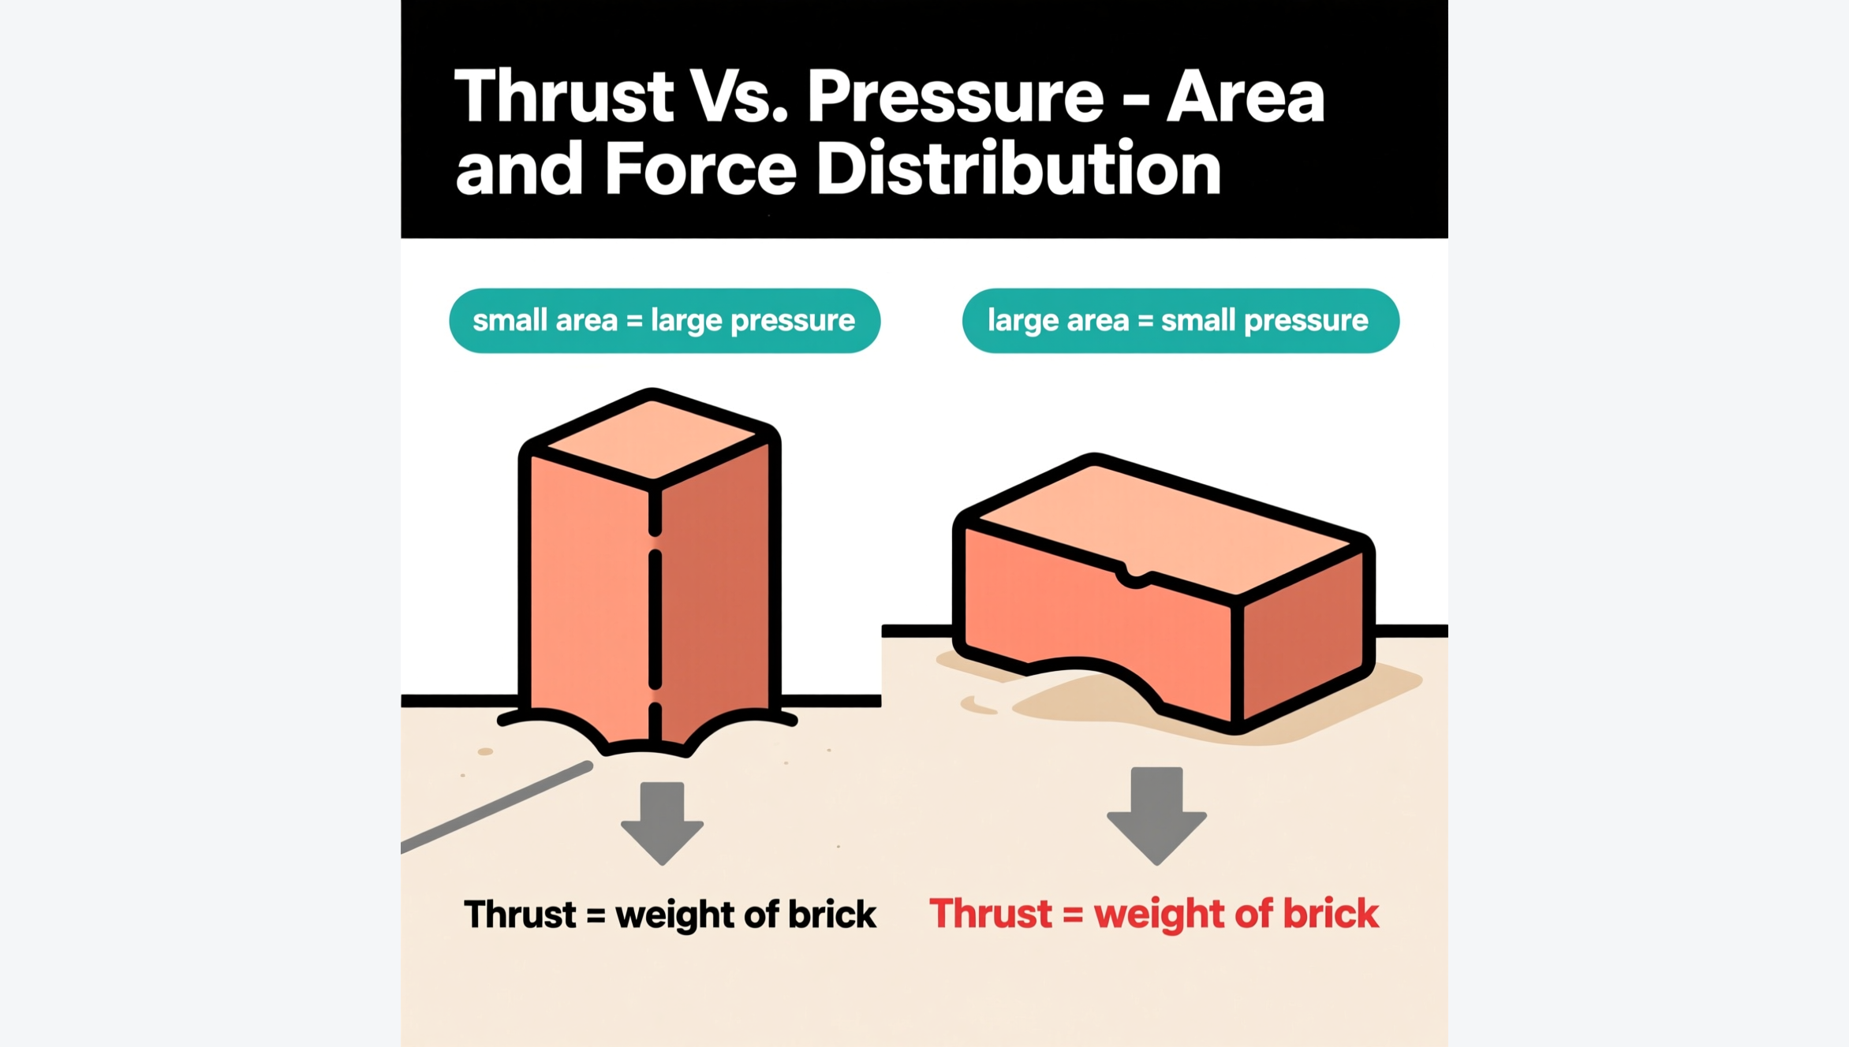
FACTORS
Factors Affecting Pressure
P = F / A
• The pressure on a surface depends on two things: the thrust, and the area it acts on.
• Larger the area for a given thrust, smaller the pressure (brick lying flat).
• Larger the thrust on a given area, greater the pressure (stacking a second brick doubles it).
• The same brick therefore gives different pressures in different positions.
Fig 4.1 — same brick, two positions
Notes:
Use the brick figure: weight (thrust) is the same in every position, but the contact area changes, so the pressure changes.

Slide 8

USING AREA
Changing Pressure by Changing Area
Increase pressure: sharp point
Increase pressure: sharp edge
Nails, pins and needles are pointed — a tiny area gives large pressure, so they pierce easily.
Knives and cutting tools are given sharp edges so a small thrust makes a large pressure and cuts.
Decrease pressure: wide base
Decrease pressure: foundations
Railway sleepers are broad so the rails press on the ground with less pressure.
Building foundations are made wider than the walls to lower the pressure on the soil.
Notes:
Two mirror-image ideas: reduce area to raise pressure (sharp tools); increase area to lower it (sleepers, foundations, camel feet, snow shoes).

Slide 9
SECTION 4.2
Pressure in Fluids
2
Why liquids and gases press on everything they touch

Slide 10
FLUIDS
Fluids Exert Pressure in All Directions
A fluid contained in a vessel exerts pressure at all points and in all directions.
A substance that can flow (a liquid or a gas) is a fluid
• A solid presses only on the surface it rests on; a fluid presses on the base and on the walls too.
• A fluid exerts pressure because of its own weight.
• Because it tends to flow, this pressure acts in every direction, not just downward.
Notes:
Fluids (liquids and gases) flow, so their weight presses outward in all directions — on the base and the sides of the container alike.

Slide 11
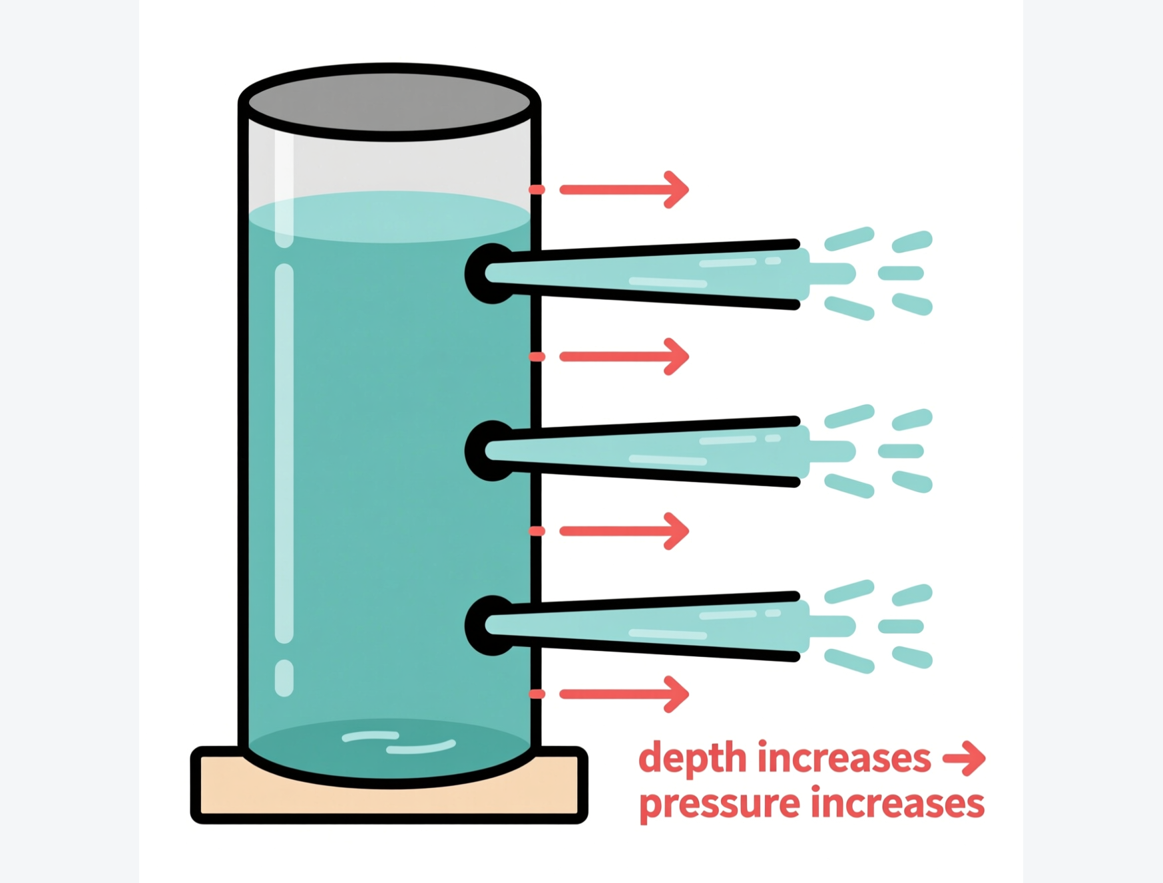
DEMONSTRATION
Liquid Pressure Increases with Depth
Deeper → greater pressure
• Make several small holes down the side of a water-filled vessel.
• Water spurts out of every hole — the liquid presses at each point on the wall.
• A finger on a hole feels a thrust — the liquid exerts thrust at all points.
• The lower the hole, the farther the water reaches — pressure grows with depth.
Fig 4.2 — the lowest jet travels farthest
Notes:
Classic leaking-can demonstration: jets from lower holes travel farther, proving pressure increases with depth below the free surface.

Slide 12
SECTION 4.3
Pressure of a Liquid Column
3
The formula P = h ρ g and where it comes from

Slide 13
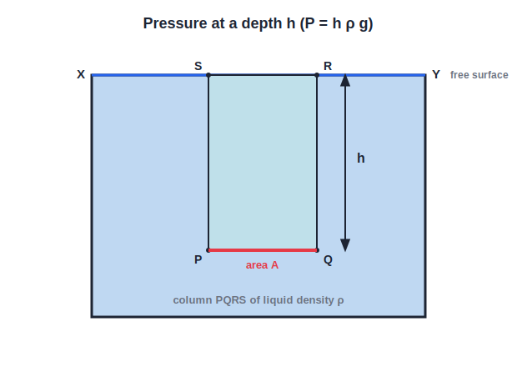
P = HΡG
Pressure at a Depth in a Liquid
P = h ρ g
• The pressure at depth h in a liquid of density ρ is P = h ρ g.
• In words: pressure = depth × density × acceleration due to gravity.
• So pressure rises with depth and with the density of the liquid.
• It does NOT depend on the area of the surface or the shape of the vessel.
Fig 4.3 — column PQRS of area A at depth h
Notes:
Introduce P = hρg and stress the three factors (h, ρ, g). Independence from area/shape is a favourite exam point.

Slide 14
PROOF
Deriving P = h ρ g
Problem. Find the pressure on a horizontal surface PQ of area A at a depth h below the free surface of a liquid of density ρ.
Thrust on PQ = weight of the liquid column PQRS above it
= volume × density × g = (A × h) × ρ × g
Pressure = Thrust / Area = (A h ρ g) / A
P = h ρ g
Answer: P = h ρ g — the area A cancels, so pressure is independent of A
Notes:
The column's weight divided by its base area gives hρg; the area cancels, which is why pressure depends only on depth, density and g.

Slide 15
TOTAL PRESSURE
Total Pressure at a Depth
The free surface of a liquid also carries the atmosphere's pressure, which must be added to the liquid's own pressure.
P_total = P₀ + h ρ g
• h ρ g is the pressure due to the liquid column alone (the gauge pressure).
• P₀ is the atmospheric pressure pushing down on the free surface.
• Their sum is the total (absolute) pressure at that depth.
Notes:
Separate gauge pressure (hρg) from total pressure (P₀ + hρg). Numericals state which one is wanted.

Slide 16


FACTORS
What the Pressure at a Point Depends On
Depth (h)
Density (ρ)
Directly proportional — twice the depth, twice the liquid pressure.
Directly proportional — a denser liquid presses harder at the same depth.
Gravity (g)
NOT on shape or area
Depends on g, which is nearly constant at a place.
The pressure is independent of the shape and size of the vessel and the area of the surface.
Notes:
Pressure at a point in a liquid depends on h, ρ and g only — never on the container's shape or the area chosen.

Slide 17
SECTION 4.4
Laws of Liquid Pressure
4
Five rules that follow from P = h ρ g

Slide 18
FIVE LAWS
The Laws of Liquid Pressure
All five follow from P = h ρ g
• 1 — Increases with depth Inside a liquid, the pressure increases with depth below the free surface.
• 2 — Same on a level In a stationary liquid the pressure is the same at all points on the same horizontal plane.
• 3 — Same in all directions At a point, the pressure is the same in every direction.
• 4 — Depends on density At the same depth, a denser liquid exerts a greater pressure than a lighter one.
• 5 — Seeks its own level A liquid always settles to the same level in connected vessels, whatever their shape.
Notes:
The five laws. Laws 2 and 3 (same on a level / same in all directions) and law 5 (own level) are the most commonly tested.

Slide 19
QUIZ 1
Check — Thrust, Pressure & Units
5 questions • think before the answer reveals on the next slide

Slide 20
QUIZ QUESTION
Q1 — Thrust vs pressure
A brick is placed once on its broad face and once on its narrow end. Compared with lying flat, standing on its end gives:
The same pressure and the same thrust
A greater pressure but the same thrust
A
B
A smaller pressure but a greater thrust
A greater thrust and a greater pressure
C
D

Slide 21
ANSWER REVEALED
Q1 — Thrust vs pressure
A brick is placed once on its broad face and once on its narrow end. Compared with lying flat, standing on its end gives:
The same pressure and the same thrust
A greater pressure but the same thrust
A
✓
A smaller pressure but a greater thrust
A greater thrust and a greater pressure
C
D
WHY
The weight (thrust) is unchanged, but the end face has a smaller area. Since P = F/A, the smaller area gives a greater pressure.

Slide 22
QUIZ QUESTION
Q2 — Unit check
Which of the following equals 1 N m⁻²?
1 dyne cm⁻²
10 dyne cm⁻²
A
B
0.1 dyne cm⁻²
100 dyne cm⁻²
C
D

Slide 23
ANSWER REVEALED
Q2 — Unit check
Which of the following equals 1 N m⁻²?
1 dyne cm⁻²
10 dyne cm⁻²
A
✓
0.1 dyne cm⁻²
100 dyne cm⁻²
C
D
WHY
1 N = 10⁵ dyne and 1 m² = 10⁴ cm², so 1 N m⁻² = 10⁵/10⁴ = 10 dyne cm⁻². (Equivalently 1 dyne cm⁻² = 0.1 N m⁻².)

Slide 24
QUIZ QUESTION
Q3 — Sharp tools
Cutting and piercing tools are given sharp edges or points because a small area:
Reduces the thrust needed
Gives a large pressure for a small thrust
A
B
Increases the total force
Lowers the pressure at the edge
C
D

Slide 25
ANSWER REVEALED
Q3 — Sharp tools
Cutting and piercing tools are given sharp edges or points because a small area:
Reduces the thrust needed
Gives a large pressure for a small thrust
A
✓
Increases the total force
Lowers the pressure at the edge
C
D
WHY
A sharp edge concentrates the thrust on a tiny area, so P = F/A is very large even for a modest force — enough to cut or pierce.

Slide 26
QUIZ QUESTION
Q4 — One atmosphere
Normal atmospheric pressure of 0.76 m of mercury is equal to:
760 torr
1 bar exactly
A
B
10² N m⁻²
76 torr
C
D

Slide 27
ANSWER REVEALED
Q4 — One atmosphere
Normal atmospheric pressure of 0.76 m of mercury is equal to:
760 torr
1 bar exactly
✓
B
10² N m⁻²
76 torr
C
D
WHY
1 torr = 1 mm of Hg, and 0.76 m of Hg = 760 mm of Hg = 760 torr (≈ 1.013 × 10⁵ Pa). This is defined as 1 atmosphere.

Slide 28
QUIZ QUESTION
Q5 — Wide foundations
The foundations of a building are made wider than its walls in order to:
Increase the thrust on the soil
Reduce the pressure on the soil so it does not sink
A
B
Make the building heavier
Increase the pressure on the soil
C
D

Slide 29
ANSWER REVEALED
Q5 — Wide foundations
The foundations of a building are made wider than its walls in order to:
Increase the thrust on the soil
Reduce the pressure on the soil so it does not sink
A
✓
Make the building heavier
Increase the pressure on the soil
C
D
WHY
A wider base spreads the same weight (thrust) over a larger area, lowering the pressure so the ground can bear the building without giving way.

Slide 30
QUIZ 2
Check — Liquid Pressure & Laws
5 questions • think before the answer reveals on the next slide

Slide 31
QUIZ QUESTION
Q1 — P = hρg
The pressure due to a liquid column depends on:
The area of the base of the column
The depth, the density and g
A
B
The total volume of liquid
The shape of the vessel
C
D

Slide 32
ANSWER REVEALED
Q1 — P = hρg
The pressure due to a liquid column depends on:
The area of the base of the column
The depth, the density and g
A
✓
The total volume of liquid
The shape of the vessel
C
D
WHY
P = h ρ g. Only depth, density and g matter; the area, volume and shape of the container do not affect the pressure at a point.

Slide 33
QUIZ QUESTION
Q2 — Find the pressure
The pressure due to a 4 m column of water (ρ = 1000 kg m⁻³, g = 10 m s⁻²) is:
4000 Pa
40,000 Pa
A
B
400 Pa
4 × 10⁵ Pa
C
D

Slide 34
ANSWER REVEALED
Q2 — Find the pressure
The pressure due to a 4 m column of water (ρ = 1000 kg m⁻³, g = 10 m s⁻²) is:
4000 Pa
40,000 Pa
A
✓
400 Pa
4 × 10⁵ Pa
C
D
WHY
P = h ρ g = 4 × 1000 × 10 = 40,000 Pa (= 4 × 10⁴ N m⁻²). Multiply depth, density and g.

Slide 35
QUIZ QUESTION
Q3 — Same level
Two points inside a stationary liquid lie on the same horizontal level. The pressure at them is:
Greater at the point nearer the wall
Exactly the same
A
B
Greater at the point nearer the centre
Different, depending on direction
C
D

Slide 36
ANSWER REVEALED
Q3 — Same level
Two points inside a stationary liquid lie on the same horizontal level. The pressure at them is:
Greater at the point nearer the wall
Exactly the same
A
✓
Greater at the point nearer the centre
Different, depending on direction
C
D
WHY
By the laws of liquid pressure, all points on the same horizontal plane in a stationary liquid are at the same depth, so they are at the same pressure.

Slide 37
QUIZ QUESTION
Q4 — Total pressure
At a depth h in an open tank of liquid, the total pressure is:
h ρ g only
P₀ only
A
B
P₀ + h ρ g
P₀ − h ρ g
C
D

Slide 38
ANSWER REVEALED
Q4 — Total pressure
At a depth h in an open tank of liquid, the total pressure is:
h ρ g only
P₀ only
A
B
P₀ + h ρ g
P₀ − h ρ g
✓
D
WHY
The atmosphere presses P₀ on the free surface and the liquid column adds h ρ g, so the total (absolute) pressure at depth h is P₀ + h ρ g.

Slide 39
QUIZ QUESTION
Q5 — Denser liquid
At the same depth, the pressure in sea water is greater than in river water because sea water:
Is deeper
Is denser
A
B
Flows faster
Is colder
C
D

Slide 40
ANSWER REVEALED
Q5 — Denser liquid
At the same depth, the pressure in sea water is greater than in river water because sea water:
Is deeper
Is denser
A
✓
Flows faster
Is colder
C
D
WHY
Pressure at a depth is h ρ g. At the same depth h, the denser sea water (larger ρ) exerts a greater pressure than the less dense river water.

Slide 41
WRAP UP
Quick Recap — Part 1
✓ Thrust — the normal force on a surface (= weight of the body); unit newton
✓ Pressure — P = thrust / area (scalar); SI unit pascal, 1 Pa = 1 N m⁻²
✓ Area effect — sharp points raise pressure; wide bases lower it
✓ Fluids — press in all directions; pressure grows with depth
✓ Liquid column — P = h ρ g; total pressure = P₀ + h ρ g
✓ Five laws — depth, level, all directions, density, own level
Notes:
Recap of 4.1–4.4. P = hρg and the five laws lead into the consequences and Pascal's law in Part 2.

Slide 42
From a Pinpoint to the Deep Sea
Pressure is simply force shared over area — and in a liquid it grows steadily with depth, exactly as P = h ρ g predicts.

