Slide 1
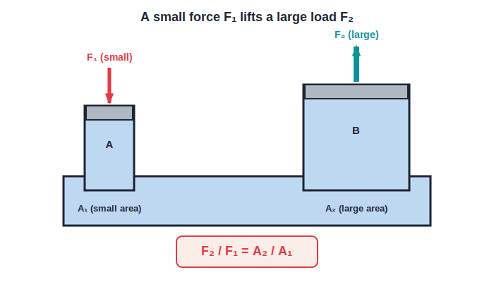
ICSE • CLASS 9 • CHAPTER 4
Pascal's Law & Hydraulics
Consequences of P = hρg • Pascal's law • Hydraulic press, jack & brakes • Numericals

Slide 2
INTRODUCTION
Learning Objectives
1
Explain everyday consequences of P = h ρ g
2
State Pascal's law of transmission of pressure
3
Show how a hydraulic machine multiplies force
4
Describe the hydraulic press, jack and brakes
5
Relate mechanical advantage and velocity ratio
6
Solve numerical problems on fluid pressure
Notes:
Open by previewing these objectives so students know what they should be able to do by the end of the session.

Slide 3
SECTION 4.5
Consequences of P = h ρ g
1
Everyday effects of pressure growing with depth

Slide 4
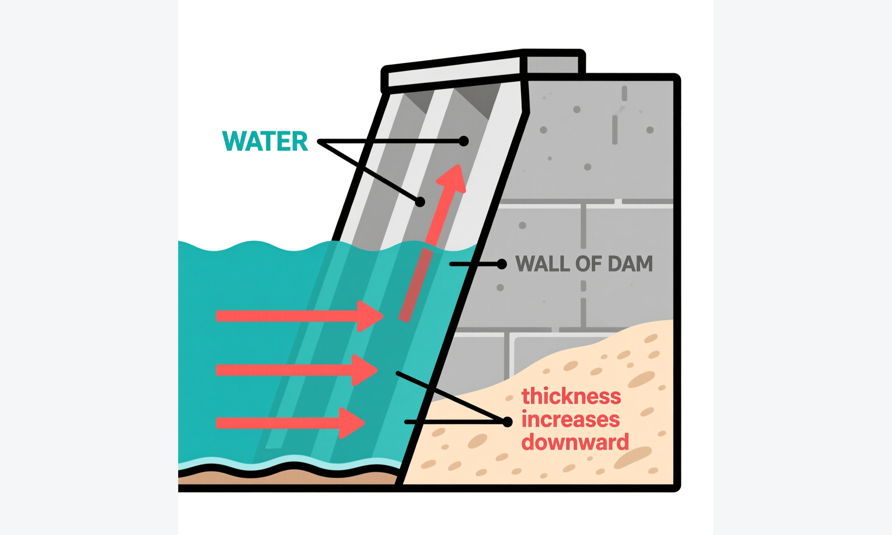
DAM WALL
Why a Dam is Thicker at the Bottom
Deepest = strongest
• Water pressure on a dam increases with depth (P = h ρ g).
• The deepest part of the wall must withstand the greatest pressure.
• So the wall is built thin at the top and much thicker at the base.
• The lengthening arrows show the pressure rising toward the bottom.
Fig 4.4 — wall thickens toward the base
Notes:
The dam is the classic consequence: pressure at the base is largest, so the wall is thickest there.

Slide 5


MORE CONSEQUENCES
Other Consequences of Liquid Pressure
Sea vs river water
Overhead water tank
At the same depth the pressure is greater in the sea because sea water is denser than river water.
A supply tank is placed high so the large depth gives enough pressure for water to reach the taps.
Diver's suit
Rising gas bubble
Deep-sea divers wear a strong suit kept at about one atmosphere, because the water pressure deep down is far above their blood pressure.
A bubble grows as it rises: less depth means less pressure, so by Boyle's law its volume increases.
Notes:
Each effect follows from P = hρg (or, for the bubble, from pressure falling as depth decreases). The diver's suit and the high water tank are common exam contexts.

Slide 6
SECTION 4.6
Transmission of Pressure — Pascal's Law
2
Passing pressure on through a confined liquid

Slide 7
PASCAL'S LAW
Pascal's Law
The pressure exerted anywhere in a confined liquid is transmitted equally and undiminished in all directions throughout the liquid.
Increase the pressure at one point → it rises equally everywhere
• The pressure difference between two points depends only on their difference in height (Δh).
• So raising the pressure at one point raises it by the same amount at every other point.
• This works because a liquid is almost incompressible.
Notes:
State Pascal's law precisely. It is the basis of every hydraulic machine that follows.

Slide 8
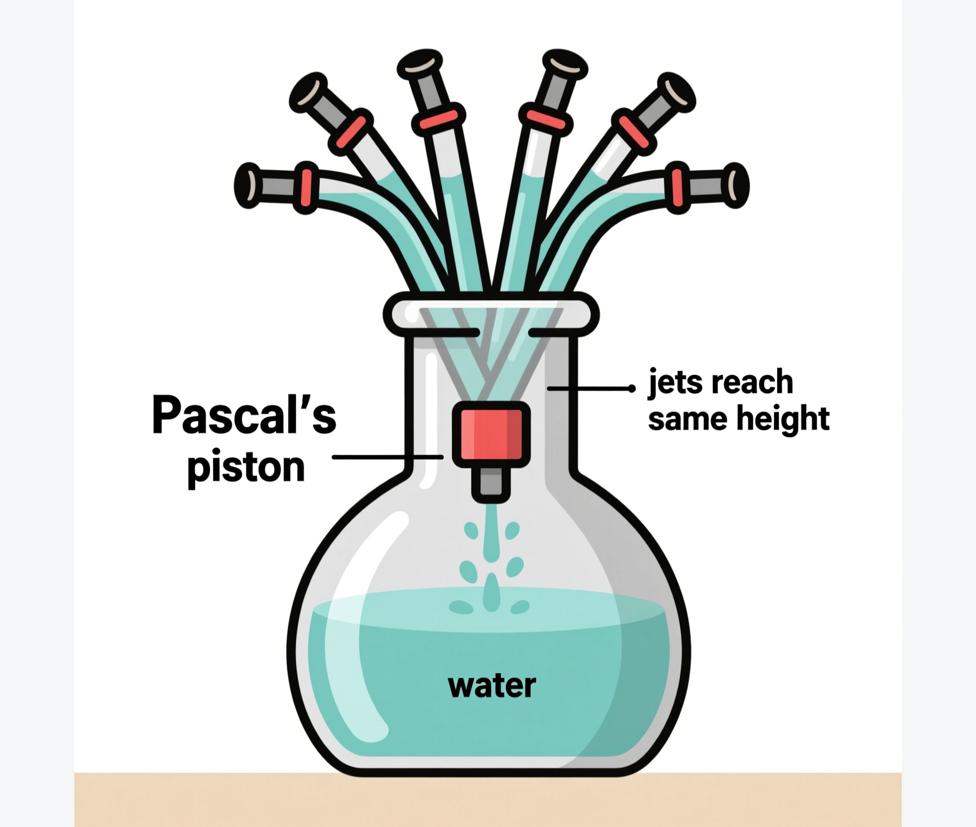
DEMONSTRATION
Demonstrating Pascal's Law
Equal jets everywhere
• A glass flask has several narrow tubes and a piston at its mouth.
• Filled with water, the level in each tube is the same to begin with.
• Pushing the piston in makes water jet from every tube to the SAME height.
• The applied pressure has been passed on equally to all parts of the liquid.
Fig 4.5 — jets rise equally in all tubes
Notes:
The equal jet heights show the applied pressure reaches every part of the enclosed liquid equally.

Slide 9
SECTION 4.7
Application — The Hydraulic Machine
3
Turning a small force into a large one

Slide 10
FORCE MULTIPLIER
Principle of a Hydraulic Machine
F₂ / F₁ = A₂ / A₁
• Two connected cylinders of areas A₁ (small) and A₂ (large) hold a liquid.
• A force F₁ on the small piston makes a pressure P₁ = F₁ / A₁.
• By Pascal's law this pressure reaches the big piston unchanged, so P₂ = P₁.
• Since P₂ = F₂ / A₂, we get F₂ / F₁ = A₂ / A₁ — a large force on the big piston.
Fig 4.6 — a small F₁ balances a large F₂
Notes:
Derive the force-multiplier relation step by step: P₁ = F₁/A₁, P₂ = P₁ (Pascal), P₂ = F₂/A₂, hence F₂/F₁ = A₂/A₁.

Slide 11
WORKED EXAMPLE
How Much Force is Multiplied?
Problem. In a hydraulic machine the small piston has area 0.01 m² and the large piston 0.50 m². A force of 50 N is applied to the small piston. Find the force on the large piston.
F₂ / F₁ = A₂ / A₁ → F₂ = F₁ × A₂ / A₁
F₂ = 50 × 0.50 / 0.01
F₂ = 50 × 50 = 2500 N
Answer: F₂ = 2500 N — the force is multiplied 50 times
Notes:
The area ratio (0.50/0.01 = 50) is the force multiplier. The output force is 50× the input force.

Slide 12
NO FREE LUNCH
Force Multiplier, Not Energy Multiplier
A hydraulic machine multiplies force, but the small piston must move much farther than the load rises.
work by effort = work by load (in the ideal case)
• Mechanical advantage MA = Load / Effort > 1.
• Velocity ratio VR = distance moved by effort / distance moved by load > 1.
• Energy is conserved: extra force is paid for with extra distance.
Notes:
Stress that hydraulics trade distance for force — the effort moves a long way to raise the load a little; work in equals work out.

Slide 13
SECTION 4.8
Hydraulic Machines in Use
4
The press, the jack and the brakes

Slide 14
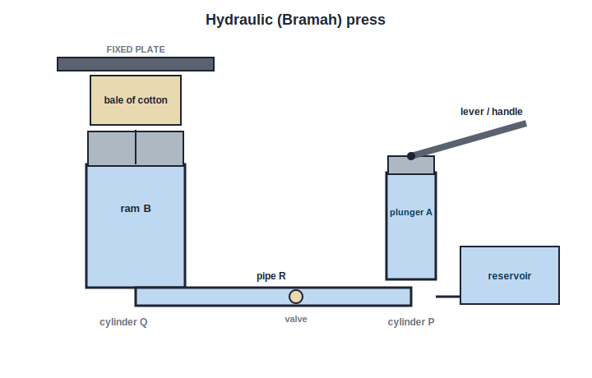
HYDRAULIC PRESS
The Hydraulic (Bramah) Press
Small plunger, big ram
• A small pump plunger A in a narrow cylinder P is worked by a lever.
• It drives liquid through a pipe to a large ram B in a wide cylinder Q.
• The large area makes a huge upward force that presses goods against a fixed plate.
• Uses: pressing cotton bales and books, extracting juice or oil, and engraving.
Fig 4.7 — the Bramah press
Notes:
Construction and working of the press; the ram's large area gives the pressing force. List the everyday uses.

Slide 15
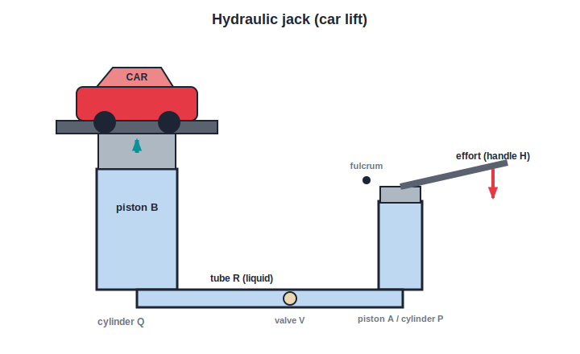
HYDRAULIC JACK
The Hydraulic Jack / Lift
Lifting a car by hand
• Pressing the handle raises the pressure in the narrow cylinder P.
• Liquid is forced through valve V into the wide cylinder Q.
• The large piston B rises and lifts a car on its platform.
• A small effort at the handle raises a very heavy load — a force multiplier.
Fig 4.8 — the hydraulic jack
Notes:
The jack lifts vehicles for repair; the valve lets the load be raised step by step and holds it up.

Slide 16
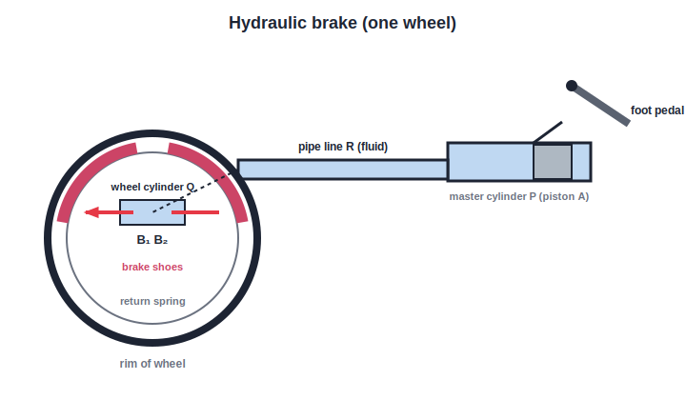
HYDRAULIC BRAKES
The Hydraulic Brakes
One pedal, all wheels
• The foot pedal pushes piston A in the master cylinder P.
• Brake fluid carries the pressure equally along pipe R to every wheel.
• At each wheel, pistons B₁ and B₂ push the brake shoes against the rim.
• One light push on the pedal brakes all the wheels together.
Fig 4.9 — a hydraulic brake
Notes:
Pascal's law shares the pedal pressure equally to all wheels; releasing the pedal lets the spring pull the shoes back.

Slide 17
QUIZ 1
Check — Consequences & Pascal's Law
5 questions • think before the answer reveals on the next slide

Slide 18
QUIZ QUESTION
Q1 — Dam design
A dam wall is built much thicker at its base than at its top because water pressure:
Is greatest at the surface
Increases with depth, so it is greatest at the base
A
B
Is the same at every depth
Acts only sideways at the top
C
D

Slide 19
ANSWER REVEALED
Q1 — Dam design
A dam wall is built much thicker at its base than at its top because water pressure:
Is greatest at the surface
Increases with depth, so it is greatest at the base
A
✓
Is the same at every depth
Acts only sideways at the top
C
D
WHY
Since P = h ρ g, the pressure is largest at the deepest point of the wall, so the base must be thickest to withstand it.

Slide 20
QUIZ QUESTION
Q2 — Rising bubble
As an air bubble rises from the bottom of a lake to the surface, its size:
Decreases
Stays the same
A
B
Increases
First increases then decreases
C
D

Slide 21
ANSWER REVEALED
Q2 — Rising bubble
As an air bubble rises from the bottom of a lake to the surface, its size:
Decreases
Stays the same
A
B
Increases
First increases then decreases
✓
D
WHY
Higher up, the depth and hence the pressure on the bubble fall. By Boyle's law, less pressure means more volume, so the bubble grows as it rises.

Slide 22
QUIZ QUESTION
Q3 — Pascal's law
Pascal's law states that pressure applied to an enclosed liquid is:
Lost as it spreads out
Transmitted equally and undiminished in all directions
A
B
Greatest near the piston
Halved at each point
C
D

Slide 23
ANSWER REVEALED
Q3 — Pascal's law
Pascal's law states that pressure applied to an enclosed liquid is:
Lost as it spreads out
Transmitted equally and undiminished in all directions
A
✓
Greatest near the piston
Halved at each point
C
D
WHY
An enclosed, almost incompressible liquid passes the applied pressure on to every point equally — the basis of all hydraulic machines.

Slide 24
QUIZ QUESTION
Q4 — Force multiplier
In a hydraulic machine the pistons have areas 2 cm² and 80 cm². A force of 30 N on the small piston can balance a load of:
30 N
600 N
A
B
1200 N
120 N
C
D

Slide 25
ANSWER REVEALED
Q4 — Force multiplier
In a hydraulic machine the pistons have areas 2 cm² and 80 cm². A force of 30 N on the small piston can balance a load of:
30 N
600 N
A
B
1200 N
120 N
✓
D
WHY
F₂ = F₁ × A₂/A₁ = 30 × 80/2 = 30 × 40 = 1200 N. The area ratio of 40 multiplies the force 40 times.

Slide 26
QUIZ QUESTION
Q5 — Why a liquid?
Hydraulic machines are filled with a liquid (oil) rather than a gas because a liquid:
Is lighter
Is almost incompressible, so it transmits pressure at once
A
B
Is cheaper
Evaporates easily
C
D

Slide 27
ANSWER REVEALED
Q5 — Why a liquid?
Hydraulic machines are filled with a liquid (oil) rather than a gas because a liquid:
Is lighter
Is almost incompressible, so it transmits pressure at once
A
✓
Is cheaper
Evaporates easily
C
D
WHY
A liquid barely compresses, so the applied pressure is passed on immediately and in full. A gas would simply be squashed, absorbing the effort instead of transmitting it.

Slide 28
SOLVED PROBLEMS
Numericals from the Chapter
5
Working through every solved example

Slide 29
EXAMPLE 1
Comparing Two Pressures
Problem. A boy of 60 kgf wears shoes with heel area 20 cm²; a girl of 45 kgf wears sandals with heel area 1.5 cm². Compare the pressures they exert on one heel.
Boy: P₁ = F₁ / A₁ = 60 / 20 = 3 kgf cm⁻²
Girl: P₂ = F₂ / A₂ = 45 / 1.5 = 30 kgf cm⁻²
Ratio P₂ : P₁ = 30 : 3
Answer: P₂ : P₁ = 10 : 1 — the girl's heel presses 10 times harder
Notes:
Despite weighing less, the girl's tiny heel area gives a far greater pressure — the same reason stilettos dent floors.

Slide 30
EXAMPLE 2
Pressure of a Water Column
Problem. Calculate the pressure due to a water column of height 100 m. (g = 10 m s⁻², density of water = 10³ kg m⁻³.)
P = h ρ g
P = 100 × 10³ × 10
P = 10⁶ N m⁻²
Answer: P = 10⁶ N m⁻² (= 10 × 10⁵ Pa)
Notes:
Straight substitution into P = hρg with the given values.

Slide 31
EXAMPLE 3
Depth for Twice Atmospheric Pressure
Problem. At what depth in water is the pressure equal to twice the atmospheric pressure? (P₀ = 10 N cm⁻² = 10⁵ N m⁻², ρ = 10³ kg m⁻³, g = 9.8 m s⁻².)
Total pressure at depth h = P₀ + h ρ g
For twice atmospheric: 2P₀ = P₀ + h ρ g, so h ρ g = P₀
h = P₀ / (ρ g) = 10⁵ / (10³ × 9.8)
Answer: h = 10.2 m — a 10.2 m water column adds one more atmosphere
Notes:
Set the liquid's own pressure hρg equal to P₀, so the total becomes 2P₀. Solve for h.

Slide 32
EXAMPLE 4
Thrust on a Face of a Cube
Problem. A cube of side 5 cm is placed in a liquid. The pressure at the centre of one face is 10 Pa. Find the thrust on that face.
Area A = 5 cm × 5 cm = 25 × 10⁻⁴ m²
Thrust F = P × A = 10 × 25 × 10⁻⁴
F = 250 × 10⁻⁴ N
Answer: F = 2.5 × 10⁻² N
Notes:
Convert the area to m² first, then use thrust = pressure × area.

Slide 33
EXAMPLE 5
Total Thrust on a Submerged Plate
Problem. A square plate of side 10 m lies horizontally 1 m below a water surface. Find the total thrust on it. (P₀ = 1.013 × 10⁵ N m⁻², ρ = 10³ kg m⁻³, g = 9.8 m s⁻².)
Total pressure = P₀ + h ρ g = 1.013 × 10⁵ + (10³ × 9.8 × 1)
= 1.013 × 10⁵ + 0.098 × 10⁵ = 1.111 × 10⁵ N m⁻²
Thrust = pressure × area = 1.111 × 10⁵ × (10 × 10)
Answer: Total thrust = 1.111 × 10⁷ N
Notes:
Remember to add atmospheric pressure to hρg before multiplying by the 100 m² area.

Slide 34
EXAMPLE 6
Vessel of Liquid — Several Parts
Problem. A vessel of base 100 cm × 60 cm and height 200 cm is full of liquid of density 1.1 × 10³ kg m⁻³ (g = 9.8 m s⁻²). Ignoring the atmosphere, find the pressure at the bottom and at a depth of 5 cm.
Pressure at bottom = h ρ g = 2.00 × 1.1 × 10³ × 9.8
= 2.156 × 10⁴ ≈ 2.16 × 10⁴ N m⁻²
At depth 5 cm (0.05 m): P = 0.05 × 1.1 × 10³ × 9.8
Answer: Bottom ≈ 2.16 × 10⁴ N m⁻²; at 5 cm ≈ 539 N m⁻²
Notes:
Apply P = hρg at each depth. A metal foil inside feels equal and opposite thrusts on its two faces, so the NET force on it is zero.

Slide 35
QUIZ 2
Final Check — Hydraulics & Numericals
5 questions • think before the answer reveals on the next slide

Slide 36
QUIZ QUESTION
Q1 — Hydraulic brakes
When you press a car's brake pedal, all the wheels brake together because the brake fluid:
Heats up
Transmits the pressure equally to every wheel cylinder
A
B
Freezes at the wheels
Evaporates in the pipe
C
D

Slide 37
ANSWER REVEALED
Q1 — Hydraulic brakes
When you press a car's brake pedal, all the wheels brake together because the brake fluid:
Heats up
Transmits the pressure equally to every wheel cylinder
A
✓
Freezes at the wheels
Evaporates in the pipe
C
D
WHY
The enclosed brake fluid obeys Pascal's law, carrying the pedal's pressure equally along the pipes to every wheel cylinder so all wheels brake at once.

Slide 38
QUIZ QUESTION
Q2 — The jack's cost
A hydraulic jack multiplies the effort 40 times. To raise the load, the effort piston must move:
The same distance as the load rises
40 times farther than the load rises
A
B
40 times less than the load rises
Not at all
C
D

Slide 39
ANSWER REVEALED
Q2 — The jack's cost
A hydraulic jack multiplies the effort 40 times. To raise the load, the effort piston must move:
The same distance as the load rises
40 times farther than the load rises
A
✓
40 times less than the load rises
Not at all
C
D
WHY
Work is conserved: gaining 40× the force costs 40× the distance. The effort piston travels a long way to lift the load a little.

Slide 40
QUIZ QUESTION
Q3 — Numerical
The pressure due to a 5 m column of a liquid of density 800 kg m⁻³ (g = 10 m s⁻²) is:
4000 Pa
40,000 Pa
A
B
400 Pa
4 × 10⁵ Pa
C
D

Slide 41
ANSWER REVEALED
Q3 — Numerical
The pressure due to a 5 m column of a liquid of density 800 kg m⁻³ (g = 10 m s⁻²) is:
4000 Pa
40,000 Pa
A
✓
400 Pa
4 × 10⁵ Pa
C
D
WHY
P = h ρ g = 5 × 800 × 10 = 40,000 Pa (4 × 10⁴ N m⁻²).

Slide 42
QUIZ QUESTION
Q4 — Foil in a liquid
A thin metal foil is held vertically inside a liquid. The net force the liquid exerts on it is:
Large and downward
Zero, because the two faces feel equal and opposite thrusts
A
B
Large and upward
Equal to the foil's weight
C
D

Slide 43
ANSWER REVEALED
Q4 — Foil in a liquid
A thin metal foil is held vertically inside a liquid. The net force the liquid exerts on it is:
Large and downward
Zero, because the two faces feel equal and opposite thrusts
A
✓
Large and upward
Equal to the foil's weight
C
D
WHY
At a given depth the pressure is the same in all directions, so the two faces of the foil feel equal and opposite thrusts that cancel, giving zero net force.

Slide 44
QUIZ QUESTION
Q5 — Press uses
The hydraulic press is NOT normally used for:
Pressing cotton bales
Extracting oil from seeds
A
B
Lifting a car for servicing
Engraving monograms on goods
C
D

Slide 45
ANSWER REVEALED
Q5 — Press uses
The hydraulic press is NOT normally used for:
Pressing cotton bales
Extracting oil from seeds
A
B
Lifting a car for servicing
Engraving monograms on goods
✓
D
WHY
Lifting vehicles is the job of the hydraulic jack/lift. The press is used for pressing bales and books, extracting oil or juice, and engraving.

Slide 46
WRAP UP
Quick Recap — Part 2
✓ Consequences — dam walls, high tanks, diver's suit, rising bubble
✓ Pascal's law — pressure in a confined liquid is transmitted equally
✓ Hydraulic machine — F₂/F₁ = A₂/A₁ — a force multiplier
✓ Press, jack, brakes — small effort → large useful force
✓ MA & VR — both > 1; work by effort = work by load
✓ Numericals — P = hρg, total = P₀ + hρg, thrust = P × A
Notes:
Recap of 4.5–4.8 and the numericals. Pascal's law and F₂/F₁ = A₂/A₁ are the key results.

Slide 47
Multiplying Force with a Fluid
Pascal's law lets a gentle push move mountains of cotton, lift a car, and stop it again — the quiet power of a confined liquid.

