Slide 1
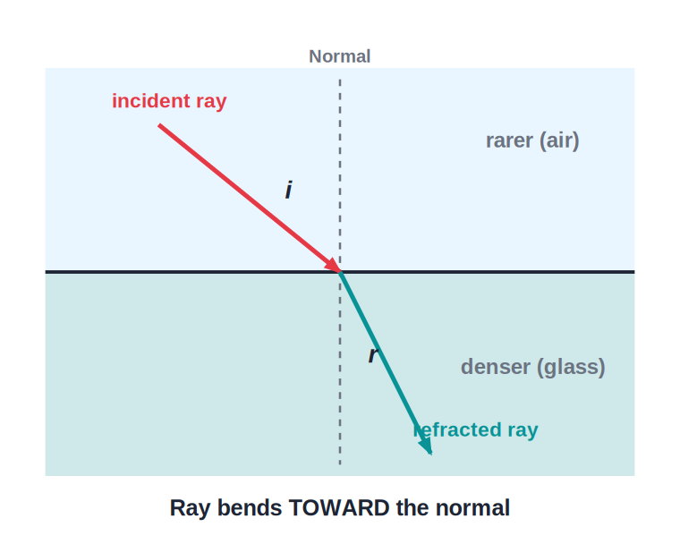
STD 10 • SCIENCE PART 1 • LIGHT
Refraction of Light
Laws of refraction • Refractive index • Total internal reflection • Dispersion • Twinkling of stars

Slide 2
INTRODUCTION
Learning Objectives
1
Explain refraction, the laws of refraction and refractive index
2
Trace a ray through a rectangular glass slab and define lateral displacement
3
Distinguish partial internal reflection from total internal reflection and use the critical angle
4
Describe how TIR explains optical fibres, mirage and diamond sparkle
5
Explain refraction and dispersion of light through a prism
6
Explain atmospheric refraction: advance sunrise, delayed sunset and the twinkling of stars
Notes:
Open by previewing these objectives so students know what they should be able to do by the end of the session.

Slide 3
PART 1
Refraction and Refractive Index
1
Why light bends, and how we measure the bending

Slide 4
REFRACTION
What Is Refraction?
Bending at a boundary
• Light bends when it crosses between two media — refraction
• Into a denser medium → bends towards the normal
• Into a rarer medium → bends away from the normal
• Along the normal → no bending
• Cause: light travels at a different speed in each medium
Notes:
Demonstrate with a pencil in a glass of water appearing bent. Stress: refraction is a change in speed and direction, not a change in frequency.

Slide 5
LAWS OF REFRACTION
The Two Laws of Refraction
First law: the incident ray, the refracted ray and the normal at the point of incidence all lie in the same plane.
• Second law (Snell's law): the ratio of the sine of the angle of incidence to the sine of the angle of refraction is constant for a given pair of media.
• This constant is called the refractive index of the second medium with respect to the first.
• Snell's law is written as: sin i / sin r = constant = ₁n₂
Notes:
Write Snell's law on the board and label i and r on the refraction_bending diagram already shown.

Slide 6
REFRACTIVE INDEX
Absolute Refractive Index
The absolute refractive index of a medium is the ratio of the speed of light in vacuum (or air) to its speed in that medium.
n = c / v
Notes:
c = speed of light in vacuum = 3 x 10^8 m/s. n has no unit since it is a ratio of two speeds. The denser the medium, the smaller v, and so the larger n.

Slide 7


REFERENCE VALUES
Absolute Refractive Indices of Common Media
Air
Water
n ≈ 1.0003 (taken as 1 for most calculations)
n = 1.33 — light travels at about 2.26 x 10⁸ m/s
Glass (crown)
Diamond
n = 1.5 — light travels at about 2 x 10⁸ m/s
n = 2.42 — the highest of common transparent materials, which is why it sparkles so brilliantly
Notes:
A higher n means light slows down more and bends more strongly on entering that medium.

Slide 8
RELATIVE REFRACTIVE INDEX
Refractive Index Between Two Media
When light travels from medium 1 into medium 2, the refractive index of medium 2 with respect to medium 1 relates their absolute indices and speeds.
₁n₂ = n₂ / n₁ = v₁ / v₂ = sin i / sin r
• If medium 2 is denser than medium 1, ₁n₂ > 1 and the ray bends towards the normal.
• If medium 2 is rarer than medium 1, ₁n₂ < 1 and the ray bends away from the normal.
• ₁n₂ and ₂n₁ are reciprocals of each other: ₁n₂ = 1 / ₂n₁
Notes:
Work through both directions (air-to-glass and glass-to-air) so students see the reciprocal relationship.

Slide 9
WORKED EXAMPLE
Finding the Speed of Light in Glass
Problem. The absolute refractive index of glass is 1.5. Find the speed of light in glass. (Speed of light in vacuum = 3 x 10⁸ m/s.)
n = c / v
1.5 = (3 x 10⁸) / v
v = (3 x 10⁸) / 1.5
Answer: v = 2 x 10⁸ m/s
Notes:
A very common numerical style in the MSBSHSE textbook — always rearrange n = c/v for whichever quantity is asked.

Slide 10
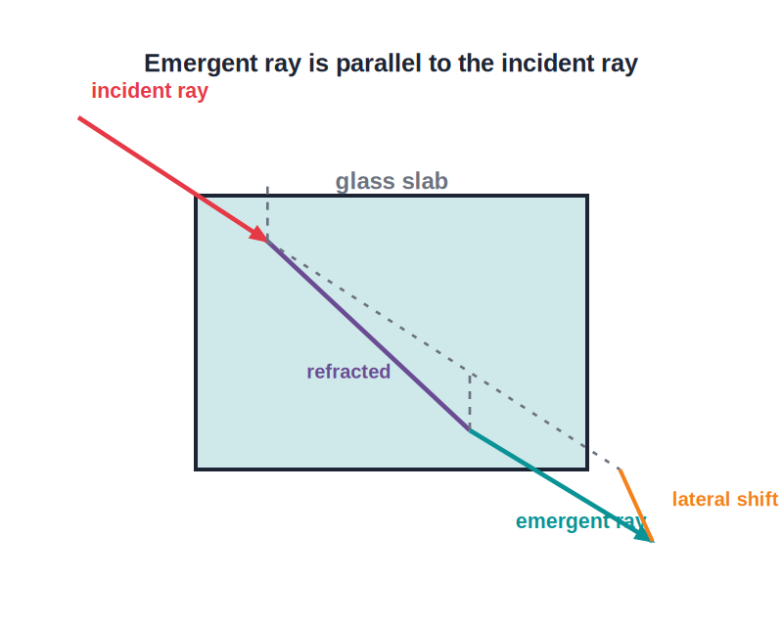
GLASS SLAB
Refraction Through a Rectangular Glass Slab
Emergent ray is parallel but shifted
• Refracts twice — on entering and on leaving
• Parallel faces bend it back by an equal amount
• Emergent ray stays parallel to the incident ray
• But shifted sideways — lateral displacement
• Shift grows with slab thickness and angle of incidence
Notes:
Stress the two key facts examiners look for: the emergent ray is parallel to the incident ray, and it is laterally displaced.

Slide 11
QUIZ 1
Check — Laws, Refractive Index & Glass Slab
5 questions • think before the answer reveals on the next slide

Slide 12
QUIZ QUESTION
Q1 — Refraction
Light bends towards the normal when it passes from:
a denser medium to a rarer medium
a rarer medium to a denser medium
A
B
air into air
vacuum into vacuum
C
D

Slide 13
ANSWER REVEALED
Q1 — Refraction
Light bends towards the normal when it passes from:
a denser medium to a rarer medium
a rarer medium to a denser medium
A
✓
air into air
vacuum into vacuum
C
D
WHY
Entering a denser medium slows the light down, and it bends towards the normal; entering a rarer medium it speeds up and bends away from the normal.

Slide 14
QUIZ QUESTION
Q2 — Snell's Law
Snell's law states that, for a given pair of media, sin i / sin r is:
always equal to 1
constant
A
B
equal to the speed of light
always greater than 90°
C
D

Slide 15
ANSWER REVEALED
Q2 — Snell's Law
Snell's law states that, for a given pair of media, sin i / sin r is:
always equal to 1
constant
A
✓
equal to the speed of light
always greater than 90°
C
D
WHY
This constant ratio is the refractive index of the second medium with respect to the first.

Slide 16
QUIZ QUESTION
Q3 — Absolute refractive index
The absolute refractive index of a medium is defined as:
v / c
c / v
A
B
c x v
sin i / sin r for any two media
C
D

Slide 17
ANSWER REVEALED
Q3 — Absolute refractive index
The absolute refractive index of a medium is defined as:
v / c
c / v
A
✓
c x v
sin i / sin r for any two media
C
D
WHY
n = speed of light in vacuum / speed of light in the medium. Since v is always less than c inside a medium, n is always greater than 1.

Slide 18
QUIZ QUESTION
Q4 — Numerical
The refractive index of water is 1.33. The approximate speed of light in water is:
3 x 10⁸ m/s
2.26 x 10⁸ m/s
A
B
4 x 10⁸ m/s
1.33 x 10⁸ m/s
C
D

Slide 19
ANSWER REVEALED
Q4 — Numerical
The refractive index of water is 1.33. The approximate speed of light in water is:
3 x 10⁸ m/s
2.26 x 10⁸ m/s
A
✓
4 x 10⁸ m/s
1.33 x 10⁸ m/s
C
D
WHY
v = c / n = (3 x 10⁸) / 1.33 ≈ 2.26 x 10⁸ m/s.

Slide 20
QUIZ QUESTION
Q5 — Glass slab
After passing through a rectangular glass slab, the emergent ray is:
bent towards the normal
parallel to the incident ray but laterally displaced
A
B
reflected straight back
split into seven colours
C
D

Slide 21
ANSWER REVEALED
Q5 — Glass slab
After passing through a rectangular glass slab, the emergent ray is:
bent towards the normal
parallel to the incident ray but laterally displaced
A
✓
reflected straight back
split into seven colours
C
D
WHY
The two equal-and-opposite refractions at the parallel faces keep the emergent ray parallel to the incident ray, but shift it sideways (lateral displacement).

Slide 22
PART 2
Internal Reflection, Prism & Atmospheric Refraction
2
Critical angle, the prism, dispersion and sky phenomena

Slide 23
PARTIAL & TOTAL
Partial and Total Internal Reflection
Partial internal reflection
When light travels from a denser to a rarer medium at a small angle of incidence, most of it refracts out (bending away from the normal) while a small part is reflected back into the denser medium — this is partial internal reflection.
As the angle increases
As the angle of incidence in the denser medium is increased, the refracted ray bends more and more towards the boundary and grows fainter, while the reflected ray grows brighter.
At the critical angle
The critical angle (C) is the angle of incidence in the denser medium for which the angle of refraction becomes 90°; the refracted ray just grazes along the surface.
Beyond the critical angle
If the angle of incidence exceeds the critical angle, no light refracts out at all — all of it is reflected back into the denser medium. This is total internal reflection (TIR).
Notes:
Emphasise the progression: partial internal reflection always accompanies refraction, but TIR is a special case that only begins once the critical angle is exceeded.

Slide 24
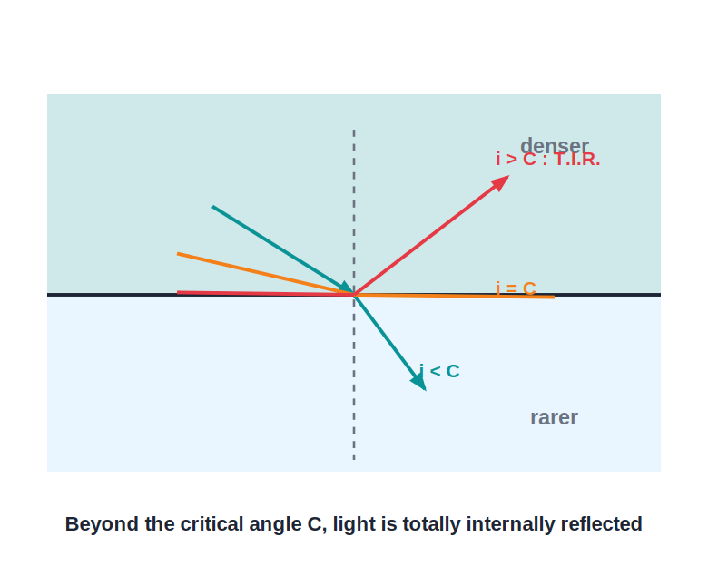
CONDITIONS FOR TIR
The Two Conditions for Total Internal Reflection
When the surface acts as a mirror
• Both conditions must hold together:
• 1. Denser medium → rarer medium (e.g. glass → air)
• 2. Angle of incidence > critical angle
• Then no light refracts out — all is reflected
• The boundary acts like a perfect mirror
Notes:
Contrast with the previous slide: below the critical angle you get refraction plus partial reflection; only above it do you get true total internal reflection.

Slide 25
CRITICAL ANGLE FORMULA
Relating Critical Angle and Refractive Index
For light travelling from a denser medium into air, the critical angle C is related to the absolute refractive index of the denser medium.
sin C = 1 / n
Notes:
Derived by setting the angle of refraction to 90° in Snell's law: n = sin 90° / sin C = 1 / sin C.

Slide 26
WORKED EXAMPLE
Critical Angle of Water
Problem. The refractive index of water is 1.33. Find its critical angle. (sin 48.8° ≈ 0.75)
sin C = 1 / n = 1 / 1.33
sin C = 0.75
Answer: C ≈ 48.8°
Notes:
This is why, looking up from underwater, the entire sky outside a cone of about 97° (2C) is compressed into that circle — beyond it, the water surface acts like a mirror.

Slide 27


APPLICATIONS OF TIR
Everyday Uses of Total Internal Reflection
Optical fibres
Sparkle of a diamond
Light entering a thin glass fibre strikes the inner wall beyond the critical angle again and again, so it travels the whole length by repeated TIR with almost no loss — used in telecommunication and medical endoscopes.
Diamond has a very high refractive index (2.42) and hence a very small critical angle (about 24.4°). Light entering a cut diamond undergoes TIR repeatedly before emerging, giving it its brilliance.
Mirage
Totally reflecting prisms
On a hot road, air near the ground is much hotter and rarer than the air above. Light from the sky bends more and more as it grazes the hot layer until it undergoes TIR, reaching the eye as if reflected from a pool of water.
A right-angled prism can turn or invert light by TIR at its hypotenuse face, used in periscopes and binoculars instead of ordinary mirrors.
Notes:
Show the optical-fibre and mirage diagrams alongside this slide; both are direct consequences of the same TIR condition just derived.

Slide 28
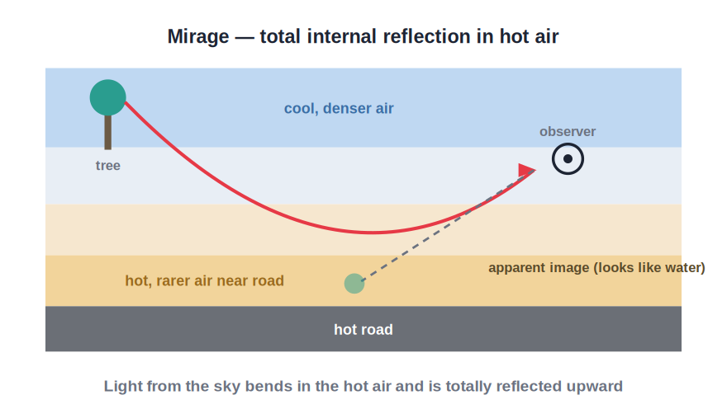
MIRAGE
Mirage: TIR in the Open Air
The 'water' that isn't there
• Hot day → air near the ground is hot and rarer
• Sky-light bends more through each hotter layer
• It undergoes total internal reflection upward
• We see an inverted patch of sky on the road
• It looks just like a pool of water
Notes:
Link back to the critical-angle condition: TIR happens here even though there is no sharp single boundary — the air's density changes gradually with height.

Slide 29
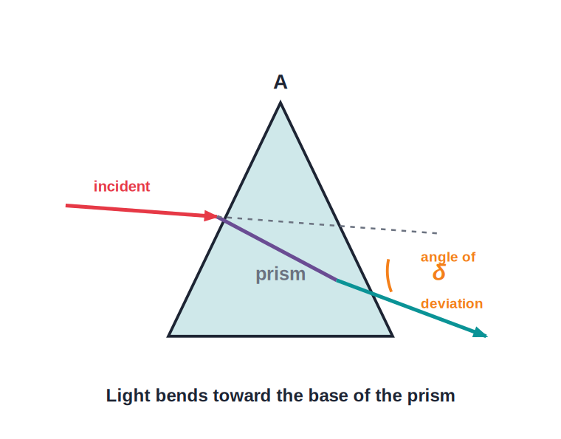
PRISM
Refraction of Light Through a Prism
Bending towards the base
• Two refractions at two non-parallel faces
• Angle between the faces = refracting angle
• Emergent ray is NOT parallel to the incident ray
• The ray bends towards the base of the prism
• This bending is the angle of deviation
Notes:
Set up the contrast: a slab keeps the ray parallel, a prism deviates it towards the base — this deviation, being different for each colour, is what produces dispersion on the next slide.

Slide 30
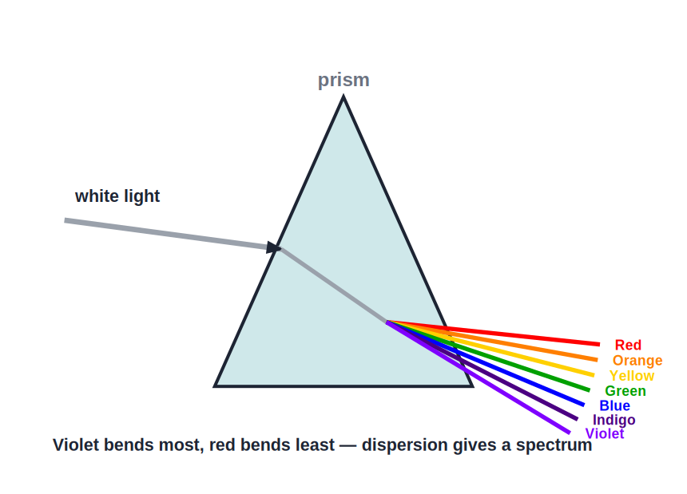
DISPERSION
Dispersion of Light Through a Prism
Splitting white light
• White light = seven colours (VIBGYOR)
• A prism bends each colour by a different amount
• Violet bends the most, red the least
• The colours emerge as a band — a spectrum
• This splitting of white light is called dispersion
Notes:
A rainbow is a natural example of dispersion combined with internal reflection inside raindrops.

Slide 31
ATMOSPHERIC REFRACTION
Advance Sunrise and Delayed Sunset
Denser air near the ground
The Earth's atmosphere is denser near the surface and gradually becomes rarer with height, so sunlight bends continuously as it passes down through it.
Advance sunrise
Because of this bending, the Sun's light reaches us even when the Sun is still slightly below the horizon, so we see the Sun about two minutes before it actually rises.
Delayed sunset
For the same reason, we continue to see the Sun for about two minutes after it has actually set below the horizon — giving roughly four extra minutes of daylight each day.
Oval-shaped Sun
Near the horizon, light from the lower edge of the Sun is refracted more than that from the upper edge, so the Sun appears slightly flattened (oval) at sunrise and sunset.
Notes:
This is the same atmospheric refraction that causes twinkling; here it shifts the Sun's apparent position rather than making it flicker.

Slide 32
TWINKLING OF STARS
Why Do Stars Twinkle?
Atmospheric refraction
Starlight enters the Earth's atmosphere and passes through air layers of continuously changing density and temperature before reaching our eyes.
Continuous bending
Because the atmosphere has no sharp boundaries, the light bends gradually and does not travel in a single straight line — it follows a slightly curved path.
Fluctuating refractive index
Air currents constantly change the density of the layers, so the amount of bending keeps changing from moment to moment.
Apparent flickering
This makes the star's apparent position and brightness fluctuate rapidly, which we see as twinkling.
Planets do not twinkle noticeably
Planets are much closer and appear as extended sources (a collection of many points), so the twinkling from different points averages out.
Notes:
Contrast with why stars appear steady when viewed from space (no atmosphere) — reinforces that twinkling is purely an atmospheric refraction effect.

Slide 33
WRAP UP
Quick Recap
✓ Refraction & Snell's law — Light bends at a boundary; sin i / sin r = refractive index; n = c / v.
✓ Glass slab — Emergent ray is parallel to the incident ray but laterally displaced.
✓ Partial vs total reflection — Below the critical angle: refraction + partial reflection; beyond it (sin C = 1/n): total internal reflection.
✓ TIR applications — Optical fibres, diamond sparkle, mirage, totally reflecting prisms.
✓ Prism & dispersion — A prism deviates light towards its base and splits white light into the VIBGYOR spectrum.
✓ Atmospheric refraction — Advance sunrise, delayed sunset and the twinkling of stars.
Notes:
Cold-call each recap point; ask students to state the formula for critical angle from memory.

Slide 34
QUIZ 2
Final Check — TIR, Dispersion & Twinkling
4 questions • think before the answer reveals on the next slide

Slide 35
QUIZ QUESTION
Q1 — Critical angle
The critical angle is the angle of incidence in the denser medium for which the angle of refraction is:
0°
45°
A
B
90°
equal to the critical angle
C
D

Slide 36
ANSWER REVEALED
Q1 — Critical angle
The critical angle is the angle of incidence in the denser medium for which the angle of refraction is:
0°
45°
A
B
90°
equal to the critical angle
✓
D
WHY
At the critical angle the refracted ray grazes along the boundary surface, making an angle of refraction of exactly 90°.

Slide 37
QUIZ QUESTION
Q2 — TIR condition
Total internal reflection can occur only when light travels:
from a rarer to a denser medium
from a denser to a rarer medium, beyond the critical angle
A
B
along the normal
through a vacuum
C
D

Slide 38
ANSWER REVEALED
Q2 — TIR condition
Total internal reflection can occur only when light travels:
from a rarer to a denser medium
from a denser to a rarer medium, beyond the critical angle
A
✓
along the normal
through a vacuum
C
D
WHY
Both conditions are needed together: denser-to-rarer travel, and an angle of incidence greater than the critical angle.

Slide 39
QUIZ QUESTION
Q3 — Diamond
A diamond sparkles brilliantly mainly because it has:
a very low refractive index
a very high refractive index and hence a small critical angle
A
B
no refractive index
a rough, unpolished surface
C
D

Slide 40
ANSWER REVEALED
Q3 — Diamond
A diamond sparkles brilliantly mainly because it has:
a very low refractive index
a very high refractive index and hence a small critical angle
A
✓
no refractive index
a rough, unpolished surface
C
D
WHY
With C ≈ 24.4°, light entering a cut diamond undergoes TIR repeatedly before it can escape, producing its brilliance.

Slide 41
QUIZ QUESTION
Q4 — Twinkling
Stars appear to twinkle mainly because of:
their own changing brightness
continuously changing refraction in the Earth's atmosphere
A
B
dispersion by a prism
total internal reflection in the star itself
C
D

Slide 42
ANSWER REVEALED
Q4 — Twinkling
Stars appear to twinkle mainly because of:
their own changing brightness
continuously changing refraction in the Earth's atmosphere
A
✓
dispersion by a prism
total internal reflection in the star itself
C
D
WHY
Air layers of constantly changing density bend starlight by varying amounts, making its apparent position and brightness flicker.

Slide 43
Bending Light, Understanding Nature
From a straw that looks bent in water to the sparkle of a diamond and the twinkle of a star, refraction explains it all — one law, endless everyday effects.

