Slide 1
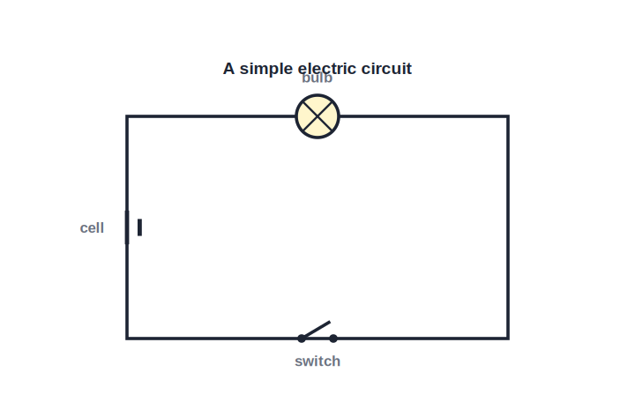
STD 10 • SCIENCE PART 1 • ELECTRICITY
Effects of Electric Current — 1
Energy transfer in a circuit • Heating effect • Magnetic effect • Right-hand thumb rule

Slide 2
INTRODUCTION
Learning Objectives
1
Explain how electrical energy is transferred and used up in a circuit
2
State Joule's law of heating and use H = I²Rt
3
Describe everyday uses of the heating effect of current
4
State Oersted's discovery of the magnetic effect of current
5
Apply the right-hand thumb rule to a straight current-carrying conductor
6
Describe the magnetic field pattern of a straight wire
Notes:
Open by previewing these objectives so students know what they should be able to do by the end of the session.

Slide 3
PART 1
Energy Transfer and the Heating Effect
1
How electrical work becomes heat

Slide 4
ENERGY TRANSFER
Energy Transfer in an Electric Circuit
From battery to heat
• A cell (or battery) does work to push charge around a circuit; this electrical energy is converted into other forms by the components in the circuit.
• The work done in moving a charge Q through a potential difference V is W = VQ; since Q = It, the work done in time t is W = VIt.
• In a purely resistive component (like a heater coil or a bulb filament), all of this electrical energy is converted into heat.
• This conversion of electrical energy into heat because of the resistance in the circuit is called the heating effect of electric current.
Notes:
Link back to V = W/Q from the current-electricity chapter; this is the same relation used to derive Joule's law.

Slide 5
JOULE'S LAW
Joule's Law of Heating
Using Ohm's law (V = IR) in W = VIt gives the heat produced in a resistor carrying a current for a given time.
H = I² R t
• The heat produced is directly proportional to the square of the current.
• The heat produced is directly proportional to the resistance.
• The heat produced is directly proportional to the time for which the current flows.
• H is in joules when I is in amperes, R in ohms and t in seconds.
Notes:
Emphasise the squared dependence on current — doubling the current quadruples the heat produced, not just doubles it.

Slide 6
WORKED EXAMPLE
Heat Produced in a Resistor
Problem. A current of 2 A flows through a resistor of 10 Ω for 5 minutes. Calculate the heat produced.
H = I² R t
t = 5 x 60 = 300 s
H = (2)² x 10 x 300
Answer: H = 12000 J = 12 kJ
Notes:
Remind students to convert time to seconds before substituting — a very common slip.

Slide 7




USES
Everyday Uses of the Heating Effect
Electric heater / iron
Incandescent bulb
A coil of high-resistance wire (nichrome) glows and produces heat when current flows through it, used for room heaters, electric irons and geysers.
A thin tungsten filament heats up so much that it glows white-hot and emits light; tungsten is used because it has a very high melting point.
Electric fuse
Soldering iron
A thin wire of low melting point is placed in series in a circuit; if the current becomes too large, the fuse wire heats up, melts and breaks the circuit, protecting the appliance.
A high-resistance heating element converts electrical energy to heat to melt solder for joining wires and components.
Notes:
Ask students to name the common factor in all four devices — each deliberately uses a high-resistance element to maximise I²Rt heating.

Slide 8
QUIZ 1
Check — Energy Transfer & Heating
4 questions • think before the answer reveals on the next slide

Slide 9
QUIZ QUESTION
Q1 — Energy transfer
The work done in moving a charge Q through a potential difference V is given by:
W = V / Q
W = VQ
A
B
W = Q / V
W = V + Q
C
D

Slide 10
ANSWER REVEALED
Q1 — Energy transfer
The work done in moving a charge Q through a potential difference V is given by:
W = V / Q
W = VQ
A
✓
W = Q / V
W = V + Q
C
D
WHY
Potential difference is defined as work done per unit charge, so W = VQ (and since Q = It, W = VIt).

Slide 11
QUIZ QUESTION
Q2 — Joule's law
According to Joule's law of heating, the heat produced in a resistor is proportional to:
I and R only
I², R and t
A
B
I and t only
R² and I
C
D

Slide 12
ANSWER REVEALED
Q2 — Joule's law
According to Joule's law of heating, the heat produced in a resistor is proportional to:
I and R only
I², R and t
A
✓
I and t only
R² and I
C
D
WHY
H = I²Rt — heat depends on the square of the current, and directly on resistance and time.

Slide 13
QUIZ QUESTION
Q3 — Numerical
A current of 3 A flows through a 4 Ω resistor for 10 s. The heat produced is:
120 J
360 J
A
B
40 J
12 J
C
D

Slide 14
ANSWER REVEALED
Q3 — Numerical
A current of 3 A flows through a 4 Ω resistor for 10 s. The heat produced is:
120 J
360 J
A
✓
40 J
12 J
C
D
WHY
H = I²Rt = (3)² x 4 x 10 = 9 x 4 x 10 = 360 J.

Slide 15
QUIZ QUESTION
Q4 — Fuse
An electric fuse protects a circuit because its wire:
has a very high melting point so it never melts
has a low melting point and melts to break the circuit when current is too high
A
B
is a perfect conductor
increases the current when it gets hot
C
D

Slide 16
ANSWER REVEALED
Q4 — Fuse
An electric fuse protects a circuit because its wire:
has a very high melting point so it never melts
has a low melting point and melts to break the circuit when current is too high
A
✓
is a perfect conductor
increases the current when it gets hot
C
D
WHY
A fuse wire is deliberately chosen to melt (via I²Rt heating) and break the circuit before the current can damage the appliance or wiring.

Slide 17
PART 2
The Magnetic Effect of Electric Current
2
Oersted's discovery and the right-hand thumb rule

Slide 18
OERSTED'S EXPERIMENT
Discovery of the Magnetic Effect
In 1820, Hans Christian Oersted found that a compass needle placed near a current-carrying wire is deflected.
The needle deflects only when current flows in the wire, and returns to normal when the current is switched off.
Reversing the direction of the current reverses the direction of the deflection.
This showed that an electric current produces a magnetic field around itself — the magnetic effect of electric current, the basis of electromagnetism.
Notes:
This experiment is historically important: it was the first evidence linking electricity and magnetism, which later led to Maxwell's unified theory.

Slide 19
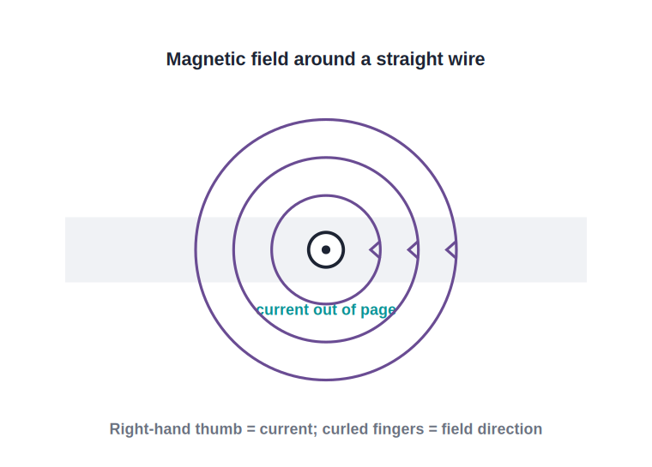
STRAIGHT CONDUCTOR
Field Around a Straight Current-Carrying Wire
Concentric field circles
• A long straight wire carrying current produces a magnetic field whose field lines are concentric circles centred on the wire, lying in a plane perpendicular to it.
• The field is stronger closer to the wire and weaker farther away — the circles are more crowded near the wire.
• Reversing the current reverses the direction of the field lines (clockwise becomes anticlockwise, viewed from a fixed end).
Notes:
Have students trace the field-line circles with their finger around a pencil representing the wire.

Slide 20
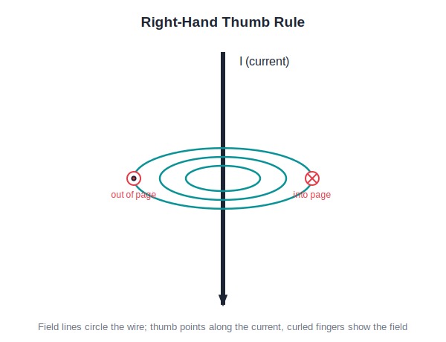
RIGHT-HAND THUMB RULE
Finding the Direction of the Field
Thumb = current, curl = field
• Maxwell's right-hand thumb rule gives a quick way to find the direction of the magnetic field around a straight conductor.
• Hold the current-carrying conductor in your right hand with the thumb pointing in the direction of the conventional current.
• Your curled fingers then point in the direction of the magnetic field lines around the wire.
• By convention, a dot (⊙) shows the field or current coming out of the page, and a cross (⊗) shows it going into the page.
Notes:
Demonstrate physically with your own hand and the diagram side by side; this rule is used repeatedly through the rest of the chapter.

Slide 21
WRAP UP
Quick Recap
✓ Heating effect — Electrical energy converts to heat in a resistor: H = I²Rt.
✓ Uses — Heaters, bulb filaments, fuses and soldering irons all use the heating effect.
✓ Oersted's experiment — A current-carrying wire deflects a nearby compass needle — proof of the magnetic effect.
✓ Straight wire field — Concentric circular field lines around the wire.
✓ Right-hand thumb rule — Thumb along the current, curled fingers show the field direction.
Notes:
Ask a student to physically demonstrate the right-hand thumb rule for the class.

Slide 22
QUIZ 2
Final Check — Magnetic Effect
4 questions • think before the answer reveals on the next slide

Slide 23
QUIZ QUESTION
Q1 — Oersted
Oersted's experiment showed that a current-carrying wire:
repels a nearby wire
deflects a nearby compass needle
A
B
heats up a nearby magnet
has no effect on a compass
C
D

Slide 24
ANSWER REVEALED
Q1 — Oersted
Oersted's experiment showed that a current-carrying wire:
repels a nearby wire
deflects a nearby compass needle
A
✓
heats up a nearby magnet
has no effect on a compass
C
D
WHY
The deflection, seen only while current flows, proved that current produces a magnetic field.

Slide 25
QUIZ QUESTION
Q2 — Field pattern
The magnetic field lines around a long straight current-carrying wire are:
straight lines parallel to the wire
concentric circles centred on the wire
A
B
radial lines pointing away from the wire
randomly scattered
C
D

Slide 26
ANSWER REVEALED
Q2 — Field pattern
The magnetic field lines around a long straight current-carrying wire are:
straight lines parallel to the wire
concentric circles centred on the wire
A
✓
radial lines pointing away from the wire
randomly scattered
C
D
WHY
The field forms circles in a plane perpendicular to the wire, crowded closer to the wire where the field is stronger.

Slide 27
QUIZ QUESTION
Q3 — Right-hand thumb rule
In the right-hand thumb rule, the thumb points along the:
magnetic field
current
A
B
force on the wire
normal to the wire
C
D

Slide 28
ANSWER REVEALED
Q3 — Right-hand thumb rule
In the right-hand thumb rule, the thumb points along the:
magnetic field
current
A
✓
force on the wire
normal to the wire
C
D
WHY
Thumb = direction of conventional current; curled fingers = direction of the magnetic field.

Slide 29
QUIZ QUESTION
Q4 — Reversal
If the current in a straight wire is reversed, the magnetic field around it:
disappears completely
also reverses direction
A
B
stays exactly the same
becomes twice as strong
C
D

Slide 30
ANSWER REVEALED
Q4 — Reversal
If the current in a straight wire is reversed, the magnetic field around it:
disappears completely
also reverses direction
A
✓
stays exactly the same
becomes twice as strong
C
D
WHY
Reversing the thumb direction in the right-hand rule reverses the curl of the fingers, so the field direction flips too.

Slide 31
Current in Motion, Heat and Magnetism
The same flowing charge that warms a heater coil also conjures a magnetic field around every wire — two effects, one current.

