Slide 1
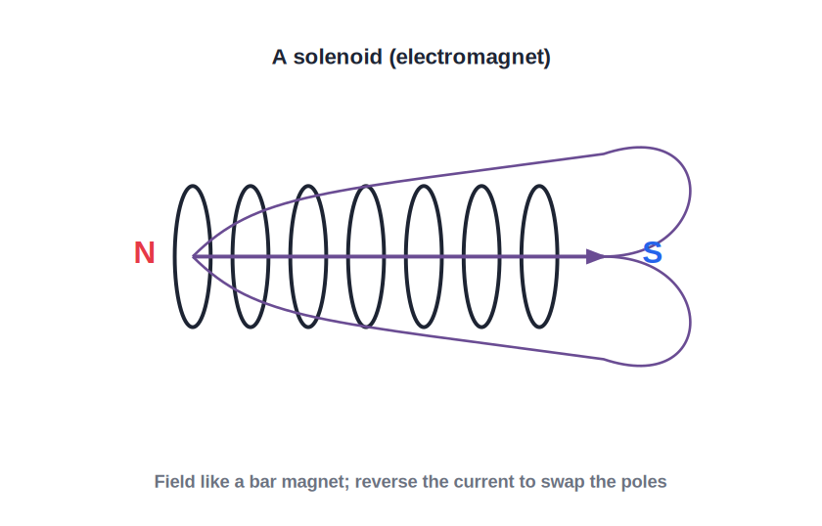
STD 10 • SCIENCE PART 1 • ELECTRICITY
Effects of Electric Current — 2
Field of a circular loop and a solenoid • Force on a current-carrying conductor • Fleming's left-hand rule

Slide 2
INTRODUCTION
Learning Objectives
1
Describe the magnetic field due to a circular loop of current
2
Describe the magnetic field pattern of a solenoid and compare it with a bar magnet
3
Explain how the strength of a solenoid's field can be increased
4
State the factors on which the force on a current-carrying conductor in a magnetic field depends
5
Apply Fleming's left-hand rule to find the direction of this force
6
Relate this force to the working principle of an electric motor
Notes:
Open by previewing these objectives so students know what they should be able to do by the end of the session.

Slide 3
PART 1
Field of a Loop and a Solenoid
1
From a single loop to a coil that behaves like a magnet

Slide 4
CIRCULAR LOOP
Magnetic Field Due to a Circular Loop
Field lines at the loop
Applying the right-hand thumb rule at every point of a circular loop shows that the field lines are circles near the wire, but they become nearly straight and parallel as you move toward the centre of the loop.
Field at the centre
At the centre of the loop, all the field contributions add up in the same direction, giving the strongest and most uniform field in that region.
Increasing the field
The field at the centre can be increased by increasing the current or by using a coil of many turns instead of a single loop — each turn adds its own contribution.
Polarity of the loop face
One face of the current loop behaves like a north pole and the other like a south pole, found using the right-hand rule (curl fingers along the current, thumb gives the north face).
Notes:
Build up from the straight-wire field of the previous session: a loop is just a straight wire bent into a circle, so the same field lines now reinforce at the centre.

Slide 5
SOLENOID
Magnetic Field of a Solenoid
A coil that behaves like a bar magnet
• A solenoid is a long coil of insulated wire wound in many closely spaced circular turns.
• When current flows through it, the field of each turn adds up so that the field inside the solenoid is strong and nearly uniform, directed along its axis.
• Outside the solenoid, the field pattern is very similar to that of a bar magnet — one end behaves like a north pole and the other like a south pole.
• The polarity of the ends is found by the same right-hand rule: curl the fingers in the direction of the current in the turns, and the thumb points towards the north-pole end.
Notes:
This is the working principle of the electromagnet, already met earlier in the syllabus — connect the two ideas explicitly.

Slide 6



STRENGTH OF THE FIELD
Increasing the Strength of a Solenoid's Field
More turns
More current
Winding more turns of wire in the same length increases the field, since each turn contributes its own magnetic field in the same direction.
Increasing the current through the solenoid directly increases the strength of the field it produces.
Soft-iron core
Placing a soft-iron core inside the solenoid greatly increases the field strength, because the core itself becomes strongly magnetised — this combination is an electromagnet.
Notes:
These three factors are exactly the ones used to design strong electromagnets for cranes, bells and motors.

Slide 7
QUIZ 1
Check — Loop & Solenoid Fields
3 questions • think before the answer reveals on the next slide

Slide 8
QUIZ QUESTION
Q1 — Circular loop
The magnetic field is strongest and most uniform at the:
edge of the loop
centre of the loop
A
B
far outside the loop
nowhere in particular
C
D

Slide 9
ANSWER REVEALED
Q1 — Circular loop
The magnetic field is strongest and most uniform at the:
edge of the loop
centre of the loop
A
✓
far outside the loop
nowhere in particular
C
D
WHY
At the centre, the field contributions from every part of the loop add up in the same direction, giving the strongest field there.

Slide 10
QUIZ QUESTION
Q2 — Solenoid
Outside a current-carrying solenoid, the magnetic field pattern closely resembles that of a:
straight wire
bar magnet
A
B
single point charge
circular loop with no current
C
D

Slide 11
ANSWER REVEALED
Q2 — Solenoid
Outside a current-carrying solenoid, the magnetic field pattern closely resembles that of a:
straight wire
bar magnet
A
✓
single point charge
circular loop with no current
C
D
WHY
A solenoid's external field lines look just like those of a bar magnet, with one end acting as north and the other as south.

Slide 12
QUIZ QUESTION
Q3 — Strength
Which of these will NOT increase the strength of a solenoid's magnetic field?
increasing the number of turns
increasing the current
A
B
inserting a soft-iron core
using a longer connecting wire outside the solenoid
C
D

Slide 13
ANSWER REVEALED
Q3 — Strength
Which of these will NOT increase the strength of a solenoid's magnetic field?
increasing the number of turns
increasing the current
A
B
inserting a soft-iron core
using a longer connecting wire outside the solenoid
C
✓
WHY
Only turns, current and a magnetic core (inside the solenoid) affect its field strength — the length of ordinary connecting wire outside it makes no difference.

Slide 14
PART 2
Force on a Current-Carrying Conductor
2
The motor effect and Fleming's left-hand rule

Slide 15
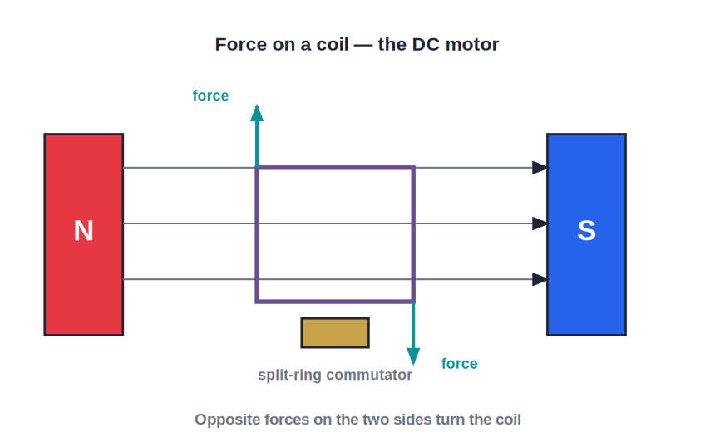
MOTOR EFFECT
Force on a Conductor in a Magnetic Field
Current + field = force
• When a current-carrying conductor is placed in a magnetic field (not parallel to it), it experiences a force — this is called the motor effect.
• The force is zero when the conductor is parallel to the field, and maximum when the conductor is perpendicular to the field.
• The magnitude of the force depends on the strength of the magnetic field, the current in the conductor, and the length of the conductor in the field.
• This force is what makes an electric motor turn, and is used in loudspeakers and moving-coil meters.
Notes:
This is the reverse idea of Oersted's experiment: instead of current producing a field, here a current in an external field feels a force.

Slide 16
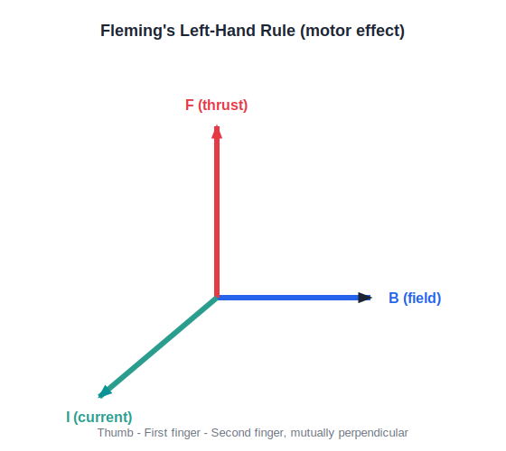
FLEMING'S LEFT-HAND RULE
Finding the Direction of the Force
Fleming's left-hand rule gives the direction of the force on a current-carrying conductor placed in a magnetic field.
Notes:
Stretch the thumb, first finger and second finger of the left hand mutually perpendicular: First finger = Field, seCond finger = Current, thuMb = Motion (force). Mnemonic: FBI (Field, current, thrust) or FCM.

Slide 17
FLEMING'S LEFT-HAND RULE
How to Apply the Rule
First finger
Point the first finger in the direction of the magnetic field (B).
Second finger
Point the second finger, held perpendicular to the first, in the direction of the conventional current (I).
Thumb
The thumb, held perpendicular to both, then gives the direction of the force (F) on the conductor — this is the direction it will move.
Left hand only
This rule always uses the left hand; the right-hand thumb rule and Fleming's right-hand rule (used for generators, next session) are entirely different rules.
Notes:
Have the whole class physically form the rule with their left hand and check it against the diagram just shown.

Slide 18
WRAP UP
Quick Recap
✓ Circular loop — Field is strongest and most uniform at the centre; each face acts like a magnetic pole.
✓ Solenoid — Behaves like a bar magnet outside; field can be strengthened by more turns, more current or a soft-iron core.
✓ Motor effect — A current-carrying conductor in a magnetic field experiences a force, maximum when perpendicular to the field.
✓ Fleming's left-hand rule — First finger = Field, second finger = Current, thumb = Force (motion).
Notes:
Ask students to distinguish the right-hand thumb rule (field due to current) from Fleming's left-hand rule (force on a current in a field) — a very common mix-up.

Slide 19
QUIZ 2
Final Check — Motor Effect
4 questions • think before the answer reveals on the next slide

Slide 20
QUIZ QUESTION
Q1 — Motor effect
A current-carrying conductor placed parallel to a magnetic field experiences a force that is:
maximum
zero
A
B
constant but not zero
infinite
C
D

Slide 21
ANSWER REVEALED
Q1 — Motor effect
A current-carrying conductor placed parallel to a magnetic field experiences a force that is:
maximum
zero
A
✓
constant but not zero
infinite
C
D
WHY
The force is zero when the current is parallel to the field and maximum when it is perpendicular to the field.

Slide 22
QUIZ QUESTION
Q2 — Fleming's left-hand rule
In Fleming's left-hand rule, the second finger represents:
the magnetic field
the current
A
B
the resulting force
the resistance
C
D

Slide 23
ANSWER REVEALED
Q2 — Fleming's left-hand rule
In Fleming's left-hand rule, the second finger represents:
the magnetic field
the current
A
✓
the resulting force
the resistance
C
D
WHY
First finger = Field, seCond finger = Current, thuMb = Motion (force) — the classic FCM mnemonic.

Slide 24
QUIZ QUESTION
Q3 — Factors
The force on a current-carrying conductor in a magnetic field does NOT depend on:
the current in the conductor
the strength of the magnetic field
A
B
the colour of the insulation on the wire
the length of the conductor in the field
C
D

Slide 25
ANSWER REVEALED
Q3 — Factors
The force on a current-carrying conductor in a magnetic field does NOT depend on:
the current in the conductor
the strength of the magnetic field
A
B
the colour of the insulation on the wire
the length of the conductor in the field
✓
D
WHY
The force depends only on the physical quantities current, field strength and length (and the angle between them) — not on the wire's appearance.

Slide 26
QUIZ QUESTION
Q4 — Application
The force on a current-carrying conductor in a magnetic field is the basic working principle of a/an:
electric motor
electric fuse
A
B
resistor
voltmeter
C
D

Slide 27
ANSWER REVEALED
Q4 — Application
The force on a current-carrying conductor in a magnetic field is the basic working principle of a/an:
electric motor
electric fuse
✓
B
resistor
voltmeter
C
D
WHY
An electric motor uses this force, acting on the two sides of a current-carrying coil, to produce a turning effect (torque).

Slide 28
Current Feels a Push
Field around a wire, force on a wire in a field — these two effects, tied together by Fleming's left-hand rule, are what spin every electric motor.

