Slide 1
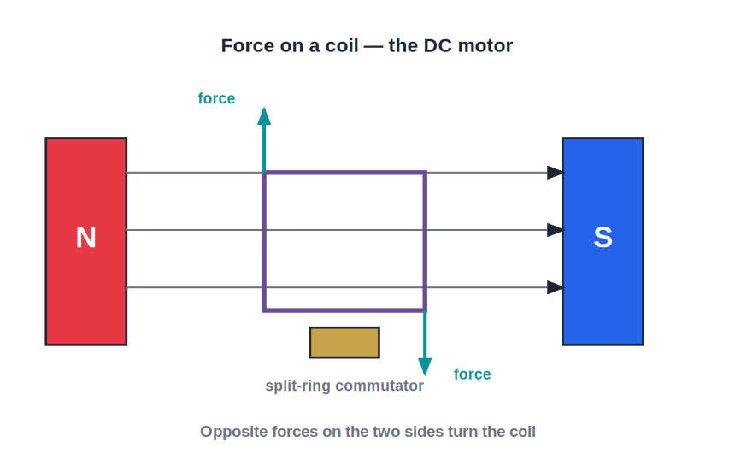
STD 10 • SCIENCE PART 1 • ELECTRICITY
Effects of Electric Current — 3
Electric motor • Electromagnetic induction • Faraday's laws • AC/DC generators

Slide 2
INTRODUCTION
Learning Objectives
1
Describe the construction and working of a simple DC electric motor
2
Explain the principle and working of a moving-coil galvanometer
3
Describe Faraday's experiments and state Faraday's laws of electromagnetic induction
4
Apply Fleming's right-hand rule to find the direction of an induced current
5
Distinguish between alternating current (AC) and direct current (DC)
6
Describe the construction and working of an AC generator
Notes:
Open by previewing these objectives so students know what they should be able to do by the end of the session.

Slide 3
PART 1
The Electric Motor and the Galvanometer
1
Turning electrical energy into motion, and detecting current

Slide 4
ELECTRIC MOTOR
Construction and Working of a DC Motor
Turning current into rotation
• A simple DC motor has a rectangular coil (the armature) mounted between the poles of a permanent magnet, connected to the circuit through a split-ring commutator and brushes.
• When current flows through the coil, the two sides of the coil carry current in opposite directions; by Fleming's left-hand rule, they experience forces in opposite directions.
• These two opposite forces form a couple that rotates the coil.
• The split-ring commutator reverses the current in the coil every half rotation, so the forces keep acting in a direction that continues the rotation instead of reversing it.
Notes:
Emphasise the role of the commutator specifically — without it, the coil would rotate only a quarter turn and then oscillate back and forth.

Slide 5
GALVANOMETER
The Moving-Coil Galvanometer
Purpose
A galvanometer is a sensitive instrument used to detect the presence and direction of a small electric current in a circuit.
Principle
It works on the same motor-effect principle as an electric motor: a current-carrying coil placed in a magnetic field experiences a torque (turning force).
Construction
A coil is wound on a light aluminium frame, suspended between the poles of a permanent magnet, attached to a pointer moving over a scale.
Reading
The coil rotates by an amount proportional to the current flowing through it, so the pointer's deflection indicates both the size and the direction of the current.
Notes:
Contrast with the motor: a motor is designed to keep spinning continuously and do mechanical work, while a galvanometer is designed to rotate only slightly and settle at a reading.

Slide 6
QUIZ 1
Check — Motor & Galvanometer
3 questions • think before the answer reveals on the next slide

Slide 7
QUIZ QUESTION
Q1 — DC motor
In a simple DC motor, the split-ring commutator's job is to:
increase the magnetic field
reverse the current in the coil every half rotation so it keeps turning one way
A
B
stop the coil from rotating
convert AC to DC before it enters the motor
C
D

Slide 8
ANSWER REVEALED
Q1 — DC motor
In a simple DC motor, the split-ring commutator's job is to:
increase the magnetic field
reverse the current in the coil every half rotation so it keeps turning one way
A
✓
stop the coil from rotating
convert AC to DC before it enters the motor
C
D
WHY
Without this reversal, the forces on the coil would reverse direction each half turn and the coil would just oscillate instead of spinning continuously.

Slide 9
QUIZ QUESTION
Q2 — Motor principle
The rotation of a DC motor's coil is a direct result of:
Faraday's law of induction
the force on a current-carrying conductor in a magnetic field
A
B
the heating effect of current
static electricity
C
D

Slide 10
ANSWER REVEALED
Q2 — Motor principle
The rotation of a DC motor's coil is a direct result of:
Faraday's law of induction
the force on a current-carrying conductor in a magnetic field
A
✓
the heating effect of current
static electricity
C
D
WHY
The two sides of the coil feel oppositely directed forces (Fleming's left-hand rule), forming a couple that turns the coil.

Slide 11
QUIZ QUESTION
Q3 — Galvanometer
A galvanometer is used to:
produce a magnetic field
detect the presence and direction of a small current
A
B
generate electricity
store electric charge
C
D

Slide 12
ANSWER REVEALED
Q3 — Galvanometer
A galvanometer is used to:
produce a magnetic field
detect the presence and direction of a small current
A
✓
generate electricity
store electric charge
C
D
WHY
Its pointer deflection, caused by the motor-effect torque on its coil, shows both the size and the direction of the current.

Slide 13
PART 2
Electromagnetic Induction and Generators
2
Producing current from a changing magnetic field

Slide 14
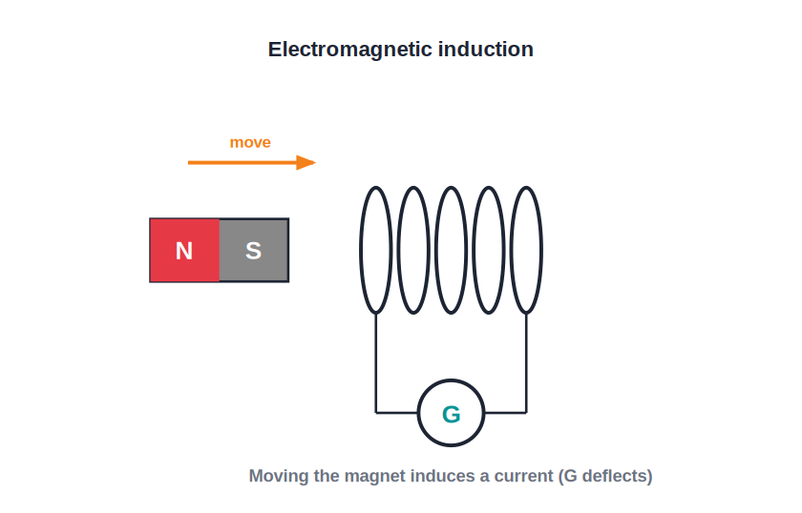
ELECTROMAGNETIC INDUCTION
Faraday's Experiments
A moving magnet induces current
• Michael Faraday found that moving a bar magnet in and out of a coil of wire connected to a galvanometer causes the galvanometer's needle to deflect — showing a current is induced in the coil.
• The needle deflects only while the magnet is moving; it shows no deflection when the magnet is held still inside or outside the coil.
• Moving the magnet faster produces a larger deflection, and reversing the direction of motion reverses the direction of deflection.
• This production of an electromotive force (EMF), and hence a current, by a changing magnetic field is called electromagnetic induction (EMI).
Notes:
Point out this is the reverse process of the motor effect: there, current + field gave motion; here, relative motion between field and coil gives current.

Slide 15
FARADAY'S LAWS
Faraday's Laws of Electromagnetic Induction
First law: whenever the magnetic flux linked with a coil changes, an EMF is induced in the coil; this induced EMF lasts only as long as the flux is changing.
• Second law: the magnitude of the induced EMF is directly proportional to the rate of change of magnetic flux linked with the coil.
• A faster change in flux (e.g. moving the magnet faster, or using more turns) induces a larger EMF.
• If the coil forms a closed circuit, this induced EMF drives an induced current through it.
Notes:
Flux can change either by moving the magnet, moving the coil, or changing the current in a nearby coil — all three are used in different generators and transformers.

Slide 16
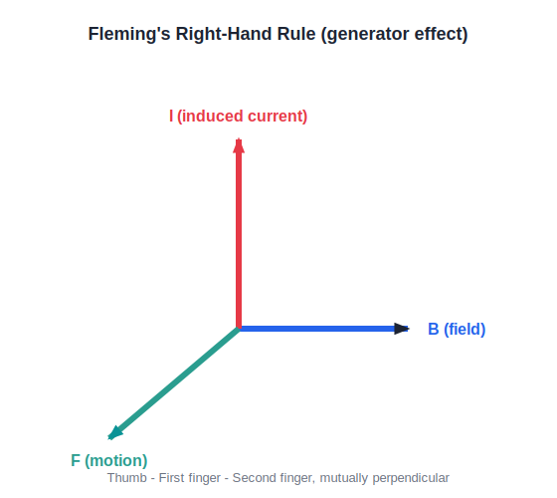
FLEMING'S RIGHT-HAND RULE
Finding the Direction of the Induced Current
Fleming's right-hand rule gives the direction of the induced current when a conductor moves through a magnetic field.
Notes:
Stretch the thumb, first finger and second finger of the RIGHT hand mutually perpendicular this time: First finger = Field, thuMb = Motion, seCond finger = induced Current. Contrast explicitly with the left-hand rule from the previous session.

Slide 17



AC VS DC
Alternating Current and Direct Current
Direct current (DC)
Alternating current (AC)
Current that flows in only one direction, with a magnitude that may be steady or varying, but never reverses — supplied by cells and batteries.
Current that regularly reverses its direction and changes magnitude, repeating this pattern at a fixed frequency — this is what mains electricity supplies to homes.
Why AC for transmission
AC can be easily stepped up or down in voltage using a transformer, making it far more efficient to transmit over long distances than DC.
Notes:
Note that household supply in India is AC at 50 Hz, meaning the current reverses direction 100 times every second.

Slide 18
AC GENERATOR
Construction and Working of an AC Generator
An AC generator has a rectangular coil (armature) that is mechanically rotated between the poles of a magnet.
As the coil rotates, the magnetic flux linked with it continuously changes, so by Faraday's law an EMF is induced in the coil.
The ends of the coil are connected to the external circuit through two separate slip rings and brushes (not a split-ring commutator), so the induced current is allowed to reverse direction — giving alternating current.
The direction of the induced current at any instant is given by Fleming's right-hand rule.
Notes:
Contrast the slip rings of an AC generator with the split-ring commutator of a DC motor — this is the key construction difference students often confuse.

Slide 19
WRAP UP
Quick Recap
✓ DC motor — Current-carrying coil in a field turns due to a couple of forces; a commutator keeps it rotating one way.
✓ Galvanometer — Same motor-effect principle, used to detect small currents.
✓ Faraday's laws — A changing magnetic flux induces an EMF, proportional to its rate of change.
✓ Fleming's right-hand rule — First finger = Field, thumb = Motion, second finger = induced Current.
✓ AC generator — Rotating coil + slip rings gives an alternating induced current.
Notes:
Ask students to state, in one sentence each, the difference between a motor and a generator (energy conversion runs in opposite directions).

Slide 20
QUIZ 2
Final Check — EMI & Generators
4 questions • think before the answer reveals on the next slide

Slide 21
QUIZ QUESTION
Q1 — Faraday's experiment
In Faraday's coil-and-magnet experiment, the galvanometer shows a deflection only when the magnet is:
held still inside the coil
moving relative to the coil
A
B
held still far away from the coil
made of iron
C
D

Slide 22
ANSWER REVEALED
Q1 — Faraday's experiment
In Faraday's coil-and-magnet experiment, the galvanometer shows a deflection only when the magnet is:
held still inside the coil
moving relative to the coil
A
✓
held still far away from the coil
made of iron
C
D
WHY
An EMF is induced only while the magnetic flux through the coil is changing, which requires relative motion.

Slide 23
QUIZ QUESTION
Q2 — Faraday's second law
According to Faraday's second law, the induced EMF is directly proportional to the:
resistance of the coil
rate of change of magnetic flux
A
B
number of cells in the circuit
colour of the wire
C
D

Slide 24
ANSWER REVEALED
Q2 — Faraday's second law
According to Faraday's second law, the induced EMF is directly proportional to the:
resistance of the coil
rate of change of magnetic flux
A
✓
number of cells in the circuit
colour of the wire
C
D
WHY
A faster-changing flux (faster motion, more turns) induces a larger EMF.

Slide 25
QUIZ QUESTION
Q3 — Fleming's right-hand rule
Fleming's right-hand rule is used to find the direction of:
the force on a current-carrying conductor
the induced current due to motion in a magnetic field
A
B
the magnetic field around a straight wire
the resistance of a conductor
C
D

Slide 26
ANSWER REVEALED
Q3 — Fleming's right-hand rule
Fleming's right-hand rule is used to find the direction of:
the force on a current-carrying conductor
the induced current due to motion in a magnetic field
A
✓
the magnetic field around a straight wire
the resistance of a conductor
C
D
WHY
It is the generator-effect rule: First finger = Field, thuMb = Motion, seCond finger = induced Current.

Slide 27
QUIZ QUESTION
Q4 — AC generator
An AC generator uses slip rings, instead of a split-ring commutator, because this allows the:
coil to rotate faster
current in the external circuit to reverse direction periodically, giving AC
A
B
coil to stop rotating smoothly
magnet to become stronger
C
D

Slide 28
ANSWER REVEALED
Q4 — AC generator
An AC generator uses slip rings, instead of a split-ring commutator, because this allows the:
coil to rotate faster
current in the external circuit to reverse direction periodically, giving AC
A
✓
coil to stop rotating smoothly
magnet to become stronger
C
D
WHY
Slip rings maintain continuous contact without reversing the connection, so the naturally alternating induced current is passed on unchanged as AC.

Slide 29
From Motion to Current, and Back Again
A motor turns current into motion using one hand's rule; a generator turns motion into current using the other. Between them lies almost every machine that moves us.

