Slide 1
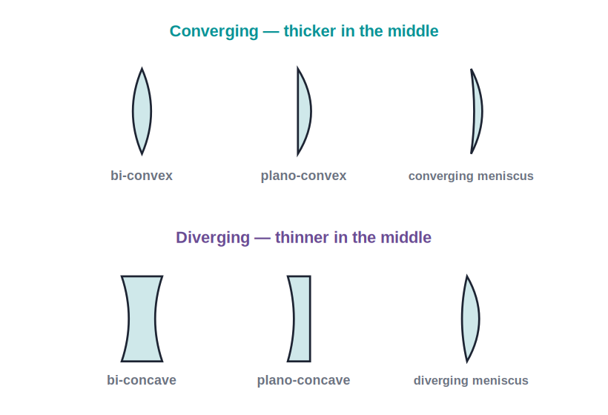
STD 10 • SCIENCE PART 1 • OPTICS
Lenses
Types of lenses • Images and ray diagrams • Lens formula and power • The human eye and defects of vision

Slide 2
INTRODUCTION
Learning Objectives
1
Identify convex and concave lenses and the terms related to them
2
Draw ray diagrams for images formed by convex and concave lenses
3
Apply the sign convention and the lens formula 1/v − 1/u = 1/f
4
Calculate magnification and the power of a lens
5
Describe the human eye and the idea of persistence of vision
6
Explain the defects of vision and how lenses correct them
Notes:
Open by previewing these objectives so students know what they should be able to do by the end of the session.

Slide 3
PART 1
Lenses and the Images They Form
1
Types of lenses, key terms and ray diagrams

Slide 4

TYPES OF LENSES
Convex and Concave Lenses
Convex (converging) lens
Concave (diverging) lens
Thicker at the middle than at the edges. A parallel beam of light passing through it converges to a real point — the principal focus. It can be seen as a set of prisms with bases towards the centre.
Thinner at the middle than at the edges. A parallel beam passing through it diverges, appearing to come from a virtual focus on the same side. It behaves like prisms with bases towards the edges.
Notes:
Use the lens_types diagram to show the cross-section shapes; connect the converging/diverging behaviour to the prism model of a lens.

Slide 5
KEY TERMS
Terms Related to a Lens
Centres of curvature (C₁, C₂)
The centres of the two spheres whose surfaces form the two faces of the lens.
Radii of curvature (R₁, R₂)
The radii of those two spheres.
Principal axis
The straight line passing through both centres of curvature (and the optical centre).
Optical centre (O)
The central point of the lens; a ray passing through it goes straight, without any deviation.
Principal focus (F)
The point on the principal axis where rays parallel to the axis converge (convex) or appear to diverge from (concave).
Focal length (f)
The distance between the optical centre and the principal focus.
Notes:
A lens has two principal foci, one on each side, equidistant from the optical centre for a thin lens.

Slide 6
RAY RULES
Rules for Drawing Ray Diagrams
Ray parallel to the principal axis
After refraction it passes through the principal focus F (convex) or appears to come from F (concave).
Ray through the optical centre
Passes straight through without any deviation.
Ray through the principal focus
A ray passing through F (convex) emerges parallel to the principal axis after refraction.
Locating the image
Any two of these rays are drawn from the top of the object; the point where they meet (or appear to meet) locates the image.
Notes:
Only two rays are needed to fix the image; the third is a useful check.

Slide 7
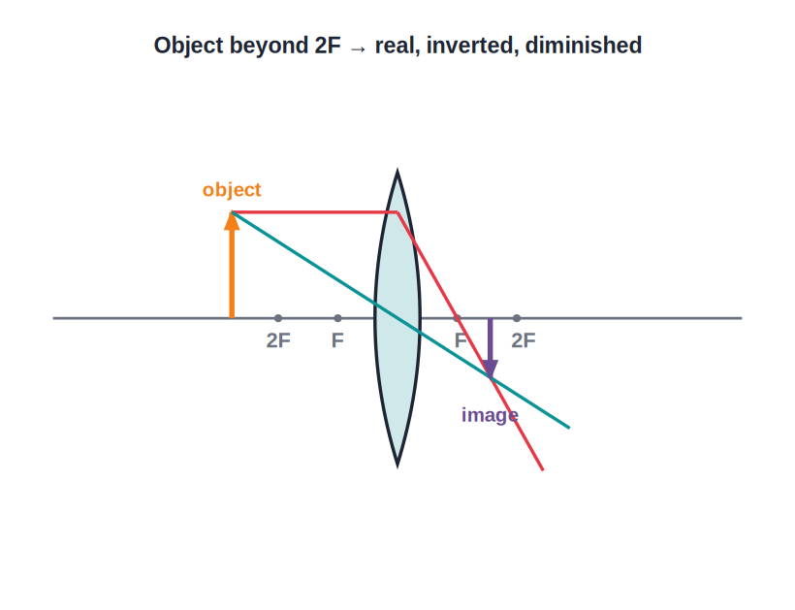
CONVEX LENS
Images Formed by a Convex Lens
Real or virtual, depending on position
• The nature, position and size of the image depend on where the object is placed relative to the focus F and 2F.
• For a distant object the image is real, inverted and very small, formed at F; as the object moves closer the real image moves out and grows.
• When the object is between F and the lens, the image becomes virtual, erect and magnified — this is how a magnifying glass works.
• A convex lens can therefore form both real images (object beyond F) and a virtual image (object within F).
Notes:
Walk the object from infinity inward, calling out the image nature at each stage (at 2F: same size; between F and 2F: magnified real; within F: magnified virtual).

Slide 8
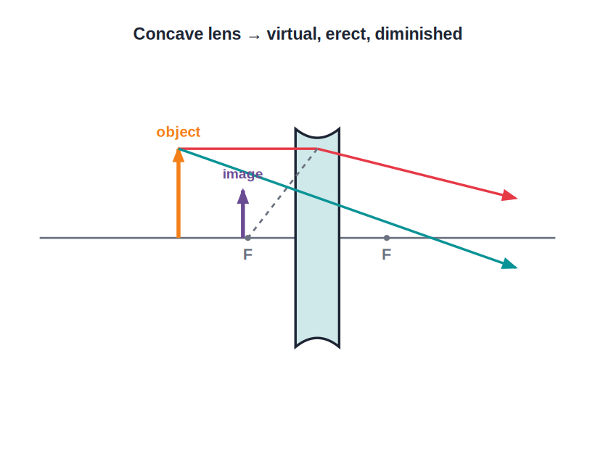
CONCAVE LENS
Images Formed by a Concave Lens
Always virtual, erect and small
• A concave lens always diverges the light passing through it.
• Whatever the position of the object, a concave lens forms an image that is always virtual, erect and diminished (smaller than the object).
• The image is always formed on the same side as the object, between the optical centre and the focus.
• Because the image is always the same kind, a concave lens is easy to identify by the small, upright image it forms.
Notes:
Contrast sharply with the convex lens, whose image changes with object position — the concave lens image never changes in nature.

Slide 9
QUIZ 1
Check — Lenses & Images
4 questions • think before the answer reveals on the next slide

Slide 10
QUIZ QUESTION
Q1 — Types
A lens that is thicker at the middle than at the edges is a:
concave (diverging) lens
convex (converging) lens
A
B
plane glass slab
prism
C
D

Slide 11
ANSWER REVEALED
Q1 — Types
A lens that is thicker at the middle than at the edges is a:
concave (diverging) lens
convex (converging) lens
A
✓
plane glass slab
prism
C
D
WHY
A convex lens is thicker in the middle and converges a parallel beam to its principal focus.

Slide 12
QUIZ QUESTION
Q2 — Optical centre
A ray of light passing through the optical centre of a thin lens:
bends towards the focus
goes straight through without deviation
A
B
is totally reflected
emerges parallel to the axis
C
D

Slide 13
ANSWER REVEALED
Q2 — Optical centre
A ray of light passing through the optical centre of a thin lens:
bends towards the focus
goes straight through without deviation
A
✓
is totally reflected
emerges parallel to the axis
C
D
WHY
The optical centre is the one point through which a ray passes undeviated, which is why it is used in ray diagrams.

Slide 14
QUIZ QUESTION
Q3 — Concave lens image
The image formed by a concave lens is always:
real, inverted and magnified
virtual, erect and diminished
A
B
real and the same size
virtual and magnified
C
D

Slide 15
ANSWER REVEALED
Q3 — Concave lens image
The image formed by a concave lens is always:
real, inverted and magnified
virtual, erect and diminished
A
✓
real and the same size
virtual and magnified
C
D
WHY
A concave (diverging) lens forms a virtual, erect and smaller image for every position of the object.

Slide 16
QUIZ QUESTION
Q4 — Convex lens application
A convex lens is used as a magnifying glass when the object is placed:
beyond 2F
at 2F
A
B
between the focus F and the lens
at the focus F
C
D

Slide 17
ANSWER REVEALED
Q4 — Convex lens application
A convex lens is used as a magnifying glass when the object is placed:
beyond 2F
at 2F
A
B
between the focus F and the lens
at the focus F
✓
D
WHY
With the object within the focal length, a convex lens forms a virtual, erect and magnified image — the magnifying-glass action.

Slide 18
PART 2
Lens Formula, Power and the Human Eye
2
Calculations, the eye and defects of vision

Slide 19
SIGN CONVENTION & LENS FORMULA
The Lens Formula
Using the Cartesian sign convention (distances measured from the optical centre; those in the direction of incident light positive, opposite negative), the object distance u, image distance v and focal length f are related by the lens formula.
1/v − 1/u = 1/f
• For a convex lens f is positive; for a concave lens f is negative.
• A real image has a positive v; a virtual image has a negative v.
• The object distance u is taken as negative (object on the left of the lens).
Notes:
Insist on the sign convention before any numerical — most errors come from wrong signs, not wrong arithmetic.

Slide 20
MAGNIFICATION
Magnification Produced by a Lens
The magnification is the ratio of the height of the image to the height of the object, and also equals the ratio of image distance to object distance.
m = h′/h = v/u
• If m is positive, the image is virtual and erect; if negative, the image is real and inverted.
• If |m| > 1 the image is magnified; if |m| < 1 it is diminished; if |m| = 1 it is the same size as the object.
Notes:
Tie the sign of m back to the sign convention: a real image (positive v, negative u) gives a negative m, i.e. inverted.

Slide 21
WORKED EXAMPLE
Using the Lens Formula
Problem. An object is placed 30 cm in front of a convex lens of focal length 20 cm. Find the position and nature of the image.
1/v − 1/u = 1/f, with u = −30 cm, f = +20 cm
1/v = 1/f + 1/u = 1/20 + 1/(−30) = (3 − 2)/60 = 1/60
v = +60 cm (positive → real, inverted image)
m = v/u = 60/(−30) = −2 (real, inverted, magnified 2×)
Answer: v = 60 cm; real, inverted, magnified image
Notes:
Show the substitution of signs explicitly; the positive v confirms a real image on the far side of the lens.

Slide 22
POWER OF A LENS
Power of a Lens and Combination of Lenses
The power of a lens is the reciprocal of its focal length (in metres); it measures the lens's ability to converge or diverge light.
P = 1 / f (in metres) • unit: dioptre (D)
• A convex lens has positive power; a concave lens has negative power.
• A lens of focal length 20 cm (0.2 m) has power P = 1/0.2 = +5 D.
• When thin lenses are placed in contact, their powers add: P = P₁ + P₂ + P₃ + ...
Notes:
Opticians prescribe spectacles in dioptres — connect the sign of the power to the type of correcting lens needed.

Slide 23
THE HUMAN EYE
The Human Eye and Persistence of Vision
Eye lens and cornea
Light enters through the cornea and the convex eye lens, which together form a real, inverted image on the retina.
Accommodation
The ciliary muscles change the focal length of the eye lens — thinner for distant objects, thicker for near ones — so objects at different distances stay in focus.
Least distance of distinct vision
The closest distance at which a normal eye can see an object clearly and without strain is about 25 cm (the near point).
Persistence of vision
An image continues to be sensed by the eye for about 1/16 of a second after the object is removed; rapidly changing still pictures therefore appear as continuous motion, as in films.
Notes:
Persistence of vision is the physics behind cinema and animation — a memorable everyday link.

Slide 24
DEFECTS OF VISION
Defects of Vision and Their Correction
Myopia (short-sightedness)
Hypermetropia (long-sightedness)
The eye can see near objects clearly but not distant ones; the image of a distant object forms in front of the retina. Corrected using a concave (diverging) lens of suitable power.
The eye can see distant objects clearly but not near ones; the image of a near object forms behind the retina. Corrected using a convex (converging) lens.
Presbyopia
Cause in general
With age the ciliary muscles weaken and the eye lens hardens, so both near and distant vision are affected. Corrected using bifocal lenses (concave upper part, convex lower part).
These defects arise from the eyeball being too long or too short, or the eye lens losing its ability to change focal length.
Notes:
Have students match each defect to its correcting lens and state where the image forms relative to the retina.

Slide 25
WRAP UP
Quick Recap
✓ Two types of lens — Convex converges light; concave diverges it.
✓ Ray rules — Parallel ray → through F; ray through O → straight; ray through F → parallel.
✓ Lens formula — 1/v − 1/u = 1/f, using the sign convention.
✓ Magnification & power — m = v/u; P = 1/f in dioptres, + for convex, − for concave.
✓ Human eye — Ciliary muscles focus the eye lens; near point 25 cm; persistence of vision ≈ 1/16 s.
✓ Vision defects — Myopia → concave lens; hypermetropia → convex lens; presbyopia → bifocals.
Notes:
Cold-call the correcting lens for each defect and the unit of lens power.

Slide 26
QUIZ 2
Final Check — Formula, Power & the Eye
4 questions • think before the answer reveals on the next slide

Slide 27
QUIZ QUESTION
Q1 — Power
A convex lens has a focal length of 25 cm. Its power is:
+4 D
+0.25 D
A
B
−4 D
+25 D
C
D

Slide 28
ANSWER REVEALED
Q1 — Power
A convex lens has a focal length of 25 cm. Its power is:
+4 D
+0.25 D
✓
B
−4 D
+25 D
C
D
WHY
P = 1/f(in m) = 1/0.25 = +4 D; the power is positive because the lens is convex.

Slide 29
QUIZ QUESTION
Q2 — Magnification
If the magnification produced by a lens is −2, the image is:
virtual, erect and magnified
real, inverted and magnified
A
B
virtual and diminished
the same size as the object
C
D

Slide 30
ANSWER REVEALED
Q2 — Magnification
If the magnification produced by a lens is −2, the image is:
virtual, erect and magnified
real, inverted and magnified
A
✓
virtual and diminished
the same size as the object
C
D
WHY
A negative magnification means a real, inverted image; its magnitude of 2 means it is twice the object's size.

Slide 31
QUIZ QUESTION
Q3 — Near point
The least distance of distinct vision for a normal human eye is about:
25 cm
25 m
A
B
2.5 cm
1 m
C
D

Slide 32
ANSWER REVEALED
Q3 — Near point
The least distance of distinct vision for a normal human eye is about:
25 cm
25 m
✓
B
2.5 cm
1 m
C
D
WHY
A normal eye can focus comfortably on objects as close as about 25 cm — the near point.

Slide 33
QUIZ QUESTION
Q4 — Myopia
A short-sighted (myopic) person cannot see distant objects clearly. This defect is corrected using a:
convex lens
concave lens
A
B
prism
plane mirror
C
D

Slide 34
ANSWER REVEALED
Q4 — Myopia
A short-sighted (myopic) person cannot see distant objects clearly. This defect is corrected using a:
convex lens
concave lens
A
✓
prism
plane mirror
C
D
WHY
A concave (diverging) lens moves the image of a distant object back onto the retina, correcting myopia.

Slide 35
Lenses: Bending Light to See
From a magnifying glass to the lens in your own eye, the same simple rules of refraction let us focus light, form images and correct how we see the world.

