Slide 1
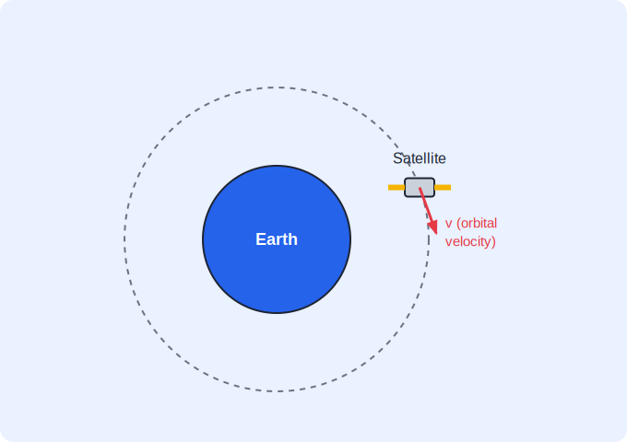
STD 10 • SCIENCE PART 1 • SPACE
Space Missions
Artificial satellites and orbits • Escape velocity • Launch vehicles • India's space programme

Slide 2
INTRODUCTION
Learning Objectives
1
Explain what a space mission and an artificial satellite are
2
Classify satellites by their use and by their orbits
3
Define orbital velocity and escape velocity
4
Describe how a multi-stage launch vehicle places a satellite in orbit
5
Outline India's major space missions and achievements
6
Explain what space debris is and why its management matters
Notes:
Open by previewing these objectives so students know what they should be able to do by the end of the session.

Slide 3
PART 1
Satellites, Orbits and Velocities
1
What keeps a satellite up, and what it takes to get there

Slide 4
SPACE MISSIONS
Space Missions and Artificial Satellites
Space mission
A planned journey or project to send a spacecraft, satellite or probe into space to study the Earth, other bodies or space itself.
Artificial satellite
A man-made object deliberately placed into orbit around the Earth (or another body) to perform a specific task.
Why it stays in orbit
The satellite moves fast enough along its path that the Earth's gravity, acting as the centripetal force, keeps bending it into a closed orbit instead of pulling it straight down.
Uses of satellites
Communication, weather forecasting, broadcasting, navigation (GPS), remote sensing, and scientific research.
Notes:
Link back to the Gravitation chapter: an orbiting satellite is in continuous free fall, with gravity providing exactly the centripetal force it needs.

Slide 5

TYPES OF SATELLITE
Classifying Satellites by Their Orbit
Geostationary satellite
Polar (sun-synchronous) satellite
Orbits about 36,000 km above the equator with a period of 24 hours, so it appears fixed over one spot on Earth. Ideal for communication and broadcasting.
Orbits at a much lower height (a few hundred km) passing over the poles, scanning different strips of the Earth on each pass. Used for weather and remote sensing.
Low, medium and high orbits
By purpose
Satellites are also grouped by orbit height as Low Earth Orbit (LEO), Medium Earth Orbit (MEO) and geostationary/high orbit, each suited to different tasks.
Communication, weather, navigation, earth-observation (remote sensing), military and scientific satellites.
Notes:
Contrast the geostationary satellite (fixed over one point, high orbit) with the polar satellite (low, scanning) — a very common comparison question.

Slide 6
ORBITAL & ESCAPE VELOCITY
Two Important Speeds
A satellite must be given exactly the right speed to stay in a circular orbit — its orbital velocity — while a body needs a much larger speed to leave the Earth's gravity altogether.
• Orbital velocity is the horizontal speed a satellite needs so that gravity keeps it in a stable orbit; it decreases as the orbit's height increases.
• Escape velocity is the minimum speed a body must be given to escape the Earth's gravitational field completely.
• For the Earth, the escape velocity is about 11.2 km/s.
• Escape velocity depends on the mass and radius of the planet, not on the mass of the escaping body.
Notes:
Emphasise that escape velocity is independent of the escaping object's mass — a common conceptual question.

Slide 7
QUIZ 1
Check — Satellites & Orbits
4 questions • think before the answer reveals on the next slide

Slide 8
QUIZ QUESTION
Q1 — Geostationary
A geostationary satellite appears to stay fixed above one point on the Earth because its orbital period is:
1 hour
12 hours
A
B
24 hours
1 month
C
D

Slide 9
ANSWER REVEALED
Q1 — Geostationary
A geostationary satellite appears to stay fixed above one point on the Earth because its orbital period is:
1 hour
12 hours
A
B
24 hours
1 month
✓
D
WHY
A geostationary satellite orbits over the equator with a period of 24 hours, matching the Earth's rotation, so it stays above the same point.

Slide 10
QUIZ QUESTION
Q2 — Polar satellite
Compared with a geostationary satellite, a polar satellite orbits at a:
much greater height
much lower height, passing over the poles
A
B
fixed point over the equator
height of exactly 36,000 km
C
D

Slide 11
ANSWER REVEALED
Q2 — Polar satellite
Compared with a geostationary satellite, a polar satellite orbits at a:
much greater height
much lower height, passing over the poles
A
✓
fixed point over the equator
height of exactly 36,000 km
C
D
WHY
Polar satellites orbit only a few hundred kilometres up and pass over the poles, scanning fresh strips of the Earth — ideal for weather and remote sensing.

Slide 12
QUIZ QUESTION
Q3 — Orbit force
The force that keeps an artificial satellite moving in its orbit around the Earth is:
magnetic force
the Earth's gravitational force acting as centripetal force
A
B
air resistance
the satellite's own thrust
C
D

Slide 13
ANSWER REVEALED
Q3 — Orbit force
The force that keeps an artificial satellite moving in its orbit around the Earth is:
magnetic force
the Earth's gravitational force acting as centripetal force
A
✓
air resistance
the satellite's own thrust
C
D
WHY
Gravity continuously pulls the satellite towards the Earth, providing the centripetal force that bends its path into an orbit.

Slide 14
QUIZ QUESTION
Q4 — Escape velocity
The escape velocity of a body from the Earth's surface is about:
9.8 m/s
11.2 km/s
A
B
3 × 10⁸ m/s
300 km/s
C
D

Slide 15
ANSWER REVEALED
Q4 — Escape velocity
The escape velocity of a body from the Earth's surface is about:
9.8 m/s
11.2 km/s
A
✓
3 × 10⁸ m/s
300 km/s
C
D
WHY
About 11.2 km/s is the minimum speed needed to escape the Earth's gravity completely; it does not depend on the mass of the escaping body.

Slide 16
PART 2
Launch Vehicles and India's Space Programme
2
Getting to orbit, and what India has achieved

Slide 17
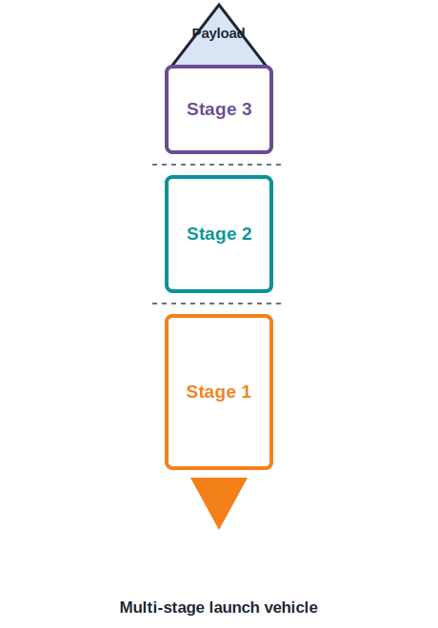
LAUNCH VEHICLES
Satellite Launch Vehicles
Why rockets have stages
• A satellite is carried into orbit by a launch vehicle (rocket) that works on the principle of conservation of momentum — hot gases are thrown out backwards, pushing the rocket forwards.
• A single rocket cannot carry enough fuel, so multi-stage launch vehicles are used: each stage burns its fuel and then separates, so the remaining rocket becomes lighter.
• The lowest, largest stage fires first and is dropped once empty; the upper stages then fire in turn to reach the required speed and height.
• India's ISRO has developed launch vehicles such as the PSLV (Polar Satellite Launch Vehicle) and the GSLV (Geosynchronous Satellite Launch Vehicle).
Notes:
Connect the staging idea to efficiency: dropping empty stages means the engine no longer has to accelerate dead weight.

Slide 18
INDIA IN SPACE
India's Major Space Missions
Chandrayaan-1 (2008)
Mangalyaan (2013)
India's first mission to the Moon; it confirmed the presence of water molecules on the lunar surface.
The Mars Orbiter Mission made India the first country to reach Mars orbit on its very first attempt, and at remarkably low cost.
Chandrayaan-2 & 3
India and space technology
Follow-up Moon missions; Chandrayaan-3 achieved a successful soft landing near the Moon's south pole, a world first for that region.
ISRO launches communication, weather and remote-sensing satellites for India and for other countries, making India a major space-faring nation.
Notes:
Keep the dates approximate; the key learning outcome is the significance of each mission, not rote memorisation.

Slide 19
SPACE DEBRIS
Space Debris and Its Management
What it is
Space debris is the collection of non-working man-made objects orbiting the Earth — spent rocket stages, dead satellites and fragments from collisions.
Why it is dangerous
Debris travels at very high speed, so even a small piece can seriously damage or destroy a working satellite or spacecraft it strikes.
Growing problem
As more satellites are launched, the amount of debris grows, increasing the risk of collisions and threatening the future use of near-Earth space.
Management
Agencies track debris, design satellites to de-orbit and burn up at the end of their life, and plan missions to remove large pieces of debris.
Notes:
A modern, discussion-friendly topic — ask students why clearing space debris is an international responsibility.

Slide 20
WRAP UP
Quick Recap
✓ Artificial satellite — A man-made body orbiting the Earth, held in orbit by gravity acting as centripetal force.
✓ Types — Geostationary (24 h, fixed over equator) vs polar (low, over the poles); grouped by orbit and by purpose.
✓ Two speeds — Orbital velocity keeps a satellite in orbit; escape velocity (≈ 11.2 km/s) lets a body leave Earth.
✓ Launch vehicles — Multi-stage rockets (PSLV, GSLV) work by conservation of momentum.
✓ India's missions — Chandrayaan-1/2/3 and Mangalyaan — Moon and Mars achievements.
✓ Space debris — Dangerous orbiting junk that must be tracked and managed.
Notes:
Cold-call students for the difference between orbital and escape velocity and one Indian mission's significance.

Slide 21
QUIZ 2
Final Check — Launch Vehicles & Missions
4 questions • think before the answer reveals on the next slide

Slide 22
QUIZ QUESTION
Q1 — Staging
Multi-stage rockets are used to launch satellites because:
they look impressive
dropping each empty stage means the rocket no longer has to carry and accelerate dead weight
A
B
a single stage is illegal
they need no fuel
C
D

Slide 23
ANSWER REVEALED
Q1 — Staging
Multi-stage rockets are used to launch satellites because:
they look impressive
dropping each empty stage means the rocket no longer has to carry and accelerate dead weight
A
✓
a single stage is illegal
they need no fuel
C
D
WHY
Shedding spent stages makes the remaining rocket lighter, so the same thrust can accelerate it to the high speed needed for orbit.

Slide 24
QUIZ QUESTION
Q2 — Rocket principle
A launch vehicle moves forward by throwing hot gases backwards. This is an application of:
Ohm's law
conservation of momentum
A
B
Snell's law
the lens formula
C
D

Slide 25
ANSWER REVEALED
Q2 — Rocket principle
A launch vehicle moves forward by throwing hot gases backwards. This is an application of:
Ohm's law
conservation of momentum
A
✓
Snell's law
the lens formula
C
D
WHY
The backward momentum given to the exhaust gases is balanced by an equal forward momentum of the rocket.

Slide 26
QUIZ QUESTION
Q3 — Indian missions
India's Mars Orbiter Mission is also known as:
Chandrayaan
Mangalyaan
A
B
Aryabhata
PSLV
C
D

Slide 27
ANSWER REVEALED
Q3 — Indian missions
India's Mars Orbiter Mission is also known as:
Chandrayaan
Mangalyaan
A
✓
Aryabhata
PSLV
C
D
WHY
Mangalyaan (the Mars Orbiter Mission) made India the first country to reach Mars orbit on its first attempt.

Slide 28
QUIZ QUESTION
Q4 — Space debris
Space debris is a serious hazard mainly because it:
blocks sunlight
travels at very high speed and can damage working satellites on impact
A
B
is radioactive
increases the Earth's gravity
C
D

Slide 29
ANSWER REVEALED
Q4 — Space debris
Space debris is a serious hazard mainly because it:
blocks sunlight
travels at very high speed and can damage working satellites on impact
A
✓
is radioactive
increases the Earth's gravity
C
D
WHY
Even a tiny fragment moving at orbital speed carries enough energy to cripple a satellite it strikes, so debris must be tracked and managed.

Slide 30
Reaching for the Stars
From understanding why a satellite stays up to landing near the Moon's south pole, space missions turn the physics of gravity and motion into humanity's journey beyond the Earth.

