Slide 1
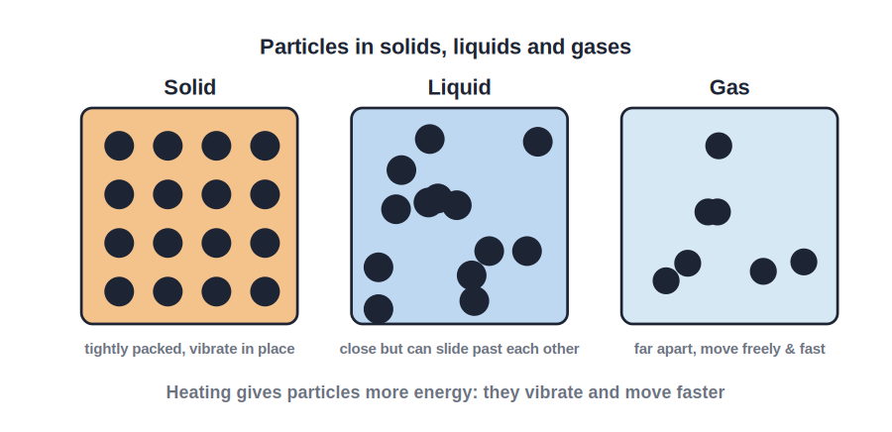
STD 8 • GENERAL SCIENCE • HEAT
Heat and Temperature
Heat as energy • Heat vs temperature • Thermometers and their types

Slide 2
INTRODUCTION
Learning Objectives
1
Explain heat as a form of energy and name its sources
2
Distinguish between heat and temperature
3
State the effects of heat on a substance
4
Describe a thermometer and its types
5
Explain the special features of a clinical thermometer
6
State the units of temperature
Notes:
Open by previewing these objectives so students know what they should be able to do by the end of the session.

Slide 3
PART 1
Heat, Temperature and Their Effects
1
What heat is, and how it differs from temperature

Slide 4
HEAT
Heat and Its Sources
Heat is energy
Heat is a form of energy that flows from a hotter body to a colder one.
Sources of heat
The Sun, fuels, electricity and chemical reactions all give out heat.
Molecular motion
Heating a body makes its molecules move faster (more kinetic energy).
Flow of heat
Heat always flows on its own from higher to lower temperature.
Notes:
Introduce heat as energy in transit; the molecular view sets up the difference from temperature on the next slide.

Slide 5
HEAT VS TEMPERATURE
Heat Is Not the Same as Temperature
Average vs total energy
• Temperature = average kinetic energy of the molecules
• Heat = total energy of all the molecules
• Temperature decides the direction of heat flow
• A bucket of warm water holds more heat than a hot cup
• …even though the cup is at a higher temperature
Notes:
The bucket-vs-cup example is the classic way to separate temperature (degree of hotness) from heat (total energy).

Slide 6
EFFECTS OF HEAT
Effects of Heat on a Substance
Rise in temperature
Adding heat usually raises the temperature of a body.
Expansion
Most substances expand on heating and contract on cooling.
Change of state
Enough heat changes a solid to liquid to gas.
Other changes
Heat can also change colour, or cause physical/chemical changes.
Notes:
These effects recur through the chapter — expansion and change of state are explored in the next session.

Slide 7
QUIZ 1
Check — Heat & Temperature
4 questions • think before the answer reveals on the next slide

Slide 8
QUIZ QUESTION
Q1 — Heat
Heat always flows on its own from a body at:
lower temperature to higher temperature
higher temperature to lower temperature
A
B
equal temperature
larger size to smaller size
C
D

Slide 9
ANSWER REVEALED
Q1 — Heat
Heat always flows on its own from a body at:
lower temperature to higher temperature
higher temperature to lower temperature
A
✓
equal temperature
larger size to smaller size
C
D
WHY
Temperature decides the direction of heat flow — from hot to cold — until both reach the same temperature.

Slide 10
QUIZ QUESTION
Q2 — Temperature
The temperature of a body is related to the ___ kinetic energy of its molecules.
total
average
A
B
highest
lowest
C
D

Slide 11
ANSWER REVEALED
Q2 — Temperature
The temperature of a body is related to the ___ kinetic energy of its molecules.
total
average
A
✓
highest
lowest
C
D
WHY
Temperature reflects the average kinetic energy of the molecules; heat is their total energy.

Slide 12
QUIZ QUESTION
Q3 — Heat content
A bucket of warm water and a cup of hotter water are compared. The bucket has:
a higher temperature
more total heat energy
A
B
no heat
less heat than the cup
C
D

Slide 13
ANSWER REVEALED
Q3 — Heat content
A bucket of warm water and a cup of hotter water are compared. The bucket has:
a higher temperature
more total heat energy
A
✓
no heat
less heat than the cup
C
D
WHY
Its much larger mass means more molecules, so more total heat energy — even at a lower temperature than the cup.

Slide 14
QUIZ QUESTION
Q4 — Effects
Which of these is NOT a usual effect of heating a substance?
expansion
change of state
A
B
rise in temperature
decrease in molecular motion
C
D

Slide 15
ANSWER REVEALED
Q4 — Effects
Which of these is NOT a usual effect of heating a substance?
expansion
change of state
A
B
rise in temperature
decrease in molecular motion
C
✓
WHY
Heating increases molecular motion; the other three are all genuine effects of heat.

Slide 16
PART 2
Measuring Temperature
2
Thermometers and their types

Slide 17
THERMOMETER
The Thermometer
Purpose
A thermometer is a device used to measure temperature.
How it works
It uses the expansion of a liquid (mercury or coloured alcohol) in a thin glass tube.
Units
Temperature is measured in degrees Celsius (°C); the SI unit is the kelvin (K).
Fixed points
The Celsius scale is fixed by ice point (0°C) and steam point (100°C).
Notes:
Relate the reading to the earlier idea: expansion of the liquid is itself an effect of heat.

Slide 18


TYPES
Types of Thermometers
Laboratory thermometer
Clinical thermometer
Range about −10°C to 110°C; used for general measurements in the lab.
Range 35°C to 42°C; has a kink so the reading holds until read; measures body temperature.
Digital thermometer
Maximum–minimum thermometer
Shows the temperature as a number on a display; mercury-free and safer.
Records the highest and lowest temperatures reached, used in weather stations.
Notes:
The kink (constriction) of the clinical thermometer stops the mercury falling back before you read it.

Slide 19
WRAP UP
Quick Recap
✓ Heat — A form of energy that flows from hot to cold.
✓ Temperature — Average KE of molecules; decides heat-flow direction.
✓ Heat vs temperature — Total energy vs degree of hotness.
✓ Effects of heat — Rise in temperature, expansion, change of state.
✓ Thermometer — Measures temperature via expansion of a liquid; unit °C.
✓ Types — Laboratory, clinical, digital, maximum–minimum.
Notes:
Cold-call the range and special feature of a clinical thermometer.

Slide 20
QUIZ 2
Final Check — Thermometers
4 questions • think before the answer reveals on the next slide

Slide 21
QUIZ QUESTION
Q1 — Clinical
The temperature range of a clinical thermometer is about:
−10°C to 110°C
35°C to 42°C
A
B
0°C to 100°C
0°C to 250°C
C
D

Slide 22
ANSWER REVEALED
Q1 — Clinical
The temperature range of a clinical thermometer is about:
−10°C to 110°C
35°C to 42°C
A
✓
0°C to 100°C
0°C to 250°C
C
D
WHY
A clinical thermometer covers the narrow range of human body temperature.

Slide 23
QUIZ QUESTION
Q2 — Kink
The kink (constriction) in a clinical thermometer:
makes it cheaper
stops the mercury falling back before it is read
A
B
measures room temperature
lets it measure boiling water
C
D

Slide 24
ANSWER REVEALED
Q2 — Kink
The kink (constriction) in a clinical thermometer:
makes it cheaper
stops the mercury falling back before it is read
A
✓
measures room temperature
lets it measure boiling water
C
D
WHY
The kink holds the reading after the thermometer is removed, until it is shaken down.

Slide 25
QUIZ QUESTION
Q3 — Units
The SI unit of temperature is the:
degree Celsius
kelvin
A
B
joule
calorie
C
D

Slide 26
ANSWER REVEALED
Q3 — Units
The SI unit of temperature is the:
degree Celsius
kelvin
A
✓
joule
calorie
C
D
WHY
The kelvin (K) is the SI unit of temperature; everyday measurements use degrees Celsius (°C).

Slide 27
QUIZ QUESTION
Q4 — Weather
The thermometer that records the highest and lowest temperatures of a day is the:
clinical thermometer
laboratory thermometer
A
B
maximum–minimum thermometer
digital thermometer
C
D

Slide 28
ANSWER REVEALED
Q4 — Weather
The thermometer that records the highest and lowest temperatures of a day is the:
clinical thermometer
laboratory thermometer
A
B
maximum–minimum thermometer
digital thermometer
✓
D
WHY
It is used at weather stations to record the day's extreme temperatures.

Slide 29
Measuring the Warmth of Things
Heat is energy on the move and temperature its degree of hotness — and a simple thermometer lets us pin that hotness down to a number.

