Slide 1
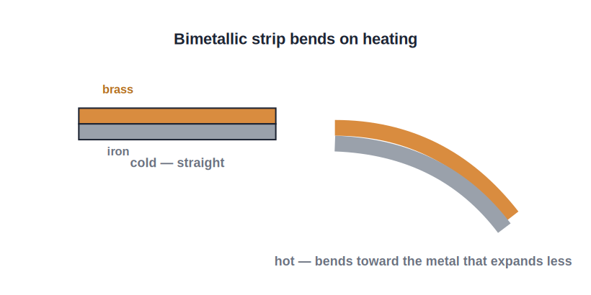
STD 8 • GENERAL SCIENCE • HEAT
Measurement and Effects of Heat — 2
Thermal expansion • Specific heat capacity • Calorimeter and calorimetry

Slide 2
INTRODUCTION
Learning Objectives
1
Describe the thermal expansion of solids, liquids and gases
2
Give everyday applications of thermal expansion
3
Define specific heat capacity
4
Use the relation heat = mass × specific heat × rise in temperature
5
Explain the working of a calorimeter
6
State the principle of calorimetry (heat exchange)
Notes:
Open by previewing these objectives so students know what they should be able to do by the end of the session.

Slide 3
PART 1
Thermal Expansion
1
How solids, liquids and gases expand on heating

Slide 4
EXPANSION
Thermal Expansion of Matter
Solids, liquids, gases
• Almost all substances expand on heating
• Gases expand the most, then liquids, then solids
• Rails have gaps so they can expand in summer
• A tight metal lid loosens under hot water
• Expansion happens because molecules move apart
Notes:
A bimetallic strip bends because its two metals expand by different amounts — used in thermostats and fire alarms.

Slide 5
APPLICATIONS
Everyday Uses of Expansion
Railway gaps
Gaps are left between rails so they do not buckle when they expand.
Bimetallic strip
Two metals that expand unequally bend on heating — used in a thermostat.
Overhead wires
Wires are strung with a slight sag so they do not snap when they contract in winter.
Opening a lid
Warming a tight metal lid makes it expand and loosen.
Notes:
Each application is really the same physics: materials change size with temperature.

Slide 6
QUIZ 1
Check — Thermal Expansion
4 questions • think before the answer reveals on the next slide

Slide 7
QUIZ QUESTION
Q1 — Expansion order
For the same rise in temperature, the greatest expansion is shown by a:
solid
liquid
A
B
gas
all expand equally
C
D

Slide 8
ANSWER REVEALED
Q1 — Expansion order
For the same rise in temperature, the greatest expansion is shown by a:
solid
liquid
A
B
gas
all expand equally
✓
D
WHY
Gases expand the most for a given temperature rise, then liquids, and solids the least.

Slide 9
QUIZ QUESTION
Q2 — Rails
Gaps are left between railway rails so that they:
look neat
have room to expand in hot weather
A
B
carry more load
rust less
C
D

Slide 10
ANSWER REVEALED
Q2 — Rails
Gaps are left between railway rails so that they:
look neat
have room to expand in hot weather
A
✓
carry more load
rust less
C
D
WHY
Without the gaps, expansion in summer would make the rails buckle and bend.

Slide 11
QUIZ QUESTION
Q3 — Bimetallic strip
A bimetallic strip bends on heating because its two metals:
melt
expand by different amounts
A
B
contract equally
change colour
C
D

Slide 12
ANSWER REVEALED
Q3 — Bimetallic strip
A bimetallic strip bends on heating because its two metals:
melt
expand by different amounts
A
✓
contract equally
change colour
C
D
WHY
Unequal expansion of the two metals makes the strip bend — the basis of a thermostat.

Slide 13
QUIZ QUESTION
Q4 — Cause
On heating, a substance expands because its molecules:
disappear
move farther apart
A
B
come closer together
stop moving
C
D

Slide 14
ANSWER REVEALED
Q4 — Cause
On heating, a substance expands because its molecules:
disappear
move farther apart
A
✓
come closer together
stop moving
C
D
WHY
Heating increases molecular motion, so the molecules move apart and the substance expands.

Slide 15
PART 2
Specific Heat Capacity and Calorimetry
2
How much heat a substance needs, and how we measure it

Slide 16
SPECIFIC HEAT CAPACITY
Specific Heat Capacity
The specific heat capacity of a substance is the amount of heat needed to raise the temperature of unit mass of it by one degree.
Heat Q = m × c × ΔT
• m = mass, c = specific heat capacity, ΔT = rise in temperature.
• Water has a very high specific heat capacity, so it heats up and cools down slowly.
• This is why water is used as a coolant and to moderate climate.
Notes:
The high specific heat of water explains coastal climates and its use in radiators — link it to everyday life.

Slide 17
WORKED EXAMPLE
Using Q = m c ΔT
Problem. How much heat is needed to raise the temperature of 2 kg of water by 10°C? (Specific heat of water = 4200 J/kg°C)
Q = m × c × ΔT
Q = 2 × 4200 × 10
Answer: Q = 84,000 J
Notes:
Watch the units: mass in kg, specific heat in J/kg°C, temperature rise in °C, heat in joules.

Slide 18
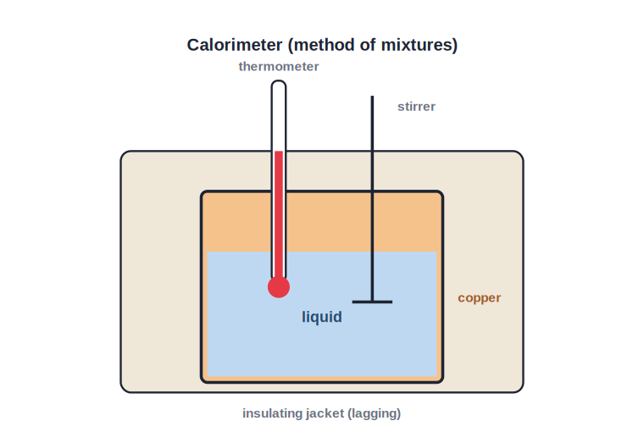
CALORIMETRY
Calorimeter and Calorimetry
Measuring heat exchange
• A calorimeter measures the heat given out or absorbed
• It is a metal vessel inside an insulating jacket
• Principle: heat lost by hot body = heat gained by cold body
• This is the principle of heat exchange
• Used to find specific heats by the method of mixtures
Notes:
The insulating jacket stops heat leaking to the surroundings, so the heat-exchange balance holds.

Slide 19
WRAP UP
Quick Recap
✓ Expansion — Gases > liquids > solids for the same temperature rise.
✓ Applications — Rail gaps, bimetallic strip, wire sag, loosening lids.
✓ Specific heat capacity — Heat to raise unit mass by 1°; Q = m c ΔT.
✓ Water — Very high specific heat — a good coolant and climate moderator.
✓ Calorimeter — Measures heat exchange (heat lost = heat gained).
Notes:
Cold-call the Q = m c ΔT formula and why water is used as a coolant.

Slide 20
QUIZ 2
Final Check — Specific Heat & Calorimetry
4 questions • think before the answer reveals on the next slide

Slide 21
QUIZ QUESTION
Q1 — Definition
The specific heat capacity of a substance is the heat needed to raise the temperature of:
any mass by any amount
unit mass by one degree
A
B
one litre by ten degrees
the whole body by 100°C
C
D

Slide 22
ANSWER REVEALED
Q1 — Definition
The specific heat capacity of a substance is the heat needed to raise the temperature of:
any mass by any amount
unit mass by one degree
A
✓
one litre by ten degrees
the whole body by 100°C
C
D
WHY
Specific heat capacity is per unit mass per degree rise — a property of the material.

Slide 23
QUIZ QUESTION
Q2 — Numerical
The heat needed to raise 1 kg of water by 5°C is (c = 4200 J/kg°C):
21,000 J
4200 J
A
B
840 J
5 J
C
D

Slide 24
ANSWER REVEALED
Q2 — Numerical
The heat needed to raise 1 kg of water by 5°C is (c = 4200 J/kg°C):
21,000 J
4200 J
✓
B
840 J
5 J
C
D
WHY
Q = m c ΔT = 1 × 4200 × 5 = 21,000 J.

Slide 25
QUIZ QUESTION
Q3 — Water
Water is used as a coolant in car radiators because it has a:
low specific heat capacity
high specific heat capacity
A
B
low boiling point
high density only
C
D

Slide 26
ANSWER REVEALED
Q3 — Water
Water is used as a coolant in car radiators because it has a:
low specific heat capacity
high specific heat capacity
A
✓
low boiling point
high density only
C
D
WHY
Its high specific heat lets water absorb a large amount of heat with only a small rise in temperature.

Slide 27
QUIZ QUESTION
Q4 — Calorimetry
The principle of calorimetry states that:
heat is destroyed
heat lost by the hot body = heat gained by the cold body
A
B
temperature never changes
heat only flows upward
C
D

Slide 28
ANSWER REVEALED
Q4 — Calorimetry
The principle of calorimetry states that:
heat is destroyed
heat lost by the hot body = heat gained by the cold body
A
✓
temperature never changes
heat only flows upward
C
D
WHY
In an insulated calorimeter, the heat exchange balances — the basis for measuring specific heats.

Slide 29
Heat, Measured Exactly
Expansion, specific heat and the calorimeter turn the vague idea of 'hotness' into quantities we can calculate and measure.

