Slide 1
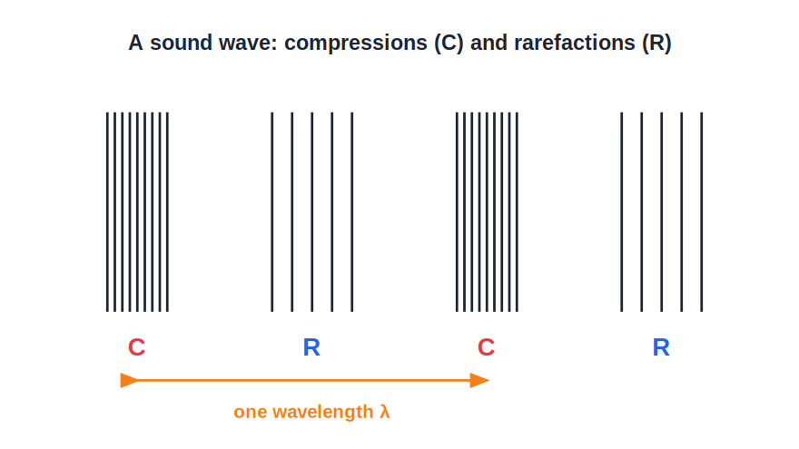
STD 8 • GENERAL SCIENCE • SOUND
Sound
Production and propagation • Sound waves • Characteristics • Music, noise and sound pollution

Slide 2
INTRODUCTION
Learning Objectives
1
Explain how sound is produced and propagates
2
State that sound needs a medium to travel
3
Describe sound as a wave with compressions and rarefactions
4
State the characteristics of sound
5
Distinguish between music and noise
6
Explain sound pollution and how to reduce it
Notes:
Open by previewing these objectives so students know what they should be able to do by the end of the session.

Slide 3
PART 1
Production and Propagation of Sound
1
How sound is made and how it travels

Slide 4
PRODUCTION
How Sound Is Produced and Travels
By vibration
Sound is produced by a vibrating object — a string, a membrane, vocal cords.
Needs a medium
Sound needs a material medium; it cannot travel through a vacuum.
Energy transfer
Vibrating particles pass the energy on to the next particles.
Human voice
In humans, sound is produced by the vibration of the vocal cords in the voice box.
Notes:
A loudspeaker works the same way in reverse: an electrical signal makes a cone vibrate and produce sound.

Slide 5
SOUND WAVES
Sound Travels as a Wave
Compressions and rarefactions
• In air, sound is a longitudinal wave
• Made of compressions and rarefactions
• Compression = crowded, high-pressure region
• Rarefaction = spread-out, low-pressure region
• Wave carries energy, not the air itself, forward
Notes:
Stress that the particles vibrate in place; it is the disturbance (energy) that travels forward.

Slide 6
QUIZ 1
Check — Production & Propagation
4 questions • think before the answer reveals on the next slide

Slide 7
QUIZ QUESTION
Q1 — Production
Sound is produced by a body that is:
hot
vibrating
A
B
coloured
at rest
C
D

Slide 8
ANSWER REVEALED
Q1 — Production
Sound is produced by a body that is:
hot
vibrating
A
✓
coloured
at rest
C
D
WHY
Every source of sound — a string, a drum, vocal cords — is vibrating.

Slide 9
QUIZ QUESTION
Q2 — Medium
Sound cannot travel through:
water
iron
A
B
air
a vacuum
C
D

Slide 10
ANSWER REVEALED
Q2 — Medium
Sound cannot travel through:
water
iron
A
B
air
a vacuum
C
✓
WHY
With no particles to pass on the vibration, sound cannot travel through a vacuum.

Slide 11
QUIZ QUESTION
Q3 — Wave
Sound travels through air as a:
transverse wave
longitudinal wave
A
B
light wave
water wave
C
D

Slide 12
ANSWER REVEALED
Q3 — Wave
Sound travels through air as a:
transverse wave
longitudinal wave
A
✓
light wave
water wave
C
D
WHY
The air particles vibrate along the direction of travel, forming compressions and rarefactions.

Slide 13
QUIZ QUESTION
Q4 — Voice
The human voice is produced by the vibration of the:
teeth
vocal cords
A
B
tongue only
ears
C
D

Slide 14
ANSWER REVEALED
Q4 — Voice
The human voice is produced by the vibration of the:
teeth
vocal cords
A
✓
tongue only
ears
C
D
WHY
Air from the lungs makes the vocal cords in the voice box vibrate, producing sound.

Slide 15
PART 2
Characteristics, Music and Noise
2
What makes sounds different, and sound pollution

Slide 16
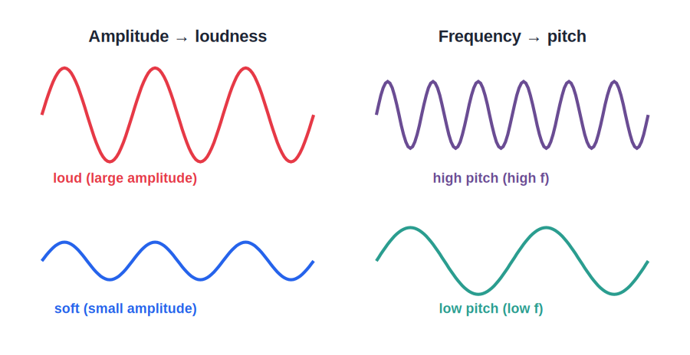
CHARACTERISTICS
Characteristics of Sound
Loudness, pitch, quality
• Loudness depends on amplitude
• Pitch depends on frequency
• Quality (timbre) depends on the waveform
• Higher frequency → higher pitch
• Larger amplitude → louder sound
Notes:
Quality lets us recognise a voice or tell instruments apart playing the same note.

Slide 17



MUSIC & NOISE
Music, Noise and Sound Pollution
Music
Noise
A pleasant sound with a regular, periodic pattern — from a flute, violin or piano.
An unpleasant sound with an irregular pattern — like traffic or machinery.
Sound pollution
Reducing it
Unwanted, excessive noise that harms health and the environment.
Limit loudspeakers and horns, plant trees, and use sound-absorbing materials.
Notes:
Sound pollution links to social health — a good discussion point about responsible behaviour.

Slide 18
WRAP UP
Quick Recap
✓ Production — Sound comes from a vibrating body.
✓ Medium — Sound needs a medium; no sound in a vacuum.
✓ Sound wave — Longitudinal — compressions and rarefactions.
✓ Characteristics — Loudness (amplitude), pitch (frequency), quality (waveform).
✓ Music vs noise — Regular pleasant sound vs irregular unpleasant sound.
✓ Sound pollution — Excess noise harms health; reduce it.
Notes:
Cold-call which property changes when a drum is struck harder versus a smaller drum.

Slide 19
QUIZ 2
Final Check — Characteristics & Noise
4 questions • think before the answer reveals on the next slide

Slide 20
QUIZ QUESTION
Q1 — Loudness
The loudness of a sound depends on its:
frequency
amplitude
A
B
speed
wavelength
C
D

Slide 21
ANSWER REVEALED
Q1 — Loudness
The loudness of a sound depends on its:
frequency
amplitude
A
✓
speed
wavelength
C
D
WHY
A larger amplitude of vibration produces a louder sound.

Slide 22
QUIZ QUESTION
Q2 — Pitch
A high-pitched, shrill sound has a high:
amplitude
frequency
A
B
speed
loudness
C
D

Slide 23
ANSWER REVEALED
Q2 — Pitch
A high-pitched, shrill sound has a high:
amplitude
frequency
A
✓
speed
loudness
C
D
WHY
Pitch depends on frequency — the higher the frequency, the shriller the sound.

Slide 24
QUIZ QUESTION
Q3 — Music vs noise
Compared with noise, a musical sound has a:
very large amplitude
regular, periodic waveform
A
B
no frequency
no medium
C
D

Slide 25
ANSWER REVEALED
Q3 — Music vs noise
Compared with noise, a musical sound has a:
very large amplitude
regular, periodic waveform
A
✓
no frequency
no medium
C
D
WHY
Music is pleasant because its waveform is regular; noise is irregular and unpleasant.

Slide 26
QUIZ QUESTION
Q4 — Sound pollution
Sound pollution can be reduced by:
using more loudspeakers
planting trees and limiting horns
A
B
increasing traffic
removing all soft materials
C
D

Slide 27
ANSWER REVEALED
Q4 — Sound pollution
Sound pollution can be reduced by:
using more loudspeakers
planting trees and limiting horns
A
✓
increasing traffic
removing all soft materials
C
D
WHY
Trees absorb sound and limiting horns/loudspeakers cuts unwanted noise at the source.

Slide 28
The Science of Sound
From a vibrating string to the roar of traffic, sound is a wave we can describe, enjoy as music, and control when it becomes noise.

