Slide 1
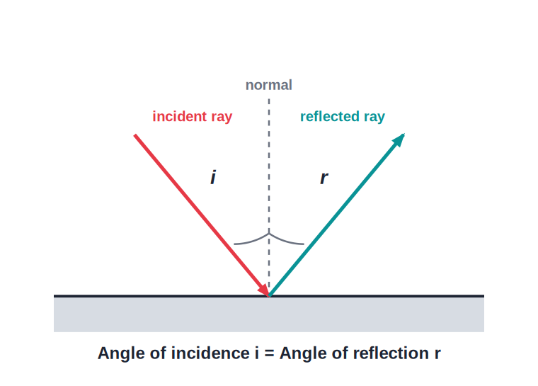
STD 8 • GENERAL SCIENCE • OPTICS
Reflection of Light
Reflection and its terms • Laws of reflection • Types of reflection • Periscope and kaleidoscope

Slide 2
INTRODUCTION
Learning Objectives
1
Define reflection and the terms used in it
2
State the laws of reflection of light
3
Distinguish regular and irregular reflection
4
Explain reflection of reflected light (multiple reflection)
5
Describe the working of a periscope
6
Explain how a kaleidoscope works
Notes:
Open by previewing these objectives so students know what they should be able to do by the end of the session.

Slide 3
PART 1
Reflection and Its Laws
1
How light bounces off a surface

Slide 4
TERMS
Reflection and Its Terms
Reflection
The bouncing back of light from a polished surface.
Incident ray
The ray of light striking the surface.
Reflected ray
The ray that bounces back.
Normal
The perpendicular to the surface at the point of incidence; angles are measured from it.
Notes:
Draw and label all four terms on the reflection_law diagram before stating the laws.

Slide 5
LAWS OF REFLECTION
The Laws of Reflection of Light
Reflection of light follows three laws.
Notes:
1. The angle of reflection equals the angle of incidence. 2. The incident ray, the reflected ray and the normal lie in the same plane. 3. The incident ray and the reflected ray are on opposite sides of the normal.

Slide 6
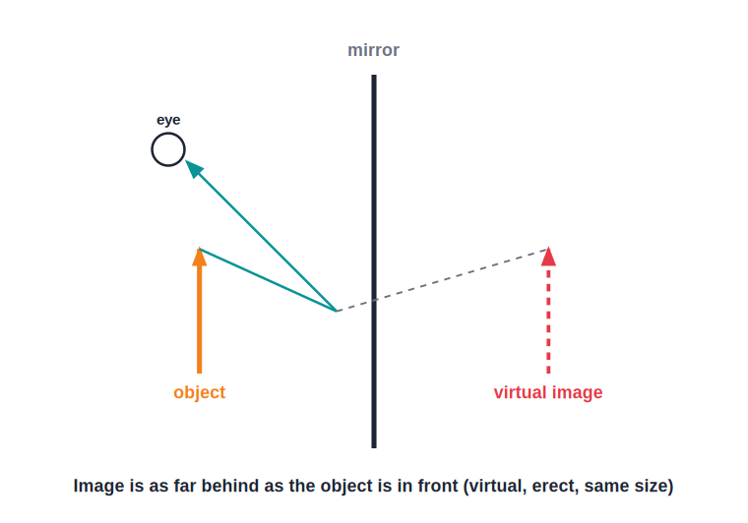
TYPES
Regular and Irregular Reflection
Smooth vs rough surfaces
• Regular reflection: from a smooth, polished surface
• Parallel rays stay parallel → a clear image
• Irregular (diffuse): from a rough surface
• Rays scatter in all directions → no clear image
• A mirror gives regular; paper gives irregular reflection
Notes:
This is why we see a clear image in a mirror but only a lit surface on a wall or a page.

Slide 7
QUIZ 1
Check — Reflection & Laws
4 questions • think before the answer reveals on the next slide

Slide 8
QUIZ QUESTION
Q1 — Angles
According to the laws of reflection, the angle of reflection is:
greater than the angle of incidence
equal to the angle of incidence
A
B
less than the angle of incidence
always 90°
C
D

Slide 9
ANSWER REVEALED
Q1 — Angles
According to the laws of reflection, the angle of reflection is:
greater than the angle of incidence
equal to the angle of incidence
A
✓
less than the angle of incidence
always 90°
C
D
WHY
The angle of reflection always equals the angle of incidence, both measured from the normal.

Slide 10
QUIZ QUESTION
Q2 — Normal
In reflection, the angles are measured from the:
surface
normal at the point of incidence
A
B
reflected object
edge of the mirror
C
D

Slide 11
ANSWER REVEALED
Q2 — Normal
In reflection, the angles are measured from the:
surface
normal at the point of incidence
A
✓
reflected object
edge of the mirror
C
D
WHY
The normal is the perpendicular to the surface at the point the ray strikes; both angles are measured from it.

Slide 12
QUIZ QUESTION
Q3 — Regular
Reflection from a smooth, polished surface, giving a clear image, is:
irregular reflection
regular reflection
A
B
diffuse reflection
refraction
C
D

Slide 13
ANSWER REVEALED
Q3 — Regular
Reflection from a smooth, polished surface, giving a clear image, is:
irregular reflection
regular reflection
A
✓
diffuse reflection
refraction
C
D
WHY
A smooth surface reflects parallel rays parallel, forming a clear image — regular reflection.

Slide 14
QUIZ QUESTION
Q4 — Irregular
We cannot see our image in a sheet of paper because it causes:
regular reflection
irregular (diffuse) reflection
A
B
no reflection
refraction
C
D

Slide 15
ANSWER REVEALED
Q4 — Irregular
We cannot see our image in a sheet of paper because it causes:
regular reflection
irregular (diffuse) reflection
A
✓
no reflection
refraction
C
D
WHY
The rough surface of paper scatters light in all directions, so no clear image forms.

Slide 16
PART 2
Multiple Reflection and Its Uses
2
Periscope and kaleidoscope

Slide 17
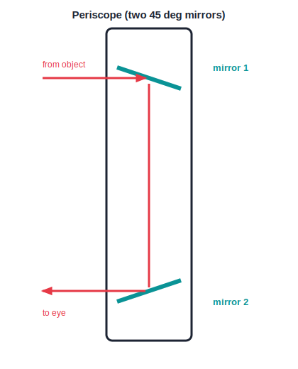
PERISCOPE
The Periscope
Seeing over an obstacle
• Uses reflection of reflected light (two mirrors)
• Two plane mirrors are fixed at 45°, parallel to each other
• Light reflects off the top mirror, then the bottom mirror
• The emergent ray is parallel to the incident ray
• Used to see over walls and from submarines
Notes:
Trace the ray on the periscope diagram: down the tube and out to the eye, letting you see over an obstacle.

Slide 18
KALEIDOSCOPE
The Kaleidoscope
Multiple reflection
It works on repeated reflection of reflected light.
Mirrors at an angle
Two or three plane mirrors are placed at an angle inside a tube.
Beautiful patterns
Coloured pieces are reflected many times to form symmetrical patterns.
Changing view
Turning the tube rearranges the pieces and changes the pattern.
Notes:
Both the periscope and kaleidoscope use multiple reflection — the difference is the mirror arrangement.

Slide 19
WRAP UP
Quick Recap
✓ Reflection — Bouncing back of light from a polished surface.
✓ Laws — Angle of reflection = angle of incidence; rays and normal coplanar; on opposite sides of the normal.
✓ Regular vs irregular — Smooth surface → clear image; rough surface → scattered light.
✓ Periscope — Two 45° mirrors let you see over an obstacle.
✓ Kaleidoscope — Multiple reflection makes symmetrical patterns.
Notes:
Cold-call the three laws of reflection before the final quiz.

Slide 20
QUIZ 2
Final Check — Periscope & Kaleidoscope
4 questions • think before the answer reveals on the next slide

Slide 21
QUIZ QUESTION
Q1 — Periscope
A periscope uses two plane mirrors fixed at an angle of:
30°
45°
A
B
60°
90°
C
D

Slide 22
ANSWER REVEALED
Q1 — Periscope
A periscope uses two plane mirrors fixed at an angle of:
30°
45°
A
✓
60°
90°
C
D
WHY
Each mirror at 45° turns the light through 90°, so the two together let you see over an obstacle.

Slide 23
QUIZ QUESTION
Q2 — Principle
Both the periscope and the kaleidoscope work on the:
refraction of light
reflection of reflected light
A
B
dispersion of light
absorption of light
C
D

Slide 24
ANSWER REVEALED
Q2 — Principle
Both the periscope and the kaleidoscope work on the:
refraction of light
reflection of reflected light
A
✓
dispersion of light
absorption of light
C
D
WHY
Both use multiple reflection — light reflected from one mirror is reflected again by another.

Slide 25
QUIZ QUESTION
Q3 — Periscope ray
In a periscope, the emergent ray is ___ to the incident ray.
perpendicular
parallel
A
B
opposite
at 45°
C
D

Slide 26
ANSWER REVEALED
Q3 — Periscope ray
In a periscope, the emergent ray is ___ to the incident ray.
perpendicular
parallel
A
✓
opposite
at 45°
C
D
WHY
Because the two mirrors are parallel, the ray leaving the periscope is parallel to the ray that entered.

Slide 27
QUIZ QUESTION
Q4 — Kaleidoscope
A kaleidoscope produces symmetrical patterns using:
a single lens
plane mirrors at an angle
A
B
a concave mirror
a prism
C
D

Slide 28
ANSWER REVEALED
Q4 — Kaleidoscope
A kaleidoscope produces symmetrical patterns using:
a single lens
plane mirrors at an angle
A
✓
a concave mirror
a prism
C
D
WHY
Coloured pieces are reflected repeatedly by mirrors set at an angle, forming symmetrical patterns.

Slide 29
Light That Bounces
The simple laws of reflection, used once or many times over, give us mirrors, periscopes and the endless patterns of a kaleidoscope.

