Slide 1
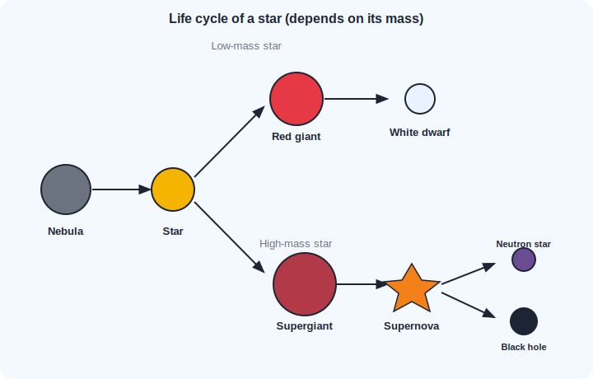
STD 8 • GENERAL SCIENCE • ASTRONOMY
Life Cycle of Stars
Galaxies and the Milky Way • Birth of stars • How stars evolve • White dwarfs, neutron stars and black holes

Slide 2
INTRODUCTION
Learning Objectives
1
Describe a galaxy and name the galaxy we live in
2
Use the light year as a unit of distance
3
Explain how stars are born from interstellar clouds
4
Explain what keeps a star stable
5
Describe how a star evolves depending on its mass
6
Name the final stages: white dwarf, neutron star and black hole
Notes:
Open by previewing these objectives so students know what they should be able to do by the end of the session.

Slide 3
PART 1
Galaxies and the Birth of Stars
1
Where stars live, and how they form

Slide 4
GALAXY
Galaxies and the Milky Way
Galaxy
A huge collection of stars, gas and dust held together by gravity.
Our galaxy
We live in the Milky Way (Mandakini), which has about 100 billion stars.
Light year
The distance light travels in one year — a unit for the vast distances in space.
The Sun
The Sun is our nearest star and the source of almost all our energy.
Notes:
Give a sense of scale: light from the nearest star after the Sun takes over four years to reach us.

Slide 5
BIRTH
How Stars Are Born
Interstellar clouds
Stars are born inside huge clouds of gas and dust (nebulae).
Gravity pulls in
Gravity makes the cloud contract and heat up at the centre.
A star ignites
When it is hot enough, nuclear reactions begin and the star starts to shine.
Stability
The outward push of these reactions balances the inward pull of gravity, keeping the star stable.
Notes:
Stability is a balance of two forces — set this up because the star's fate depends on it running out of fuel.

Slide 6
QUIZ 1
Check — Galaxies & Birth of Stars
4 questions • think before the answer reveals on the next slide

Slide 7
QUIZ QUESTION
Q1 — Galaxy
The galaxy in which we live is called the:
Andromeda
Milky Way (Mandakini)
A
B
Solar System
Great Bear
C
D

Slide 8
ANSWER REVEALED
Q1 — Galaxy
The galaxy in which we live is called the:
Andromeda
Milky Way (Mandakini)
A
✓
Solar System
Great Bear
C
D
WHY
Our galaxy, the Milky Way (Mandakini), contains about 100 billion stars.

Slide 9
QUIZ QUESTION
Q2 — Light year
A light year is a unit of:
time
distance
A
B
mass
temperature
C
D

Slide 10
ANSWER REVEALED
Q2 — Light year
A light year is a unit of:
time
distance
A
✓
mass
temperature
C
D
WHY
A light year is the distance light travels in one year — used for the huge distances between stars.

Slide 11
QUIZ QUESTION
Q3 — Birth
Stars are born from:
black holes
clouds of gas and dust (nebulae)
A
B
planets
comets
C
D

Slide 12
ANSWER REVEALED
Q3 — Birth
Stars are born from:
black holes
clouds of gas and dust (nebulae)
A
✓
planets
comets
C
D
WHY
Gravity pulls together a nebula until its centre is hot enough for nuclear reactions to start.

Slide 13
QUIZ QUESTION
Q4 — Stability
A star stays stable because the inward pull of gravity is balanced by the:
Earth's gravity
outward push of its nuclear reactions
A
B
solar wind
magnetic field
C
D

Slide 14
ANSWER REVEALED
Q4 — Stability
A star stays stable because the inward pull of gravity is balanced by the:
Earth's gravity
outward push of its nuclear reactions
A
✓
solar wind
magnetic field
C
D
WHY
The energy released inside pushes outward and balances gravity, keeping the star stable while it has fuel.

Slide 15
PART 2
How Stars Evolve
2
The fate of a star depends on its mass

Slide 16
EVOLUTION
Three Ways a Star Can Evolve
Depends on the star's mass
• When the fuel runs low, the star swells up
• Low-mass star → red giant → white dwarf
• High-mass star → supergiant → supernova
• Supernova remnant → neutron star or black hole
• The bigger the star, the more dramatic its end
Notes:
Walk the flow diagram left to right along both branches; the split point is the star's initial mass.

Slide 17
END STAGES
White Dwarfs, Neutron Stars and Black Holes
White dwarf
The small, dense end stage of a low-mass star like the Sun.
Supernova
The huge explosion that ends a very massive star's life.
Neutron star
An extremely dense remnant left after some supernovae.
Black hole
The end of a very massive star — its gravity is so strong that not even light escapes.
Notes:
Emphasise the black hole definition (nothing, not even light, can escape) — a favourite exam point.

Slide 18
WRAP UP
Quick Recap
✓ Galaxy — Milky Way (Mandakini); ~100 billion stars; distances in light years.
✓ Birth — Stars form in nebulae as gravity pulls gas and dust together.
✓ Stability — Gravity inward balanced by nuclear push outward.
✓ Low-mass star — Red giant → white dwarf.
✓ High-mass star — Supergiant → supernova → neutron star or black hole.
✓ Black hole — Gravity so strong that not even light escapes.
Notes:
Cold-call the two evolutionary paths and what decides which one a star follows.

Slide 19
QUIZ 2
Final Check — Evolution of Stars
4 questions • think before the answer reveals on the next slide

Slide 20
QUIZ QUESTION
Q1 — Sun's fate
The Sun, a low-mass star, will end its life as a:
black hole
white dwarf
A
B
neutron star
supernova
C
D

Slide 21
ANSWER REVEALED
Q1 — Sun's fate
The Sun, a low-mass star, will end its life as a:
black hole
white dwarf
A
✓
neutron star
supernova
C
D
WHY
A low-mass star like the Sun becomes a red giant and then settles into a small, dense white dwarf.

Slide 22
QUIZ QUESTION
Q2 — Big star
A very massive star ends its life in a huge explosion called a:
red giant
supernova
A
B
white dwarf
nebula
C
D

Slide 23
ANSWER REVEALED
Q2 — Big star
A very massive star ends its life in a huge explosion called a:
red giant
supernova
A
✓
white dwarf
nebula
C
D
WHY
A high-mass star becomes a supergiant and then explodes as a supernova.

Slide 24
QUIZ QUESTION
Q3 — Black hole
A black hole is a region where the gravitational force is so strong that:
it glows brightly
not even light can escape
A
B
stars are born
sound cannot travel
C
D

Slide 25
ANSWER REVEALED
Q3 — Black hole
A black hole is a region where the gravitational force is so strong that:
it glows brightly
not even light can escape
A
✓
stars are born
sound cannot travel
C
D
WHY
A black hole, the end stage of a very massive star, has gravity so strong that nothing, not even light, escapes.

Slide 26
QUIZ QUESTION
Q4 — Deciding factor
Whether a star ends as a white dwarf or a black hole depends mainly on its:
colour
mass
A
B
distance from Earth
temperature only
C
D

Slide 27
ANSWER REVEALED
Q4 — Deciding factor
Whether a star ends as a white dwarf or a black hole depends mainly on its:
colour
mass
A
✓
distance from Earth
temperature only
C
D
WHY
A star's initial mass decides its evolutionary path and its final stage.

Slide 28
The Lives of the Stars
Born in clouds of gas, shining for billions of years, and ending as white dwarfs, neutron stars or black holes — every star's story is written by its mass.

