Slide 1







TO FLY OR NOT TO FLY MAKING DATA-EDUCATED TRAVEL DECISIONS
SHIRA ORLOWEK, DANIEL PARMET,
STEPHEN MURPHY AND MAGGIE BRINK
Notes:
Title Slide

Slide 2

MOTIVATION:
APPLYING DATA TO MAKE EDUCATED TRAVEL PURCHASING DECISIONS
QUESTIONS:
Which day of the week is the cheapest to travel?
Of the 6 most popular routes from O’Hare, which route has the cheapest flights on average?
Of the API’s included Airlines, which has the cheapest flight options?
PREDICTIONS:
It will be cheaper to fly on Tuesday and Wednesday.
Spirit Airline will have the cheapest flight options.
Due to more flights out of O’Hare overall, United will skew the results.
Duration of flights by Airline for the same route, United will be the shortest.
SUMMARY:
Using Kiwi’s API, Tequila, we were able to answer all of our questions.
Among other insights, we discovered that our hypotheses were confirmed based on our analysis of the data.
Notes:
Shira

Slide 3
QUESTIONS
Which day of the week is the cheapest to travel?
Of the 6 most popular routes from O’Hare, which route has the cheapest flights?
3. Of the API’s included Airlines, which has the cheapest flight options?
What we needed from the API:
Prices of flights
Destination
Day of the week
Airlines
Additional flight costs
What we extracted:
We generated 1,086 API calls detailing daily flights out of O’Hare to six different airports across five different airlines.
Used nested for loops to iterate the API calls.
Notes:
Shira

Slide 4
DATA CLEANUP AND EXPLORATION
DATA CLEANUP STEPS:
Determined required data points needed to answer questions.
Created data frame within Jupyter Notebook.
Deleted extraneous columns.
Formatted IATA codes (airline codes).
Separated date and time from original date format.
Determined day of the week from datetime formatted data:
2019-02-01T05:51:00.000Z to Friday
Created new columns including; Day of the Week, Length of flight, Total cost (incl. bags).
INSIGHTS AND ISSUES:
American Airlines did not pull into the API.
Booking date was not included in the API to determine an original question.
We noticed that baggage price was separated out from flight price, so we took a look at bag price across airlines.
Notes:
Maggie

Slide 5
DATA ANALYSIS
DATA ANALYTICS STEPS:
1. Determined how we needed to manipulate the data to best visualize our questions
i.e. bar, pie, scatter, bubble, box plot.
2. Worked through different ways to group the data in order to achieve proper visualizations.
3. Collaborated on code to create graphs.
Notes:
Maggie

Slide 6
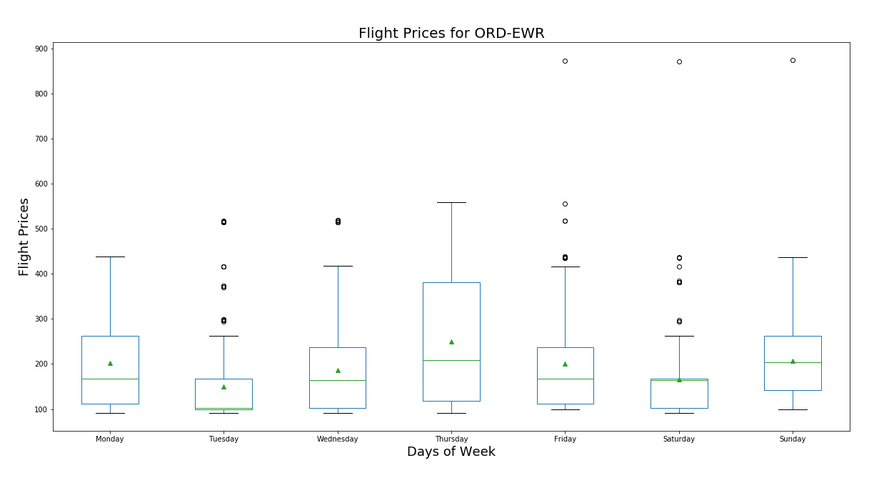
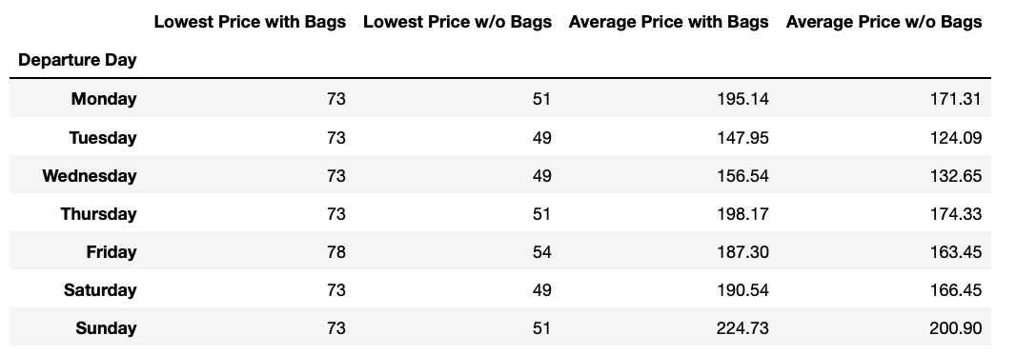
QUESTION 1: Which day of the week is the cheapest to travel?
Our data shows that, on average, it is cheapest to fly on a Tuesday but the least expensive flight without bags for each route is most often found on a Wednesday.
Notes:
Daneil

Slide 7
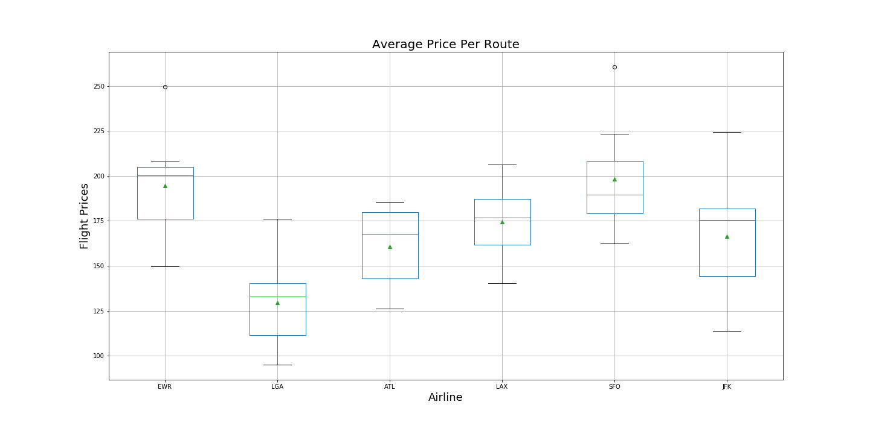
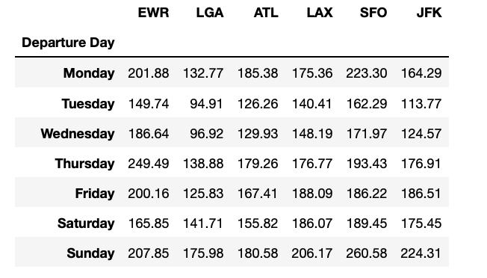
QUESTION 2: Of the 6 most popular routes from O’Hare, which route has the cheapest flights on average?
We examined routes to LGA, EWR, JFK, ATL, SFO and LAX and found that the least expensive route is ORD to LGA on a Tuesday.
Notes:
Daniel

Slide 8
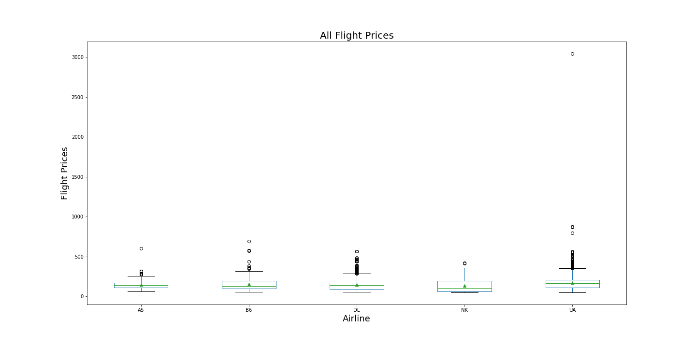
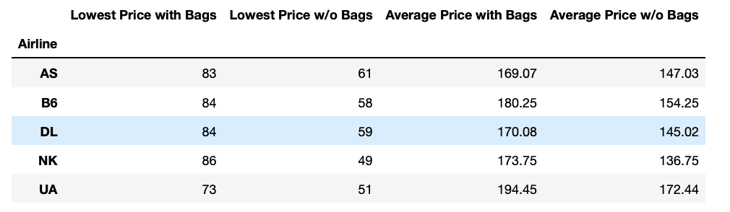
QUESTION 3: Of the API’s included Airlines, which has the cheapest flight options?
Prices do not vary substantially across airlines.
Spirit airline has the overall lowest fare without a bag.
Alaskan airlines has the lowest average far with a bag.
Notes:
Daniel

Slide 9
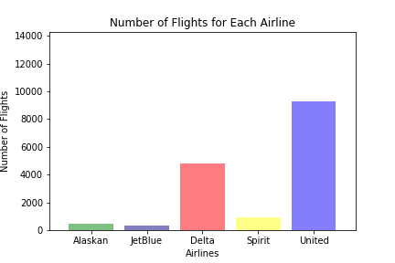
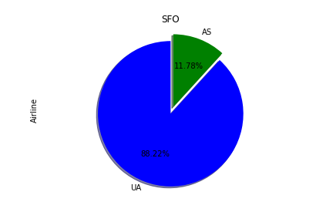
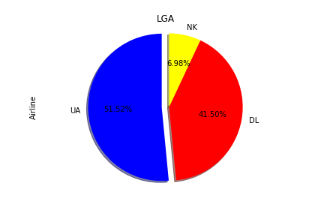
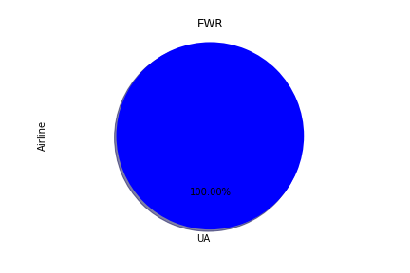
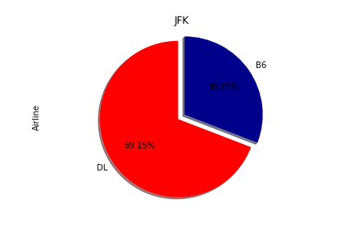
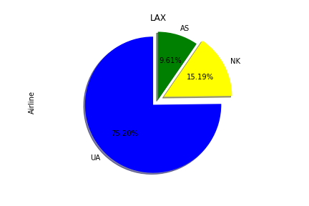
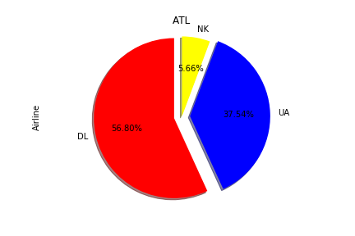
Overall Flights by Airline:
As we chose O’Hare as our starting location, United’s data was skewed in comparison to other airlines as O’Hare is a United hub.
From our API call we also noted that not all of the five airlines fly to each destination.
Notes:
Stephen

Slide 10
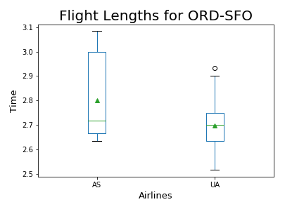
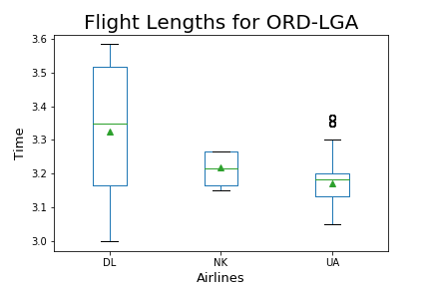
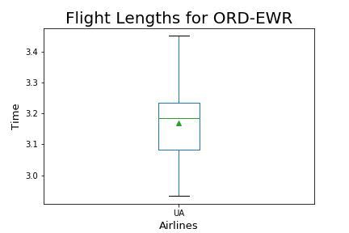
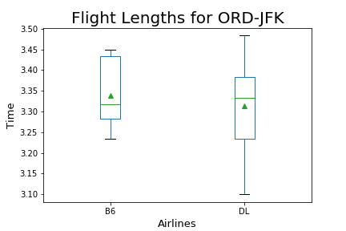
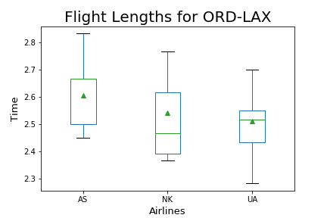
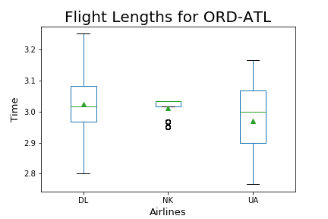
Flight Duration for Routes by Airline:
Creating new columns from the Departure/Arrival Date and Time we calculated the length of each flight and analysed this by route by airline.
Notes:
Stephen

Slide 11
POST MORTEM
LIMITATIONS
Finding a public flight API was extremely difficult.
The API we used did not have all the data points we wanted for our analysis
Time constraints
WHAT THIS API COULDN’T REPORT
American Airlines did not pull into the API
Booking date was not included in the API to determine the cheapest date to book
WITH MORE TIME…
Analysis of baggage prices in comparison to lowest priced airlines
Round trip vs. One way vs. Multi-stop trip analysis
Included routes leaving Midway
Allow user to choose their route for automation population of analysis (including International)
Compare these economy prices to business and first
Automate error fare capturing
Notes:
Stephen

Slide 12
QUESTIONS?

