Slide 1
CI/CD

Slide 2
Devops
CI CD Pipeline implementation or the Continuous Integration/Continuous Deployment software is the backbone of the modern DevOps environment.
CI/CD bridges the gap between development and operations teams by automating build, test and deployment of applications.

Slide 3
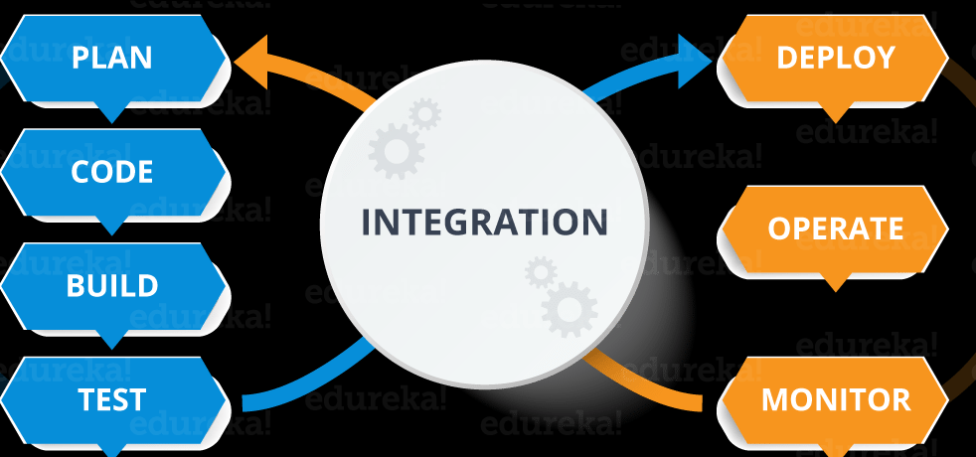
What is Devops

Slide 4
DevOps is a software development approach which involves continuous development, continuous testing, continuous integration, continuous deployment and continuous monitoring of the software throughout its development life cycle.
This is exactly the process adopted by all the top companies to develop high-quality software and shorter development life cycles, resulting in greater customer satisfaction, something that every company wants.

Slide 5
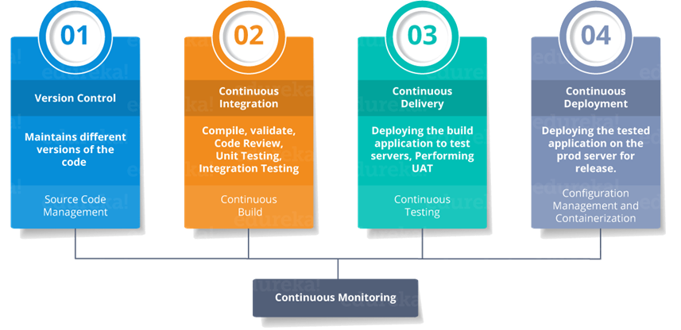
Devops stages

Slide 6
CI/CD stands for Continuous Integration and Continuous Delivery and Deployment.
CI/CD pipeline
A CI/CD pipeline automates the process of software delivery. It builds code, runs tests, and helps you to safely deploy a new version of the software.
CI/CD pipeline reduces manual errors, provides feedback to developers, and allows fast product iterations.
CI/CD pipeline introduces automation and continuous monitoring throughout the lifecycle of a software product.

Slide 7
It involves from the integration and testing phase to delivery and deployment. These connected practices are referred as CI/CD pipeline.
.

Slide 8
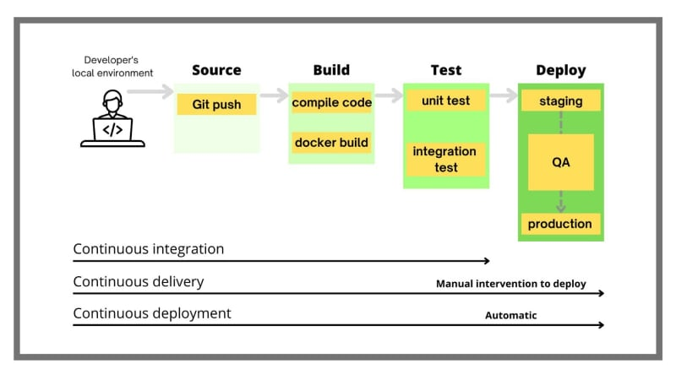
CI/CD workflow

Slide 9
What is Continuous Integration, Continuous Delivery, and Continuous Deployment?
Continuous integration is a software development method where members of the team can integrate their work at least once a day. In this method, every integration is checked by an automated build to search the error.
Continuous delivery is a software engineering method in which a team develops software products in a short cycle. It ensures that software can be easily

Slide 10
released at any time.
Continuous deployment is a software engineering process in which product functionalities are delivered using automatic deployment. It helps testers to validate whether the codebase changes are correct, and it is stable or not.

Slide 11
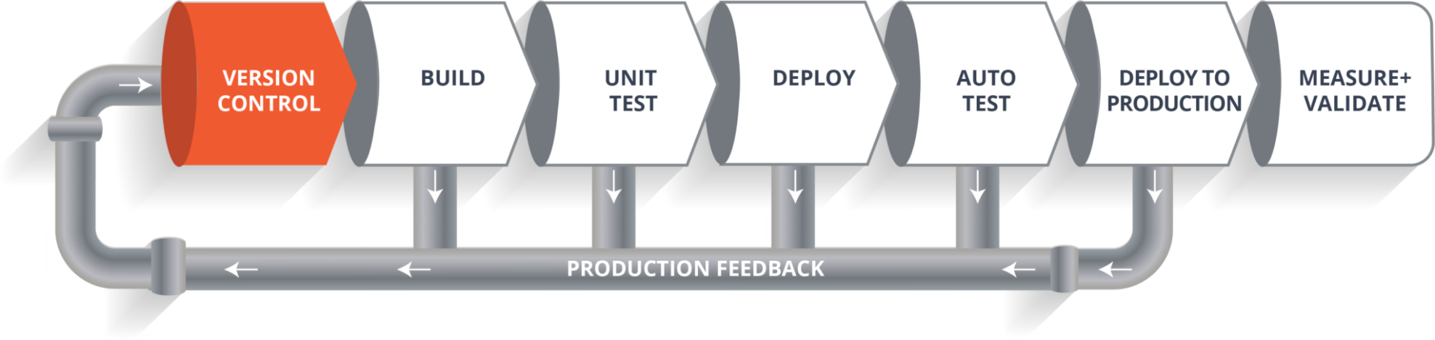
CI CD Pipeline

Slide 12
Stages in pipeline
Source Stage
In the source stage, CI/CD pipeline is triggered by a code repository. Any change in the program triggers a notification to the CI/CD tool that runs an equivalent pipeline. Other common triggers include user-initiated workflows, automated schedules, and the results of other pipelines.
Build Stage
This is the second stage of the CI/CD Pipeline in which you merge the source code and its dependencies.

Slide 13
It is done mainly to build a runnable instance of software that you can potentially ship to the end-user.
Test Stage
Test Stage includes the execution of automated tests to validate the correctness of code and the behaviour of the software. This stage prevents easily reproducible bugs from reaching the clients. It is the responsibility of developers to write automated tests.

Slide 14
Deploy Stage
This is the last stage where your product goes live. Once the build has successfully passed through all the required test scenarios, it is ready to deploy to live server.

Slide 15
First, the code is committed into a version control system(such as git, svn) by the team of developers.
Next, it goes through the build phase which is the first phase of the pipeline, it goes to build phase where it gets compiled.
Once the build phase is over, then you move on to the testing phase. In this phase, we have various kinds of testing, one of them is the unit test.
When the test is completed, you move on to the deploy phase, where you deploy it into a staging or a test server.

Slide 16
Once the code is deployed successfully, you can run another set of a sanity test. If everything is accepted, then it can be deployed to production.
Meanwhile in every step, if there is some error, you can shoot a mail back to the development team so that they can fix them. Then they will push it into the version control system and goes back into the pipeline.
Once again if there is any error reported during testing, again the feedback goes to the dev team where they fix it and the process re-iterates if required.

Slide 17
This lifecycle continues until we get a code or a product which can be deployed in the production server where we measure and validate the code.

Slide 18
Advantages of CI/CD pipeline
CI/CD pipeline can streamline communication.
It can automate the process of software delivery.
Helps you to achieve faster customer feedback.
It enables you to remove manual errors.
Reduces costs and labour.
CI/CD pipelines can make the software development lifecycle faster.
It has automated pipeline deployment.
A CD pipeline gives a rapid feedback loop starting from developer to client.
Improves communications between organization employees.

Slide 19
It enables developers to know which changes in the build can turn to the brokerage and to avoid them in the future.
The automated tests, along with few manual test runs, help to fix any issues that may arise.

Slide 20
CI CD Tools
Our task is to automate the entire process, from the time the development team gives us the code and commits it to the time we get it into production.
Our task is to automate the pipeline in order to make the entire software development lifecycle on the dev-ops mode/ automated mode. For this, they would need automation tools.

Slide 21
Important CI/CD tools
Here are the important CI/CD tools:
Jenkins
Jenkins is an open-source Continuous Integration server that helps to achieve the Continuous Integration process (and not only) in an automated fashion.
Jenkins is free and is entirely written in Java.
Jenkins is a widely used application around the world.
It provides us with various interfaces and tools in order to automate the entire process.

Slide 22
Bamboo is a continuous integration build server that performs – automatic build, test, and releases in a single place. It works seamlessly with JIRA software and Bitbucket.
Features:
Run parallel batch tests
Setting up Bamboo is pretty simple
Per-environment permissions feature allows developers and QA to deploy to their environments
Built-in Git branching and workflows. It automatically merges the branches.

Slide 23
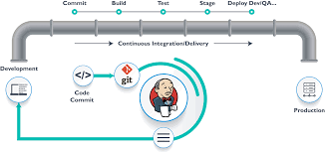
CI/CD pipeline

Slide 24
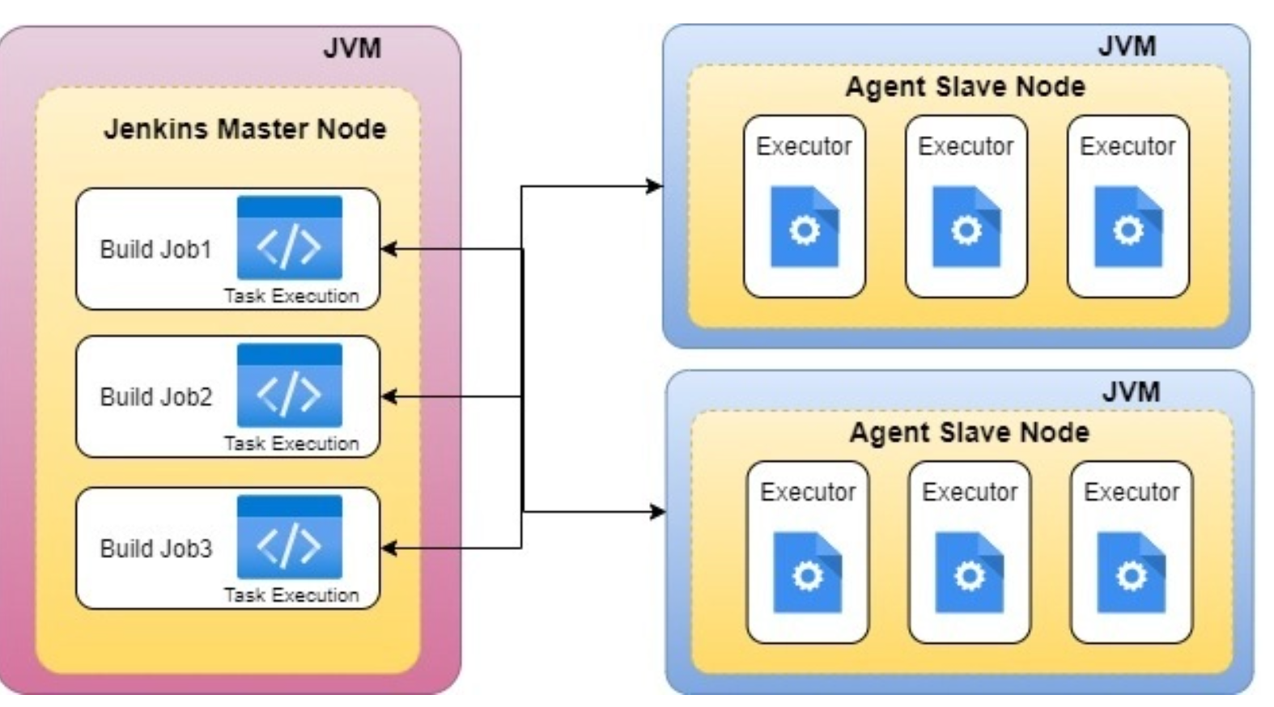
Jenkins Master-Slave

Slide 25
In Jenkins, We can build all our applications on a single server. As the requirement grows and changes, we will come cross many issues like what if there are thousands build which needs to be done, what if different builds need to be done on different flavor of OS.
In such cases the master-slave architecture comes in picture which takes care of all such odd requirements.
For example there might be an application which needs to be build on Ubuntu. There is another application that needs to be build on CentOS.

Slide 26
As a solution we can have two slave nodes(one with Ubuntu installed and another with CentOS installed) and build the respective applications on these servers.
Jenkins Master
The Jenkins master acts to schedule the jobs, assign slaves, and send builds to slaves to execute the jobs. It will also monitor the slave state (offline or online) and get back the build result responses from slaves and the display build results on the console output.

Slide 27
Jenkins Slave
Slave is a java executable which receives the build instructions from the central master node. Let’s do the Master-Slave Configuration on GCP by following below steps and instructions.

Slide 28
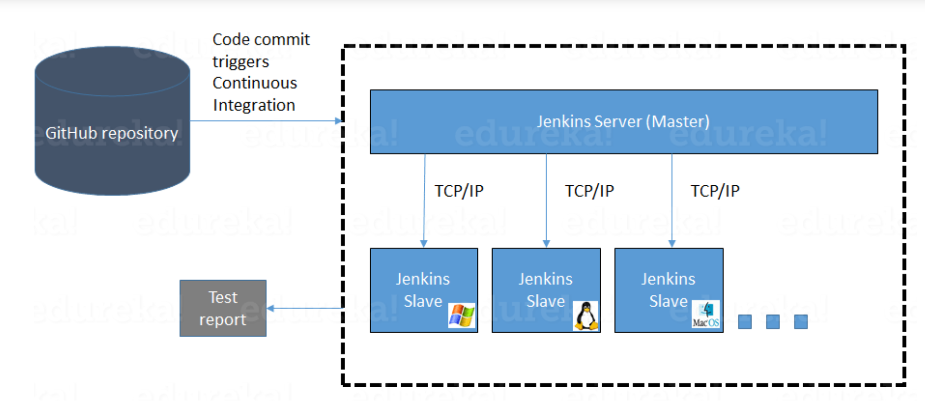

Slide 29
Jenkins checks the Git repository at periodic intervals for any changes made in the source code.
Each builds requires a different testing environment which is not possible for a single Jenkins server. In order to perform testing in different environments, Jenkins uses various Slaves as shown in the diagram.
Jenkins Master requests these Slaves to perform testing and to generate test reports.

Slide 30
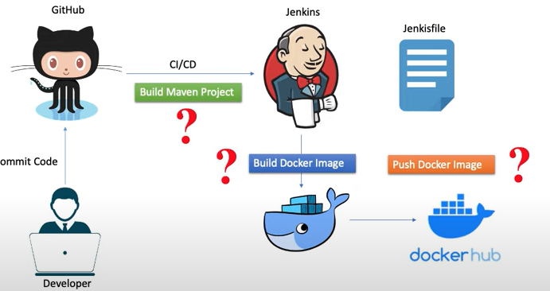
Jenkins and Docker

