Slide 1
Docker

Slide 2
Introduction to Docker
Platform for Build, Ship and Run.
Docker is a software containerization platform, meaning you can build your application, package them along with their dependencies into a container and then these containers can be easily shipped to run on other machines.
Containers uses Containerization which can be considered as an evolved version of Virtualization. The same task can also be achieved using Virtual Machines, however it is not very efficient.

Slide 3
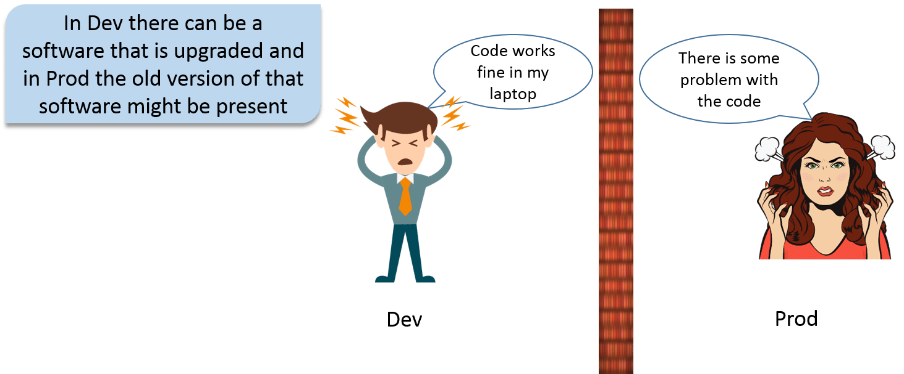
Why to use Docker?

Slide 4
What is Virtualization?
Virtualization is the technique of importing a Guest operating system on top of a Host operating system. This technique was a revelation at the beginning because it allowed developers to run multiple operating systems in different virtual machines all running on the same host.
The advantages of Virtual Machines or Virtualization are:
Multiple operating systems can run on the same machine
Maintenance and Recovery were easy in case of failure conditions
Total cost of ownership was also less due to the reduced need for infrastructure

Slide 5
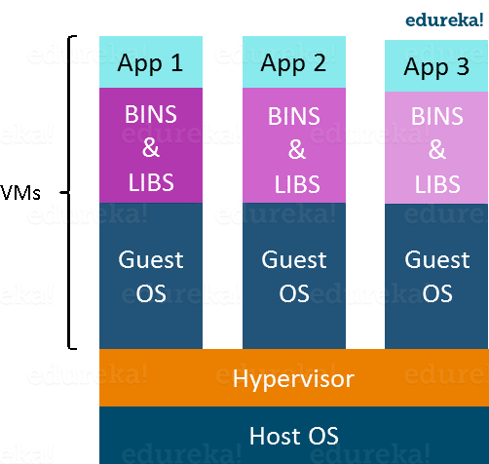
Virtual Machines

Slide 6
Shortcoming of Virtual Machines
Running multiple Virtual Machines in the same host operating system leads to performance degradation.
This is because of the guest OS running on top of the host OS, which will have its own kernel and set of libraries and dependencies. This takes up a large chunk of system resources, i.e. hard disk, processor and especially RAM.
Hypervisors are not as efficient as the host operating system
Boot up process is long and takes time

Slide 7
What is Containerization?
Containerization is the technique of bringing virtualization to the operating system level.
While Virtualization brings abstraction to the hardware, Containerization brings abstraction to the operating system.
Containerization is also a type of Virtualization.
Containers on the same OS kernel are lighter and smaller
Better resource utilization compared to VMs.
Boot-up process is short and takes few seconds.
Containers only contain application specific libraries which are separate for each container and they are faster and do not waste any resources.

Slide 8
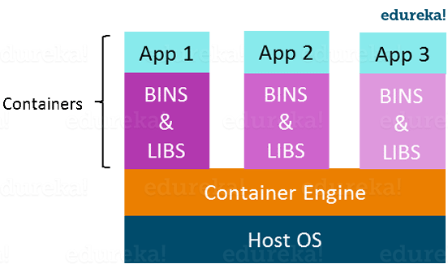
Containers

Slide 9
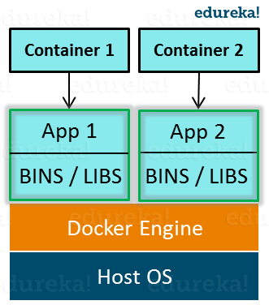
Docker

Slide 10
Each application will run on a separate container and will have its own set of libraries and dependencies.
This also ensures that there is process level isolation, meaning each application is independent of other applications, giving developers surety that they can build applications that will not interfere with one another.

Slide 11
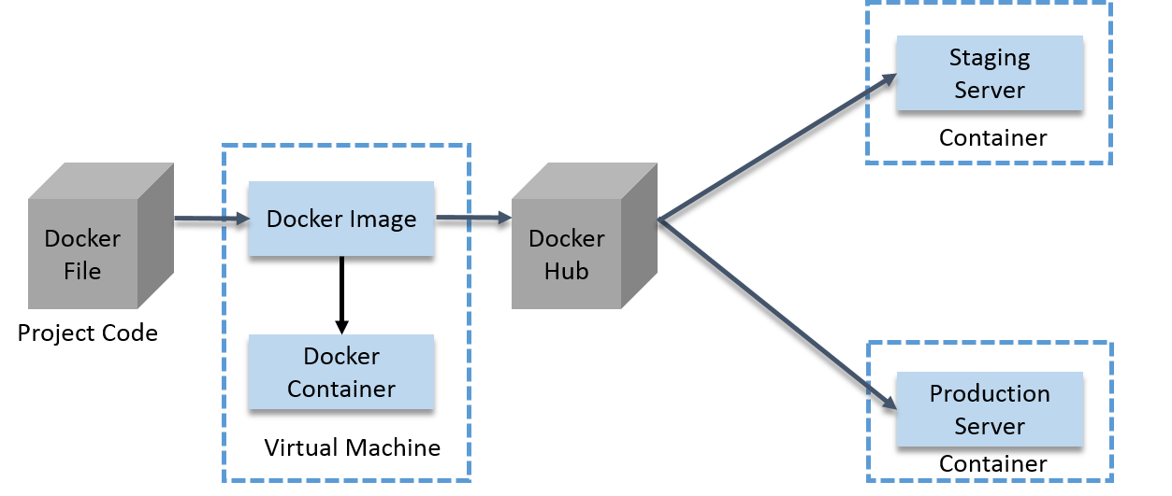
How Docker container work?

Slide 12
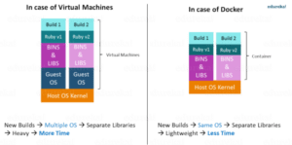
Virtualization vs Containerization

Slide 13
Virtualization deals with creating many operating systems in a single host machine. Containerization on the other hand will create multiple containers for every type of application as required.
The major difference is that there are multiple Guest Operating Systems in Virtualization which are absent in Containerization.
The best part of Containerization is that it is very lightweight as compared to the heavy virtualization.

Slide 14
Docker Installation
Docker for different operating systems can be downloaded from
https://docs.docker.com/get-docker/
Hyper-V and Containers Windows features must be enabled.
The following hardware prerequisites are required to successfully run Client Hyper-V on Windows 10:
64 bit processor with Second Level Address Translation (SLAT)
4GB system RAM
BIOS-level hardware virtualization support must be enabled in the BIOS settings.

Slide 15
For installation, follow
https://docs.docker.com/desktop/windows/install/
Once installed, Docker container can be started.

Slide 16
Dockerfile, Docker Image And Docker Container:
A Docker Image is created by the sequence of commands written in a file called as Dockerfile.
When this Dockerfile is executed using a docker command it results into a Docker Image with a name.
When this Image is executed by “docker run” command it will by itself start whatever application or service it must start on its execution.
Docker Hub:
Docker Hub is like GitHub for Docker Images. It is basically a cloud registry where you can find Docker Images uploaded by

Slide 17
different communities, also you can develop your own image and upload on Docker Hub, but first, you need to create an account on DockerHub.
Docker Architecture:
It consists of a Docker Engine which is a client-server application with three major components:
A server which is a type of long-running program called a daemon process (the docker command).
A REST API which specifies interfaces that programs can use to talk to the daemon and instruct it what to do.
A command line interface (CLI) client (the docker command).
The CLI uses the Docker REST API to control or interact with the Docker daemon through scripting or direct CLI commands. Many other Docker applications use the underlying API and CLI.

Slide 18
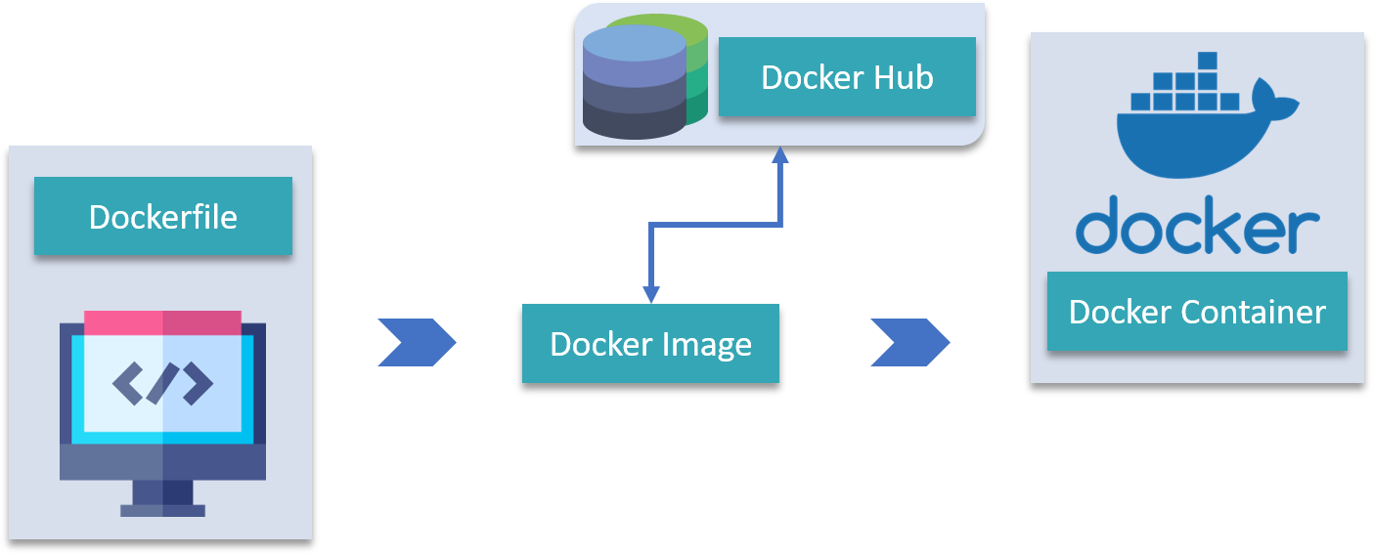

Slide 19
Docker Commands
After docker container is started, we can execute the docker commands in the command prompt.
docker version
docker run hello-world
docker run --it alpine:latest
docker images
docker container ls
Docker build --tag “docker-hello-world:latest”
docker run docker-hello-world:latest

Slide 20
Docker run –it centos /bin/bash
For running an application in docker container,
Create image for application
To create image create docker file in the application folder.
Build an image using the build command
Run the image

Slide 21
AWS Container Services
AWS offers services that give you a secure place to store and manage your container images, orchestration that manages when and where your containers run, and flexible compute engines to power your containers.

Slide 22
Amazon Elastic Container Service
Amazon Elastic Container Service (Amazon ECS) is a fully managed container orchestration service that provides the most secure, reliable and scalable way to run containerized applications.
Amazon Elastic Kubernetes Service
Amazon Elastic Kubernetes Service (Amazon EKS) is a fully managed Kubernetes service that provides the most secure, reliable, and scalable way to run containerized applications using Kubernetes.

Slide 23
AWS Fargate
AWS Fargate is a serverless compute engine for containers. Fargate makes it easy for you to focus on building your applications.
Amazon EC2
Run containers on virtual machine infrastructure with full control over configuration and scaling.
AWS ECR
Amazon ECR is a fully managed container registry offering high-performance hosting, so you can reliably deploy application images and artifacts anywhere.

