Slide 1
GIT

Slide 2
GIT
GIT Overview
Git is an open-source, version control tool created in 2005 by developers working on the Linux operating system.
Git was initially designed and developed by Linus Torvalds for Linux kernel development.

Slide 3
Version Control System
Version Control System (VCS) is a software that helps software developers to work together and maintain a complete history of their work.
Functions of a VCS
Allows developers to work simultaneously.
Does not allow overwriting each other’s changes.
Maintains a history of every version.

Slide 4
Types of VCS
Centralized version control system (CVCS).
Distributed/Decentralized version control system (DVCS).
Centralized version control system (CVCS) uses a central server to store all files and enables team collaboration. But the major drawback of CVCS is its single point of failure, i.e., failure of the central server.
The most common centralized version control systems are Concurrent Versions System (CVS), Perforce, and Subversion (SVN). There's also Microsoft Team Foundation Server (TFS), which is now known as Azure DevOps Server.

Slide 5
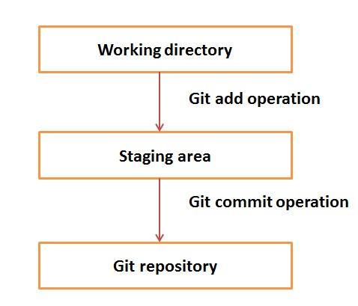

Slide 6
DVCS clients not only check out the latest snapshot of the directory but they also fully mirror the repository.
If the server goes down, then the repository from any client can be copied back to the server to restore it. Every checkout is a full backup of the repository.
The working directory is the place where files are checked out. In other CVCS, developers generally make modifications and commit their changes directly to the repository.
Git doesn’t track each and every modified file. Whenever you do commit an operation,

Slide 7
Git looks for the files present in the staging area. Only those files present in the staging area are considered for commit and not all the modified files.
Git Environment Setup
The most official build is available for download on the Git website. Just go to https://git-scm.com/download/win
After installing, in the git bash prompt type,
$ git –version - to check git installation
Checking Your Settings
If you want to check your configuration settings, you can use the git config --list command to list all the settings Git can find at that point.

Slide 8
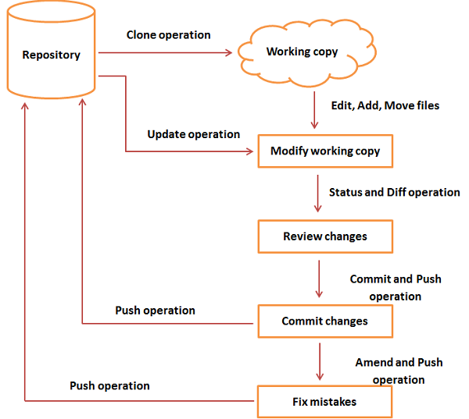
Git Workflow

Slide 9
Git Vs. GitHub
Git is a distributed version control system, so here, every developer gets their local repository with full commit history.
GitHub is a Git repository hosting service that provides a web-based graphical interface (GUI). It helps every team member work together on a project from anywhere, making it easy to collaborate.
GitHub is one place where project managers and developers coordinate, track, and update their work, so projects stay transparent and on schedule.
GitHub helps all team members stay organized.

Slide 10
Git Terminologies
Local Repository
Every VCS tool provides a private workplace as a working copy. Developers make changes in their private workplace and after commit, these changes become a part of the repository.
Git takes it one step further by providing them a private copy of the whole repository. Users can perform many operations with this repository such as add file, remove file, rename file, move file, commit changes, and many more.

Slide 11
Working Directory and Staging Area or Index
The working directory is the place where files are checked out. In other CVCS, developers generally make modifications and commit their changes directly to the repository.
Commits
Commit holds the current state of the repository.
Branches
Branches are used to create another line of development. By default, Git has a master branch, which is same as trunk in Subversion. Usually, a branch is created to work on a new feature.

Slide 12
Once the feature is completed, it is merged back with the master branch and we delete the branch.
Every branch is referenced by HEAD, which points to the latest commit in the branch. Whenever you make a commit, HEAD is updated with the latest commit.
Clone
Clone operation creates the instance of the repository. Clone operation not only checks out the working copy, but it also mirrors the complete repository. Users can perform many operations with this local repository.
Pull
Pull operation copies the changes from a remote

Slide 13
repository instance to a local one.
The pull operation is used for synchronization between two repository instance.
Push
Push operation copies changes from a local repository instance to a remote one. This is used to store the changes permanently into the Git repository.
HEAD
HEAD is a pointer, which always points to the latest commit in the branch. Whenever you make a commit, HEAD is updated with the latest commit. The heads of the branches are stored in .git/refs/heads/ directory.

Slide 14
ls -1 .git/refs/heads/ - to list the heads of the branches.
Revision
Revision represents the version of the source code. Revisions in Git are represented by commits.
URL
URL represents the location of the Git repository. Git URL is stored in config file.
cat .git/config - to display the config file.

Slide 15
Git commands
Configure user and email
Create an account in github
Git commands can be executed from gitbash,
git config --global user.name “your username“ (username of github account)
git config --global user.email “your email” (email registered with github account)
git config –list
pwd – to see the current working directory

Slide 16
To create a repository in the working directory,
mkdir Git_Demo
cd Git_Demo
Pwd
To initialize a repository to our folder.
git init
notepad alpha.txt – type some contents and save
To check the status of the file created,
git status
For Git to track that file, add command is used
git add .

Slide 17
To commit the file,
git commit –m “alpha version”
To check all the information regarding the commits that were made,
git log
Create one more file,
notepad beta.txt
git add .
git commit –m “beta version”
git remote add origin url,
git remote add origin https://github.com/parmuthu/gitnew.git
git remote -v

Slide 18
To push the content to the remote repository,
git push –u origin master
To create a new branch,
git checkout –b newbranch
git branch – to view the current branch
To clone the remote repo,
git clone http_url

Slide 19
pull means adopting the changes on the remote repository to your local repository. push merges the changes from your local repository to the remote repository.
git pull origin master

