Slide 1
Kubernetes

Slide 2
What is Kubernetes?
Kubernetes is an open-source container orchestration platform that automates the deployment, scaling, and management of containerized applications.
It helps developers and operators to manage containerized applications effortlessly.
Kubernetes achieves this by providing a robust and scalable platform for deploying, scaling, and managing containerized applications.
It abstracts the underlying infrastructure and provides a consistent API for interacting with the cluster.

Slide 3
This abstraction allows developers to focus on their applications’ logic and not worry about the complexities of managing the infrastructure.

Slide 4
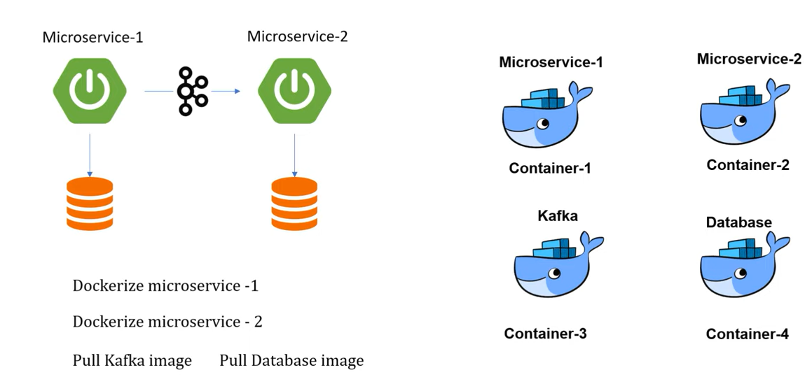

Slide 5


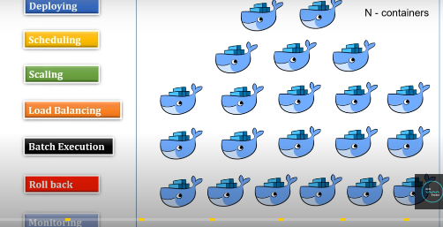
Ecommerce application

Slide 6
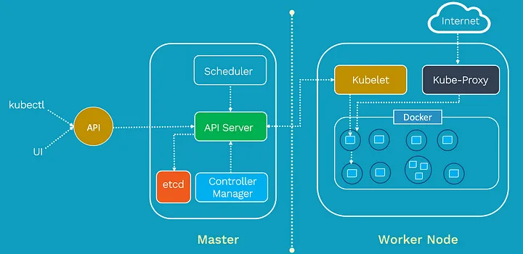
Kubernetes Architecture

Slide 7
Master Node:
The heart of a Kubernetes cluster is the Master Node. It acts as the control plane for the entire cluster and manages the overall cluster state. The Master Node is responsible for making global decisions about the cluster, such as scheduling new pods, monitoring the health of nodes and pods, and scaling applications based on demand.
The Master Node consists of several key components:
API Server: This is the central management point of the cluster. It exposes the Kubernetes API, which allows users and other components to interact with

Slide 8
the cluster.
etcd: It is a distributed key-value store that stores the configuration data of the cluster. All information about the cluster’s state is stored here.
Controller Manager: The Controller Manager includes several controllers that watch the cluster state through the API Server and take corrective actions to ensure the desired state is maintained. For example, the ReplicaSet controller ensures the specified number of pod replicas are running.
Scheduler: The Scheduler is responsible for assigning new pods to nodes based on resource requirements

Slide 9
and availability. It helps distribute the workload evenly across the worker nodes.
Worker Nodes:
The Worker Nodes are the machines where containers (pods) are scheduled and run. They form the data plane of the cluster, executing the actual workloads. Each Worker Node runs several key components:
Kubelet: The Kubelet is the agent that runs on each Worker Node and communicates with the Master Node. It ensures that the containers described in the pod specifications are running and healthy.

Slide 10
Container Runtime: Kubernetes supports multiple container runtimes, such as Docker or containerd. The Container Runtime is responsible for pulling container images and running containers on the Worker Nodes.
Kube Proxy: Kube Proxy is responsible for network communication within the cluster. It manages the network routing for services and performs load balancing.
How They Interact:
The Master Node and Worker Nodes communicate through the Kubernetes API Server. Users and other

Slide 11
components interact with the cluster through the API Server as well. For example, when a user deploys a new application, the configuration is sent to the API Server, which then stores it in etcd.
The Controller Manager continuously monitors the cluster state through the API Server. If there are any deviations from the desired state (e.g., a pod is not running), the Controller Manager takes corrective actions to reconcile the state.
When a new pod needs to be scheduled, the Scheduler selects an appropriate Worker Node based on resource availability and other constraints. The API

Slide 12
Server informs the chosen Worker Node, and the Kubelet on that node starts the container.
The Worker Nodes report the status of the running pods back to the Master Node through the Kubelet. This way, the Master Node always has an up-to-date view of the entire cluster.

Slide 13
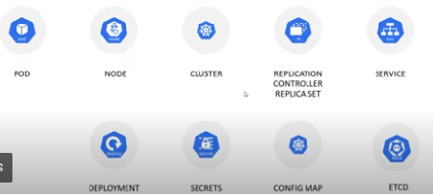
K8s Components

Slide 14
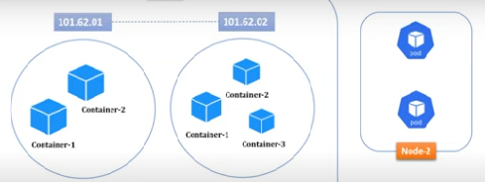
Cluster,Nodes,Pods

Slide 15
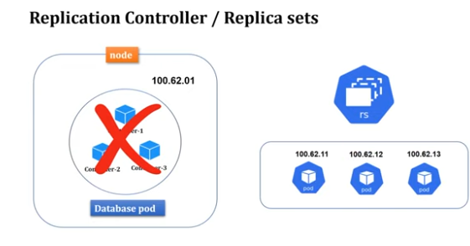
Replica Sets

Slide 16
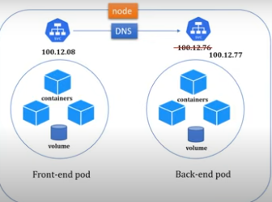
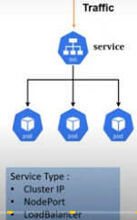

Slide 17
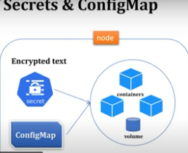
Secrets & ConfigMap

Slide 18
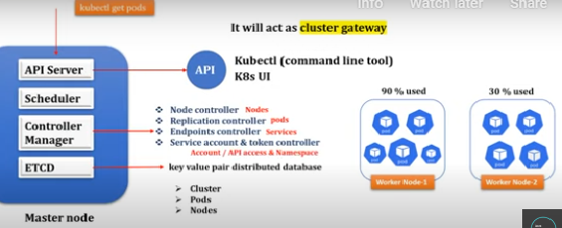

Slide 19
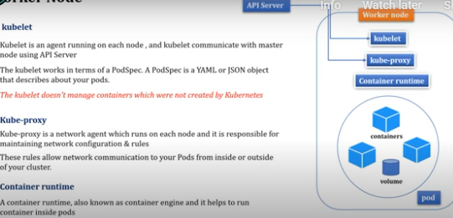
Worker Node

Slide 20
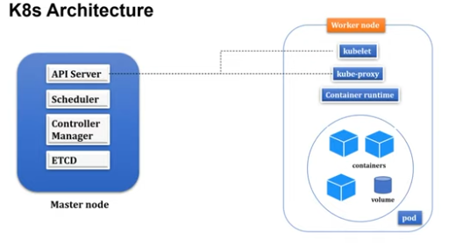

Slide 21
Main K8s Components
Nodes and Pods
Nodes represent individual machines in a cluster, and pods are the smallest deployable units that can hold one or more containers.
Nodes:
In Kubernetes, a Node is a worker machine where containers are deployed and run. Each node represents an individual machine within the cluster, and it could be a physical or virtual machine. Nodes are responsible for running the actual workloads and

Slide 22
providing the necessary resources to run containers.
Let’s consider an example where we have a Kubernetes cluster with three worker nodes: Node A, Node B, and Node C. These nodes are responsible for hosting and running our containerized applications.
Nodes: - Node A - Node B - Node C

Slide 23
Pods:
A Pod is the smallest deployable unit in Kubernetes and represents one or more tightly coupled containers. Containers within a pod share the same network namespace, enabling them to communicate with each other over localhost. A pod represents a single instance of a process in the cluster.
Suppose we want to deploy a simple web application in our Kubernetes cluster, and this web application requires both an application server and a database. We can package both the application server and the database server into a single pod.

Slide 24
Pods: - Pod 1 (Web App + Database)
Why Pods and Not Just Containers?
You might wonder why Kubernetes introduces the concept of pods when we can directly deploy individual containers. The reason is that pods provide several benefits:
Grouping Containers: Pods allow us to group logically related containers together, simplifying their scheduling, scaling, and management.
Shared Resources: Containers within a pod share the same network namespace and can share volumes,

Slide 25
making it easier for them to communicate and share data.
Atomic Unit: Pods represent an atomic unit of deployment. When you need to scale or manage your application, you typically do it at the pod level.
Scheduling and Affinity: Kubernetes schedules pods to nodes, not individual containers. This ensures that related containers within the pod are co-located on the same node.
While individual containers can be deployed directly in Kubernetes, pods provide an additional layer of abstraction that facilitates the management of

Slide 26
related containers and enables more advanced scheduling and resource sharing capabilities.
Service:
A Kubernetes Service is an abstraction that defines a stable endpoint to access a group of pods. It allows you to expose your application to other pods within the cluster or to external clients.
Services provide load balancing and automatic scaling for the pods behind them, ensuring that the application remains highly available.

Slide 27
ConfigMap:
A Kubernetes ConfigMap is used to store configuration data that can be consumed by pods as environment variables or mounted as configuration files. It helps separate the configuration from the container image, making it easier to update configurations without rebuilding the container.
Secret:
Kubernetes Secrets are used to store sensitive information, such as passwords, API keys etc. Secrets are base64-encoded by default and can be mounted as files or used as environment variables in pods.

Slide 28
Volume:
A Kubernetes Volume is a directory that is accessible to all containers in a pod. It decouples the storage from the containers, ensuring that data persists even if a container is restarted or rescheduled.
Selectors and Labels
In Kubernetes, selectors and labels are fundamental concepts used for identifying and grouping resources. Labels are key-value pairs attached to Kubernetes objects like pods, services, deployments, etc., while selectors are used to query and filter those objects based on their labels.

