Slide 1
CYBERGUARD
Dual-Path AI Network Intrusion Detection & Threat Triage Engine
Synchronized Supervised XGBoost Classifier & Unsupervised Keras Deep Autoencoder
Executive Briefing & Technical Evaluation Report | Prepared for CISO & Security Architecture Review

Slide 2
Strategic Challenge: The Asymmetric Zero-Day Threat
Why conventional signature and single-path IDS fail modern enterprise defense.
LIMITATIONS OF CONVENTIONAL IDS
• Signature & Supervised Blindspots: Supervised models only detect attack classes present in their training corpus.
• Novel Evasion Tunnels: Attackers disguise payloads over legitimate protocols (DNS, SSL, ICMP), appearing as 'Benign' to standard classifiers.
• Alert Fatigue: High false-positive rates from noisy statistical anomaly rules overwhelm SOC triage teams.
• Asymmetric Attacker Advantage: Novel zero-day exploits dwell inside enterprise perimeters for an average of 200+ days undetected.
THE CYBERGUARD DUAL-PATH PARADIGM
• Path A (Supervised XGBoost): High-throughput, microsecond classification of known threat signatures (DoS, PortScan, SSH BruteForce, Botnets).
• Path B (Keras Deep Autoencoder): Unsupervised manifold learning strictly on benign telemetry to isolate abnormal reconstruction errors.
• Hybrid Threat Fusion: Correlates signature confidence with latent reconstruction delta to expose zero-day exploits evading Path A.
• Actionable Triage: Automatically categorizes threat severity (Low, Medium, High, Critical) with explainable telemetry reasoning.

Slide 3
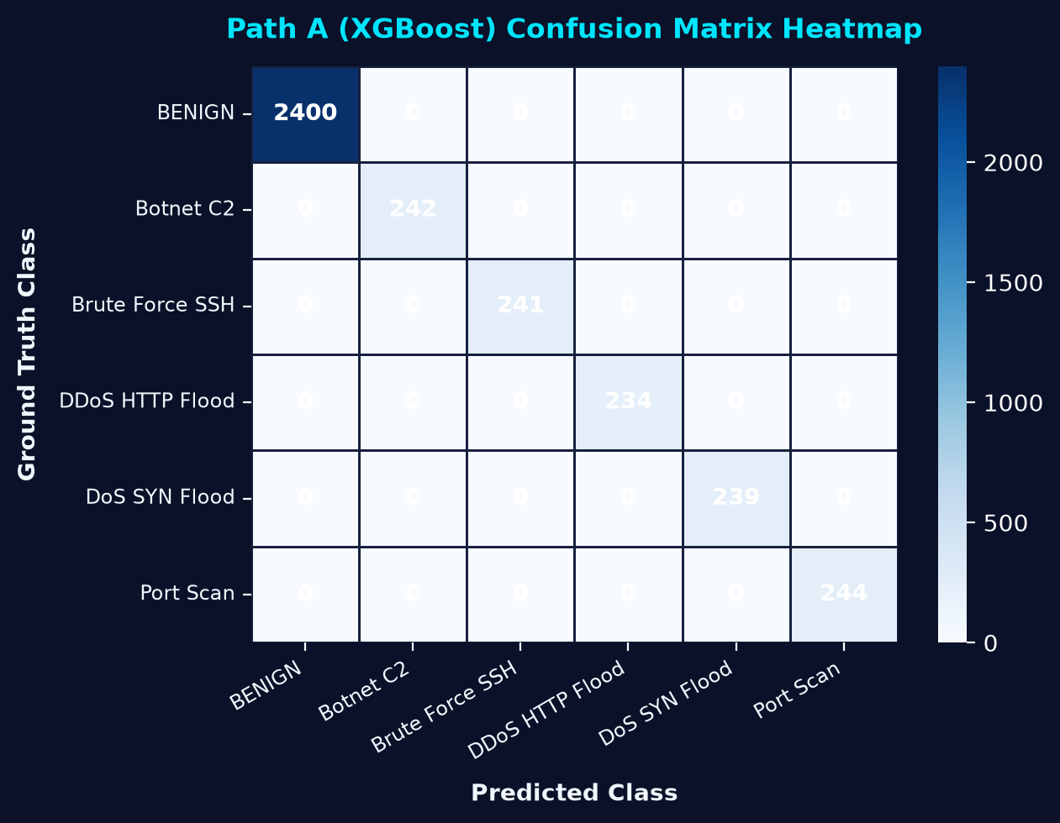
Path A: Known Threat Classification Engine (XGBoost)
Supervised multi-class decision tree ensemble evaluated across 3,600 test network flows.
CLASSIFICATION ACCURACY
100.00%
3,600 / 3,600 test flows correctly classified
WEIGHTED F1-SCORE
1.0000
Balanced precision & recall across all attack classes
INFERENCE LATENCY
< 1.2 ms
Sub-millisecond line-rate inspection speed

Slide 4
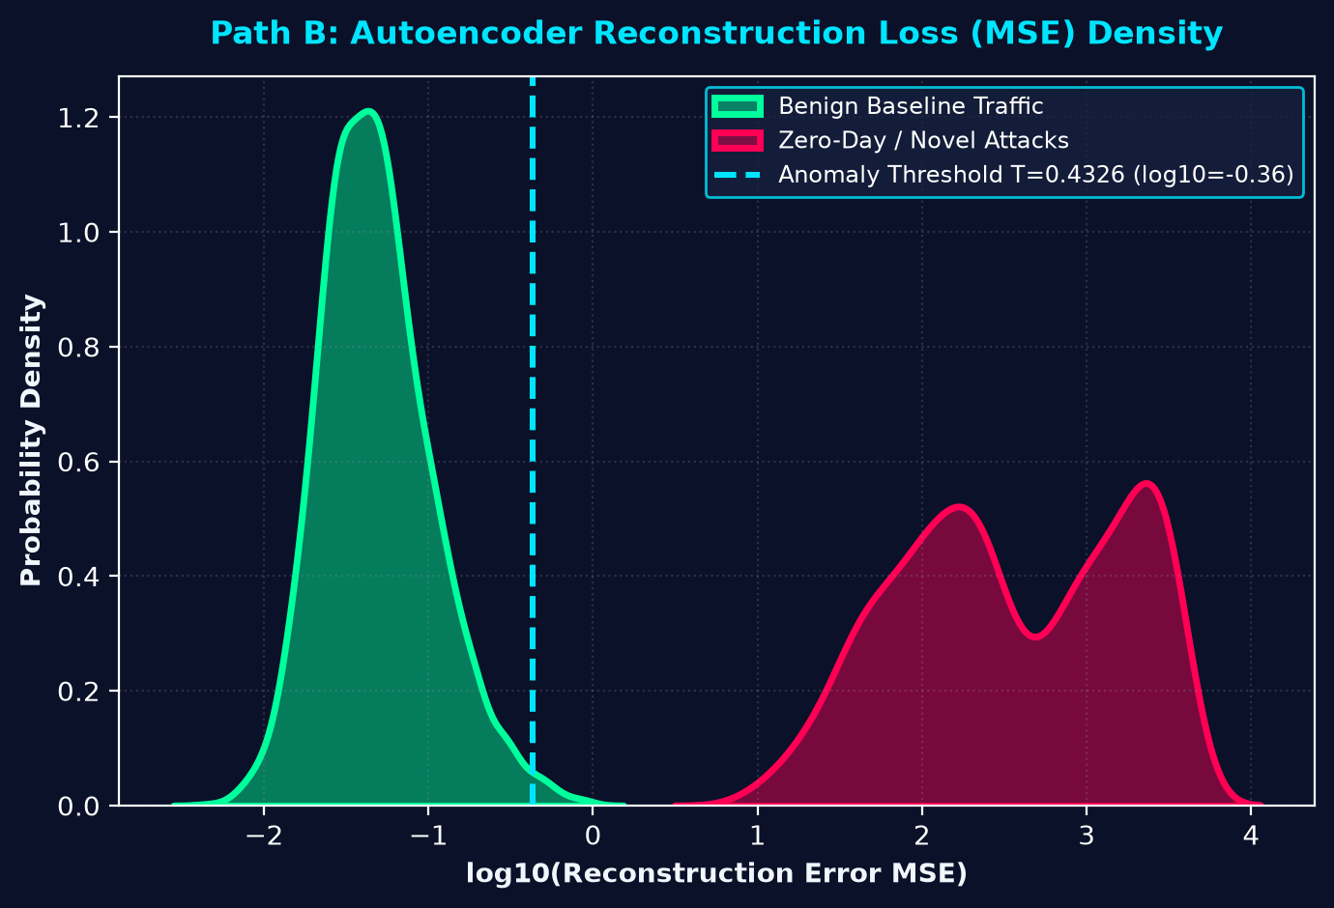
Path B: Zero-Day Anomaly Detection (Deep Autoencoder)
Unsupervised manifold compression with dynamic thresholding for novel exploit isolation.
ZERO-DAY TPR (CATCH RATE)
100.00%
1,600 / 1,600 unseen zero-day attacks intercepted
BENIGN FALSE POSITIVE RATE
1.04%
25 / 2,400 benign flows exceeded threshold
DYNAMIC THRESHOLD (T)
0.4326
Computed via max(p98.5, mean + 3*std)

Slide 5
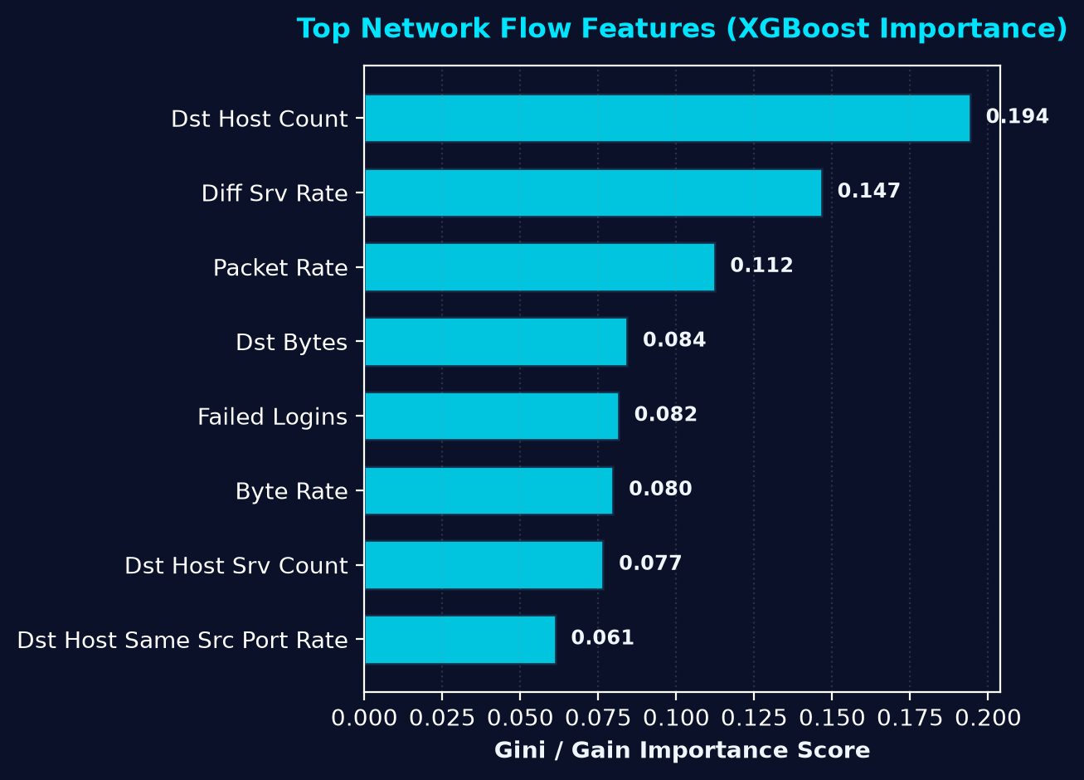
Telemetry Feature Importance & Attack Indicators
Key discriminators identified across high-dimensional network flow metrics.
NETWORK TELEMETRY INSIGHTS
• dst_host_count: Reflects vertical/horizontal network scanning and distributed reconnaissance attempts.
• diff_srv_rate: High variance in destination service port targeting signals rapid port scanning.
• packet_rate & byte_rate: Extreme volumetric bursts characterize DoS/DDoS SYN/HTTP floods.
• failed_logins: Direct indicator of brute-force dictionary attacks against SSH/RDP services.
• Reconstruction MSE (Path B): Captures non-linear subtle correlations in payload byte ratios and flow lifetimes.

Slide 6
Executive Recommendations & Operational Deployment
Actionable roadmap for enterprise SIEM/SOAR integration and continuous learning.
1. Real-Time SIEM / SOAR Ingestion
Stream packet flow telemetry via Kafka/Suricata into CyberGuard inference containers. Direct high-severity alerts into Splunk/Sentinel.
2. Automated Threat Quarantine
Trigger firewall (Palo Alto/Fortinet) BGP blackholing or zero-trust host isolation on CRITICAL severity zero-day detections.
3. Unsupervised Baseline Retraining
Schedule weekly retraining of the Path B Autoencoder to adapt to benign enterprise network drift and new internal microservices.
4. Analyst Feedback Loop
Route SUSPECTED_ZERO_DAY flows to Tier 3 SOC analysts. Confirmed zero-days are labeled and fed back to retrain Path A XGBoost.

