Slide 1
DATA ANALYSIS
Customer shopping behavior analysis
Turn 3,900 shopping records into a clear story about revenue, categories, loyalty, subscriptions, and customer segments.

Slide 2
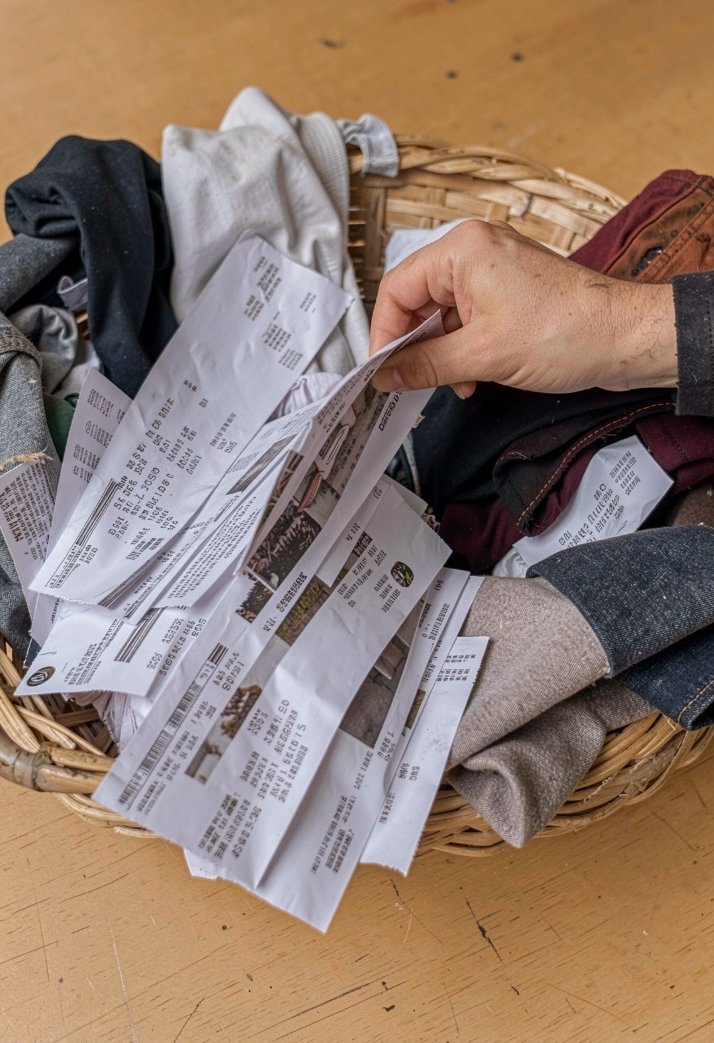
DATASET OVERVIEW
The dataset points to a $59.76 average purchase
$59.76
3.75
Average purchase amount
Average review rating
Scope: 3,900 shopping records across 18 original fields.
Clothing leads the business, while loyalty is already high.

Slide 3
METHOD
The analysis pipeline turns raw records into business-ready fields
01
02
03
04
Clean ratings
Standardize fields
Create segments
Communicate results
Clean missing review ratings using category medians.
Standardize column names and simplify purchase amount naming.
Create quantile-based age groups and remove a redundant promotion flag.
Use SQL business questions and an interactive dashboard to communicate results.

Slide 4
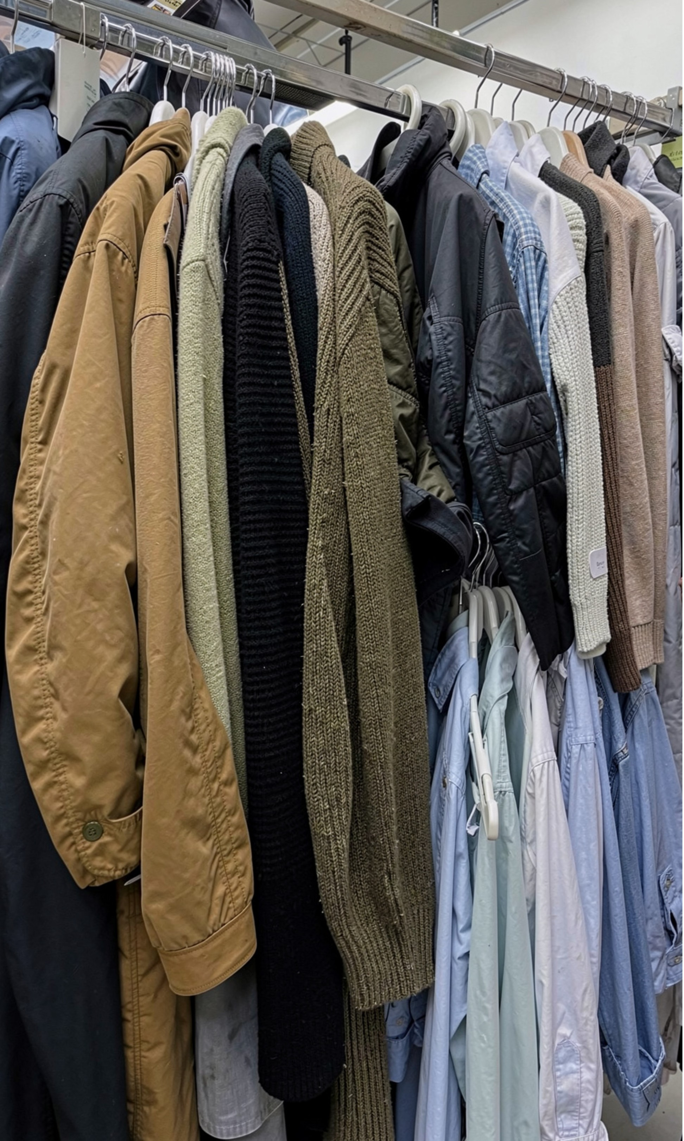
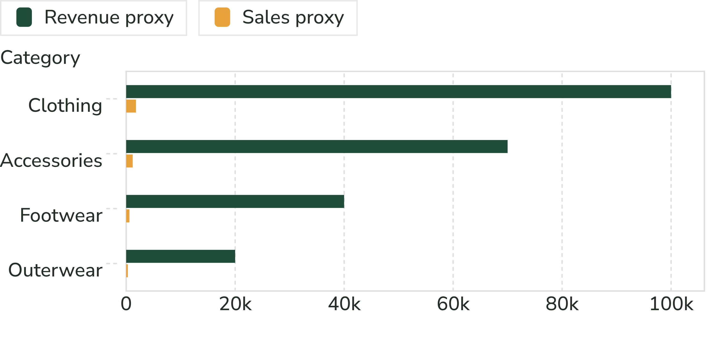
CATEGORY MIX
Clothing is the commercial center of the dataset
Clothing leads both sales volume and revenue. Accessories follows, then Footwear and Outerwear.

Slide 5
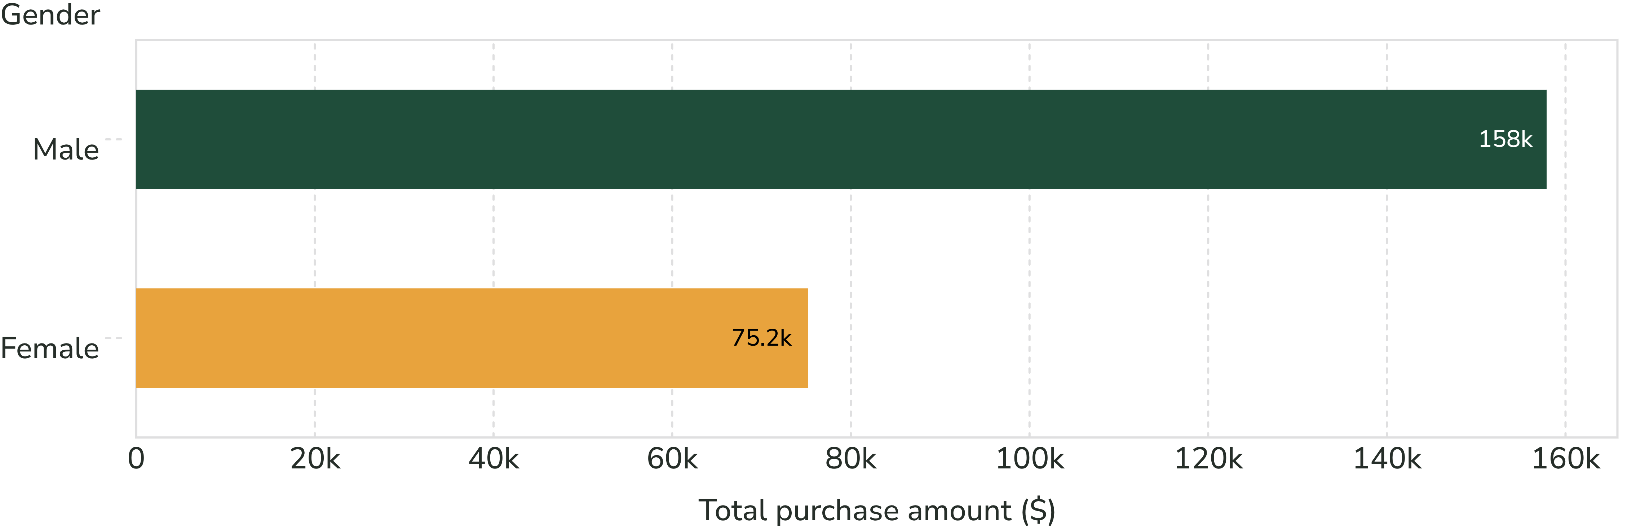
GENDER VIEW
Male customers contribute more total revenue in this sample
Total purchase amount is higher for male customers, but revenue scale should be paired with customer counts before targeting decisions.
Observed total purchase amount in the analyzed records.

Slide 6
SUBSCRIPTION STATUS
Subscription is a minority status, not a higher-spend status
27%
73%
Read carefully
Subscription value may be retention-led rather than driven by larger baskets.
Subscribers
Non-subscribers
$59.49 average spend
$62,645 total spend
$59.87 average spend
$170,436 total spend

Slide 7
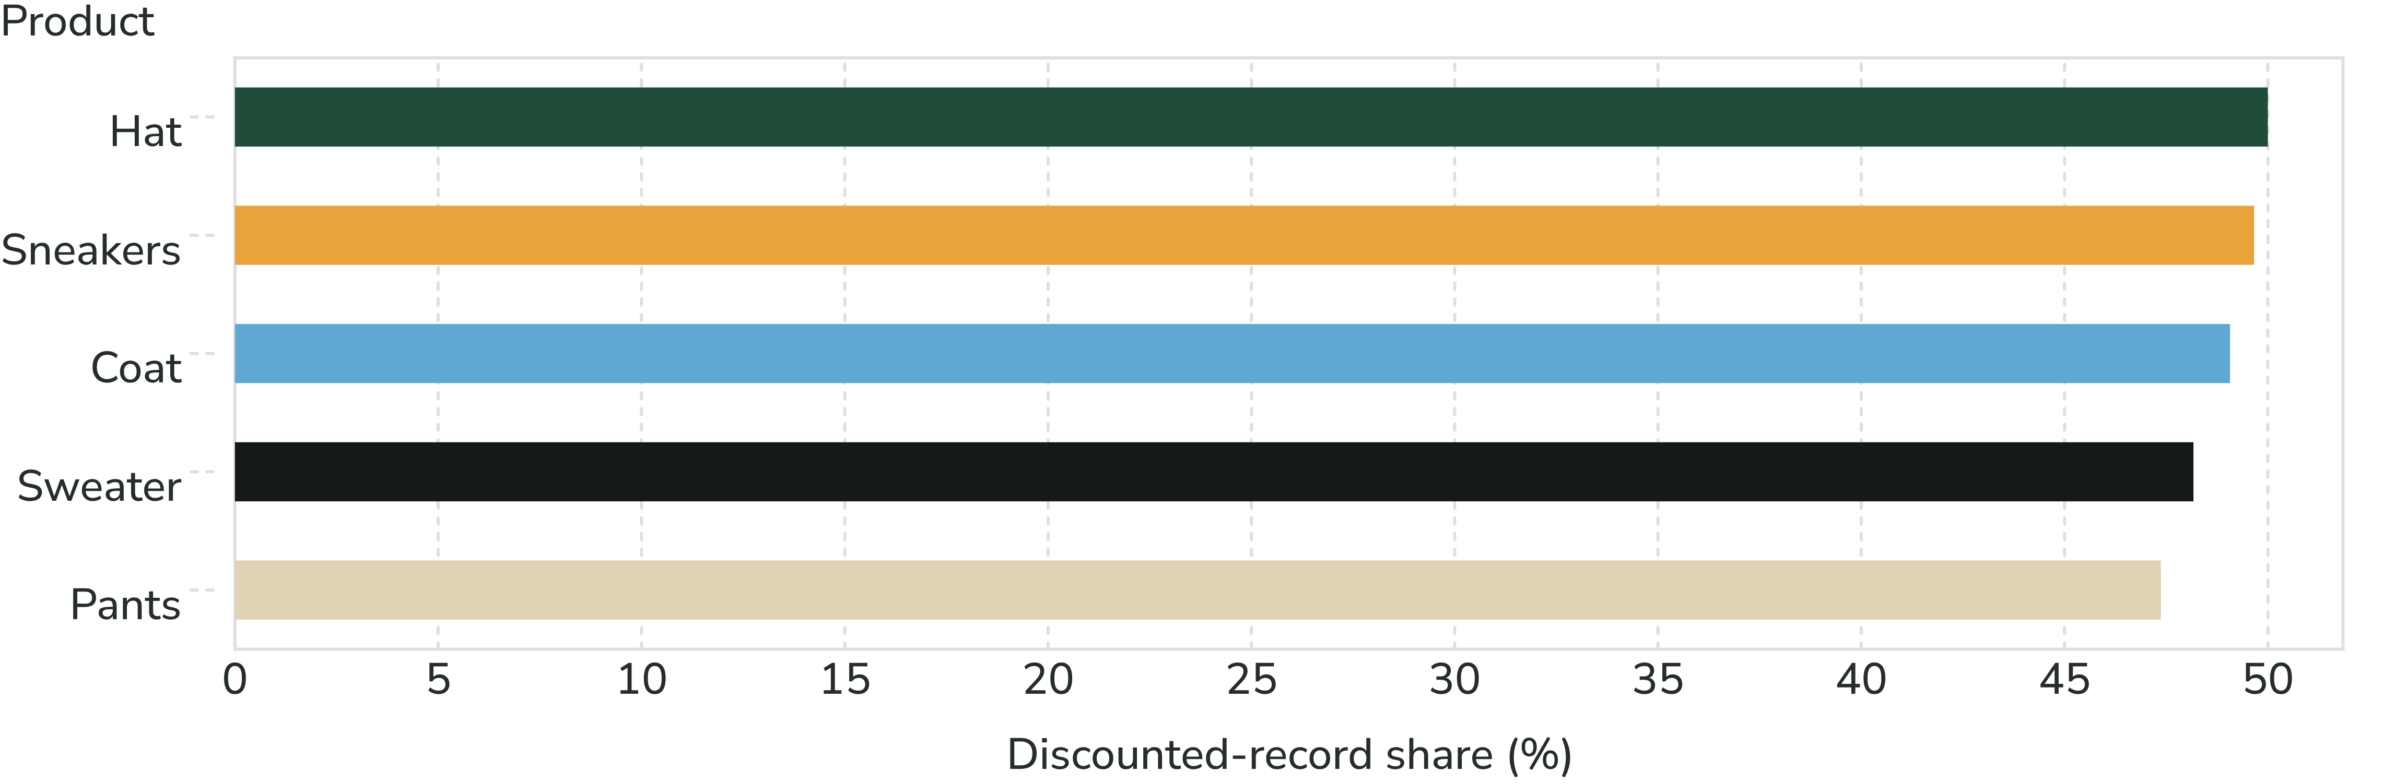
DISCOUNT EXPOSURE
Discounting is concentrated around a handful of products
Hat, Sneakers, Coat, Sweater, and Pants have the highest discounted-record shares.
839 records met the report’s discounted-and-above-average condition. Overall average purchase amount: $59.76.
Compare discount exposure with margin and repeat purchase behavior before scaling promotions.

Slide 8
SHIPPING METHOD
Express shipping correlates with a slightly higher average basket
$60.48
$58.46
Express
Standard
Average purchase amount
Average purchase amount
Gap: Express is $2.02 higher on average, a useful signal but not proof of causation. Higher-value or time-sensitive orders may be more likely to use Express.

Slide 9
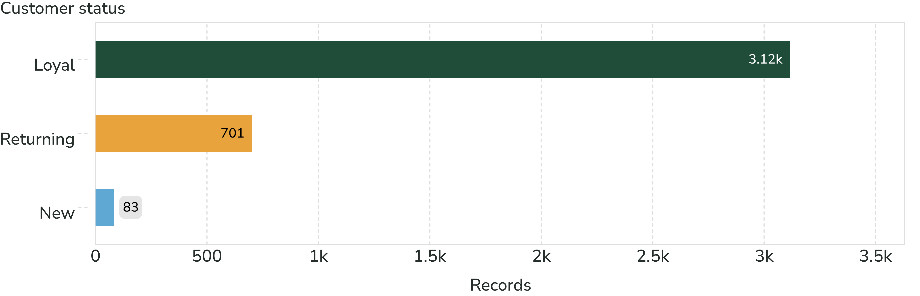
CUSTOMER STATUS
Loyalty dominates the customer base
Most records are loyal customers, while new customers represent a small minority.
Repeat buyers: 2,518 non-subscribers and 958 subscribers had more than five previous purchases.

Slide 10
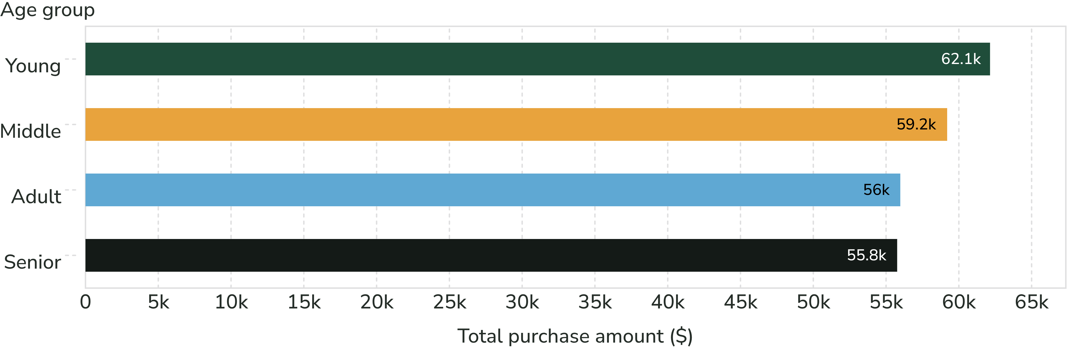
AGE GROUP TOTALS
Young customers generate the most total purchase amount
Total purchase amount ranks Young first, followed by Middle, Adult, and Senior.
These are age-group totals, not per-customer value.

