Slide 1
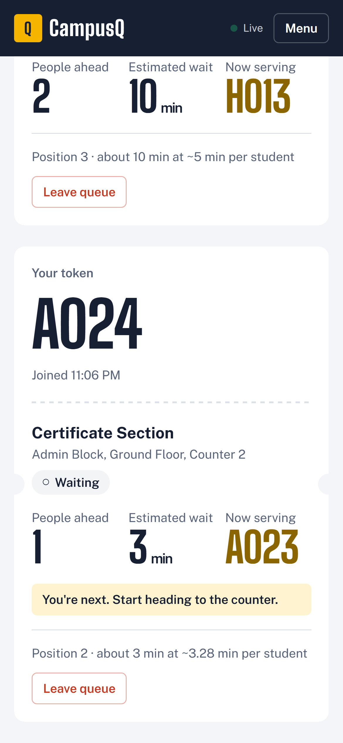
Q
CampusQ
NOW SERVING
VISION2WEB FULL STACK HACKATHON · IDEA PITCH
A023
Skip the line,
not the class.
CampusQ is a smart queue system for campus counters. Take a token from your phone, watch your place update live, and walk over when it’s your turn.
YOU’RE NEXT
~3 min
PRESENTED BY
Parnavi Sharma
Diya Wadhwani
RA2411003010038
RA2411003010039
Notes:
Hi, we are Parnavi Sharma and Diya Wadhwani. Our idea is CampusQ: a smart queue system for campus service counters. The phone on the right is the real app: a student holding token A024 sees that A023 is being served and that they are next.

Slide 2



A002
THE PROBLEM
Campus counters still run on standing in line
Certificate sections, fee counters, help desks and labs all share the same pain.
Time lost in line
No visibility
Stress for staff
Students wait at the counter for their turn, often during class hours, with no way to step away without losing their place.
Nobody knows how many people are ahead or how long it will take, so everyone stays and crowds the counter.
Staff manage the crowd by calling out names, settle “who’s next” disputes, and have no data on busy hours.
“How long will this take?” — the one question every campus counter keeps hearing.
Notes:
Every campus has counters where students physically wait: the certificate section, fee payment, help desks, lab access. Students cannot tell how long it will take, so they stay and crowd the counter, and staff spend their time managing the line instead of serving.

Slide 3
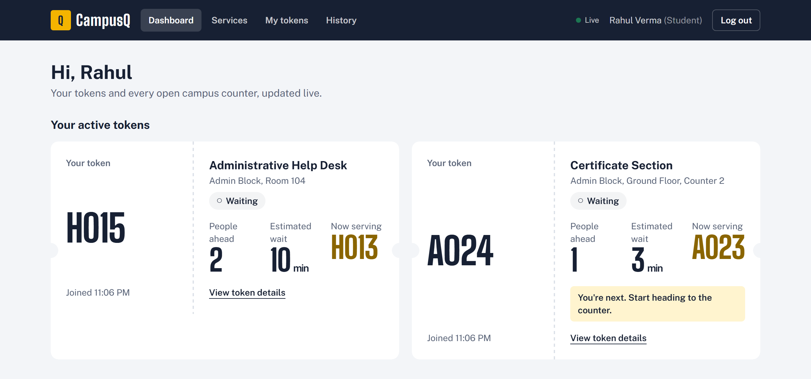
A003
OUR SOLUTION
CampusQ: take a token, not a place in line
1
Pick a counter
Every service with its live queue and estimated wait.
localhost:5173/student
2
Join and get a token
A sequential token like A024, issued instantly.
3
Track it live
Position and wait update in real time. No refresh.
4
Get alerted
“You’re next”, then “It’s your turn” with a notification.
5
Walk up and get served
Staff call the next token with one tap.
Real screen: the student dashboard with two live tokens, people ahead and estimated wait.
Notes:
CampusQ turns the physical line into a digital token. The student picks a counter, joins, and gets a token such as A024. Their position and estimated wait update live, they get a heads-up when they are next and an alert when it is their turn, and staff call them with one tap.

Slide 4
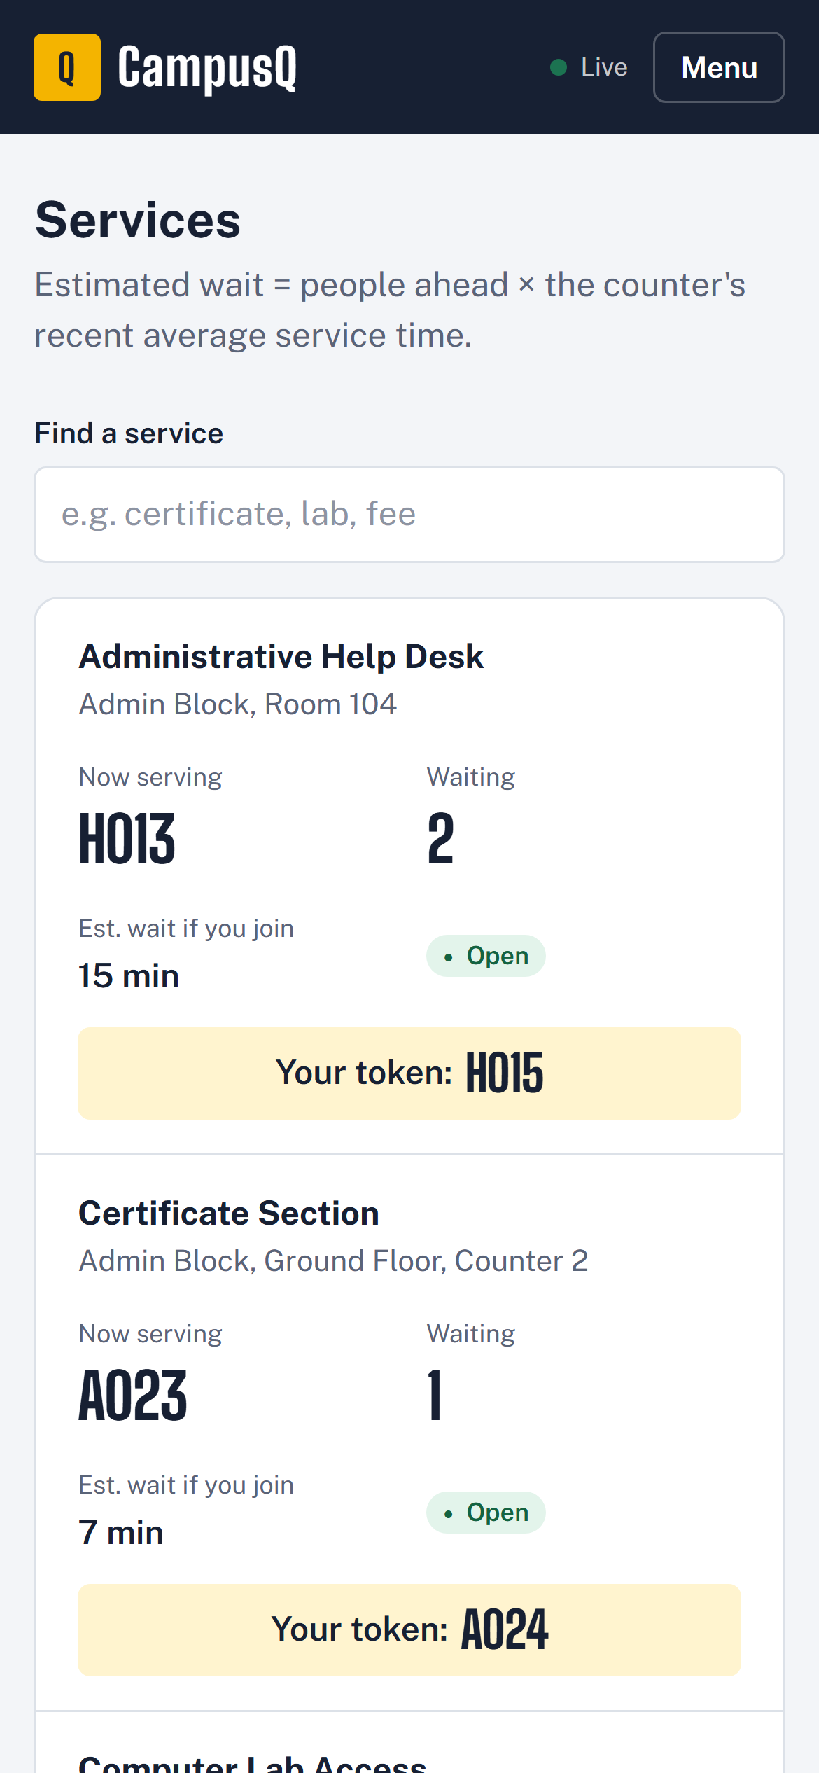




A004
FOR STUDENTS
Built for the phone in every student’s pocket
No app to install
Works in any phone browser, from small 360 px screens to desktops.
Live position and wait
People ahead, estimated minutes and the token now being served.
Alerts when it matters
“You’re next” heads-up, then “It’s your turn” with a notification and vibration.
Leave any time
Cancel a waiting token in one tap; everyone behind moves up.
Notes:
Students use CampusQ from the phone they already carry, with no app store download. The left phone is the live services list; the right phone is Rahul’s token A024, which tells him he is next and should head to the counter.

Slide 5
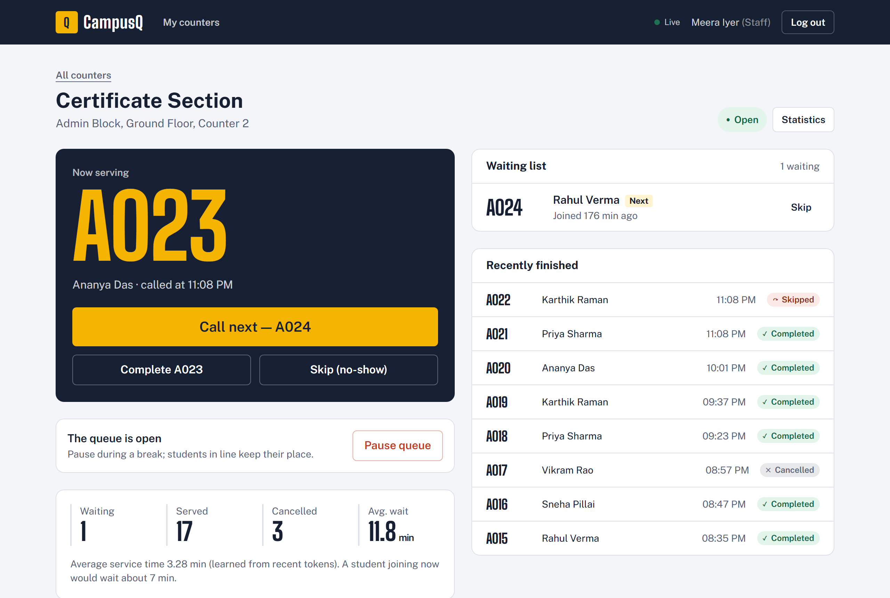




A005
FOR STAFF
One tap calls the next student
localhost:5173/staff/services/1
Call next
Completes the current token and calls the next. The student is alerted instantly.
Skip no-shows
Move past a student who did not turn up; the line closes the gap.
Pause for breaks
New joins stop, and students already waiting keep their place.
Live waiting list
Who is next, what just finished, and today’s numbers.
Notes:
This is the real staff console for the Certificate Section. A023 is being served, and the big amber button calls A024 next. Staff can complete, skip a no-show, or pause the queue during a break without anyone losing their place.

Slide 6
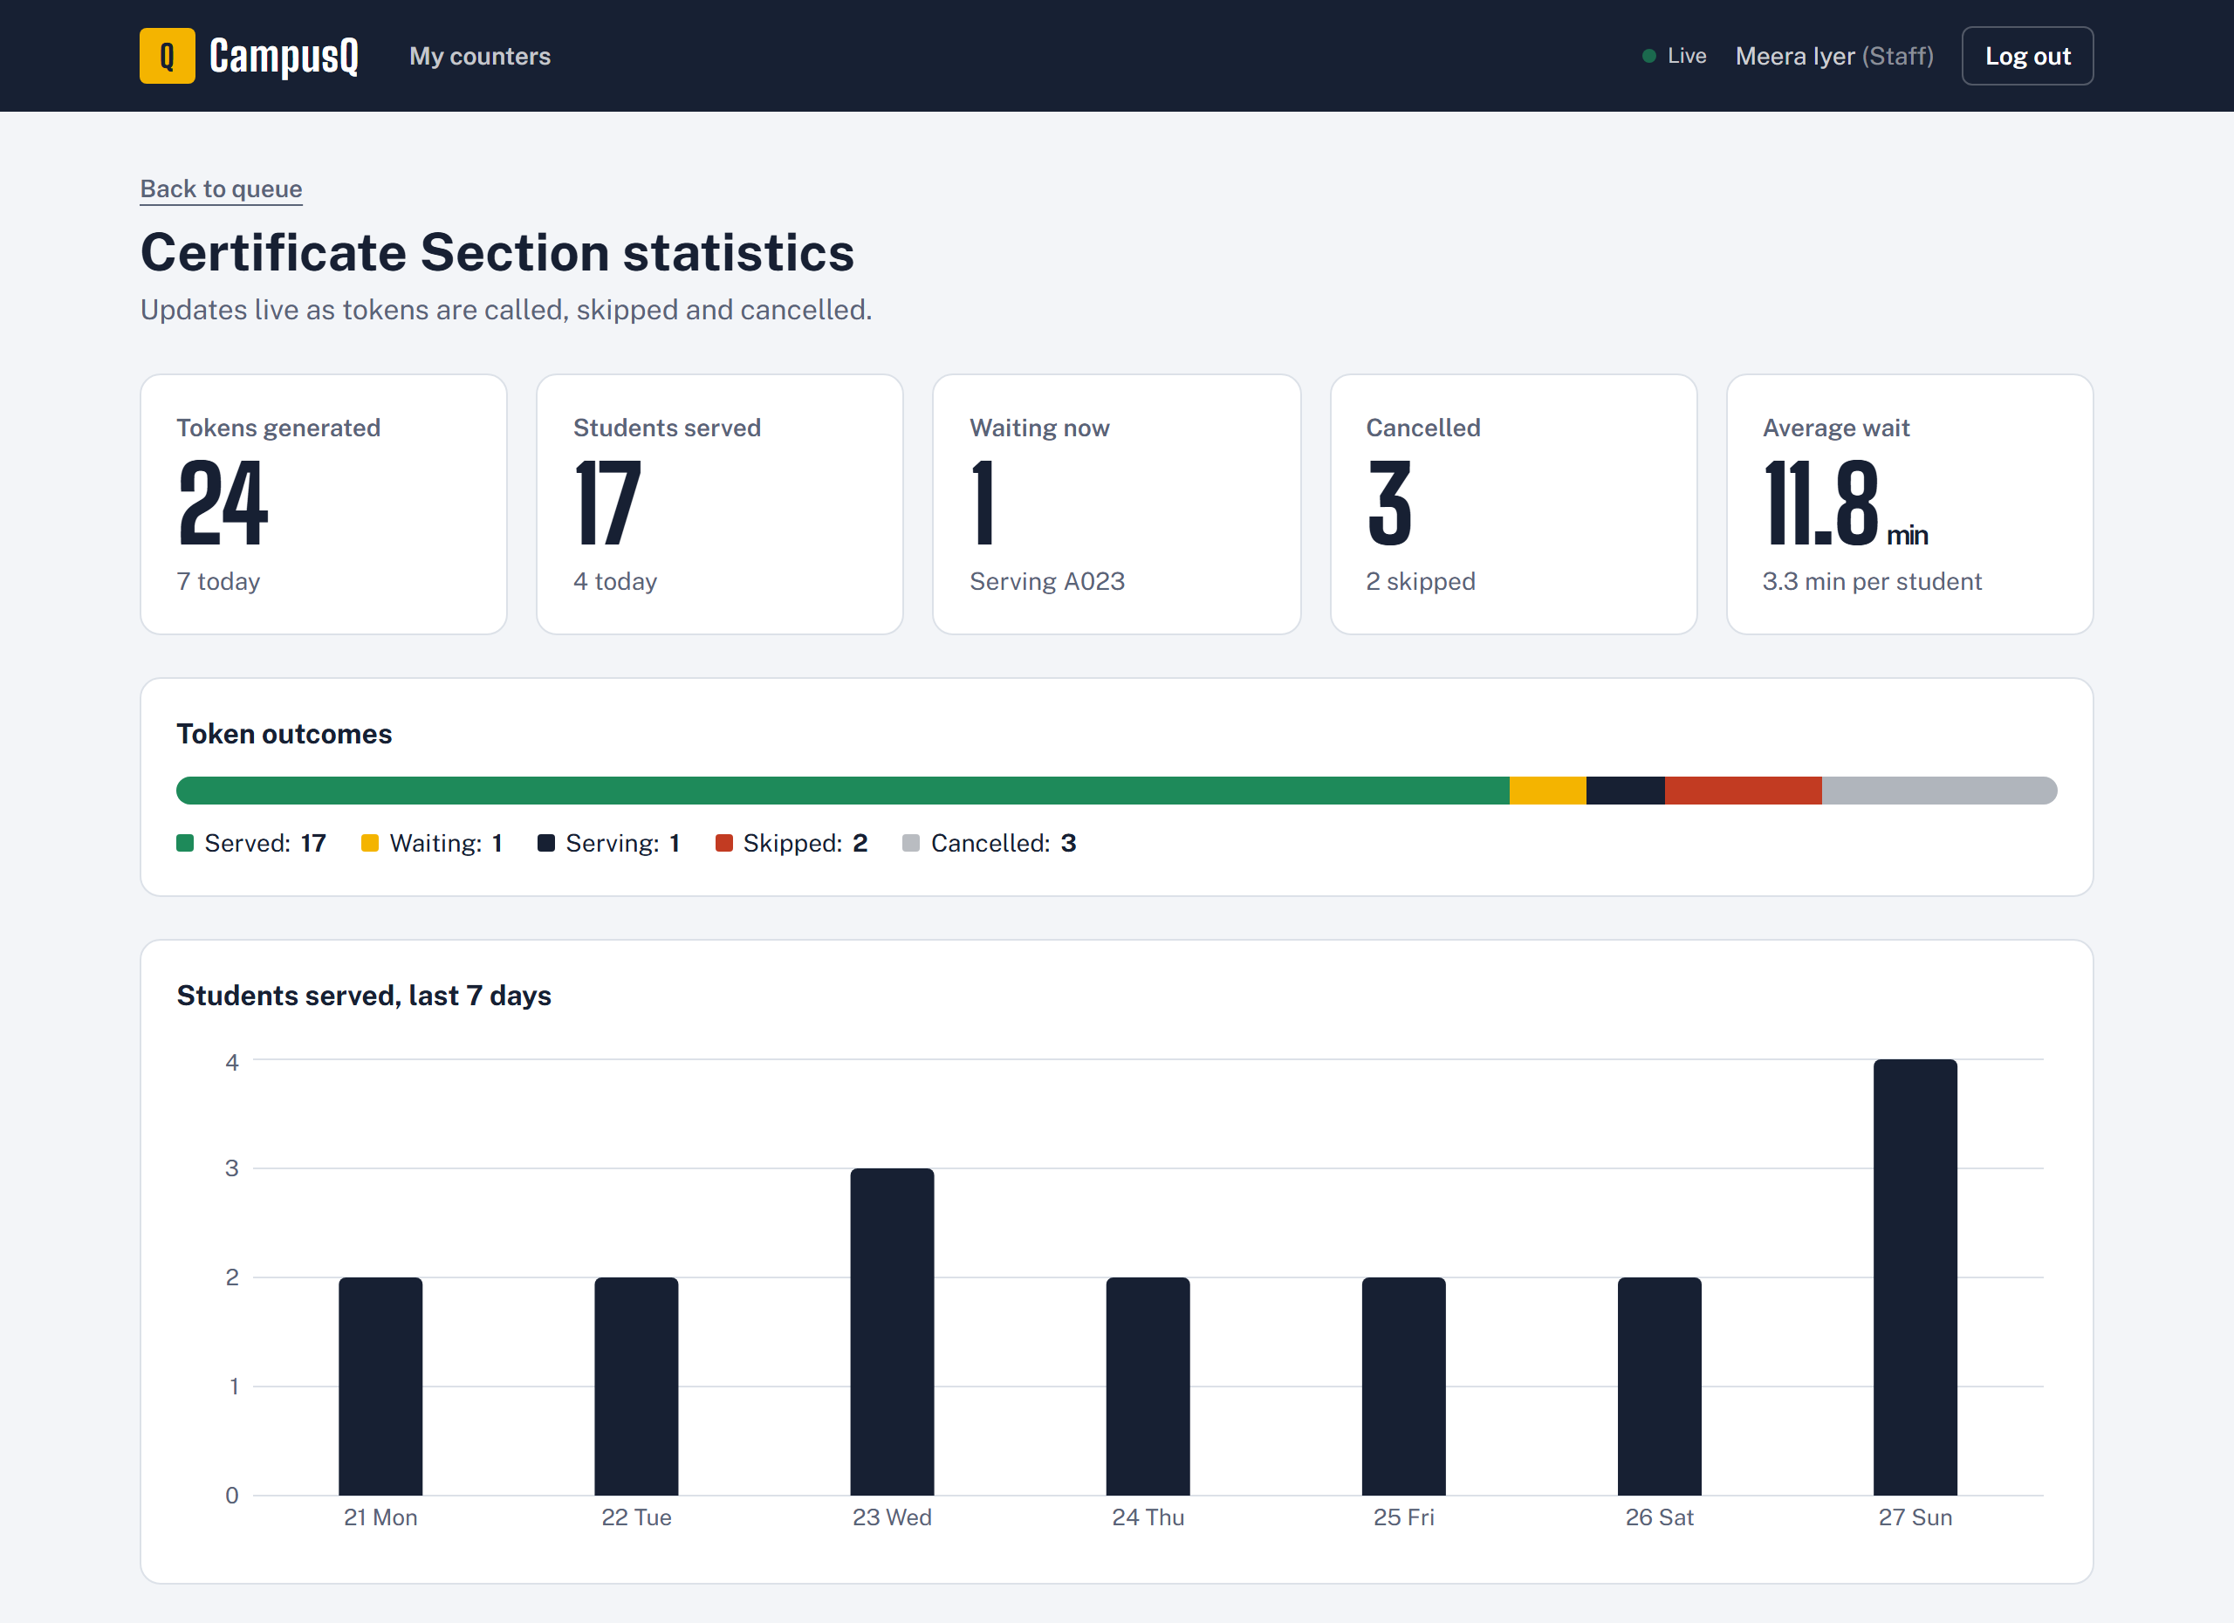
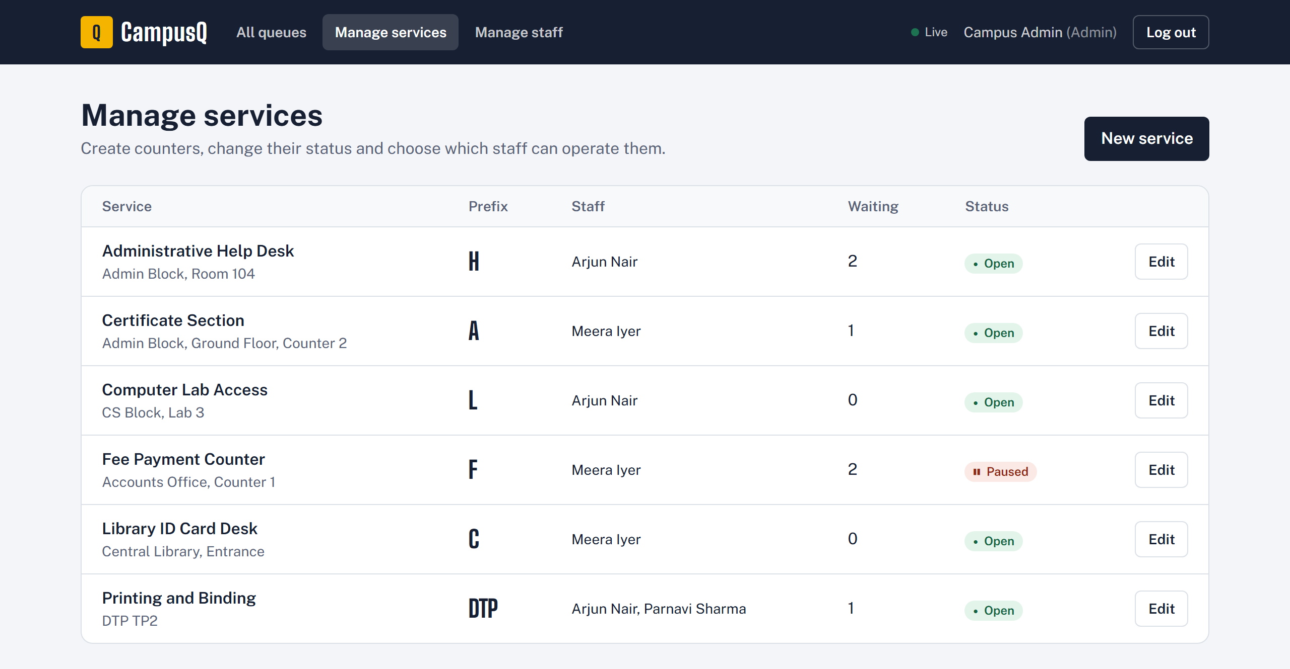
A006
INSIGHTS & ADMIN
Numbers for staff, control for admins
localhost:5173/staff/services/1/stats
localhost:5173/admin/services
Admins can
Create counters with their own token prefix (A001, H001 …)
Open, pause or close any counter
Create staff logins and assign each person to their counters
Live per-counter statistics with a 7-day chart.
Notes:
Staff get live statistics per counter, including a seven-day chart. Admins manage the whole system: they create counters with their own token prefixes, change their status, and create staff accounts and assign them to counters.

Slide 7
A007
SMART WAIT TIMES
Wait times that learn from the counter
SERVING
WAITING
WAITING
YOU JOIN
A021
A022
A023
A024
3 people ahead of you
3 ahead × 3 min average = ~9 min
Learns
Filters noise
Starts sensibly
Averages the last 20 completed tokens, so estimates follow how fast the counter is really moving.
Accidental completions under 20 seconds are ignored, so a double-click can’t skew the average.
A brand-new counter uses the admin’s default minutes per student until history exists.
Notes:
The estimate is simple and honest: people ahead times the counter’s real average service time. In our demo, A021 is being served and two students are waiting, so a new student gets A024 with three ahead, which at three minutes each is about nine minutes. The average comes from the last 20 completed tokens.

Slide 8





A008
HOW IT’S BUILT
A real-time full-stack web app
Frontend
Backend
Database
REST +
WebSocket
SQL
React 18 + Vite
Tailwind CSS
Recharts for statistics
Socket.IO client
Node.js + Express REST API
Socket.IO with JWT auth
Queue logic and validation
Role + per-service permissions
MySQL 8
Transactions + row locks
UNIQUE rules for tokens
Parameterised queries only
Real-time, safely
Security basics
Socket events only say what changed; each screen re-fetches over REST, so the same permission checks always apply.
bcrypt password hashing, JWT sessions, rate-limited login, Helmet headers, and server-side validation on every request.
Notes:
CampusQ is a full-stack web app: a React front end, a Node and Express API with Socket.IO for live updates, and MySQL. Sockets only announce that something changed; screens then re-fetch over the REST API, so every permission rule is enforced in one place.

Slide 9
A009
BUILT TO BE TRUSTED
Correct even when everyone taps at once
0
1
70+
3
duplicate tokens
token served at a time
end-to-end checks
roles, enforced by the server
Six students joining at the same instant received C001 to C006, in order.
Rapid repeated “Call next” taps still leave exactly one token being served.
One automated command replays the student and staff workflow over REST and Socket.IO.
Staff can only run counters assigned to them; the API refuses anything else.
Enforced in MySQL with row locks and UNIQUE indexes, not just hidden buttons in the UI.
Notes:
Queues break when many people act at once, so we built for that. Six simultaneous joins get six consecutive tokens, rapid Call Next clicks never produce two tokens being served, and staff can only operate their assigned counters. The rules live in the database and the API, and an automated script checks the whole workflow.

Slide 10




A010
WHAT’S NEXT
Where CampusQ goes next
SMS and WhatsApp alerts
Thank you
Reach students who are offline or low on data.
QR code at every counter
Scan to join the queue in seconds.
Parnavi Sharma
Peak-hour insights
RA2411003010038
Help offices plan staffing for busy days.
Diya Wadhwani
Campus-wide rollout
RA2411003010039
Every department and campus on one system.
CampusQ · Skip the line, not the class.
Notes:
Next we would add SMS and WhatsApp alerts, QR codes at each counter so joining is one scan, peak-hour insights for offices, and a rollout across departments. Thank you, we are happy to take questions or show a live demo.

