Slide 1
Hybrid Deep Learning for Reflectance Confocal Microscopy Skin Images
Parneet Kaur, Kristin Dana
Rutgers University, USA
Oana G. Cula, Catherine Mack
Johnson & Johnson, USA
ICPR 2016, Cancun, Mexico
Dec. 6, 2016

Slide 2
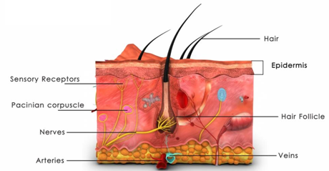
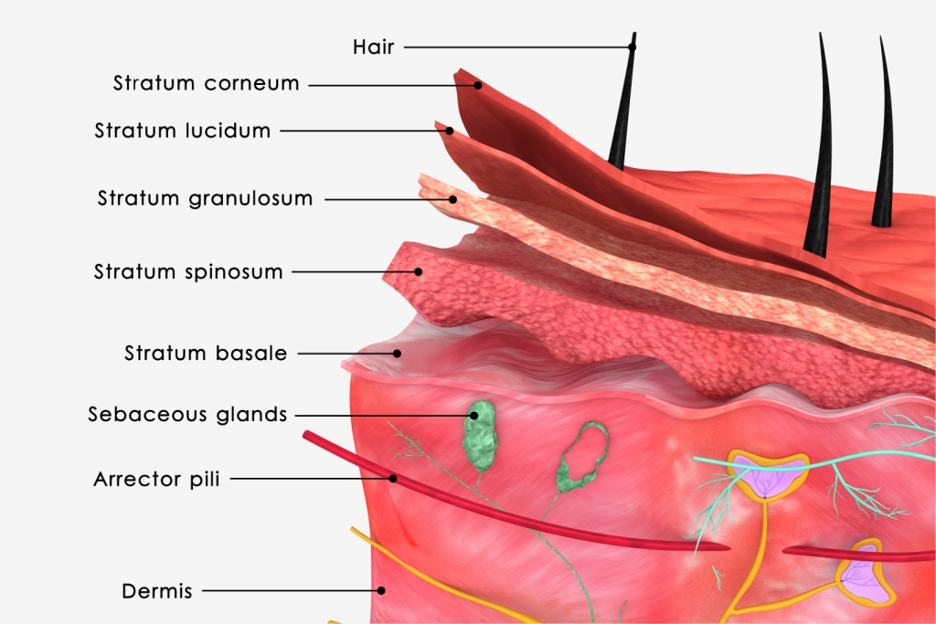
Skin Anatomy
Objective: Find thickness of each layer in epidermis
Skin Upper Layers
Full Thickness Skin
Why?
Effect of skin treatments
Skin aging
Pigmentation disorders
Skin cancer

Slide 3
Reflectance Confocal Microscopy (RCM)
Non-invasive technique
Captures skin cellular details
Epidermis
1μm
RCM Stack: Images are captured up to 100μm in steps of 1μm
100μm

Slide 4
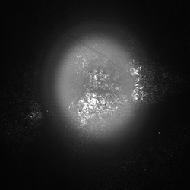
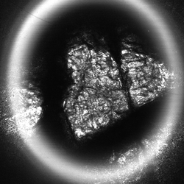
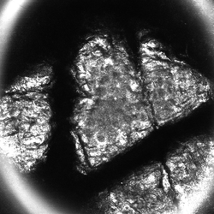
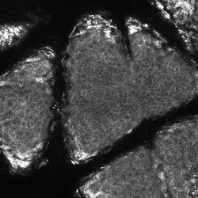
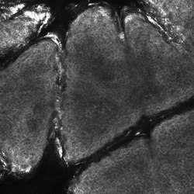
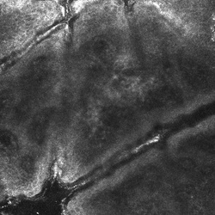
RCM Skin Images
Outside Epidermis
Outside Epidermis
(OE)
Stratum Corneum
(SC)
Stratum Granulosum
(SG)
Stratum Spinosum
(SS)
Stratum Basale
(SB)
Portions of
Papillary Dermis (PD)

Slide 5
Goal
Traditional Approach:
Each skin image is qualitatively labeled by a clinical expert
Limitations:
Time-consuming
Subjective
Objective:
Automate the process of skin image labeling to find the thickness of each skin layer

Slide 6
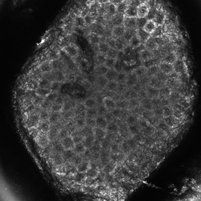
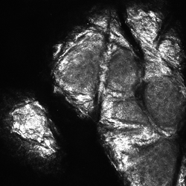
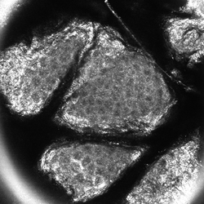
Challenges for Automatic Classification
Small Dataset: 15 stacks, 1500 images
Intra-Class Variation:
Skin Images from different RCM stacks belonging to Stratum Granulosum

Slide 7
Prior Work
 | Approach
Somoza et al. 2014 | Texton-based + kmeans clustering
Hames et al. 2015 | Bag-of-features + logistic regression
Kurugol et al. 2015 | Contrast difference
Our Methods
Hybrid deep learning
Attribute-based method
Convolutional Neural Networks

Slide 8
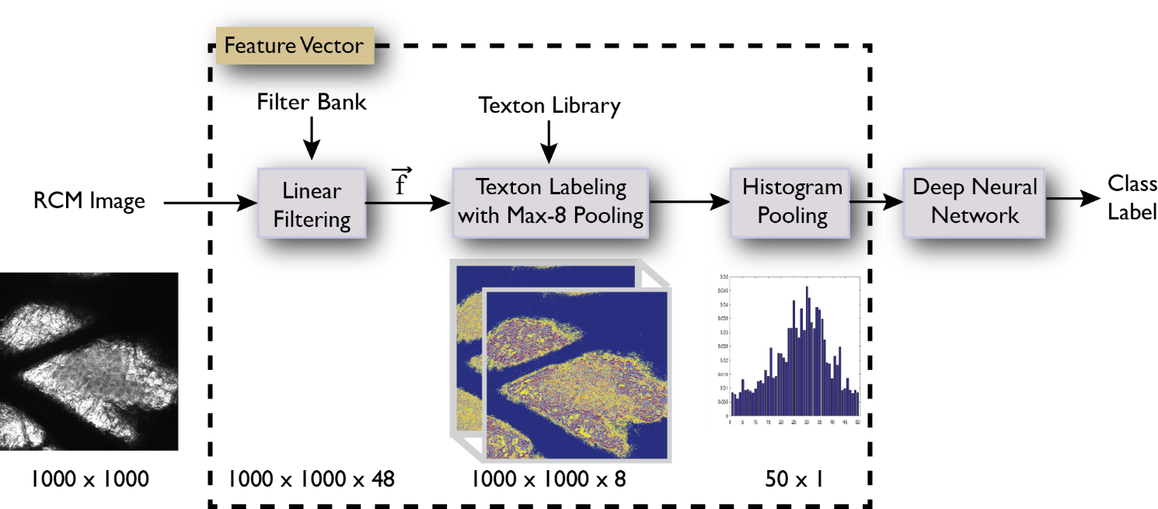
Proposed Method 1: Hybrid Deep Learning
Unsupervised texton-based feature vectors
Supervised deep neural networks

Slide 9
Proposed Method 1: Hybrid Deep Learning
Convolution Layer:
Use fixed weight filter banks
Each pixel is filtered over a 5x5 region and represented by a 48-dimensional vector

Slide 10
Proposed Method 1: Hybrid Deep Learning
Texton Library:
Obtained by k-means clustering of filter outputs
Each cluster accounts for local structural similarities and is called a texton
Texton labeling with Max-8 Pooling:
Each pixel is labeled to its nearest neighbors

Slide 11
Proposed Method 1: Hybrid Deep Learning
Histogram Pooling:
Texton labels from all the texton maps are pooled together in texton histogram.

Slide 12
Proposed Method 1: Hybrid Deep Learning
Deep Neural Network:
Feed-forward deep neural network
Input feature vector: texton histogram

Slide 13
Proposed Method 1: Hybrid Deep Learning

Slide 14
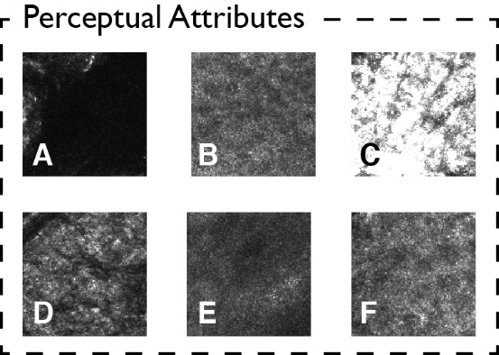
Proposed Method 2: Attribute-Based Approach
Perceptual Attributes: inspired by human perception
Prior Work:
Kaur et al., “From photography to microbiology: Eigenbiome models for skin appearance”, CVPRW 2015
Cimpoi et al., “Describing Textures in the wild”, CVPR 2014
For RCM Skin Images:
Each image can be represented as a distribution of perceptual attributes

Slide 15
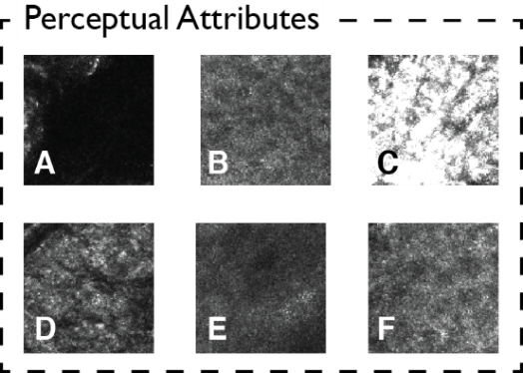
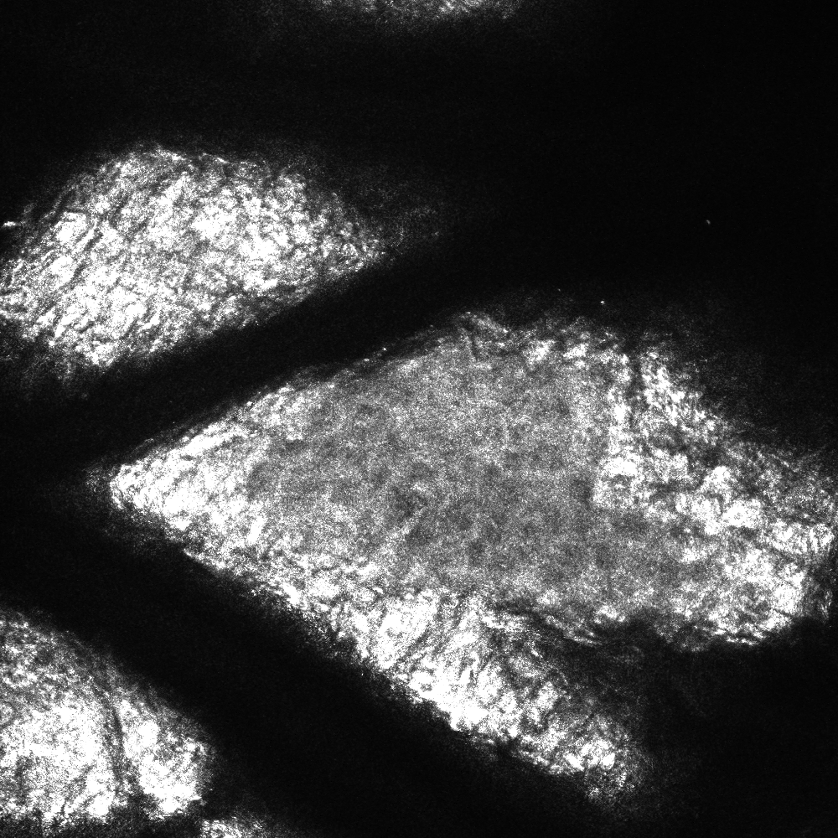
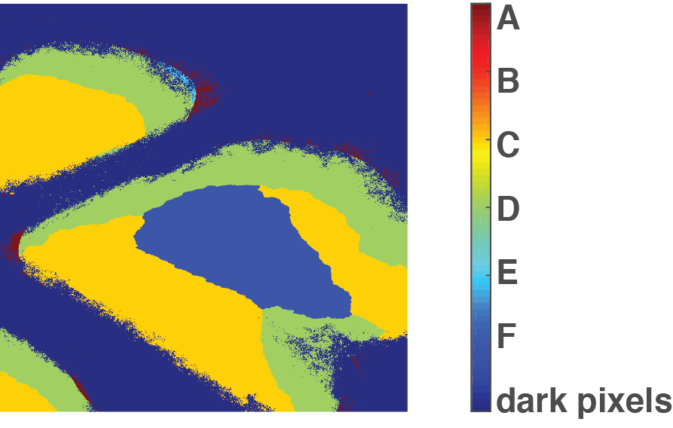
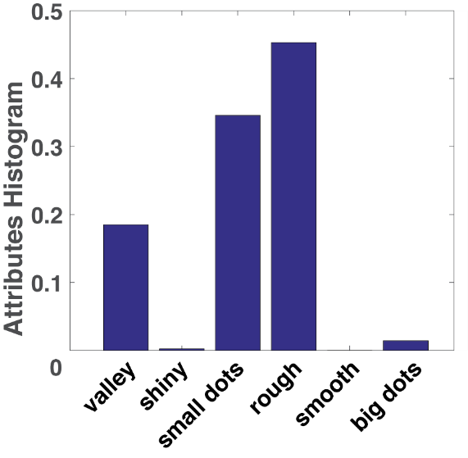
Proposed Method 2: Attribute-Based Approach
Approach:
Training data: labelled attribute patches
Attribute Classifier: Neural networks trained with texton histograms of attribute patches as feature vector
RCM Image
Attributes Map
Histogram of Attributes
A B C D E F
A
Each pixel is assigned an
attribute label by the trained classifier
Notes:
This approach provides pixel level attribute labels.

Slide 16
Proposed Method 3: Convolutional Neural Networks (CNN)
Learn a hierarchy of features for classification automatically from the input images.
Popular for several computer vision tasks such as image classification, facial and object recognition, video analysis [Cimpoi CVPR 2015, Karpathy CVPR 2014, Dosovitskiy NIPS 2014, Le ICASSP 2014].
Require huge amount of data

Slide 17
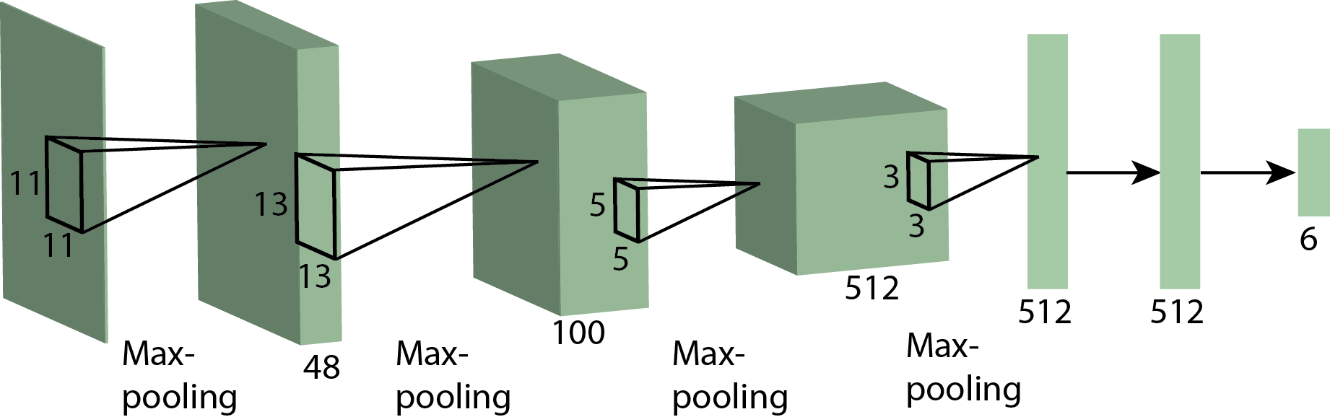
Proposed Method 3: Convolutional Neural Networks (CNN)
We train CNN from perceptual attributes or use pre-trained networks
It consists of: 4 convolutional layers, 2 fully connected layers
Notes:
We tried different combinations of CNN layers but found that training it doesn’t improve the results.

Slide 18
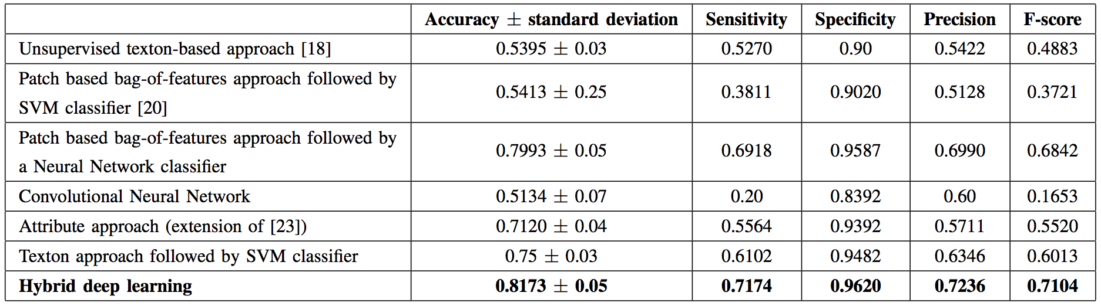
Results
Proposed method 1 “hybrid deep learning” performs the best.
Notes:
The hybrid deep learning method performs the best with ~82% accuracy
Even though attribute-based approach provides pixel level attribute labels, the test image accuracy using attribute histograms for training a neural network on the RCM data is relatively low (~71%).
CNNs have been found to perform very well on many computer vision problems but here we observe that training the CNNs does not work well for RCM skin images. One reason is that CNNs require huge data and our dataset is relatively small.

Slide 19
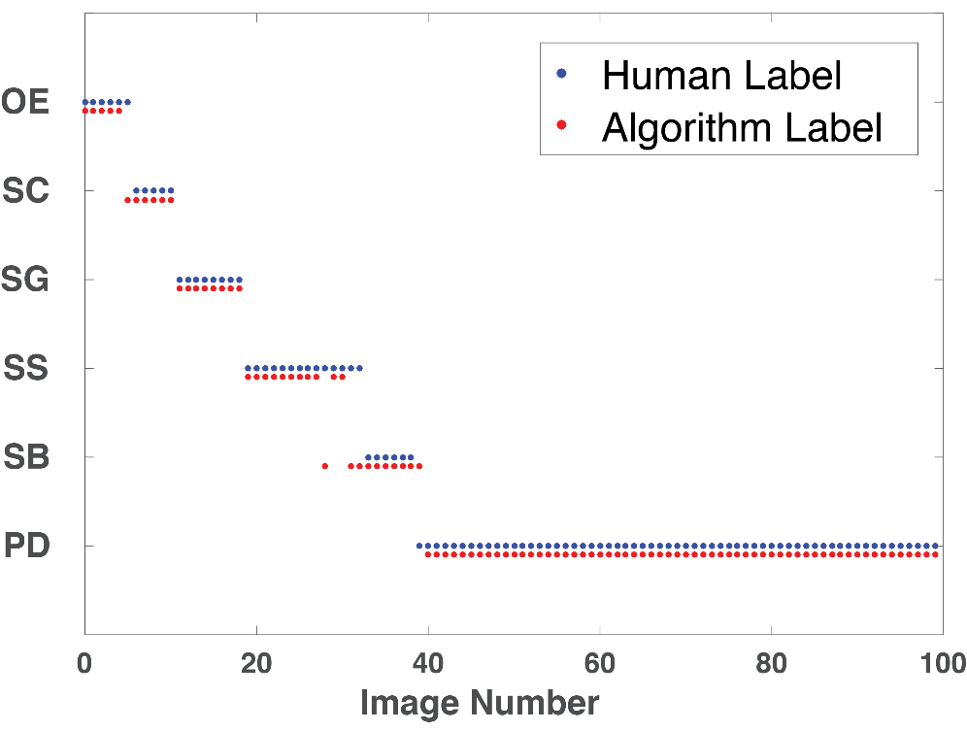
RCM Stack Labeling
RCM Image Labeling
The mislabeling occurs in the transition regions
Notes:
Blue dots are the human labels. Red dots are the algorithm labels. Note that the mislabeling occurs in the transition regions.
These transitions may be ambiguous to a clinical expert as well.

Slide 20
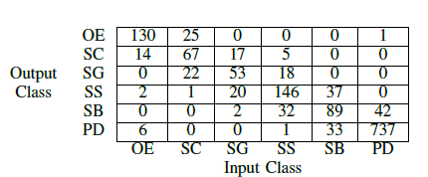
Confusion Matrix
The mislabeling occurs in the transition regions

Slide 21
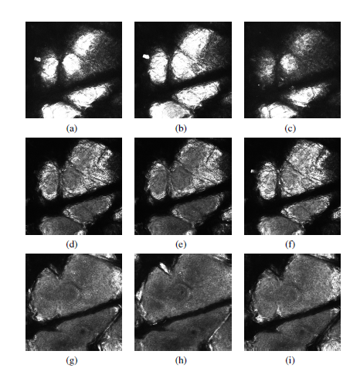
Mislabeled Images
Mislabeled
Images
Correctly
Labeled
Correctly
Labeled
SC
OE
(a) Human Label : OE
Automated Label : SC
SS
SC
(d) Human Label : SC
Automated Label : SS
SB
SS
(g) Human Label : SS
Automated Label : SB

Slide 22
Conclusions
We propose 3 different methods to classify RCM skin images
Hybrid Deep Learning gives the best performance
Mislabeling occurs mostly between adjacent skin layers
Future Work:
Explore variability in human labeling
Guide the algorithms based on the information analyzed by the clinical expert

Slide 23
Thank You!
Questions?
Support provided by
Johnson and Johnson Consumer Products Research & Development

